Slide 1
GCBASIC
PIC18FxxQ24
Part 15 – External interrupt

Slide 2

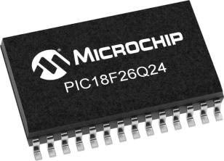
GCBASIC
PIC18FxxQ24
Part 15 – External interrupt

Slide 3
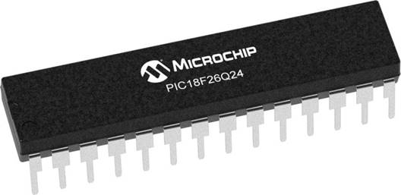
GCBASIC
Like and subscribe!

Slide 4
PIC18FxxQ24
PIC18-Q24 is a high performance PIC18
Digital and Analog peripherals
10-bit ADC
Multiple communication interfaces
Serial, I2C and SPI
PWM – CCP/PWM and 16Bit
Configurable Logic Cells
Multi voltage domains
The PIC18xxQ24 offers 28, 40 and 48-pin products in small footprint packages to support customers in a wide variety of applications.

Slide 5
Videos...
Install the hardware and make the board work – three LED programs
Make four LEDs flash in a sequence
Set the LEDs to represent the value of ADC
Sequence the LEDs with a delay using the value of ADC
Using an input to set the state of the LEDs
Using the reset switch
Using the switch, ADC – make the LEDs flash in a sequence with reverse
Using the serial to display values
Using the timer0 overflow, 8bit timer, 16bit timer to flash the LEDs
Using EEProm – showing values on the serial terminal, and more constants insights
Using I2C with serial to discover I2C devices
Using I2C GCLD display solutions
Using a SPI GLCD display solutions
Using PWM, 6 ways, to dim the LEDS
Using an external interrupt to control an LED
Using storage within the chip – Progmem, SAF memory, EEPROM and DATA blocks
Using CLC
The GCBASIC tool chain
Assembly , alternatives assemblers and MPLAB-X
Summary

Slide 6
GCBASIC Compiler
GCBASIC Compiler
GCBASIC is an Open Source compiler for PIC and AVR microcontrollers
GCBASIC now supports the 18FxxQ24 chip family

Slide 7
Prerequisites
Assumes you have
Installed the GCBASIC software
Installed your programmer software
Test that you have the 18FxxQ24 attached
You have the 4 LEDs operating
You have a POT connected
You have SWITCHes connected
You have a USB/TTL converter

Slide 8
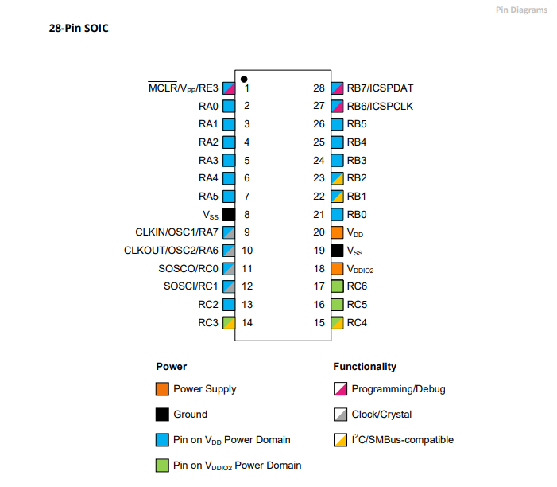
Power Domain – VDDIO2

Slide 9
Hardware
Hardware
-------------------PORTA----------------
Bit#: -7---6---5---4---3---2---1---0---
IO: ----------------SW----------ADC--
----------------------------------------
-------------------PORTB----------------
Bit#: -7---6---5---4---3---2---1---0---
IO: ----------------LED-LED-LED-LED--
----------------------------------------
------------------PORTC-----------------
Bit#: -X---6---5---4---3---2---1---0---
IO: -^--TX---------------------------
-----VDDIO2-----------------------------
You must apply correct Voltage
------------------PORTE-----------------
Bit#: -----------------3---------------
IO: ----------------SW---------------
Prototype Board
Power 5v0
Programmer
LEDs & resistors
Switches & resistors
SPI device and circuit

Slide 10
Principles of Interrupts
Interrupts are events that alter the normal execution flow of a program to respond to external or internal events.
Advantages
Immediate response to critical events
Efficient use of the microcontroller's resources
Types of Interrupts
External Interrupts: Triggered by events on external pins (RB0/INT0, RB1/INT1, etc.)
Timer Interrupts: Triggered by timer overflows or matches
Peripheral Interrupts: Triggered by events from peripherals (USART, ADC, etc.)
Software Interrupts: Triggered by software instructions
Key Registers
INTCON: Controls global interrupt enable and individual interrupt flags
PIE1, PIE2: Peripheral Interrupt Enable registers
PIR1, PIR2: Peripheral Interrupt Request (flag) registers
Interrupt Service Routine (ISR)
Special function that executes when an interrupt occurs
Must be as short and efficient as possible to avoid delaying other operations

Slide 11
Interrupts…
ExtInt1:INT1IE,INT1IF
ExtInt2:INT2IE,INT2IF
I2C1ErrorInterrupt:I2C1EIE,I2C1EIF
I2C1Interrupt:I2C1IE,I2C1IF
I2C1ReceiveInterrupt:I2C1RXIE,I2C1RXIF
I2C1TransmitInterrupt:I2C1TXIE,I2C1TXIF
LogicCell1Event:CLC1IE,CLC1IF
LogicCell2Event:CLC2IE,CLC2IF
LogicCell3Event:CLC3IE,CLC3IF
LogicCell4Event:CLC4IE,CLC4IF
NVMComplete:NVMIE,NVMIF
OscillatorFail:OSFIE,OSFIF
PORTABChange:IOCIE,IOCIF
PWM1MatchEvent:PWM1IE,PWM1IF
PWM2MatchEvent:PWM2IE,PWM2IF
PWM2PeriodEvent:PWM2PIE,PWM2PIF
PWMPeriodEvent:PWM1PIE,PWM1PIF
PortChange:IOCIE,IOCIF
SPIInterrupt:SPI1IE,SPI1IF
SPIReceiveInterrupt:SPI1RXIE,SPI1RXIF
SPITransmitInterrupt:SPI1TXIE,SPI1TXIF
ScanComplete:SCANIE,SCANIF
SoftwareInterrupt:SWIE,SWIF
Timer0Overflow:TMR0IE,TMR0IF
Timer1Gate:TMR1GIE,TMR1GIF
Timer1Overflow:TMR1IE,TMR1IF
Timer2Match:TMR2IE,TMR2IF
Timer4Match:TMR4IE,TMR4IF
UART1FramingErrorInterrupt:U1EIE,U1EIF
UART1Interrupt:U1IE,U1IF
UART1ReceiveInterrupt:U1RXIE,U1RXIF
UART1TransmitInterrupt:U1TXIE,U1TXIF
UART2FramingErrorInterrupt:U2EIE,U2EIF
UART2Interrupt:U2IE,U2IF
UART2ReceiveInterrupt:U2RXIE,U2RXIF
UART2TransmitInterrupt:U2TXIE,U2TXIF
VoltageFail:HLVDIE,HLVDIF
For specific details of the interrupts see the microcontroller datasheet
The first parameter is the GCBASIC identifier used in user code to expose the specific interrupt
16bitUniversalTimerAInterrupt:TU16AIE,TU16AIF
16bitUniversalTimerBInterrupt:TU16BIE,TU16BIF
ADCReady:ADIE,ADIF
ADThreshold:ADTIE,ADTIF
ActiveClockTuning:ACTIE,ACTIF
CCP1:CCP1IE,CCP1IF
CCP2:CCP2IE,CCP2IF
CRCComplete:CRCIE,CRCIF
CWG1ShutDown:CWG1IE,CWG1IF
ClockSwitchComplete:CSWIE,CSWIF
DMA1AbortInterrupt:DMA1AIE,DMA1AIF
DMA1DestinationCountInterrupt:DMA1DCNTIE,DMA1DCNTIF
DMA1OverrunInterrupt:DMA1ORIE,DMA1ORIF
DMA1SourceCountInterrupt:DMA1SCNTIE,DMA1SCNTIF
DMA2AbortInterrupt:DMA2AIE,DMA2AIF
DMA2DestinationCountInterrupt:DMA2DCNTIE,DMA2DCNTIF
DMA2OverrunInterrupt:DMA2ORIE,DMA2ORIF
DMA2SourceCountInterrupt:DMA2SCNTIE,DMA2SCNTIF
DMA3AbortInterrupt:DMA3AIE,DMA3AIF
DMA3DestinationCountInterrupt:DMA3DCNTIE,DMA3DCNTIF
DMA3OverrunInterrupt:DMA3ORIE,DMA3ORIF
DMA3SourceCountInterrupt:DMA3SCNTIE,DMA3SCNTIF
DMA4AbortInterrupt:DMA4AIE,DMA4AIF
DMA4DestinationCountInterrupt:DMA4DCNTIE,DMA4DCNTIF
DMA4OverrunInterrupt:DMA4ORIE,DMA4ORIF
DMA4SourceCountInterrupt:DMA4SCNTIE,DMA4SCNTIF
ExtInt0:INT0IE,INT0IF
ExtInt1:INT1IE,INT1IF

Slide 12
Interrupt on Change (IOC)
Detects changes in the state of selected pins
Key Points
Configuration: Set IO port.pin as inputs and configure the correct register for edge detection (rising or falling edge).
Interrupt Service Routine (ISR)
Handles the interrupt event
Global Interrupt Enable (GIE):
Enables the microcontroller to respond to interrupts

Slide 13
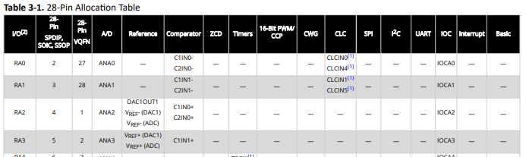
Interrupt - IOC

Slide 14
Interrupt Code
……
//IO ports setup
/* Interrupt-on-change enabled on the IOCx pin for a negative-going edge. Associated Status bit
and interrupt flag will be set upon detecting an edge. */
IOCAN3 = 1
//Sets up GIE, create handler for interrupt
On Interrupt PORTChange Call InterruptHandler
Do lots of code
Loop
Sub InterruptHandler
Dim SWState as BIT
'Save the switch state
SWState = SWITCHIN
'Toggle the LED
LEDD7 = !LEDD7
'a little delay to see if the switch has changed state
Do while SWITCHIN = SWState
wait 10 us
Loop
'We must clear this specific bit flag in software, the main IOC is cleare by the GCBASIC interrupt handler
IOCAF3 = 0
End Sub

Slide 15
Lab
Walk the examples
View the scope

Slide 17
Videos...
Install the hardware and make the board work – three LED programs
Make four LEDs flash in a sequence
Set the LEDs to represent the value of ADC
Sequence the LEDs with a delay using the value of ADC
Using an input to set the state of the LEDs
Using the reset switch
Using the switch, ADC – make the LEDs flash in a sequence with reverse
Using the serial to display values
Using the timer0 overflow, 8bit timer, 16bit timer to flash the LEDs
Using EEProm – showing values on the serial terminal, and more constants insights
Using I2C with serial to discover I2C devices
Using I2C GCLD display solutions
Using a SPI GLCD display solutions
Using PWM, 6 ways, to dim the LEDS
Using an external interrupt to control an LED
Using storage within the chip – Progmem, SAF memory, EEPROM and DATA blocks
Using CLC
The GCBASIC tool chain
Assembly , alternatives assemblers and MPLAB-X
Summary

Slide 18
GCBASIC
PIC18FxxQ24
Part 15 – External interrupt

