Slide 1
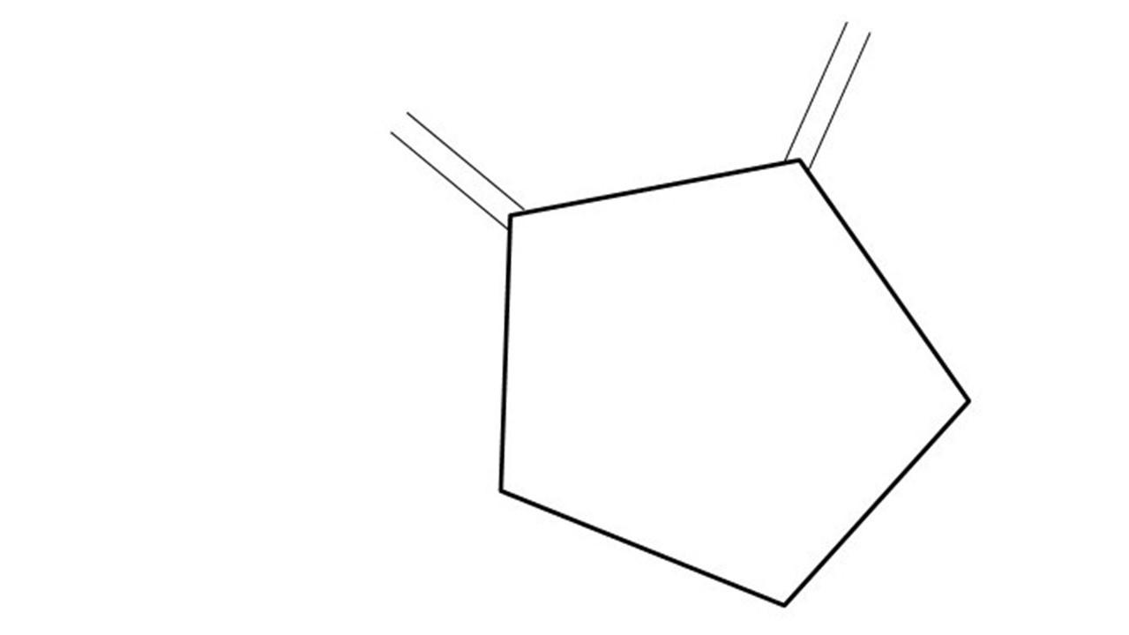
GCBASIC Part 2
AS726x
April 2024
Spectral Sensor!

