Slide 1
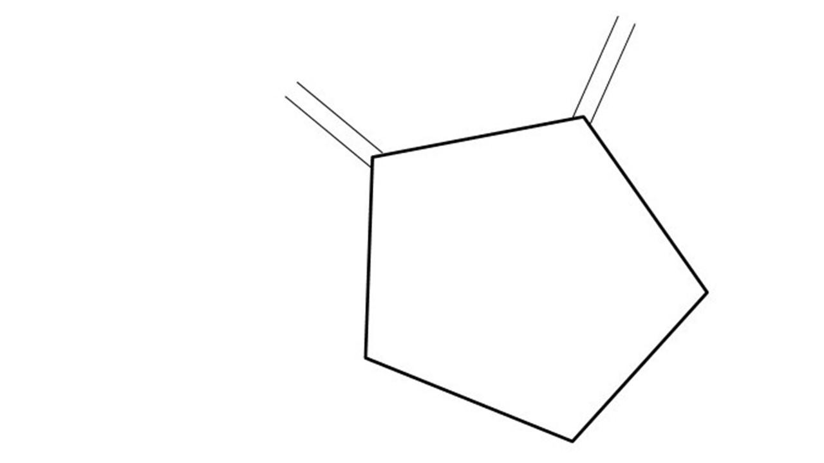
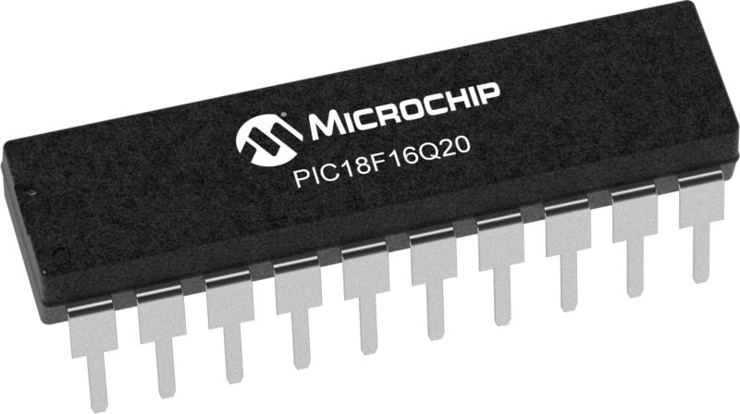
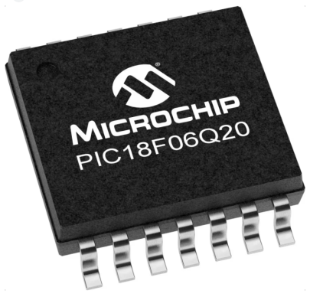
GCBASIC Part 16 - Storage
GCBASIC for the PIC18FxxQ20 chip Family
November 2024

Slide 2
GCBASIC Part 16 - Storage
GCBASIC for the PIC18FxxQ20 chip Family
November 2024
Like and subscribe!

Slide 3
Videos...
Install the hardware and make the board work – three LED programs
Make four LEDs flash in a sequence
Set the LEDs to represent the value of ADC
Sequence the LEDs with a delay using the value of ADC
Using an input to set the state of the LEDs
Using the reset switch
Using the switch, ADC – make the LEDs flash in a sequence with reverse
Using the serial to display values
Using the timer0 overflow, 8bit timer, 16bit timer to flash the LEDs
Using EEProm – showing values on the serial terminal, and more constants insights
Using I2C with serial to discover I2C devices
Using an I2C GCLD display
Using a SPI GCLD display
Using PWM, 7 ways, to dim the LEDS
Using an external interrupt to control an LED
Using storage within the chip – Progmem, SAF memory, EEPROM and DATA blocks
Using CLC
The GCBASIC tool chain
Assembly , alternatives assemblers and MPLAB-X
Summary

Slide 4
PIC18FxxQ20
PIC18-Q20 is a high performance PIC18
Digital and Analog peripherals
10-bit ADC
Multiple communication interfaces
Serial, I2C, SPI, I3C
PWM – CCP/PWM and 16Bit
Configurable Logic Cells
Multi voltage domains
The PIC18xxQ20 offers 14 and 20 pin products in small footprint packages to support customers in a variety of space constrained and sensor node applications.

Slide 5
GCBASIC Toolchain
GCBASIC is an Open Source compiler for PIC, AVR and LGT microcontrollers
GCBASIC now supports the 18FxxQ20 chip family
GCBASIC simplifies the use of storage
GCBASIC
Toolchain

Slide 6
GCBASIC Compiler
GCBASIC is an Open Source compiler for PIC and AVR microcontrollers
GCBASIC now supports the 18FxxQ41 chip family
GCBASIC Compiler

Slide 7
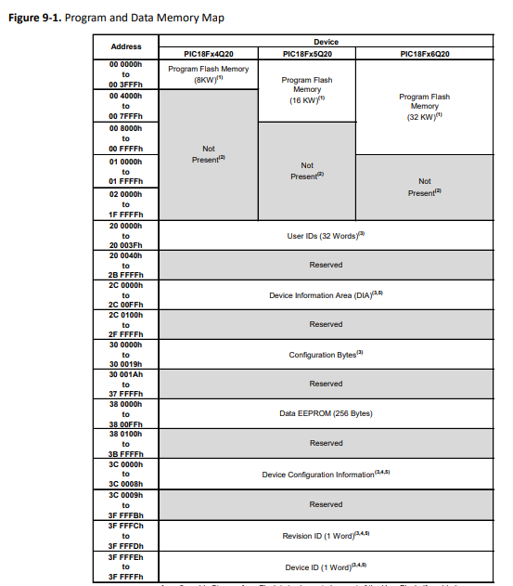
Storage Overview Types
 | Type | Characteristics
1 | Progmem | Program, Config etc And, Storage Area Flash (SAF) block
2 | Data RAM | Volatile
3 | Data EEPROM | Consider as a peripheral

Slide 8
Storage Overview SAF
 | Type | Characteristics
1 | Progmem | Program, Config etc And, Storage Area Flash (SAF) block
2 | Data RAM | Volatile
3 | Data EEPROM | Consider as a peripheral
Storage Area Flash (SAF) is the area in program memory that can be used as data storage. SAF is enabled by the SAFEN Configuration bit. If enabled, the code placed in this area cannot be executed by the CPU. The SAF block is placed at the end of memory and spans 128 Words. The WRTSAF Configuration bit is used to write-protect the Storage Area Flash.

Slide 9
Storage Overview EEProm
 | Type | Characteristics
1 | Progmem | Program, Config etc And, Storage Area Flash (SAF) block
2 | Data RAM | Volatile
3 | Data EEPROM | Consider as a peripheral

Slide 10
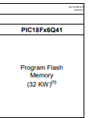
Storage usage
Progmem usage
Your program
and/or
Reference data
Pictures
Uses PFM direct addressing
Program
Reference Data
or
Program
Reference Data

Slide 11
SAF usage
SAF usage
Reference data
Must not be overwritten by user program – you MUST adjust program to NOT use SAF block
Uses SAF offset addressing
PIC18FxxQ20
PIC18FxxQ20
Program
or
Program
SAF Reference Data
SAF Reference Data

Slide 12
EEDATA & DATA Blocks
Program
Reference Data
 | Type | Characteristics
1 | EEDATA | An EEPROM block or blocks of data that is programmed into the EEPROM
2 | DATA | An DATA block or blocks of data that is programmed just above your program
Both can area be easily used for reference data

Slide 13
Lab
Walk the examples
PROGMEM
SAF
EEPROM
DATA

Slide 15
Videos...
Install the hardware and make the board work – three LED programs
Make four LEDs flash in a sequence
Set the LEDs to represent the value of ADC
Sequence the LEDs with a delay using the value of ADC
Using an input to set the state of the LEDs
Using the reset switch
Using the switch, ADC – make the LEDs flash in a sequence with reverse
Using the serial to display values
Using the timer0 overflow, 8bit timer, 16bit timer to flash the LEDs
Using EEProm – showing values on the serial terminal, and more constants insights
Using I2C with serial to discover I2C devices
Using an I2C GCLD display
Using a SPI GCLD display
Using PWM, 7 ways, to dim the LEDS
Using an external interrupt to control an LED
Using storage within the chip– Progmem, SAF memory, EEPROM and DATA blocks
Using CLC
The GCBASIC tool chain
Assembly , alternatives assemblers and MPLAB-X
Summary

Slide 16
GCBASIC Part 16 - Storage
GCBASIC for the PIC18FxxQ20 chip Family
November 2024

