Slide 1

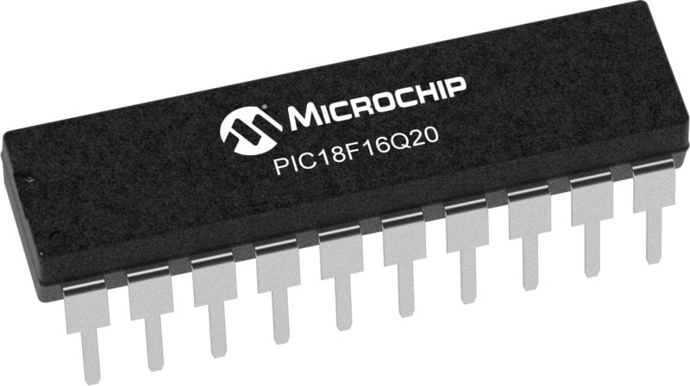
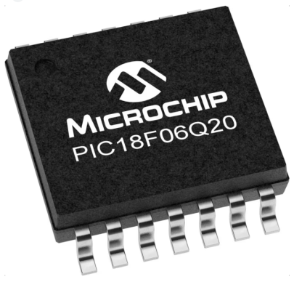
GCBASIC Part 17 - Configurable Logic Cell ( CLC )
GCBASIC for the PIC18FxxQ20 chip Family
November 2024

Slide 2
GCBASIC Part 17 - Configurable Logic Cell ( CLC )
GCBASIC for the PIC18FxxQ20 chip Family
November 2024
Like and subscribe!

Slide 3
Videos...
Install the hardware and make the board work – three LED programs
Make four LEDs flash in a sequence
Set the LEDs to represent the value of ADC
Sequence the LEDs with a delay using the value of ADC
Using an input to set the state of the LEDs
Using the reset switch
Using the switch, ADC – make the LEDs flash in a sequence with reverse
Using the serial to display values
Using the timer0 overflow, 8bit timer, 16bit timer to flash the LEDs
Using EEProm – showing values on the serial terminal, and more constants insights
Using I2C with serial to discover I2C devices
Using an I2C GCLD display
Using a SPI GCLD display
Using PWM, 7 ways, to dim the LEDS
Using an external interrupt to control an LED
Using storage within the chip – Progmem, SAF memory, EEPROM and DATA blocks
Using CLC
The GCBASIC tool chain
Assembly , alternatives assemblers and MPLAB-X
Summary

Slide 4
PIC18FxxQ20
PIC18-Q20 is a high performance PIC18
Digital and Analog peripherals
10-bit ADC
Multiple communication interfaces
Serial, I2C, SPI, I3C
PWM – CCP/PWM and 16Bit
Configurable Logic Cells
Multi voltage domains
The PIC18xxQ20 offers 14 and 20 pin products in small footprint packages to support customers in a variety of space constrained and sensor node applications.

Slide 5
CLC
CLC Functionality
The CLC module allows users to implement custom logic functions directly in hardware, providing flexibility without CPU intervention
Purpose
It can be used to create complex logic functions with simple configurations

Slide 6
CLC
Key Features
Logic Gates: Configures standard logic gates like AND, OR, XOR, etc
Sequential Logic: Supports latches and flip-flops
Input Sources: Can use internal signals (from other peripherals) and external signals (from pins)
Output Options: Outputs can be routed to other peripherals or I/O pins
Applications
Custom PWM Generation: Used for tasks like motor control
Data Signal Modulation: Can be used to create custom communication protocols
LED Control: Efficiently manage LED lighting sequences.

Slide 7
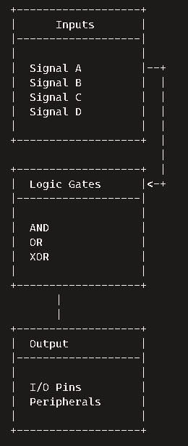
CLC
CLC Diagram
Inputs
Up to 16 input sources can be selected from internal and external signals
Logic Gates Configuration
Configurable logic gates like AND, OR, XOR are used to combine the inputs
Sequential Logic Options
Supports sequential elements like latches and flip-flops
Output
The final logic output can be routed to I/O pins or other peripherals

Slide 8
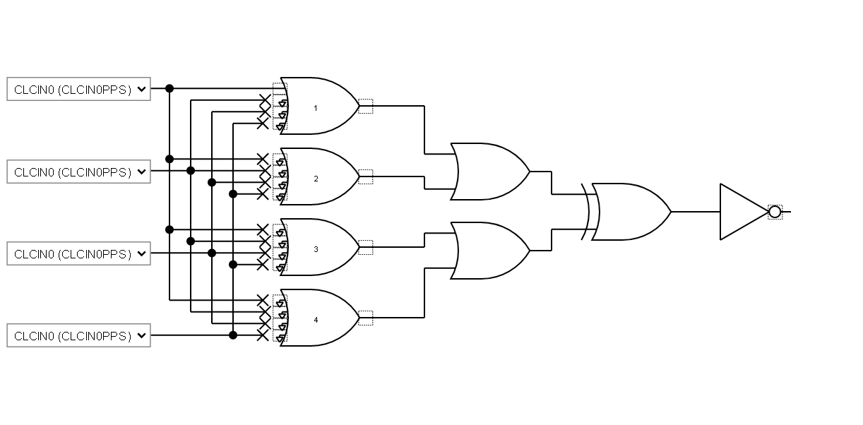
CLC
Digital logic circuit diagram consisting of multiple logic gates. A detailed breakdown:
Inputs:
CLCIN0 (CLCIN0PPS): The primary input signal fed into the circuit.
Logic Gates:
AND Gates: There are several AND gates that process the input signals. These gates output a high signal (1) only if all their inputs are high.
OR Gates: The outputs from the AND gates are fed into OR gates. These gates output a high signal if at least one of their inputs is high.
NOT Gate: The final output from the OR gates is sent through a NOT gate, which inverts the signal. If the input is high, the output will be low, and vice versa.
Outputs:
The result of the NOT gate is the final output of the circuit.

Slide 9
Lab
Create an example using
Microchip Standalone MCC
https://gallery.microchip.com/packages/MCC-Standalone-(Windows)/
https://www.microchip.com/en-us/tools-resources/configure/mplab-code-configurator#download/
C:\Users\{userID}\.mcc
C:\Users\{userID}\.mcc\mcc_generated_files\clc\src\clc1.c - for CLC
C:\Users\{userID}\.mcc\mcc_generated_files\system\src\pins.c - for PPS
GCStudio
Basic Hardware
Merge contents
Test and enjoy

Slide 11
Videos...
Install the hardware and make the board work – three LED programs
Make four LEDs flash in a sequence
Set the LEDs to represent the value of ADC
Sequence the LEDs with a delay using the value of ADC
Using an input to set the state of the LEDs
Using the reset switch
Using the switch, ADC – make the LEDs flash in a sequence with reverse
Using the serial to display values
Using the timer0 overflow, 8bit timer, 16bit timer to flash the LEDs
Using EEProm – showing values on the serial terminal, and more constants insights
Using I2C with serial to discover I2C devices
Using an I2C GCLD display
Using a SPI GCLD display
Using PWM, 7 ways, to dim the LEDS
Using an external interrupt to control an LED
Using storage within the chip – Progmem, SAF memory, EEPROM and DATA blocks
Using CLC
The GCBASIC tool chain
Assembly , alternatives assemblers and MPLAB-X
Summary

Slide 12
GCBASIC Part 17 - Configurable Logic Cell ( CLC )
GCBASIC for the PIC18FxxQ20 chip Family
November 2024
Like and subscribe!

