Slide 1
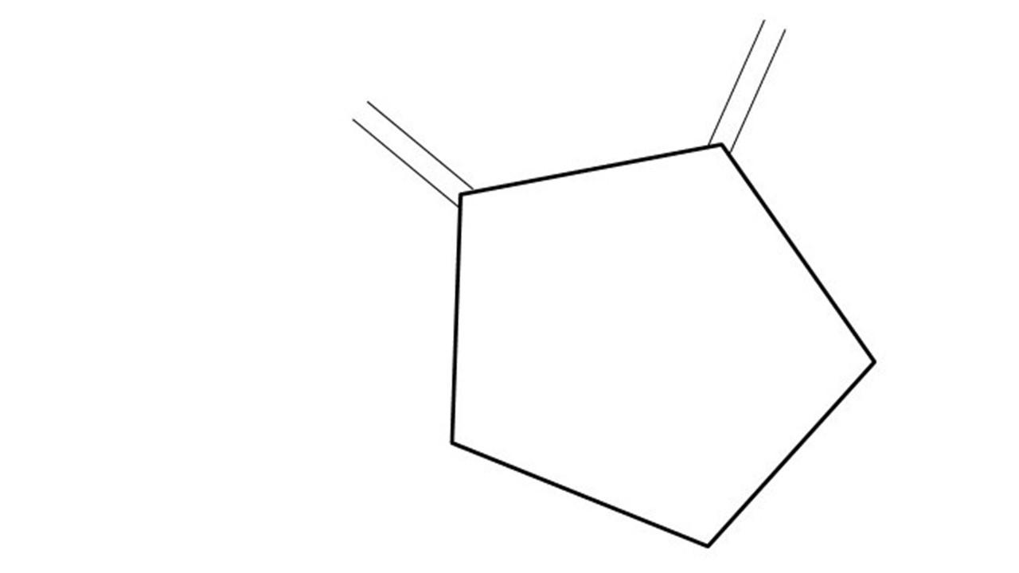
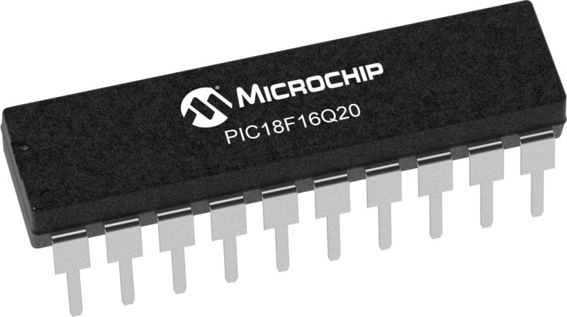
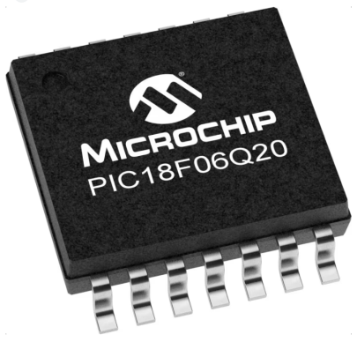
GCBASIC Part 18 – GCBASIC Toolchain
GCBASIC for the PIC18FxxQ20 chip Family
November 2024

Slide 2
GCBASIC Part 18
GCBASIC for the PIC18FxxQ20 chip Family
November 2024
Like and subscribe!

Slide 3
Videos...
Install the hardware and make the board work – three LED programs
Make four LEDs flash in a sequence
Set the LEDs to represent the value of ADC
Sequence the LEDs with a delay using the value of ADC
Using an input to set the state of the LEDs
Using the reset switch
Using the switch, ADC – make the LEDs flash in a sequence with reverse
Using the serial to display values
Using the timer0 overflow, 8bit timer, 16bit timer to flash the LEDs
Using EEProm – showing values on the serial terminal, and more constants insights
Using I2C with serial to discover I2C devices
Using an I2C GCLD display
Using a SPI GCLD display
Using PWM, 7 ways, to dim the LEDS
Using an external interrupt to control an LED
Using storage within the chip – Progmem, SAF memory, EEPROM and DATA blocks
Using CLC
The GCBASIC tool chain
Assembly , alternatives assemblers and MPLAB-X
Summary

Slide 4
GCBASIC Compiler
GCBASIC is an Open Source compiler for PIC, AVR and LGT microcontrollers
GCBASIC now supports the 18FxxQ20 chip family
GCBASIC is a cross platform with common code translation
GCBASIC Compiler

Slide 5
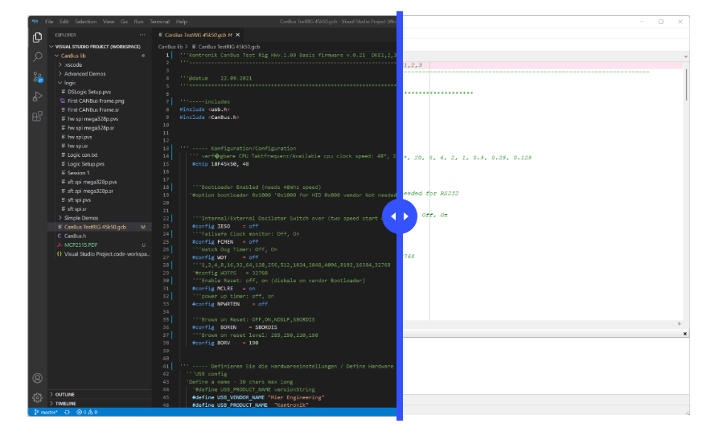
The Windows IDEs
PPSTool
AVRInfo
CLC
PicInfo
PSMC
GCBASIC IDE
GCBASIC Compiler
Programmers
GC Studio
Program Editor
Terminal
https://gcbasic.com/

Slide 6
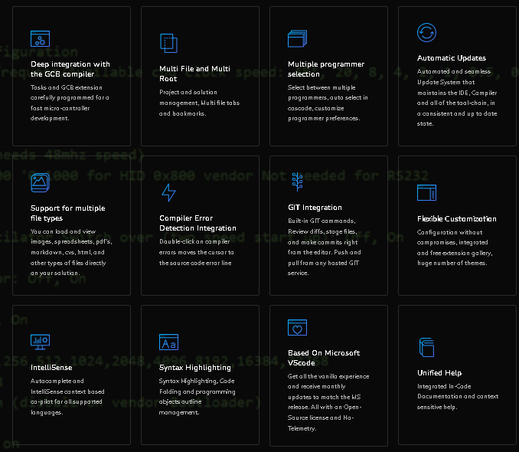

Slide 7
Tool chain
APPLICATION TITLE | CLASS | CORE | OS | SEEN | MAINTAINED
GCBASIC compiler | Compiler/Linker | Y | Windows, Linux, BSD, MAC | Y | Yes by GCBASIC team
Great Cow Graphical BASIC IDE | IDE/Compiler/Linker | y | Windows | N | Yes by GCBASIC team
AVRInfo | Code Generator | n | Windows, Linux, BSD, MAC | Y | Yes by GCBASIC team
AVRDude | Programmer | n | - | Y | http://savannah.nongnu.org\projects\avrdude
CLC Designer | Code Generator | n | Windows | Y | No
Converters | Converter | y | Windows, Linux, BSD, MAC | Y | Yes by GCBASIC team
CoolTerm | Terminal | n | Windows | N | Yes, see website
DFU Bootloader | Programmer | n | Windows, Linux, BSD, MAC | N | Anobium..GITHub
GC Code | IDE | y | Windows | Y | Yes by GCBASIC team
GC Studio | IDE | y | Windows | Y | Yes by GCBASIC team
G+Stool | Management Supervisor | y | Windows | Y | Yes by GCBASIC team
K150 | Programmer | n | Windows | N | http://www.kitsrus.com/pic.html
Micronucleus | Programmer | n | - | N | Micronucleus..GitHub
Northern Software | Programmer | n | Windows, Linux, BSD, MAC | Y | https://www.northernsoftware.com/
PICInfo | Code Generator | n | Windows, Linux, BSD, MAC | Y | Yes by GCBASIC team
PicKit2 command line – for older chips | Programmer | n | Windows, Linux | N | Microchip website
PicKit2 GUI – for older chips | Programmer | n | Windows | N | Microchip website
PicKit3 GUI – for older chips | Programmer | n | Windows | N | Microchip Website
PicKit3 MPLAB-IPE integration tool | Programmer | n | Windows, Linux | N | http://www.autoitscript.com
PICKitPlus – PICkit2 and PICKit3 suite | Programmer | n | Windows, Linux | Y | www.pickitplus.co.uk
PICPgm | Programmer | n | Windows | N | http://picpgm.picprojects.net/
PPS Tool | Code Generator | y | Windows | Y | Yes by GCBASIC team
Programmer editor | IDE | y | Windows | Y | Yes by GCBASIC team
PSMC Designer | Code Generator | n | Windows | N | No
Putty | Terminal | n | Windows | N | Yes, see website
SynWrite IDE | IDE | y | Windows | Y | Yes by GCBASIC team
Terminal | Terminal | n | Windows | Y | Yes, see website
TinyBootLoader | Programmer | n | Windows | N | http://tinypicbootload.sourceforge.net/
XpressLoader for Microchip Xpress boards | Programmer | n | Windows | N | https://sourceforge.net/p/gcbasic/code/HEAD/tree/utils/
MPLAB_IPE | Programmer | n | Windows, Linux | Y | https://www.microchip.com/mplab/mplab-x-ide
GCASM | Compiler/Linker | Y | Windows, Linux, BSD, MAC | Y | Yes by GCBASIC team
PIC-AS | Linker | n | Windows, Linux, BSD, MAC | Y | https://www.microchip.com/mplab/mplab-x-ide
MPASM | Linker | n | Windows, Linux, BSD, MAC | Y | https://www.microchip.com/mplab/mplab-x-ide
GPASM | Linker | n | Windows, Linux, BSD, MAC | Y | https://www.microchip.com/mplab/mplab-x-ide

Slide 8
The core compiler
High Level Language
Reports:
TXT and HTML
Source Code
GCBASIC Compiler
GCBASIC Compiler
Preprocessor
Code Translator
Assembler
Linker
Assembly Language
ASM file
Absolute Machine Code
HEX file
Libraries
8 bit PIC, AVR, AVR-DX and LGT

Slide 9
Compiler options
High Level Language
Reports:
TXT and HTML
Source Code
PIC-AS, MPASM,
MPLAB-IDE,
GPASM, AVRASM2
GCBASIC Compiler
GCBASIC Compiler
Preprocessor
Code Translator
Assembler
Linker
Assembly Language
file
Absolute Machine Code
HEX file
Libraries
8 bit PIC, AVR, AVR-DX and LGT

Slide 10
The Variants for Linux, BSD & Mac
$ time LC_ALL=C /opt/GCBASIC/makehex.sh code9.gcb GCBASIC (0.98.07 RC07 2020-04-01 (Linux 64 bit)) Compiling code9.gcb ... Done Assembling program ... Program assembled successfully! real 0m2,947s user 0m2,886s sys 0m0,045s
An Editor
GCBASIC Compiler
Programmers
Scripts

Slide 11
Lab
We will
Review PICINFO application
Review AVRInfo application
Edit Preferences application
Code portability

Slide 13
GCBASIC Part 18
GCBASIC for the PIC18FxxQ20 chip Family
November 2024

Slide 14
Videos...
Install the hardware and make the board work – three LED programs
Make four LEDs flash in a sequence
Set the LEDs to represent the value of ADC
Sequence the LEDs with a delay using the value of ADC
Using an input to set the state of the LEDs
Using the reset switch
Using the switch, ADC – make the LEDs flash in a sequence with reverse
Using the serial to display values
Using the timer0 overflow, 8bit timer, 16bit timer to flash the LEDs
Using EEProm – showing values on the serial terminal, and more constants insights
Using I2C with serial to discover I2C devices
Using an I2C GCLD display
Using a SPI GCLD display
Using PWM, 7 ways, to dim the LEDS
Using an external interrupt to control an LED
Using storage within the chip – Progmem, SAF memory, EEPROM and DATA blocks
Using CLC
The GCBASIC tool chain
Assembly , alternatives assemblers and MPLAB-X
Summary

