Slide 1

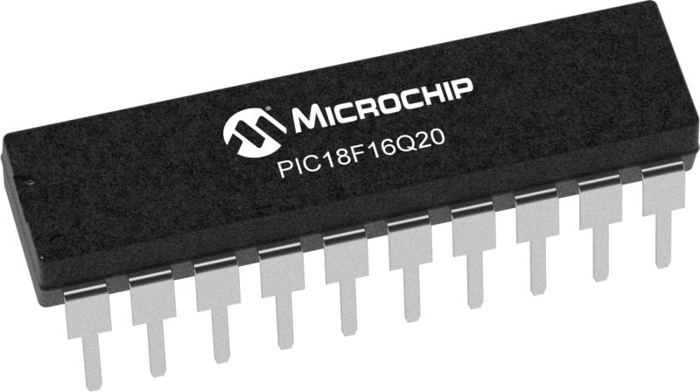
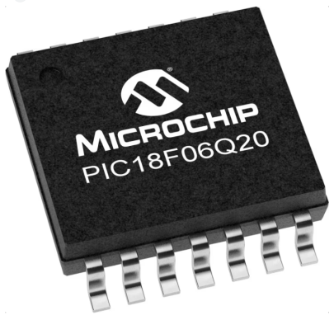
GCBASIC Part 19 - Assembly , alternatives assemblers and MPLAB-X
GCBASIC for the PIC18FxxQ20 chip Family
November 2024

Slide 2
GCBASIC Part 19 - Assembly , alternatives assemblers and MPLAB-X
GCBASIC for the PIC18FxxQ20 chip Family
November 2024
Like and subscribe!

Slide 3
Videos...
Install the hardware and make the board work – three LED programs
Make four LEDs flash in a sequence
Set the LEDs to represent the value of ADC
Sequence the LEDs with a delay using the value of ADC
Using an input to set the state of the LEDs
Using the reset switch
Using the switch, ADC – make the LEDs flash in a sequence with reverse
Using the serial to display values
Using the timer0 overflow, 8bit timer, 16bit timer to flash the LEDs
Using EEProm – showing values on the serial terminal, and more constants insights
Using I2C with serial to discover I2C devices
Using an I2C GCLD display
Using a SPI GCLD display
Using PWM, 7 ways, to dim the LEDS
Using an external interrupt to control an LED
Using storage within the chip – Progmem, SAF memory, EEPROM and DATA blocks
Using CLC
The GCBASIC tool chain
Assembly , alternatives assemblers and MPLAB-X
Summary

Slide 4
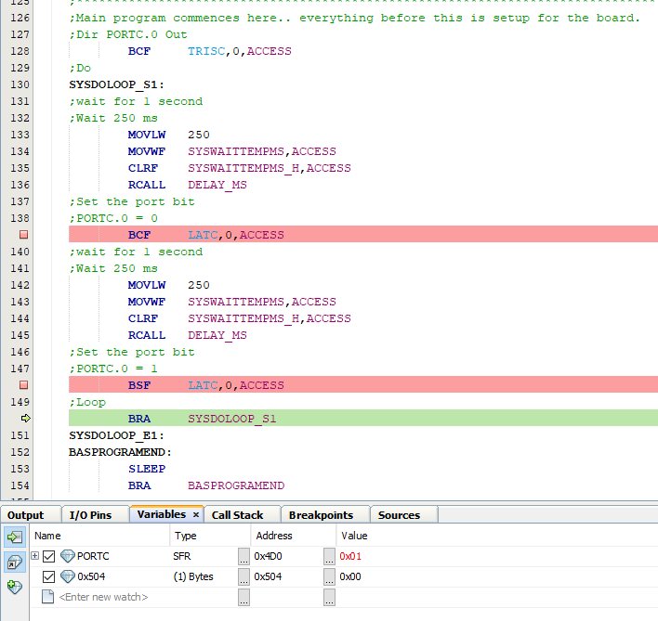
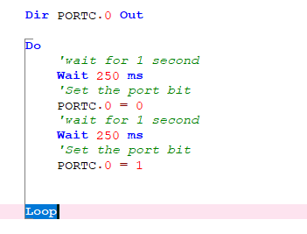
GCBASIC & MPLAB-X/PIC-AS

Slide 5
GCBASIC Compiler
GCBASIC is an Open Source compiler for PIC, AVR and LGT microcontrollers
GCBASIC now supports the 18FxxQ20 chip family
GCBASIC is a cross platform with common code translation
GCBASIC Compiler

Slide 6
The core compiler
High Level Language
Reports:
TXT and HTML
Source Code
GCBASIC Compiler
GCBASIC Compiler
Preprocessor
Code Translator
Assembler
Linker
Assembly Language
ASM file
Absolute Machine Code
HEX file
Libraries
8 bit PIC, AVR, AVR-DX and LGT

Slide 7
Compiler options
High Level Language
Reports:
TXT and HTML
Source Code
PIC-AS, MPASM,
MPLAB-IDE,
GPASM, AVRASM2
GCBASIC Compiler
GCBASIC Compiler
Preprocessor
Code Translator
Assembler
Linker
Assembly Language
file
Absolute Machine Code
HEX file
Libraries
8 bit PIC, AVR, AVR-DX and LGT

Slide 8
Lab
We will
Review a simple LED program
Create a Project in MPLAB-X using the GCBASIC .S as the source
Select Standalone project
Specify chip, select the Simulator
Select PIC-AS, latest version
Name project {chipname}, specify same directory.
Finish
Now Add the GCBASIC source file
Add existing item/select source .S file with AUTO
Select File/Project Properties
Set Conf:[default] Simulator / Instruction Frequency to 64
Set Conf:[default] Building / Check Execute this line after build
C:\GCSTUDIO\PICKitPlus\pickitcommandline.exe -w -p${Device} -f${ImagePath} -mpec -zv -a5
Press OK to save
Test compile <F11> and program
Use the debugger to walk the code

Slide 10
Videos...
Install the hardware and make the board work – three LED programs
Make four LEDs flash in a sequence
Set the LEDs to represent the value of ADC
Sequence the LEDs with a delay using the value of ADC
Using an input to set the state of the LEDs
Using the reset switch
Using the switch, ADC – make the LEDs flash in a sequence with reverse
Using the serial to display values
Using the timer0 overflow, 8bit timer, 16bit timer to flash the LEDs
Using EEProm – showing values on the serial terminal, and more constants insights
Using I2C with serial to discover I2C devices
Using an I2C GCLD display
Using a SPI GCLD display
Using PWM, 7 ways, to dim the LEDS
Using an external interrupt to control an LED
Using storage within the chip – Progmem, SAF memory, EEPROM and DATA blocks
Using CLC
The GCBASIC tool chain
Assembly , alternatives assemblers and MPLAB-X
Summary

Slide 11
GCBASIC Part 19 - Assembly , alternatives assemblers and MPLAB-X
GCBASIC for the PIC18FxxQ20 chip Family
November 2024

