Slide 1
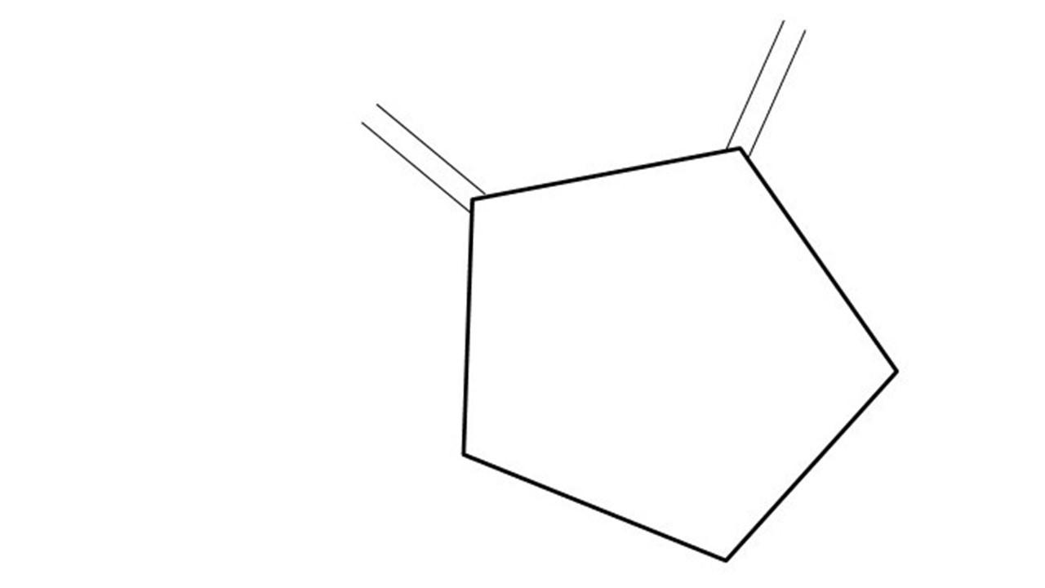
GCBASIC
AS726x
April 2024
Spectral Sensor!

