Slide 1

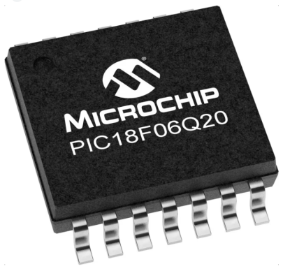
GCBASIC Part 3
GCBASIC for the PIC18FxxQ20 chip Family
February 2024

Slide 2
PIC18FxxQ20
PIC18-Q20 is a high performance PIC18
Digital and Analog peripherals
12-bit ADC
Multiple communication interfaces
Serial, I2C, SPI, I3C
PWM – CCP/PWM and 16Bit
Configurable Logic Cells
Multi voltage domains
The PIC18xxQ20 offers 14- and 20-pin products in small footprint packages to support customers in a variety of space constrained and sensor node applications.

Slide 3
Videos...
Install the hardware and make the board work – three LED programs
Make four LEDs flash in a sequence
Set the LEDs to represent the value of ADC
Sequence the LEDs with a delay using the value of ADC
Using an input to set the state of the LEDs
Using the reset switch
Using the switch, ADC – may the LEDs flash in a sequence with reverse
Using the serial to display values
Using the timer0 overflow, 8bit timer, 16bit timer to flash the LEDs
Using CCP/PWM to dim the LEDS
Using I2C with serial to discover I2C devices
Using EEProm – showing values on the serial terminal
Using an I2C GCLD display
Using an SPI GCLD display
Using PWM to dim the LEDS
Using memory within the PIC – Progmem and SAF memory
The GCBASIC tool chain
Assembly and alternatives assemblers
Summary

Slide 4
GCBASIC Toolchain
GCBASIC is an Open Source compiler for PIC, AVR and LGT microcontrollers
GCBASIC now supports the 18FxxQ20 chip family
GCBASIC
Toolchain

Slide 5
Hardware
Prototype Board
Power 5v0
Programmer
LEDs & resistors
Hardware
-------------------PORTA---------------- Bit#: -7---6---5---4---3---2---1---0--- IO: ----------------------------ADC-- ----------------------------------------- -------------------PORTB---------------- Bit#: -7---6---5---4---3---2---1---0--- IO: --------------------------------- ----------------------------------------- ------------------PORTC----------------- Bit#: -7---6---5---4---3---2---1---0--- IO: LED-LED-LED-LED------------------ -----------------------------------------

Slide 6
Analog-to-Digital
We configure the ADC, run a conversion, read the analog voltage controlled by the potentiometer on the board, and display the results on the LEDs.

Slide 7
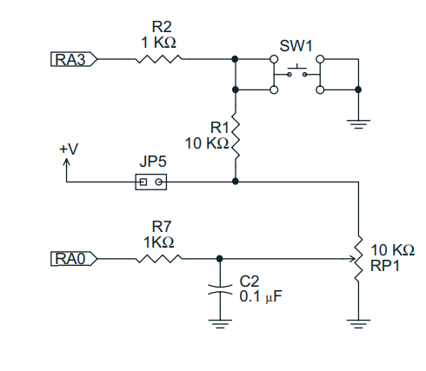
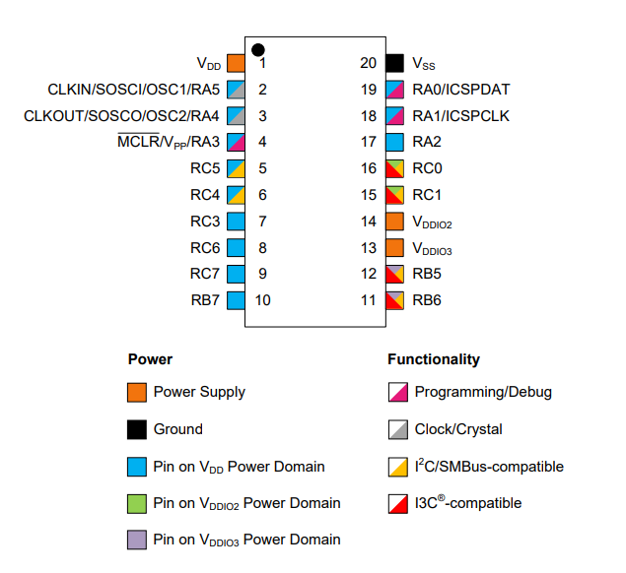
Analog-to-Digital
Using AN0 connected to RA0 (PortA.0)

Slide 8
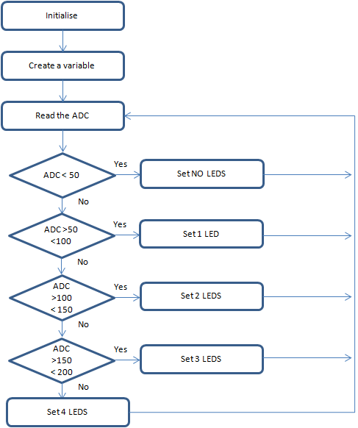
Analog-to-Digital
GCBASIC completes the initialisation
Create a variable to store the ADC results
Read the ADC
GCBASIC makes the process easy via the ReadADC()
ReadADC returns a value of 0 to 255
Set the LEDs
Do it again….

Slide 9
Analog-to-Digital

Slide 10
Lab
Examine the sample code
Review the results

Slide 12
Videos...
Install the hardware and make the board work – three LED programs
Make four LEDs flash in a sequence
Set the LEDs to represent the value of ADC
Sequence the LEDs with a delay using the value of ADC
Using an input to set the state of the LEDs
Using the reset switch
Using the switch, ADC – may the LEDs flash in a sequence with reverse
Using the serial to display values
Using the timer0 overflow, 8bit timer, 16bit timer to flash the LEDs
Using CCP/PWM to dim the LEDS
Using I2C with serial to discover I2C devices
Using EEProm – showing values on the serial terminal
Using an I2C GCLD display
Using an SPI GCLD display
Using PWM to dim the LEDS
Using memory within the PIC – Progmem and SAF memory
The GCBASIC tool chain
Assembly and alternatives assemblers
Summary

Slide 13
GCBASIC Part 3
GCBASIC for the PIC18FxxQ20 chip Family
February 2024

Slide 14
Backup Slides

Slide 15
Initialise
Create a variable
Read the ADC
ADC < 50
Yes
Set NO LEDS
No
ADC >50 <100
Yes
Set 1 LED
No
ADC >100
< 150
Yes
Set 2 LEDS
No
ADC >150
< 200
Yes
Set 3 LEDS
No
Set 4 LEDS

