Slide 1

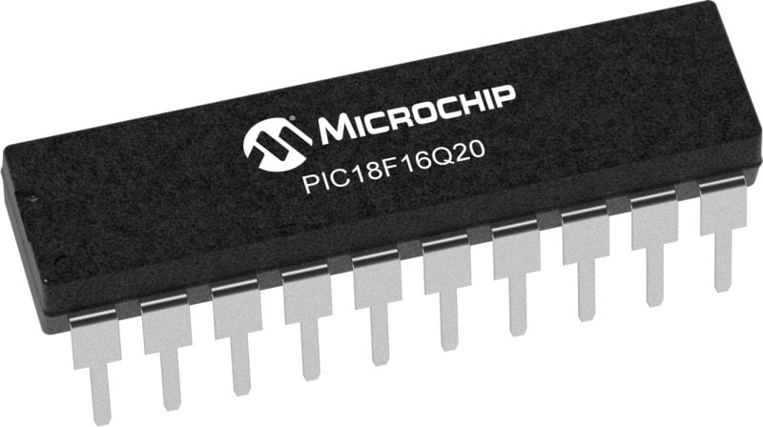
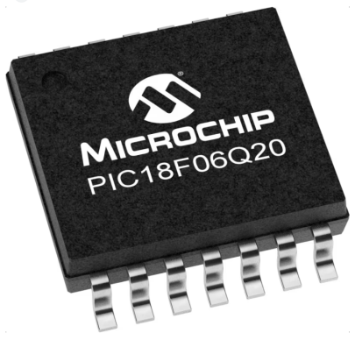
GCBASIC Part 5
GCBASIC for the PIC18FxxQ20 chip Family
February 2024

Slide 2
Videos...
Install the hardware and make the board work – three LED programs
Make four LEDs flash in a sequence
Set the LEDs to represent the value of ADC
Sequence the LEDs with a delay using the value of ADC
Using an input to set the state of the LEDs
Using the reset switch
Using the switch, ADC – may the LEDs flash in a sequence with reverse
Using the serial to display values
Using the timer0 overflow, 8bit timer, 16bit timer to flash the LEDs
Using CCP/PWM to dim the LEDS
Using I2C with serial to discover I2C devices
Using EEProm – showing values on the serial terminal
Using an I2C GCLD display
Using an SPI GCLD display
Using PWM to dim the LEDS
Using memory within the PIC – Progmem and SAF memory
The GCBASIC tool chain
Assembly and alternatives assemblers
Summary

Slide 3
PIC18FxxQ20
PIC18-Q20 is a high performance PIC18
Digital and Analog peripherals
10-bit ADC
Multiple communication interfaces
Serial, I2C, SPI, I3C
PWM – CCP/PWM and 16Bit
Configurable Logic Cells
Multi voltage domains
The PIC18xxQ20 offers 14 and 20 pin products in small footprint packages to support customers in a variety of space constrained and sensor node applications.

Slide 4
GCBASIC Toolchain
GCBASIC is an Open Source compiler for PIC, AVR and LGT microcontrollers
GCBASIC now supports the 18FxxQ20 chip family
GCBASIC
Toolchain

Slide 5
Hardware
Prototype Board
Power 5v0
Programmer
LEDs & resistors
Potentiometer
Hardware
-------------------PORTA---------------- Bit#: -7---6---5---4---3---2---1---0--- IO: -----------------SW---------ADC-- ----------------------------------------- -------------------PORTB---------------- Bit#: -7---6---5---4---3---2---1---0--- IO: --------------------------------- ----------------------------------------- ------------------PORTC----------------- Bit#: -7---6---5---4---3---2---1---0--- IO: LED-LED-LED-LED------------------ -----------------------------------------

Slide 6
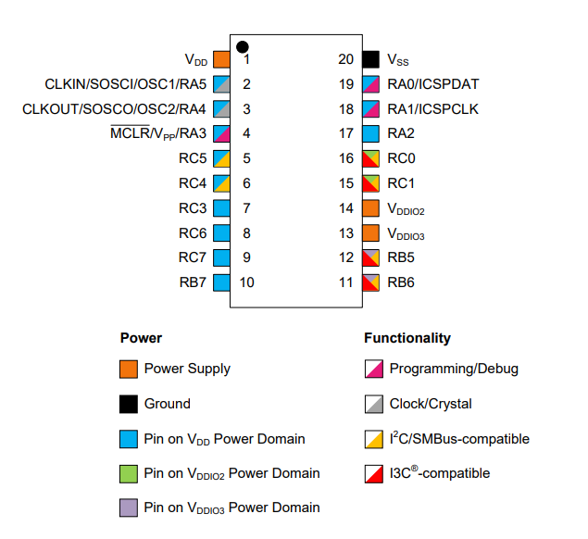

Slide 7
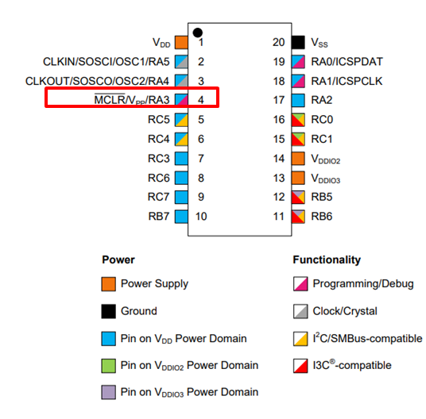
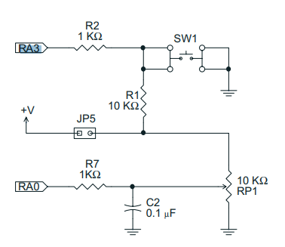
Switch
The switch is connected RA3
When the switch is depressed RA3 will transition to 0v

Slide 8
Tutorial overview
Initialise
Set LED off
Initialise
Check the switch
If pushed then toggle LED
If not pushed then do it again
Checking the switch by using function to inspect the switch state
Keypressed = TRUE
Yes
No
Toggle LED
Loop

Slide 9
Lab
Review GCSTUDIO options
Examine the sample code
Review the results

Slide 11
Videos...
Install the hardware and make the board work – three LED programs
Make four LEDs flash in a sequence
Set the LEDs to represent the value of ADC
Sequence the LEDs with a delay using the value of ADC
Using an input to set the state of the LEDs
Using the reset switch
Using the switch, ADC – may the LEDs flash in a sequence with reverse
Using the serial to display values
Using the timer0 overflow, 8bit timer, 16bit timer to flash the LEDs
Using CCP/PWM to dim the LEDS
Using I2C with serial to discover I2C devices
Using EEProm – showing values on the serial terminal
Using an I2C GCLD display
Using an SPI GCLD display
Using PWM to dim the LEDS
Using memory within the PIC – Progmem and SAF memory
The Great Cow BASIC tool chain
Assembly and alternatives assemblers
Summary

Slide 12
GCBASIC Part 5
GCBASIC for the PIC18FxxQ20 chip Family
February 2024

Slide 13
Backup Slides

Slide 14
Initialise
Set 1st LED
Wait for a Delay
Rotate the LEDs
Did it overflow ?
No
Yes
Set 1st LED

