Slide 1

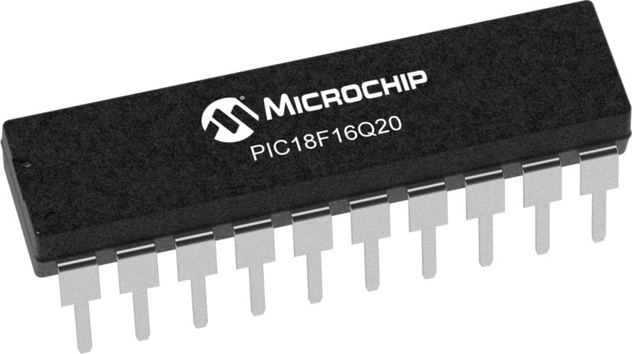
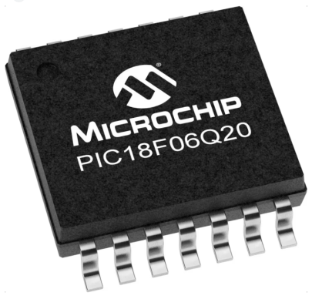
GCBASIC Part 6
GCBASIC for the PIC18FxxQ20 chip Family
February 2024

Slide 2
Videos...
Install the hardware and make the board work – three LED programs
Make four LEDs flash in a sequence
Set the LEDs to represent the value of ADC
Sequence the LEDs with a delay using the value of ADC
Using an input to set the state of the LEDs
Using the reset switch
Using the switch, ADC – may the LEDs flash in a sequence with reverse
Using the serial to display values
Using the timer0 overflow, 8bit timer, 16bit timer to flash the LEDs
Using CCP/PWM to dim the LEDS
Using I2C with serial to discover I2C devices
Using EEProm – showing values on the serial terminal
Using an I2C GCLD display
Using an SPI GCLD display
Using PWM to dim the LEDS
Using memory within the PIC – Progmem and SAF memory
The GCBASIC tool chain
Assembly and alternatives assemblers
Summary

Slide 3
PIC18FxxQ20
PIC18-Q20 is a high performance PIC18
Digital and Analog peripherals
10-bit ADC
Multiple communication interfaces
Serial, I2C, SPI, I3C
PWM – CCP/PWM and 16Bit
Configurable Logic Cells
Multi voltage domains
The PIC18xxQ20 offers 14 and 20 pin products in small footprint packages to support customers in a variety of space constrained and sensor node applications.

Slide 4
GCBASIC Toolchain
GCBASIC is an Open Source compiler for PIC, AVR and LGT microcontrollers
GCBASIC now supports the 18FxxQ20 chip family
GCBASIC
Toolchain

Slide 5
Hardware
Prototype Board
Power 5v0
Programmer
LEDs & resistors
Potentiometer
Switch
Hardware
-------------------PORTA---------------- Bit#: -7---6---5---4---3---2---1---0--- IO: -----------------SW---------ADC-- ----------------------------------------- -------------------PORTB---------------- Bit#: -7---6---5---4---3---2---1---0--- IO: --------------------------------- ----------------------------------------- ------------------PORTC----------------- Bit#: -7---6---5---4---3---2---1---0--- IO: LED-LED-LED-LED------------------ -----------------------------------------

Slide 6
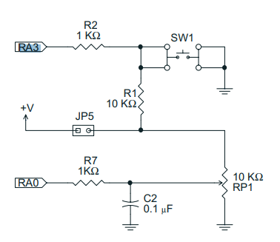
Using the Reset as input or Master Clear
The switch is connected RA3
The configuration switches control the operation of RA3
MCRLE
EXTMCRL - pin is MCLR
INTMCRL - pin function is port defined function

Slide 7
Tutorial overview
Initialise
Flash an LED
Part 1 – RA3 as input
Initialise
Check the reset switch
If pushed then toggle LED
Part 2 – RA3 as reset
Initialise
Resets every time…
Do Forever
RSTButton = 0
Yes
No
Set LED State
Loop

Slide 8
Lab
Examine the sample code
Review the results

Slide 10
Videos...
Install the hardware and make the board work – three LED programs
Make four LEDs flash in a sequence
Set the LEDs to represent the value of ADC
Sequence the LEDs with a delay using the value of ADC
Using an input to set the state of the LEDs
Using the reset switch
Using the switch, ADC – may the LEDs flash in a sequence with reverse
Using the serial to display values
Using the timer0 overflow, 8bit timer, 16bit timer to flash the LEDs
Using CCP/PWM to dim the LEDS
Using I2C with serial to discover I2C devices
Using EEProm – showing values on the serial terminal
Using an I2C GCLD display
Using an SPI GCLD display
Using PWM to dim the LEDS
Using memory within the PIC – Progmem and SAF memory
The Great Cow BASIC tool chain
Assembly and alternatives assemblers
Summary

Slide 11
GCBASIC Part 6
GCBASIC for the PIC18FxxQ20 chip Family
February 2024

Slide 12
Backup Slides

Slide 13
Initialise
Set 1st LED
Wait for a Delay
Rotate the LEDs
Did it overflow ?
No
Yes
Set 1st LED

