Slide 1
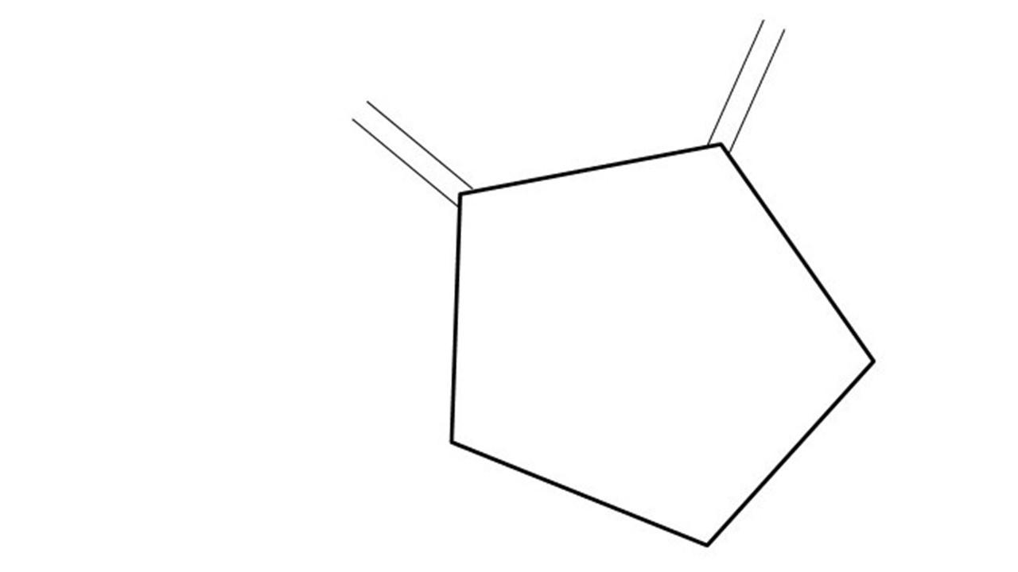
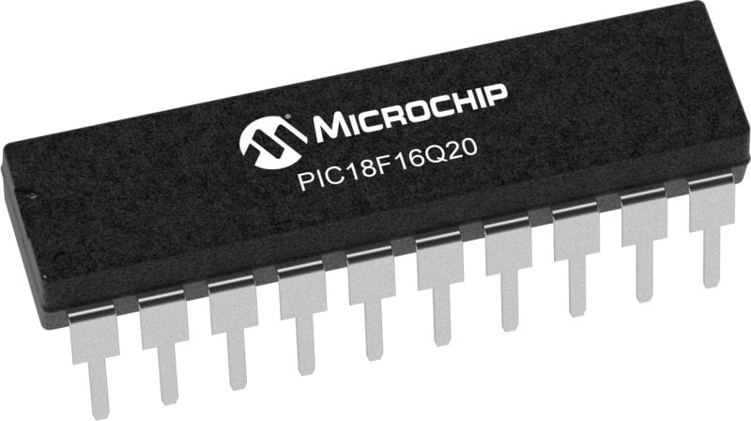
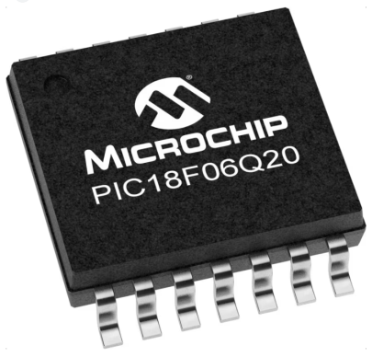
GCBASIC Part 9
GCBASIC for the PIC18FxxQ20 chip Family
February 2024

Slide 2
Videos...
Install the hardware and make the board work – three LED programs
Make four LEDs flash in a sequence
Set the LEDs to represent the value of ADC
Sequence the LEDs with a delay using the value of ADC
Using an input to set the state of the LEDs
Using the reset switch
Using the switch, ADC – make the LEDs flash in a sequence with reverse
Using the serial to display values
Using the timer0 overflow, 8bit timer, 16bit timer to flash the LEDs
Using EEProm – showing values on the serial terminal, and more constants
Using I2C with serial to discover I2C devices
Using an I2C GCLD display
Using a SPI GCLD display
Using PWM, 6 ways, to dim the LEDS
Using an external interrupt to sequence the LEDs
Using memory within the PIC – Progmem and SAF memory
Using CLC
The GCBASIC tool chain
Assembly , alternatives assemblers and MPLAB-X
Summary

Slide 3
PIC18FxxQ20
PIC18-Q20 is a high performance PIC18
Digital and Analog peripherals
10-bit ADC
Multiple communication interfaces
Serial, I2C, SPI, I3C
PWM – CCP/PWM and 16Bit
Configurable Logic Cells
Multi voltage domains
The PIC18xxQ20 offers 14 and 20 pin products in small footprint packages to support customers in a variety of space constrained and sensor node applications.

Slide 4
GCBASIC Toolchain
GCBASIC is an Open Source compiler for PIC, AVR and LGT microcontrollers
GCBASIC now supports the 18FxxQ20 chip family
GCBASIC simplifies the use of Timers
GCBASIC
Toolchain

Slide 5
Hardware
Prototype Board
Power 5v0
Programmer
Serial Port
LEDs & resistors
Potentiometer
Switch
Hardware
-------------------PORTA---------------- Bit#: -7---6---5---4---3---2---1---0--- IO: -----------------SW---------ADC-- ----------------------------------------- -------------------PORTB---------------- Bit#: -7---6---5---4---3---2---1---0--- IO: TX-------------------------------- ----------------------------------------- ------------------PORTC----------------- Bit#: -7---6---5---4---3---2---1---0--- IO: LED-LED-LED-LED------------------ -----------------------------------------

Slide 6
Timer Block Diagram
Timers generate the accurate time delays. The microcontroller can also generate/measure the required time delays by running loops, in your program, but the timer/counter relieves the CPU from that operation by using the prescalar and postscalar A timer is nothing but a simple binary counter that can be configured to count clock pulses(Internal/External). A register increments from a specific value. Once it reaches the maximum value, it will roll back to zero setting up an OverFlow flag and generates the interrupt ... if enabled.

Slide 7
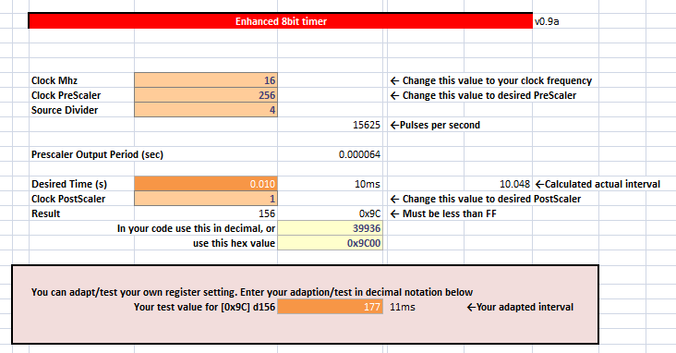
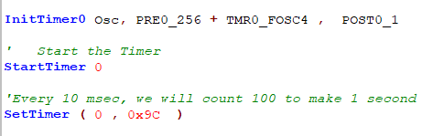
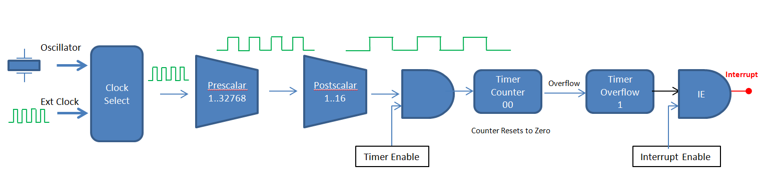
Timer Overview

Slide 8
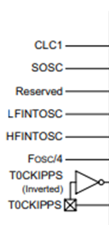
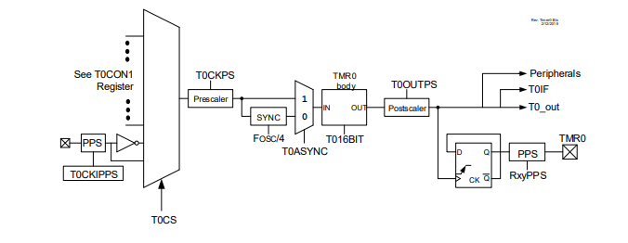
Timer0 block diagram

Slide 9
Timer Block Diagram
Oscillator
Clock Select
Prescalar
1..32768
Postscalar
1..16
Interrupt
Timer Counter nn..FF.00
Overflow
Timer Overflow
IE
Ext Clock
Counter Resets to Zero
Timer Enable
Interrupt Enable
Timers generate the accurate time delays. The microcontroller can also generate/measure the required time delays by running loops, in your program, but the timer/counter relieves the CPU from that operation by using the prescalar and postscalar A timer is nothing but a simple binary counter that can be configured to count clock pulses(Internal/External). A register increments from a specific value. Once it reaches the maximum value, it will roll back to zero setting up an OverFlow flag and generates the interrupt ... if enabled.

Slide 10
Timer Block Diagram
Oscillator
Clock Select
Ext Clock

Slide 11
Timer Block Diagram
Oscillator
Clock Select
Ext Clock

Slide 12
Timer Block Diagram
Oscillator
Clock Select
Prescalar
1..32768
Ext Clock

Slide 13
Timer Block Diagram
Oscillator
Clock Select
Prescalar
1..32768
Ext Clock

Slide 14
Timer Block Diagram
Oscillator
Clock Select
Prescalar
1..32768
Postscalar
1..16
Ext Clock

Slide 15
Timer Block Diagram
Oscillator
Clock Select
Prescalar
1..32768
Postscalar
1..16
Ext Clock

Slide 16
Timer Block Diagram
Oscillator
Clock Select
Prescalar
1..32768
Postscalar
1..16
Ext Clock
Timer Enable

Slide 17
Timer Block Diagram
Oscillator
Clock Select
Prescalar
1..32768
Postscalar
1..16
Timer Counter B1
Timer Overflow
0
Ext Clock
Set timer value
Timer Enable

Slide 18
Timer Block Diagram
Oscillator
Clock Select
Prescalar
1..32768
Postscalar
1..16
Timer Counter B1
Timer Overflow
0
Ext Clock
Timer Enable

Slide 19
Timer Block Diagram
Oscillator
Clock Select
Prescalar
1..32768
Postscalar
1..16
Timer Counter B2
Timer Overflow
0
Ext Clock
Timer Enable

Slide 20
Timer Block Diagram
Oscillator
Clock Select
Prescalar
1..32768
Postscalar
1..16
Timer Counter B3
Timer Overflow
0
Ext Clock
Timer Enable

Slide 21
Timer Block Diagram
Oscillator
Clock Select
Prescalar
1..32768
Postscalar
1..16
Timer Counter
..
Timer Overflow
0
Ext Clock
Timer Enable

Slide 22
Timer Block Diagram
Oscillator
Clock Select
Prescalar
1..32768
Postscalar
1..16
Timer Counter FE
Timer Overflow
0
Ext Clock
Timer Enable

Slide 23
Timer Block Diagram
Oscillator
Clock Select
Prescalar
1..32768
Postscalar
1..16
Timer Counter FF
Timer Overflow
0
Ext Clock
Timer Enable

Slide 24
Timer Block Diagram
Oscillator
Clock Select
Prescalar
1..32768
Postscalar
1..16
Timer Counter 00
Timer Overflow
0
Ext Clock
Counter Resets to Zero
Timer Enable

Slide 25
Timer Block Diagram
Oscillator
Clock Select
Prescalar
1..32768
Postscalar
1..16
Timer Counter 00
Overflow
Timer Overflow
1
Ext Clock
Counter Resets to Zero
Timer Enable

Slide 26
Timer Block Diagram
Oscillator
Clock Select
Prescalar
1..32768
Postscalar
1..16
Timer Counter 00
Overflow
Timer Overflow
1
Ext Clock
Counter Resets to Zero
Timer Enable

Slide 27
Timer Block Diagram
Oscillator
Clock Select
Prescalar
1..32768
Postscalar
1..16
Timer Counter 00
Overflow
Timer Overflow
1
IE
Ext Clock
Counter Resets to Zero
Timer Enable
Interrupt Enable

Slide 28
Timer Block Diagram
Oscillator
Clock Select
Prescalar
1..32768
Postscalar
1..16
Interrupt
Timer Counter 00
Overflow
Timer Overflow
1
IE
Ext Clock
Counter Resets to Zero
Timer Enable
Interrupt Enable

Slide 29
Lab
Examine the sample code
Review the results
Timer0 Overflow
8 Bit timer
16 Bit timer

Slide 31
Videos...
Install the hardware and make the board work – three LED programs
Make four LEDs flash in a sequence
Set the LEDs to represent the value of ADC
Sequence the LEDs with a delay using the value of ADC
Using an input to set the state of the LEDs
Using the reset switch
Using the switch, ADC – make the LEDs flash in a sequence with reverse
Using the serial to display values
Using the timer0 overflow, 8bit timer, 16bit timer to flash the LEDs
Using EEProm – showing values on the serial terminal, and more constants
Using I2C with serial to discover I2C devices
Using an I2C GCLD display
Using a SPI GCLD display
Using PWM, 6 ways, to dim the LEDS
Using an external interrupt to sequence the LEDs
Using memory within the PIC – Progmem and SAF memory
Using CLC
The GCBASIC tool chain
Assembly , alternatives assemblers and MPLAB-X
Summary

Slide 32
GCBASIC Part 9
GCBASIC for the PIC18FxxQ20 chip Family
February 2024

Slide 33
Backup Slides

Slide 34
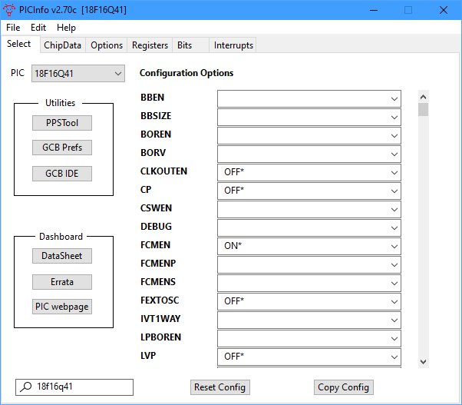
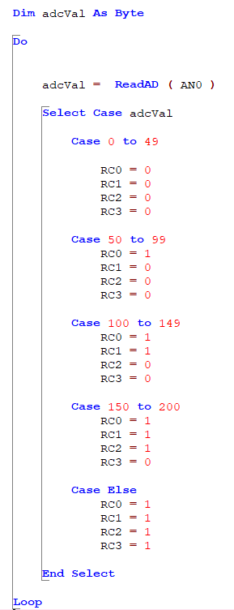
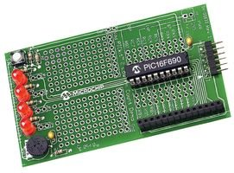
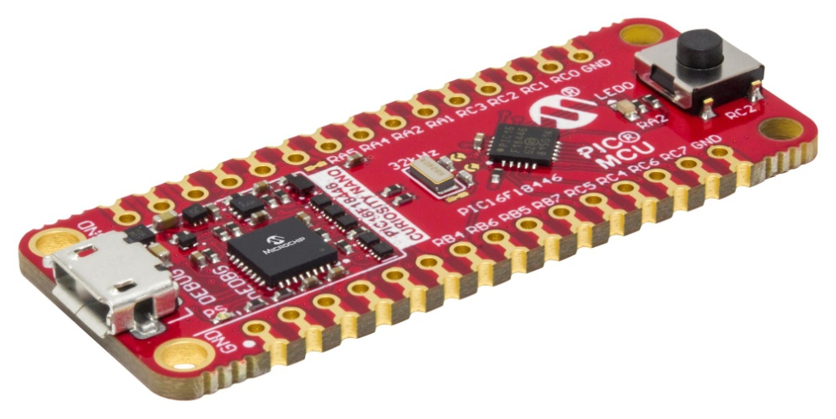

Analog-to-Digital

