Slide 1

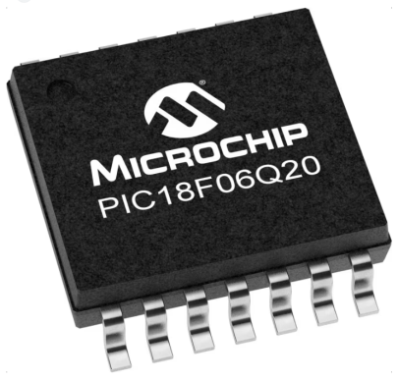
GCBASIC
GCBASIC for the PIC18FxxQ20 chip Family
January 2024

Slide 2

PIC18FxxQ20
PIC18-Q20 is a high performance PIC18
Digital and Analog peripherals
12-bit ADC
Multiple communication interfaces
Serial, I2C, SPI and I3C
PWM – CCP/PWM and 16Bit
Configurable Logic Cells
The PIC18xxQ20 offers 14- and 20-pin products in small footprint packages to support customers in a variety of space constrained and sensor node applications.

Slide 3
Videos...
Install the hardware and make the board work – three LED programs
Make four LEDs flash in a sequence
Set the LEDs to represent the value of ADC
Sequence the LEDs with a delay using the value of ADC
Using an input to set the state of the LEDs
Using the reset switch
Using the switch, ADC – may the LEDs flash in a sequence with reverse
Using the serial to display values
Using the timer0 overflow, 8bit timer, 16bit timer to flash the LEDs
Using CCP/PWM to dim the LEDS
Using I2C with serial to discover I2C devices
Using EEProm – showing values on the serial terminal
Using an I2C GCLD display
Using an SPI GCLD display
Using PWM to dim the LEDS
Using memory within the PIC – Progmem and SAF memory
The GCBASIC tool chain
Assembly and alternatives assemblers
Summary

Slide 4
GCBASIC Compiler
GCBASIC is an Open Source compiler for PIC and AVR microcontrollers
GCBASIC now supports the 18FxxQ20 chip family
GCBASIC Compiler

Slide 5
Basic setup and flash the LED
Install the GCBASIC software
Install your programmer software
Test that you have the 18FxxQ20 attached
Get started

Slide 6
GCBASIC software
Download from Sourceforge
http://sourceforge.net/projects/gcbasic/
Install using the default values

Slide 7
Hardware
Prototype Board
Power 5v0
Programmer
LEDs & resistors
Hardware'' -------------------PORTA---------------- '' Bit#: -7---6---5---4---3---2---1---0--- '' IO: --------------------------------- ''----------------------------------------- '' '' -------------------PORTB---------------- '' Bit#: -7---6---5---4---3---2---1---0--- '' IO: --------------------------------- ''----------------------------------------- '' '' ------------------PORTC----------------- '' Bit#: -7---6---5---4---3---2---1---0--- '' IO: LED-LED-LED-LED------------------ ''----------------------------------------- ''

Slide 8
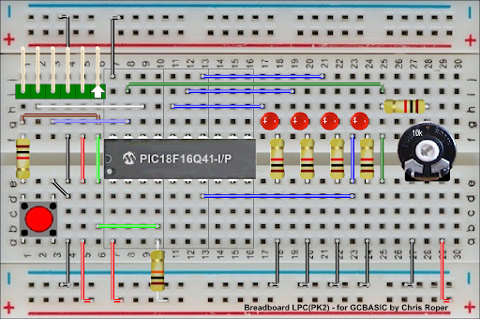
Hardware
Layout
The LEDs are connected to I/O pins RC4 through RC7. When one of these I/O pins drive high, the LED turns on. The I/O pins can be configured for input or output- on start-up, the default is input. We want digital outputs, so, these must be configured and then we set the RC0 to 1 (ON!)

Slide 9
Workshop
Install the hardware
Make the board work
Three LED programs

Slide 11
GCBASIC
GCBASIC for the PIC18FxxQ20 chip Family
January 2021

Slide 12
Videos...
Install the hardware and make the board work – three LED programs
Make four LEDs flash in a sequence
Set the LEDs to represent the value of ADC
Sequence the LEDs with a delay using the value of ADC
Using an input to set the state of the LEDs
Using the reset switch
Using the switch, ADC – may the LEDs flash in a sequence with reverse
Using the serial to display values
Using the timer0 overflow, 8bit timer, 16bit timer to flash the LEDs
Using CCP/PWM to dim the LEDS
Using I2C with serial to discover I2C devices
Using EEProm – showing values on the serial terminal
Using an I2C GCLD display
Using an SPI GCLD display
Using PWM to dim the LEDS
Using memory within the PIC – Progmem and SAF memory
The GCBASIC tool chain
Assembly and alternatives assemblers
Summary

