Slide 1
GCBASIC
18FXXQ24 CHIPFAMILY

Slide 2
GCBASIC 18FxxQ24
GCBASIC
November 2024 release
New chip family
The I2C challenge

Slide 3
Videos...
Install the hardware and make the board work – three LED programs
Make four LEDs flash in a sequence
Set the LEDs to represent the value of ADC
Sequence the LEDs with a delay using the value of ADC
Using an input to set the state of the LEDs
Using the reset switch
Using the switch, ADC – make the LEDs flash in a sequence with reverse
Using the serial to display values
Using the timer0 overflow, 8bit timer, 16bit timer to flash the LEDs
Using EEProm – showing values on the serial terminal, and more constants insights
Using I2C with serial to discover I2C devices
Using an I2C GCLD display
Using a SPI GCLD display
Using PWM, 7 ways, to dim the LEDS
Using an external interrupt to control an LED
Using storage within the chip – Progmem, SAF memory, EEPROM and DATA blocks
Using CLC
The GCBASIC tool chain
Assembly , alternatives assemblers and MPLAB-X
Summary

Slide 4
GCBASIC Compiler
GCBASIC Compiler
GCBASIC is an Open Source compiler for PIC, AVR and LGT microcontrollers
GCBASIC now supports the 18FxxQ24 chip family
GCBASIC is a cross platform with common code translation

Slide 5
The core compiler
High Level Language
Reports:
TXT and HTML
Chip Specific Constraints
Source Code
GCBASIC Compiler
GCBASIC Compiler
Preprocessor
Code Translator
Assembler
Linker
Assembly Language
ASM file
Absolute Machine Code
HEX file
Chip Specific DAT file
Libraries
HWI2C.h
I2C.h
8 bit PIC, AVR, AVR-DX and LGT

Slide 6
Hardware
GCBASIC prototype board
8, 14, 18, 28 and 40 pin devices
LEDs
Switches
POTs
Connections
USB, GLCD, LCD
Sensors
PICKit2 using PICKitPlus
External power supply
USART/TTL adapter
I2C Device attached correctly

Slide 7
Hardware
Hardware
-------------------PORTA----------------
Bit#: -7---6---5---4---3---2---1---0---
IO: ----------------SW----------ADC--
----------------------------------------
-------------------PORTB----------------
Bit#: -7---6---5---4---3---2---1---0---
IO: ----------------LED-LED-LED-LED--
----------------------------------------
------------------PORTC-----------------
Bit#: -X---6---5---4---3---2---1---0---
IO: -^--TX--SDA-SCL------------------
-----VDDIO2-----------------------------
You must apply correct Voltage
------------------PORTE-----------------
Bit#: -----------------3---------------
IO: ----------------SW---------------
Prototype Board
Power 5v0
Programmer
LEDs & resistors
Switches & resistors
I2C device

Slide 8
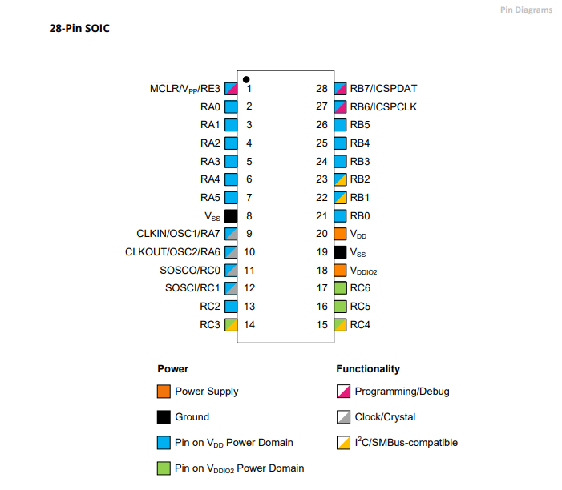
Hardware Power Domain

Slide 9
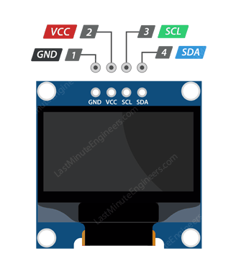
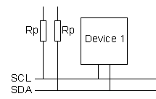
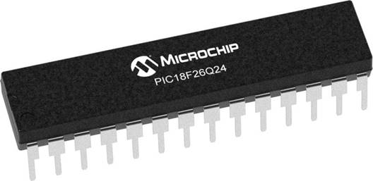
Setup
VCC
CLOCK
---------
SCL
DATA
---------
SDA

Slide 10
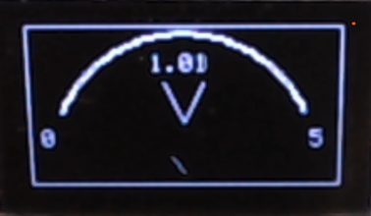
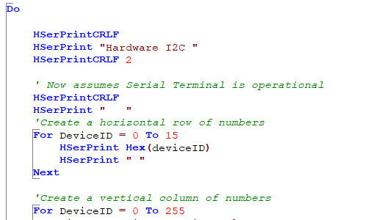
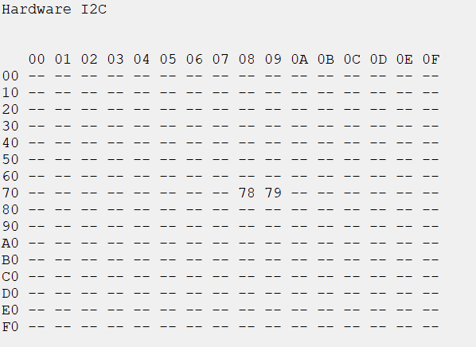
I²C

Slide 11
LAB
Try to get I2C working to show i2c results on a terminal
Software I2c – i2c.h
Select the I²C ports
Set up the I²C
See the results
Hardware i1c – hwi2c.h
Using PPS select the I²C ports
Set up the I²C
See the results

Slide 12
Summary findings
DAT memory specification section ( ‘[FreeRAM]’ ) was incorrect - resolved
[FreeRAM] RAM location – fixed within GETCHIPDATA.BAS
ADC initially shows no results
Wrong connection on the test rig!
EEPROM demo program not working as expected
EEPROM/H required updating
PPSTOOL does not support Q24
Edit XML to represent this new family
Issue Noted
Compiler does not handle undefined port.bit appropriate portc.7

Slide 13
GCBASIC 18FxxQ24
GCBASIC
Like and subscribe!
November 2024 release
New chip family – getting the basics operating

