Slide 1
GCBASIC
PIC18FxxQ24
Part 8 - Show Serial Data

Slide 2

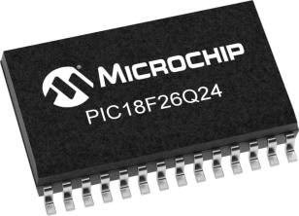
GCBASIC
PIC18FxxQ24
Part 8 - Show Serial Data

Slide 3
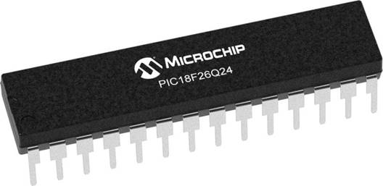
GCBASIC
Like and subscribe!

Slide 4
PIC18FxxQ24
PIC18-Q24 is a high performance PIC18
Digital and Analog peripherals
10-bit ADC
Multiple communication interfaces
Serial, I2C and SPI
PWM – CCP/PWM and 16Bit
Configurable Logic Cells
Multi voltage domains
The PIC18xxQ24 offers 28, 40 and 48-pin products in small footprint packages to support customers in a wide variety of applications.

Slide 5
Videos...
Install the hardware and make the board work – three LED programs
Make four LEDs flash in a sequence
Set the LEDs to represent the value of ADC
Sequence the LEDs with a delay using the value of ADC
Using an input to set the state of the LEDs
Using the reset switch
Using the switch, ADC – make the LEDs flash in a sequence with reverse
Using the serial to display values
Using the timer0 overflow, 8bit timer, 16bit timer to flash the LEDs
Using EEProm – showing values on the serial terminal, and more constants insights
Using I2C with serial to discover I2C devices
Using an I2C GCLD display
Using a SPI GCLD display
Using PWM, 7 ways, to dim the LEDS
Using an external interrupt to control an LED
Using storage within the chip – Progmem, SAF memory, EEPROM and DATA blocks
Using CLC
The GCBASIC tool chain
Assembly , alternatives assemblers and MPLAB-X
Summary

Slide 6
GCBASIC Compiler
GCBASIC Compiler
GCBASIC is an Open Source compiler for PIC and AVR microcontrollers
GCBASIC now supports the 18FxxQ24 chip family

Slide 7
Prerequisites
Assumes you have
Installed the GCBASIC software
Installed your programmer software
Test that you have the 18FxxQ24 attached
You have the 4 LEDs operating
You have a POT connected
You have SWITCHes connected
You have a USB/TTL converter

Slide 8
Hardware
Hardware
-------------------PORTA----------------
Bit#: -7---6---5---4---3---2---1---0---
IO: ----------------SW----------ADC--
----------------------------------------
-------------------PORTB----------------
Bit#: -7---6---5---4---3---2---1---0---
IO: ----------------LED-LED-LED-LED--
----------------------------------------
------------------PORTC-----------------
Bit#: -X---6---5---4---3---2---1---0---
IO: -^--TX---------------------------
-----VDDIO2-----------------------------
You must apply correct Voltage
------------------PORTE-----------------
Bit#: -----------------3---------------
IO: ----------------SW---------------
Prototype Board
Power 5v0
Programmer
LEDs & resistors
Switches & resistors

Slide 9
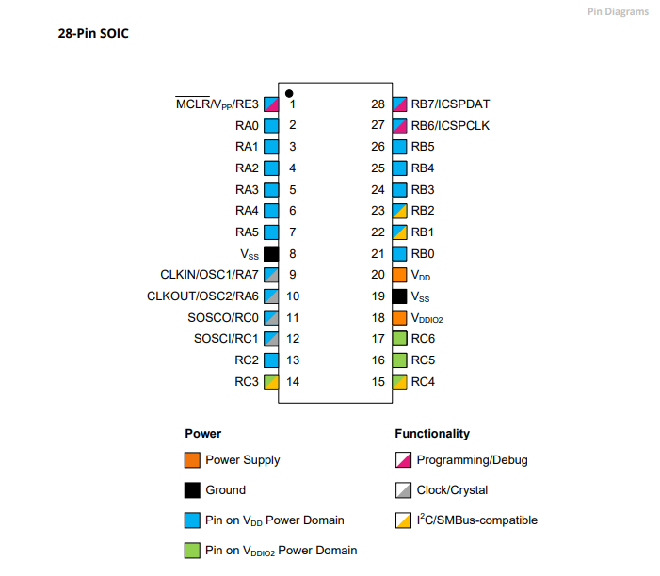
Power Domain – VDDIO2

Slide 10
Serial output
Output
Using the built-in Universal Synchronous/Asynchronous Receiver Transmitter (USART) on the PIC® Microcontroller to communicate with serial terminal on a PC
Baseline is the tutorials so far, plus a TTL/USB serial converter

Slide 11
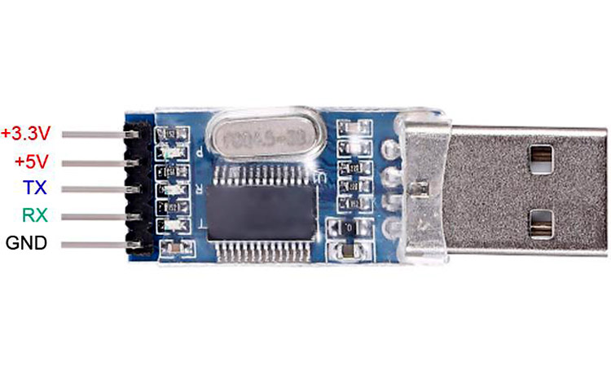
Serial output
GND and RX (RXD)

Slide 12

Peripheral Pin Select (PPS)
PPS configuration provides the method to these choices set the functionality and their placement on a wide range of I/O pins.
By increasing the pinout options available on a particular device, users can tailor the device to their entire application.
For Serial operations we must set the TX using PPS
PICINFO/PPSTOOL
PPSTOOL

Slide 13
Tutorial overview
Initialise
Serial up the serial
Do Forever
ReadADC
Initialise
Setup the serial/USART
PPS
Baud Rate
Do forever
Read ADC
Send values to serial
Determine if switch state changed
Set state of LEDs
Wait
Loop
Send Values to Serial
Switch state changed
Right
Left
Set State of LEDs
Set State of LEDS
Wait

Slide 14
Lab
Examine the sample code
Review the results
Examine the power domain
Review the results

Slide 16
Videos...
Install the hardware and make the board work – three LED programs
Make four LEDs flash in a sequence
Set the LEDs to represent the value of ADC
Sequence the LEDs with a delay using the value of ADC
Using an input to set the state of the LEDs
Using the reset switch
Using the switch, ADC – make the LEDs flash in a sequence with reverse
Using the serial to display values
Using the timer0 overflow, 8bit timer, 16bit timer to flash the LEDs
Using EEProm – showing values on the serial terminal, and more constants insights
Using I2C with serial to discover I2C devices
Using an I2C GCLD display
Using a SPI GCLD display
Using PWM, 7 ways, to dim the LEDS
Using an external interrupt to control an LED
Using storage within the chip – Progmem, SAF memory, EEPROM and DATA blocks
Using CLC
The GCBASIC tool chain
Assembly , alternatives assemblers and MPLAB-X
Summary

Slide 17
GCBASIC
PIC18FxxQ24
Part 8 - Show Serial Data

