Slide 1
GCBASIC
PIC18FxxQ24
Part 9 - Timers and Timer Interrupts

Slide 2
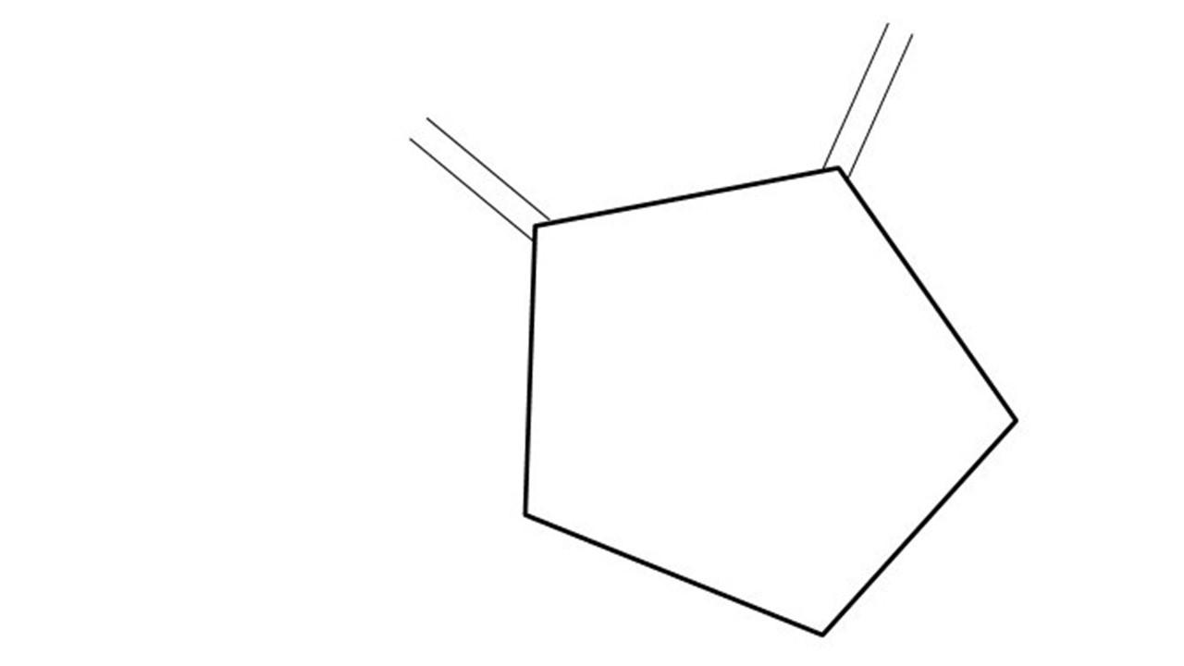
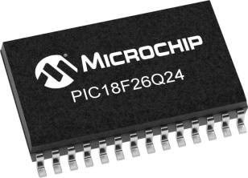
GCBASIC
PIC18FxxQ24
Part 9 - Timers and Timer Interrupts

Slide 3
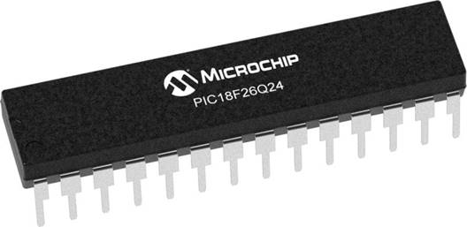
GCBASIC
Like and subscribe!

Slide 4
PIC18FxxQ24
PIC18-Q24 is a high performance PIC18
Digital and Analog peripherals
10-bit ADC
Multiple communication interfaces
Serial, I2C and SPI
PWM – CCP/PWM and 16Bit
Configurable Logic Cells
Multi voltage domains
The PIC18xxQ24 offers 28, 40 and 48-pin products in small footprint packages to support customers in a wide variety of applications.

Slide 5
Videos...
Install the hardware and make the board work – three LED programs
Make four LEDs flash in a sequence
Set the LEDs to represent the value of ADC
Sequence the LEDs with a delay using the value of ADC
Using an input to set the state of the LEDs
Using the reset switch
Using the switch, ADC – make the LEDs flash in a sequence with reverse
Using the serial to display values
Using the timer0 overflow, 8bit timer, 16bit timer to flash the LEDs
Using EEProm – showing values on the serial terminal, and more constants insights
Using I2C with serial to discover I2C devices
Using an I2C GCLD display
Using a SPI GCLD display
Using PWM, 7 ways, to dim the LEDS
Using an external interrupt to control an LED
Using storage within the chip – Progmem, SAF memory, EEPROM and DATA blocks
Using CLC
The GCBASIC tool chain
Assembly , alternatives assemblers and MPLAB-X
Summary

Slide 6
GCBASIC Compiler
GCBASIC Compiler
GCBASIC is an Open Source compiler for PIC and AVR microcontrollers
GCBASIC now supports the 18FxxQ24 chip family

Slide 7
Prerequisites
Assumes you have
Installed the GCBASIC software
Installed your programmer software
Test that you have the 18FxxQ24 attached
You have the 4 LEDs operating
You have a POT connected
You have SWITCHes connected
You have a USB/TTL converter

Slide 8
Hardware
Hardware
-------------------PORTA----------------
Bit#: -7---6---5---4---3---2---1---0---
IO: ----------------SW----------ADC--
----------------------------------------
-------------------PORTB----------------
Bit#: -7---6---5---4---3---2---1---0---
IO: ----------------LED-LED-LED-LED--
----------------------------------------
------------------PORTC-----------------
Bit#: -X---6---5---4---3---2---1---0---
IO: -^--TX---------------------------
-----VDDIO2-----------------------------
You must apply correct Voltage
------------------PORTE-----------------
Bit#: -----------------3---------------
IO: ----------------SW---------------
Prototype Board
Power 5v0
Programmer
LEDs & resistors
Switches & resistors

Slide 9
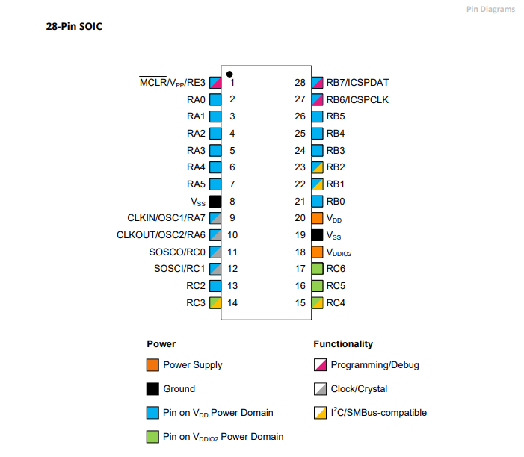
Power Domain – VDDIO2

Slide 10
Timer Primer

Slide 11
Timer Block Diagram
Timers generate the accurate time delays. The microcontroller can also generate/measure the required time delays by running loops, in your program, but the timer/counter relieves the CPU from that operation by using the prescalar and postscalar A timer is nothing but a simple binary counter that can be configured to count clock pulses(Internal/External). A register increments from a specific value. Once it reaches the maximum value, it will roll back to zero setting up an OverFlow flag and generates the interrupt ... if enabled.

Slide 12
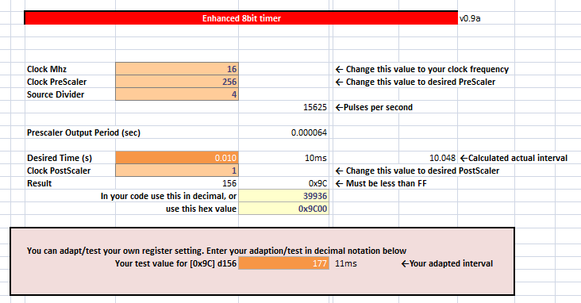
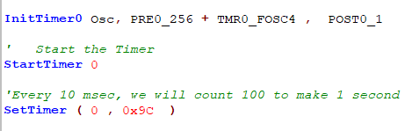
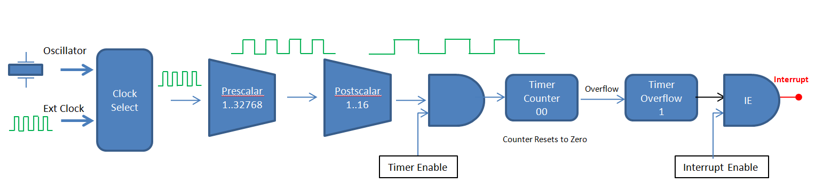
Timer Overview

Slide 13
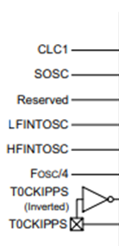
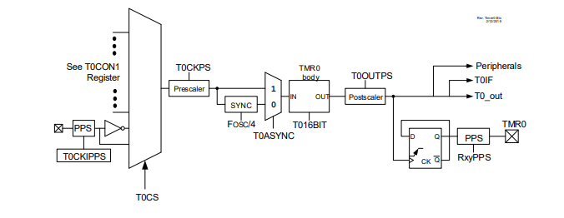
Timer0 block diagram

Slide 14
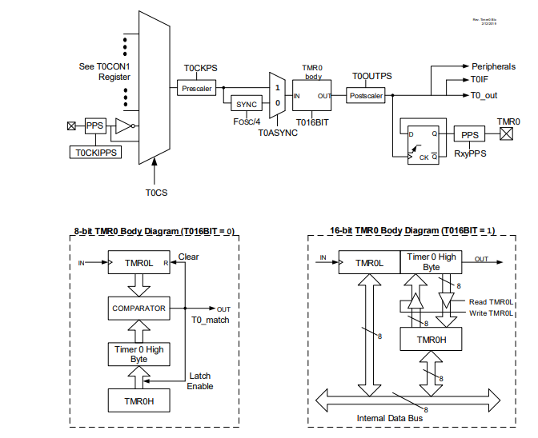
Timer0 block diagram

Slide 15
Timer0 block diagram

Slide 16
Timer Block Diagram
Oscillator
Clock Select
Prescalar
1..32768
Postscalar
1..16
Interrupt
Timer Counter nn..FF.00
Overflow
Timer Overflow
IE
Ext Clock
Counter Resets to Zero
Timer Enable
Interrupt Enable
Timers generate the accurate time delays. The microcontroller can also generate/measure the required time delays by running loops, in your program, but the timer/counter relieves the CPU from that operation by using the prescalar and postscalar A timer is nothing but a simple binary counter that can be configured to count clock pulses(Internal/External). A register increments from a specific value. Once it reaches the maximum value, it will roll back to zero setting up an OverFlow flag and generates the interrupt ... if enabled.

Slide 17
Timer Block Diagram
Oscillator
Clock Select
Ext Clock

Slide 18
Timer Block Diagram
Oscillator
Clock Select
Ext Clock

Slide 19
Timer Block Diagram
Oscillator
Clock Select
Prescalar
1..32768
Ext Clock

Slide 20
Timer Block Diagram
Oscillator
Clock Select
Prescalar
1..32768
Ext Clock

Slide 21
Timer Block Diagram
Oscillator
Clock Select
Prescalar
1..32768
Postscalar
1..16
Ext Clock

Slide 22
Timer Block Diagram
Oscillator
Clock Select
Prescalar
1..32768
Postscalar
1..16
Ext Clock

Slide 23
Timer Block Diagram
Oscillator
Clock Select
Prescalar
1..32768
Postscalar
1..16
Ext Clock
Timer Enable

Slide 24
Timer Block Diagram
Oscillator
Clock Select
Prescalar
1..32768
Postscalar
1..16
Timer Counter B1
Timer Overflow
0
Ext Clock
Set timer value
Timer Enable

Slide 25
Timer Block Diagram
Oscillator
Clock Select
Prescalar
1..32768
Postscalar
1..16
Timer Counter B1
Timer Overflow
0
Ext Clock
Timer Enable

Slide 26
Timer Block Diagram
Oscillator
Clock Select
Prescalar
1..32768
Postscalar
1..16
Timer Counter B2
Timer Overflow
0
Ext Clock
Timer Enable

Slide 27
Timer Block Diagram
Oscillator
Clock Select
Prescalar
1..32768
Postscalar
1..16
Timer Counter B3
Timer Overflow
0
Ext Clock
Timer Enable

Slide 28
Timer Block Diagram
Oscillator
Clock Select
Prescalar
1..32768
Postscalar
1..16
Timer Counter
..
Timer Overflow
0
Ext Clock
Timer Enable

Slide 29
Timer Block Diagram
Oscillator
Clock Select
Prescalar
1..32768
Postscalar
1..16
Timer Counter FE
Timer Overflow
0
Ext Clock
Timer Enable

Slide 30
Timer Block Diagram
Oscillator
Clock Select
Prescalar
1..32768
Postscalar
1..16
Timer Counter FF
Timer Overflow
0
Ext Clock
Timer Enable

Slide 31
Timer Block Diagram
Oscillator
Clock Select
Prescalar
1..32768
Postscalar
1..16
Timer Counter 00
Timer Overflow
0
Ext Clock
Counter Resets to Zero
Timer Enable

Slide 32
Timer Block Diagram
Oscillator
Clock Select
Prescalar
1..32768
Postscalar
1..16
Timer Counter 00
Overflow
Timer Overflow
1
Ext Clock
Counter Resets to Zero
Timer Enable

Slide 33
Timer Block Diagram
Oscillator
Clock Select
Prescalar
1..32768
Postscalar
1..16
Timer Counter 00
Overflow
Timer Overflow
1
Ext Clock
Counter Resets to Zero
Timer Enable

Slide 34
Timer Block Diagram
Oscillator
Clock Select
Prescalar
1..32768
Postscalar
1..16
Timer Counter 00
Overflow
Timer Overflow
1
IE
Ext Clock
Counter Resets to Zero
Timer Enable
Interrupt Enable

Slide 35
Timer Block Diagram
Oscillator
Clock Select
Prescalar
1..32768
Postscalar
1..16
Interrupt
Timer Counter 00
Overflow
Timer Overflow
1
IE
Ext Clock
Counter Resets to Zero
Timer Enable
Interrupt Enable

Slide 36
Lab
Examine the sample code
Review the results
Timer0 Overflow
8 Bit timer
16 Bit timer

Slide 38
Videos...
Install the hardware and make the board work – three LED programs
Make four LEDs flash in a sequence
Set the LEDs to represent the value of ADC
Sequence the LEDs with a delay using the value of ADC
Using an input to set the state of the LEDs
Using the reset switch
Using the switch, ADC – make the LEDs flash in a sequence with reverse
Using the serial to display values
Using the timer0 overflow, 8bit timer, 16bit timer to flash the LEDs
Using EEProm – showing values on the serial terminal, and more constants insights
Using I2C with serial to discover I2C devices
Using an I2C GCLD display
Using a SPI GCLD display
Using PWM, 7 ways, to dim the LEDS
Using an external interrupt to control an LED
Using storage within the chip – Progmem, SAF memory, EEPROM and DATA blocks
Using CLC
The GCBASIC tool chain
Assembly , alternatives assemblers and MPLAB-X
Summary

Slide 39
GCBASIC
PIC18FxxQ24
Part 9 - Timers and Timer Interrupts

