Slide 1
GCBASIC
PIC18FxxQ24
Part 16 - Progmem, SAF memory, EEPROM and DATA blocks

Slide 2
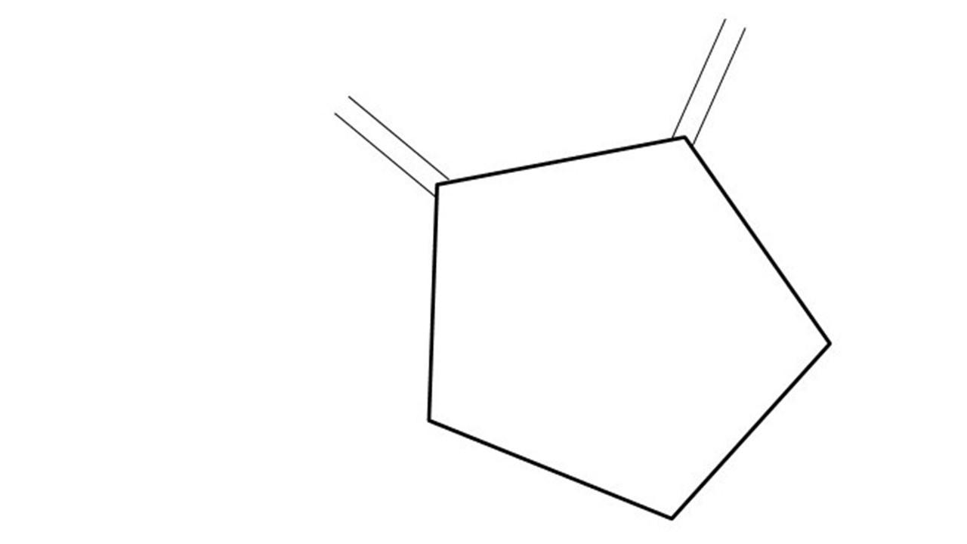
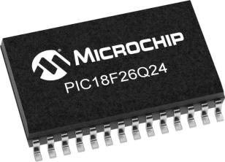
GCBASIC
PIC18FxxQ24
Part 16 - Progmem, SAF memory, EEPROM and DATA blocks

Slide 3
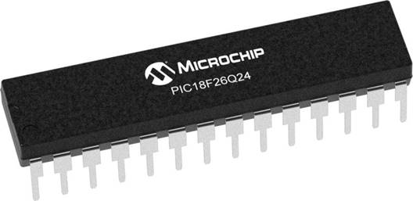
GCBASIC
Like and subscribe!

Slide 4
PIC18FxxQ24
PIC18-Q24 is a high performance PIC18
Digital and Analog peripherals
10-bit ADC
Multiple communication interfaces
Serial, I2C and SPI
PWM – CCP/PWM and 16Bit
Configurable Logic Cells
Multi voltage domains
The PIC18xxQ24 offers 28, 40 and 48-pin products in small footprint packages to support customers in a wide variety of applications.

Slide 5
Videos...
Install the hardware and make the board work – three LED programs
Make four LEDs flash in a sequence
Set the LEDs to represent the value of ADC
Sequence the LEDs with a delay using the value of ADC
Using an input to set the state of the LEDs
Using the reset switch
Using the switch, ADC – make the LEDs flash in a sequence with reverse
Using the serial to display values
Using the timer0 overflow, 8bit timer, 16bit timer to flash the LEDs
Using EEProm – showing values on the serial terminal, and more constants insights
Using I2C with serial to discover I2C devices
Using I2C GCLD display solutions
Using a SPI GLCD display solutions
Using PWM, 6 ways, to dim the LEDS
Using an external interrupt to control an LED
Using storage within the chip – Progmem, SAF memory, EEPROM and DATA blocks
Using CLC
The GCBASIC tool chain
Assembly , alternatives assemblers and MPLAB-X
Summary

Slide 6
GCBASIC Compiler
GCBASIC Compiler
GCBASIC is an Open Source compiler for PIC and AVR microcontrollers
GCBASIC now supports the 18FxxQ24 chip family

Slide 7
Prerequisites
Assumes you have
Installed the GCBASIC software
Installed your programmer software
Test that you have the 18FxxQ24 attached
You have the 4 LEDs operating
You have a POT connected
You have SWITCHes connected
You have a USB/TTL converter

Slide 8
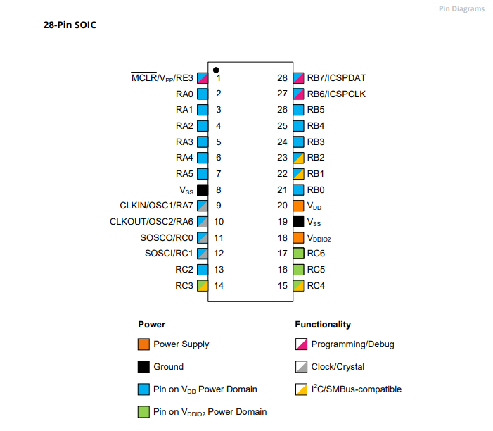
Power Domain – VDDIO2

Slide 9
Hardware
Hardware
-------------------PORTA----------------
Bit#: -7---6---5---4---3---2---1---0---
IO: ----------------SW----------ADC--
----------------------------------------
-------------------PORTB----------------
Bit#: -7---6---5---4---3---2---1---0---
IO: ----------------LED-LED-LED-LED--
----------------------------------------
------------------PORTC-----------------
Bit#: -X---6---5---4---3---2---1---0---
IO: -^--TX---------------------------
-----VDDIO2-----------------------------
You must apply correct Voltage
------------------PORTE-----------------
Bit#: -----------------3---------------
IO: ----------------SW---------------
Prototype Board
Power 5v0
Programmer
LEDs & resistors
Switches & resistors

Slide 10
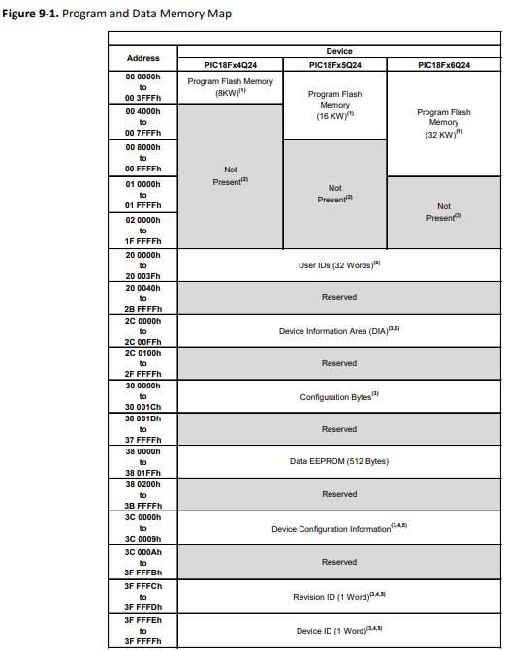
Storage Overview Types
SAF
 | Type | Characteristics
1 | Progmem | Program, and, Storage Area Flash (SAF) block
2 | Data RAM | Volatile
3 | Data EEPROM | Consider as a peripheral

Slide 11
Progmem
PIC18FxxQ24
PIC18FxxQ24
Progmem usage
Your program
and/or
Reference data
Pictures
Uses PFM direct addressing
Program
Program Flash Memory
( 32 KW )
Program Flash Memory
( 32 KW )
or
Program

Slide 12
Progmem
PIC18FxxQ24
PIC18FxxQ24
Progmem usage
Your program
and/or
Reference data
Pictures
Uses PFM direct addressing
Program
Reference Data
Program Flash Memory
( 32 KW )
Program Flash Memory
( 32 KW )
or
Program
Reference Data

Slide 13
SAF
PIC18FxxQ24
PIC18FxxQ24
SAF usage
Reference data
Must not be overwritten by user program – you MUST adjust program to NOT use SAF block
Uses SAF offset addressing
Program
Program Flash Memory
( 32 KW )
Program Flash Memory
( 32 KW )
or
Program
SAF Data
SAF Data
SAF is designated for storing non-volatile data and can be protected to ensure data integrity and security.

Slide 14
Progmem
PIC18FxxQ24
PIC18FxxQ24
Progmem usage
Your program
and/or
Reference data
Pictures
Uses PFM direct addressing
Program
Reference Data
Program Flash Memory
( 32 KW )
Program Flash Memory
( 32 KW )
or
Program
Reference Data

Slide 15
EEDATA & DATA Blocks
 | Type | Characteristics
1 | EEDATA | An EEPROM block or blocks of data that is programmed into the EEPROM
2 | DATA | An DATA block or blocks of data that is programmed just above your program
Both areas can be easily used for reference data

Slide 16
Lab
Walk the examples
PROGMEM
SAF
EEPROM and DATA blocks

Slide 18
Videos...
Install the hardware and make the board work – three LED programs
Make four LEDs flash in a sequence
Set the LEDs to represent the value of ADC
Sequence the LEDs with a delay using the value of ADC
Using an input to set the state of the LEDs
Using the reset switch
Using the switch, ADC – make the LEDs flash in a sequence with reverse
Using the serial to display values
Using the timer0 overflow, 8bit timer, 16bit timer to flash the LEDs
Using EEProm – showing values on the serial terminal, and more constants insights
Using I2C with serial to discover I2C devices
Using I2C GCLD display solutions
Using a SPI GLCD display solutions
Using PWM, 6 ways, to dim the LEDS
Using an external interrupt to control an LED
Using storage within the chip – Progmem, SAF memory, EEPROM and DATA blocks
Using CLC
The GCBASIC tool chain
Assembly , alternatives assemblers and MPLAB-X
Summary

Slide 19
GCBASIC
PIC18FxxQ24
Part 16 - Progmem, SAF memory, EEPROM and DATA blocks

