Slide 1
GCBASIC
PIC18FxxQ24
Part 12 - GLCD Operations using I2C

Slide 2
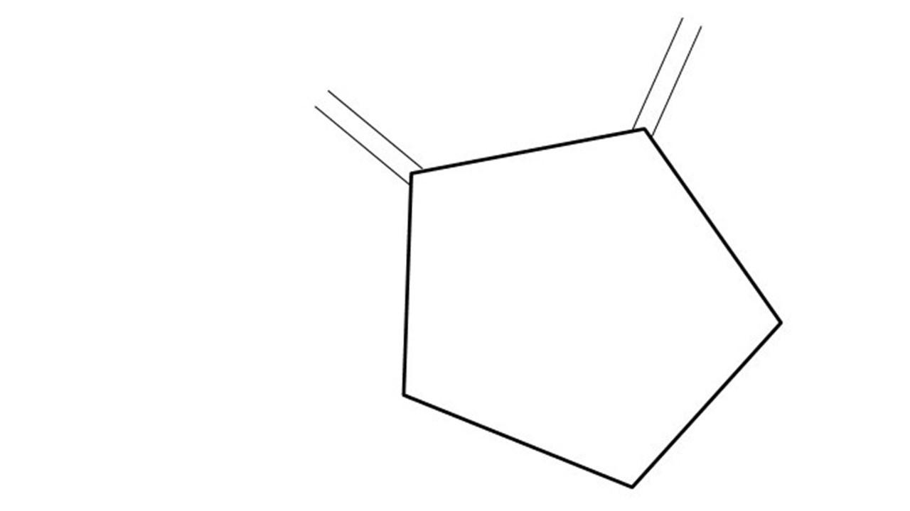
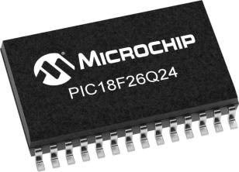
GCBASIC
PIC18FxxQ24
Part 12 - GLCD Operations using I2C

Slide 3
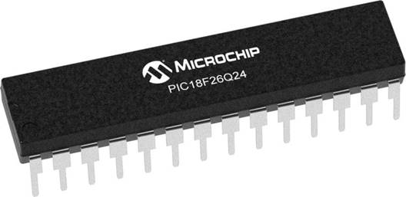
GCBASIC
Like and subscribe!

Slide 4
PIC18FxxQ24
PIC18-Q24 is a high performance PIC18
Digital and Analog peripherals
10-bit ADC
Multiple communication interfaces
Serial, I2C and SPI
PWM – CCP/PWM and 16Bit
Configurable Logic Cells
Multi voltage domains
The PIC18xxQ24 offers 28, 40 and 48-pin products in small footprint packages to support customers in a wide variety of applications.

Slide 5
Videos...
Install the hardware and make the board work – three LED programs
Make four LEDs flash in a sequence
Set the LEDs to represent the value of ADC
Sequence the LEDs with a delay using the value of ADC
Using an input to set the state of the LEDs
Using the reset switch
Using the switch, ADC – make the LEDs flash in a sequence with reverse
Using the serial to display values
Using the timer0 overflow, 8bit timer, 16bit timer to flash the LEDs
Using EEProm – showing values on the serial terminal, and more constants insights
Using I2C with serial to discover I2C devices
Using I2C GCLD display solutions
Using a SPI GCLD display
Using PWM, 7 ways, to dim the LEDS
Using an external interrupt to control an LED
Using storage within the chip – Progmem, SAF memory, EEPROM and DATA blocks
Using CLC
The GCBASIC tool chain
Assembly , alternatives assemblers and MPLAB-X
Summary

Slide 6
GCBASIC Compiler
GCBASIC Compiler
GCBASIC is an Open Source compiler for PIC and AVR microcontrollers
GCBASIC now supports the 18FxxQ24 chip family

Slide 7
Prerequisites
Assumes you have
Installed the GCBASIC software
Installed your programmer software
Test that you have the 18FxxQ24 attached
You have the 4 LEDs operating
You have a POT connected
You have SWITCHes connected
You have a USB/TTL converter
GLCD i2C device

Slide 8
I²C
I²C uses two bidirectional open collector or open drain lines pulled up with resistors
Serial Data Line (SDA)
Serial Clock Line (SCL)
Typical voltages used are +5 V or +3.3 V, although systems with other voltages are permitted

Slide 9
Hardware
Hardware
-------------------PORTA----------------
Bit#: -7---6---5---4---3---2---1---0---
IO: ----------------SW----------ADC--
----------------------------------------
-------------------PORTB----------------
Bit#: -7---6---5---4---3---2---1---0---
IO: ----------------LED-LED-LED-LED--
----------------------------------------
------------------PORTC-----------------
Bit#: -X---6---5---4---3---2---1---0---
IO: -^--TX------SCL-SDA--------------
-----VDDIO2-----------------------------
You must apply correct Voltage
------------------PORTE-----------------
Bit#: -----------------3---------------
IO: ----------------SW---------------
Prototype Board
Power 5v0
Programmer
LEDs & resistors
Switches & resistors
I2c device and circuit

Slide 10
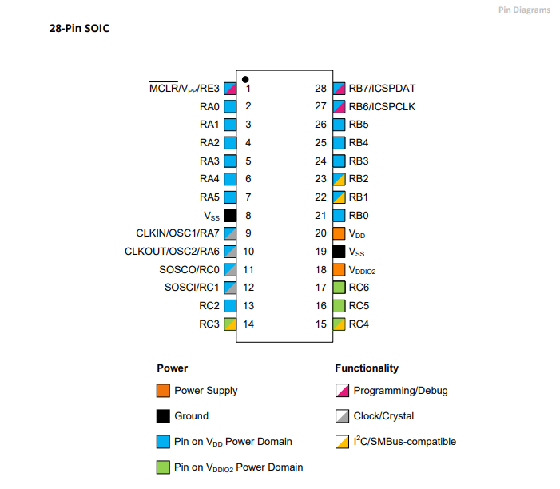
Power Domain – VDDIO2

Slide 11
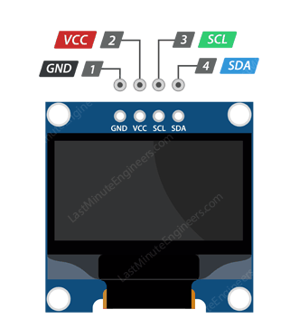
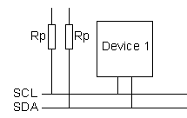
Setup
VCC
CLOCK
---------
SCL
DATA
---------
SDA

Slide 12
I2C sequence
i2cStart
i2cSend Address
i2cSend
Data
i2cStop
Start Condition:
Indicated by a high-to-low transition on the SDA line while SCL is high.
This signals the beginning of communication.
Send (Address):
Master sends the address of the slave device including by the Read/Write bit.
Slave responds with an Acknowledgment (ACK) bit.
Send (Data):
Master sends or receives data bytes.
Each byte is followed by an Acknowledgment (ACK) from the receiver.
Stop Condition:
Indicated by a low-to-high transition on the SDA line while SCL is high.
This signals the end of communication.

Slide 13
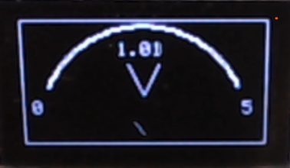
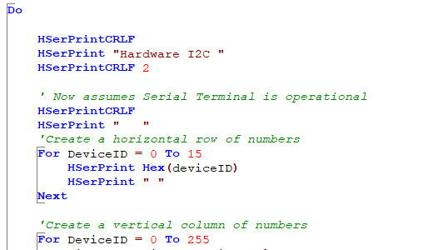
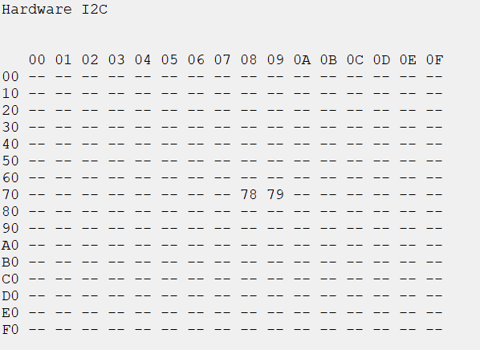
I²C

Slide 14
User Program
User Functions
External Sources
DB, BMP, Version control…
Converters
r
7 segment, GLCD, Maths…
Libraries - 125
r
USART, I2C, SPI….
Lowlevel - 26
Microcontroller specific solution (.HEX)

Slide 15
Lab
Examine the sample code
Using PPS select the I²C ports
Using PPS select the serial USART port
Set up the I²C
Review demonstrations and see the results
Demo number | Focus | Shows
180 & 190 | 128x32 & 128x64 capability demos | Primitives Memory usage & Transactions
200 | BMP converter | Converter
210 | Sprite | Expose buffer and custom I2C subroutine
220 | Voltmeter | Trig2places & Low level GLCD commands

Slide 17
Videos...
Install the hardware and make the board work – three LED programs
Make four LEDs flash in a sequence
Set the LEDs to represent the value of ADC
Sequence the LEDs with a delay using the value of ADC
Using an input to set the state of the LEDs
Using the reset switch
Using the switch, ADC – make the LEDs flash in a sequence with reverse
Using the serial to display values
Using the timer0 overflow, 8bit timer, 16bit timer to flash the LEDs
Using EEProm – showing values on the serial terminal, and more constants insights
Using I2C with serial to discover I2C devices
Using an I2C GCLD display solutions
Using SPI GCLD display solutions
Using PWM, 7 ways, to dim the LEDS
Using an external interrupt to control an LED
Using storage within the chip – Progmem, SAF memory, EEPROM and DATA blocks
Using CLC
The GCBASIC tool chain
Assembly , alternatives assemblers and MPLAB-X
Summary

Slide 18
GCBASIC
PIC18FxxQ24
Part 12 - GLCD Operations using I2C

