Slide 1

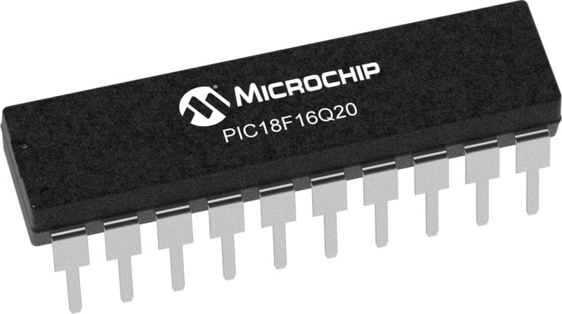
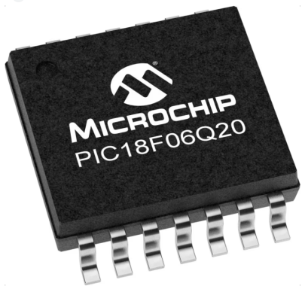
GCBASIC Part 11
GCBASIC for the PIC18FxxQ20 chip Family
October 2024
I2C discovery!

Slide 2
GCBASIC Part 11
Microchip have changed operations I2C again!!
GCBASIC for the PIC18FxxQ20 chip Family
October 2024
I2C discovery!

Slide 3
Videos...
Install the hardware and make the board work – three LED programs
Make four LEDs flash in a sequence
Set the LEDs to represent the value of ADC
Sequence the LEDs with a delay using the value of ADC
Using an input to set the state of the LEDs
Using the reset switch
Using the switch, ADC – make the LEDs flash in a sequence with reverse
Using the serial to display values
Using the timer0 overflow, 8bit timer, 16bit timer to flash the LEDs
Using EEProm – showing values on the serial terminal, and more constants insights
Using I2C with serial to discover I2C devices
Using an I2C GCLD display
Using a SPI GCLD display
Using PWM, 6 ways, to dim the LEDS
Using an external interrupt to sequence the LEDs
Using memory within the PIC – Progmem and SAF memory
Using CLC
The GCBASIC tool chain
Assembly , alternatives assemblers and MPLAB-X
Summary

Slide 4
PIC18FxxQ20
PIC18-Q20 is a high performance PIC18
Digital and Analog peripherals
10-bit ADC
Multiple communication interfaces
Serial, I2C, SPI, I3C
PWM – CCP/PWM and 16Bit
Configurable Logic Cells
Multi voltage domains
The PIC18xxQ20 offers 14 and 20 pin products in small footprint packages to support customers in a variety of space constrained and sensor node applications.

Slide 5
GCBASIC Toolchain
GCBASIC is an Open Source compiler for PIC, AVR and LGT microcontrollers
GCBASIC now supports the 18FxxQ20 chip family
GCBASIC simplifies the use of I2C
GCBASIC
Toolchain

Slide 6
I²C
I²C uses two bidirectional open collector or open drain lines pulled up with resistors
Serial Data Line (SDA)
Serial Clock Line (SCL)
Typical voltages used are +5 V or +3.3 V, although systems with other voltages are permitted

Slide 7
Hardware
Hardware
-------------------PORTA----------------
Bit#: -7---6---5---4---3---2---1---0---
IO: -----------------SW---------ADC--
-----------------------------------------
-------------------PORTB----------------
Bit#: -7---6---5---4---3---2---1---0---
IO: TX--SCL-SDA--^-------------------
------------------VDDIO3---------------- You must apply correct Voltage
------------------PORTC-----------------
Bit#: -7---6---5---4---3---2---1---0---
IO: LED-LED-LED-LED------^-----------
--------------------------VDDIO2-------- You must apply correct Voltage
Prototype Board
Power 5v0
Programmer
Serial Port
LEDs & resistors
Potentiometer
Switch

Slide 8
Hardware for I2C
Hardware
-------------------PORTA----------------
Bit#: -7---6---5---4---3---2---1---0---
IO: -----------------SW---------ADC--
-----------------------------------------
-------------------PORTB----------------
Bit#: -7---6---5---4---3---2---1---0---
IO: TX--SCL-SDA--^-------------------
------------------VDDIO3---------------- You must apply correct Voltage
------------------PORTC-----------------
Bit#: -7---6---5---4---3---2---1---0---
IO: LED-LED-LED-LED------^-----------
--------------------------VDDIO2-------- You must apply correct Voltage
Prototype Board
Power 5v0
Programmer
Serial Port
LEDs & resistors
Potentiometer
Switch

Slide 9
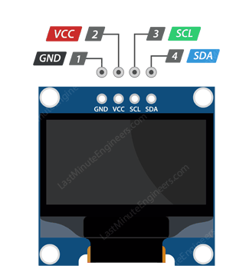
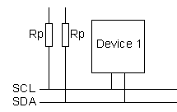
Setup
VCC
CLOCK
---------
SCL
DATA
---------
SDA

Slide 10
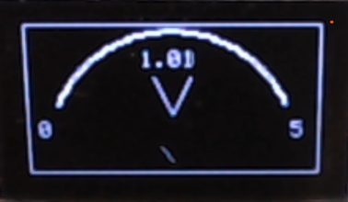
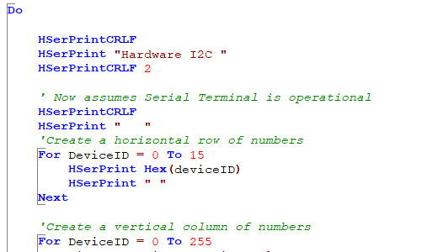
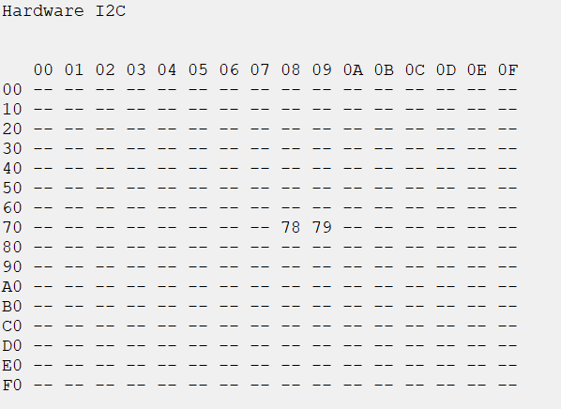
I²C

Slide 11
Lab
Examine the sample code
Using PPS select the I²C ports
Using PPS select the serial USART port
Set up the I²C
Review the code
See the results

Slide 13
Videos...
Install the hardware and make the board work – three LED programs
Make four LEDs flash in a sequence
Set the LEDs to represent the value of ADC
Sequence the LEDs with a delay using the value of ADC
Using an input to set the state of the LEDs
Using the reset switch
Using the switch, ADC – make the LEDs flash in a sequence with reverse
Using the serial to display values
Using the timer0 overflow, 8bit timer, 16bit timer to flash the LEDs
Using EEProm – showing values on the serial terminal, and more constants insights
Using I2C with serial to discover I2C devices
Using an I2C GCLD display
Using a SPI GCLD display
Using PWM, 6 ways, to dim the LEDS
Using an external interrupt to sequence the LEDs
Using memory within the PIC – Progmem and SAF memory
Using CLC
The GCBASIC tool chain
Assembly , alternatives assemblers and MPLAB-X
Summary

Slide 15
Backup Slides

Slide 16
I²C

