Slide 1
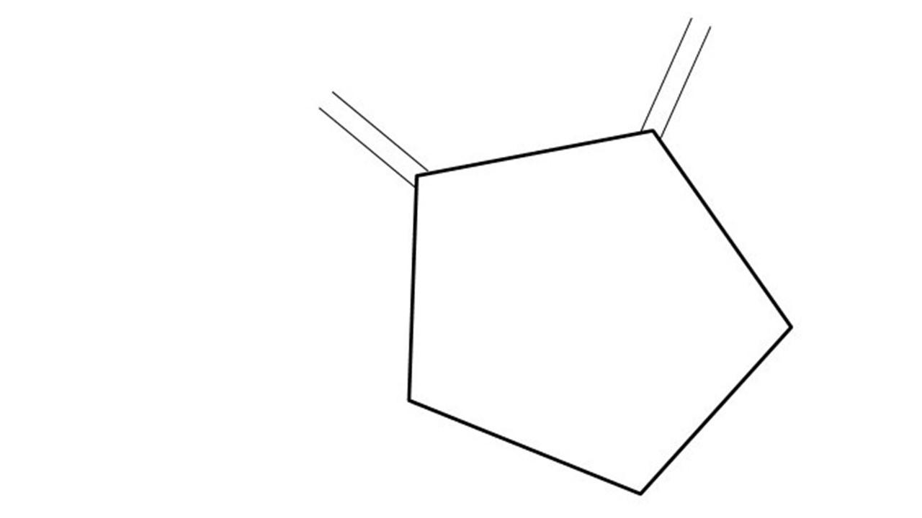
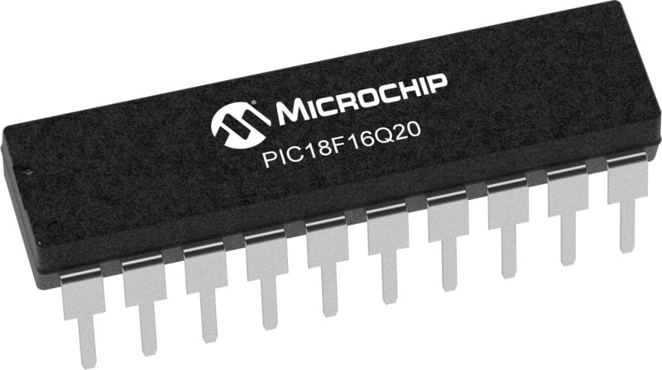
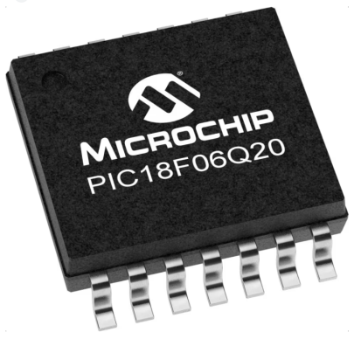
GCBASIC Part 13
GCBASIC for the PIC18FxxQ20 chip Family
November 2024

Slide 2
Videos...
Install the hardware and make the board work – three LED programs
Make four LEDs flash in a sequence
Set the LEDs to represent the value of ADC
Sequence the LEDs with a delay using the value of ADC
Using an input to set the state of the LEDs
Using the reset switch
Using the switch, ADC – make the LEDs flash in a sequence with reverse
Using the serial to display values
Using the timer0 overflow, 8bit timer, 16bit timer to flash the LEDs
Using EEProm – showing values on the serial terminal, and more constants insights
Using I2C with serial to discover I2C devices
Using an I2C GCLD display
Using a SPI GCLD display
Using PWM, 6 ways, to dim the LEDS
Using an external interrupt to sequence the LEDs
Using memory within the PIC – Progmem and SAF memory
Using CLC
The GCBASIC tool chain
Assembly , alternatives assemblers and MPLAB-X
Summary

Slide 3
PIC18FxxQ20
PIC18-Q20 is a high performance PIC18
Digital and Analog peripherals
10-bit ADC
Multiple communication interfaces
Serial, I2C, SPI, I3C
PWM – CCP/PWM and 16Bit
Configurable Logic Cells
Multi voltage domains
The PIC18xxQ20 offers 14 and 20 pin products in small footprint packages to support customers in a variety of space constrained and sensor node applications.

Slide 4
GCBASIC Toolchain
GCBASIC is an Open Source compiler for PIC, AVR and LGT microcontrollers
GCBASIC now supports the 18FxxQ20 chip family
GCBASIC simplifies the use of SPI
GCBASIC
Toolchain

Slide 5
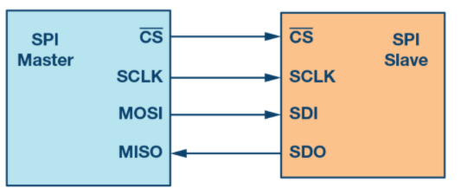
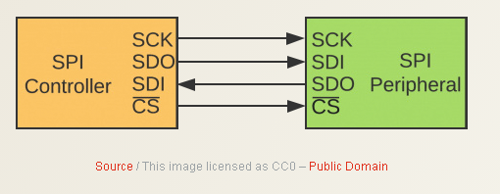
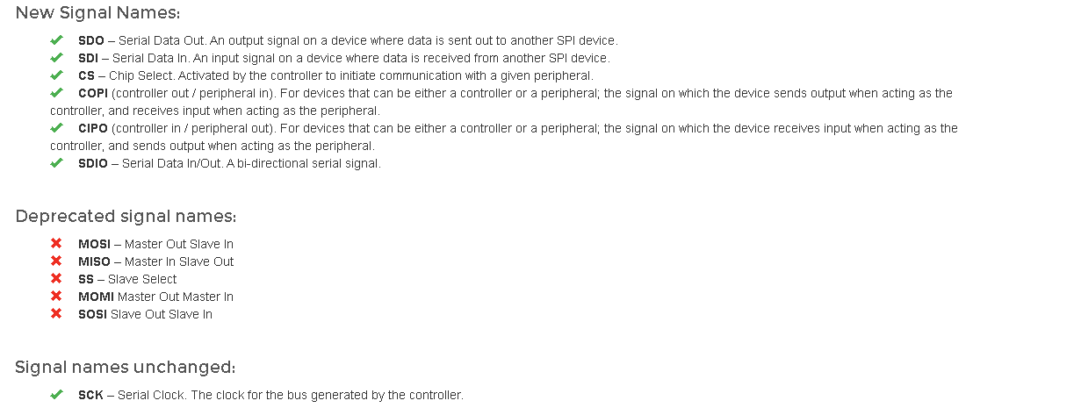
SPI
Serial Peripheral Interface (SPI) is an interface bus commonly used to send data between microcontrollers and small peripherals such as GLCD, shift registers, sensors, and SD cards.
It uses separate clock and data lines, along with a select line to choose the device you wish to talk to.

Slide 6
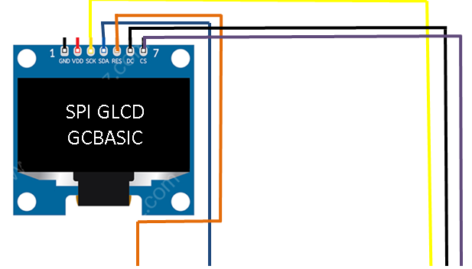
Setup - Connections
-------------------PORTA----------------
Bit#: -7---6---5---4---3---2---1---0---
IO: -----------------SW---------ADC--
-----------------------------------------
-------------------PORTB----------------
Bit#: -7---6---5---4---3---2---1---0---
IO: TX--SCK-SDO--^-------------------
------------------VDDIO3---------------- You must apply correct Voltage
------------------PORTC-----------------
Bit#: -7---6---5---4---3---2---1---0---
IO: LED-LED-LED-LED-RST--^--CS--DC---
--------------------------VDDIO2-------- You must apply correct Voltage

Slide 7
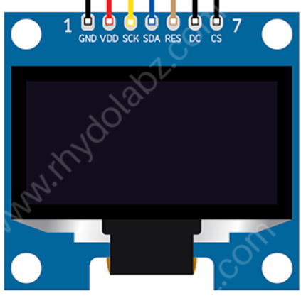
Setup - Program
SPI GLCD
GCBASIC
This is a PPS chip, so, needs to make the PPS match these assignments
#DEFINE GLCD_DO portB.5
#DEFINE GLCD_SCK portB.6
'Pin mappings for GCLD
#DEFINE GLCD_DC portC.0
#DEFINE GLCD_CS portC.1
#DEFINE GLCD_RESET portC.3
DATA

Slide 8
Setup – when things do not work ..
Things do not always work
The more connections the more trouble
Things we know
The GLCD demonstration works
Therefore is not likely to be the libraries but … work through the checklist first
Checklist
Check your connections, twice
Write a program to pulse a signal on each line, each line on at a time
Always use the software SPI first to prove connectivity
Then, use PPS/hardware SPI is #2 works

Slide 9
Lab
Examine the sample code
Software SPI
Hardware SPI

Slide 11
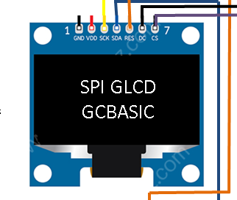
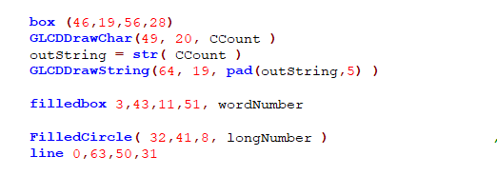
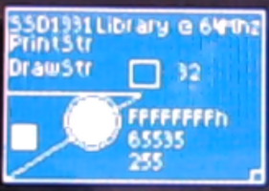
SPI

Slide 12
Videos...
Install the hardware and make the board work – three LED programs
Make four LEDs flash in a sequence
Set the LEDs to represent the value of ADC
Sequence the LEDs with a delay using the value of ADC
Using an input to set the state of the LEDs
Using the reset switch
Using the switch, ADC – make the LEDs flash in a sequence with reverse
Using the serial to display values
Using the timer0 overflow, 8bit timer, 16bit timer to flash the LEDs
Using EEProm – showing values on the serial terminal, and more constants insights
Using I2C with serial to discover I2C devices
Using an I2C GCLD display
Using a SPI GCLD display
Using PWM, 6 ways, to dim the LEDS
Using an external interrupt to sequence the LEDs
Using memory within the PIC – Progmem and SAF memory
Using CLC
The GCBASIC tool chain
Assembly , alternatives assemblers and MPLAB-X
Summary

Slide 13
GCBASIC
GCBASIC for the PIC18FxxQ20 chip Family
November 2024

