Slide 1

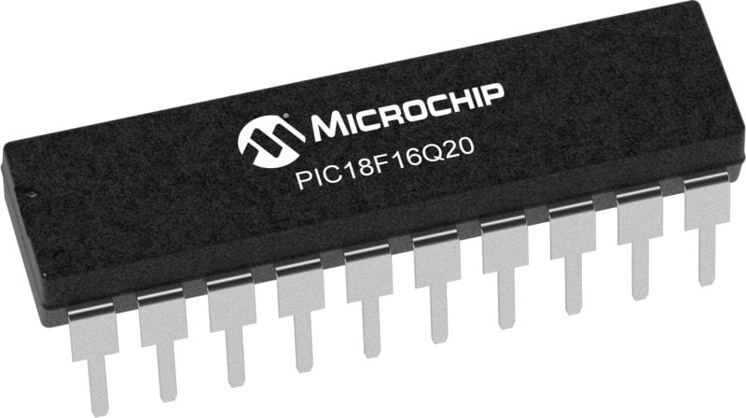
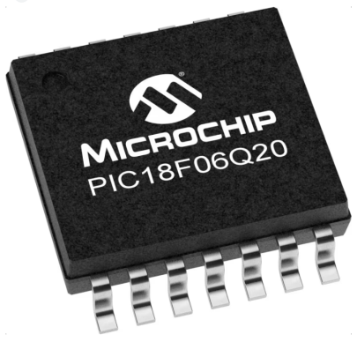
GCBASIC Part 14 - PWM
GCBASIC for the PIC18FxxQ20 chip Family
November 2024

Slide 2
Videos...
Install the hardware and make the board work – three LED programs
Make four LEDs flash in a sequence
Set the LEDs to represent the value of ADC
Sequence the LEDs with a delay using the value of ADC
Using an input to set the state of the LEDs
Using the reset switch
Using the switch, ADC – make the LEDs flash in a sequence with reverse
Using the serial to display values
Using the timer0 overflow, 8bit timer, 16bit timer to flash the LEDs
Using EEProm – showing values on the serial terminal, and more constants insights
Using I2C with serial to discover I2C devices
Using an I2C GCLD display
Using a SPI GCLD display
Using PWM, 7 ways, to dim the LEDS
Using an external interrupt to sequence the LEDs
Using memory within the PIC – Progmem and SAF memory
Using CLC
The GCBASIC tool chain
Assembly , alternatives assemblers and MPLAB-X
Summary

Slide 3
PIC18FxxQ20
PIC18-Q20 is a high performance PIC18
Digital and Analog peripherals
10-bit ADC
Multiple communication interfaces
Serial, I2C, SPI, I3C
PWM – CCP/PWM and 16Bit
Configurable Logic Cells
Multi voltage domains
The PIC18xxQ20 offers 14 and 20 pin products in small footprint packages to support customers in a variety of space constrained and sensor node applications.

Slide 4
GCBASIC Toolchain
GCBASIC is an Open Source compiler for PIC, AVR and LGT microcontrollers
GCBASIC now supports the 18FxxQ20 chip family
GCBASIC simplifies the use of Pulse Width Modulation
GCBASIC
Toolchain

Slide 6
Pulse Width Modulation
Pulse Width Modulation ( PWM ) is simply a succession of pulses – is a method of reducing the average power delivered by an electrical signal, by effectively chopping it up into discrete parts.
The average value of voltage (and current) fed to the load is controlled by turning on and off at a fast rate. The longer the signal is on compared to the off periods, the higher the total power supplied to the load.

Slide 7
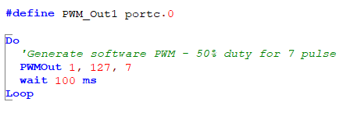
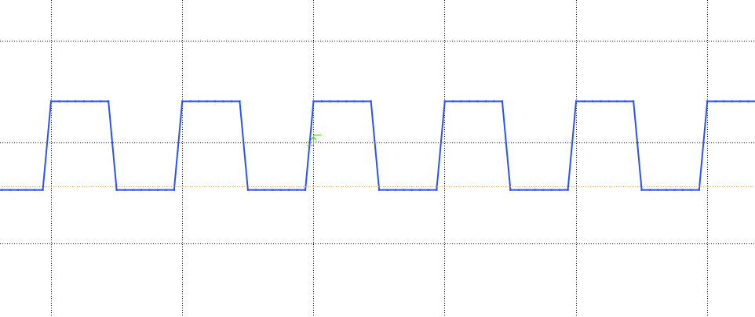
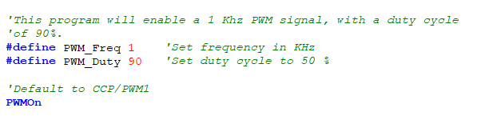
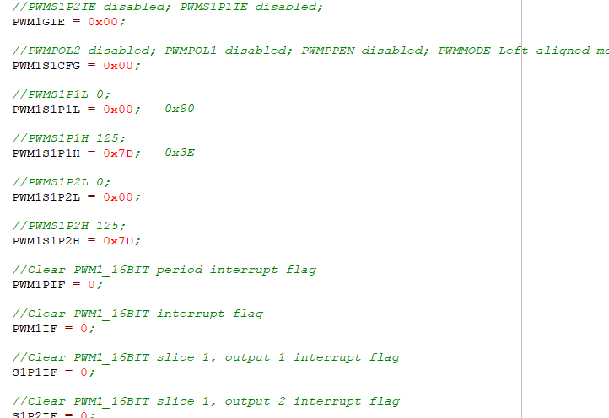
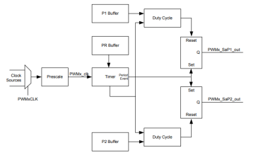
PWM

Slide 8
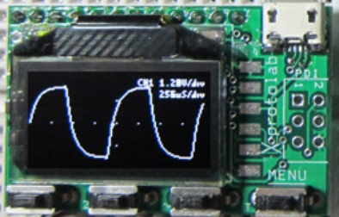
Setup
http://www.gabotronics.com/development-boards/xmega-xminilab.htm

Slide 9
PWM
 | PWM type | Characteristics | PPS required | Comment
1 | The simplest way | Port on and off | No | Any port**
2 | The pulseout() way | PulseOut() a port for a period | No | Any port**
3 | The PWMOut() way | PWMOUT() a number of pulses | No | Any port**
4 | CCP/PWM way | Fixed frequency, fixed duty using timer2* | Yes – CCP/PWMx module | Low code impact, two constants
5 | CCP/PWM way | Variable frequency, variable duty using timer2* | Yes – CCP/PWMx module | ASM does the heavy lifting
6 | PWM 16 bit way | Wide range of capabilities | Yes - PWMxx | Lots of parameters
7 | Timer interrupt way | Use a timer1* | No | Any port**
* could use other timers
** any valid output

Slide 10
Lab
Walk the examples
View the scope

Slide 12
Videos...
Install the hardware and make the board work – three LED programs
Make four LEDs flash in a sequence
Set the LEDs to represent the value of ADC
Sequence the LEDs with a delay using the value of ADC
Using an input to set the state of the LEDs
Using the reset switch
Using the switch, ADC – make the LEDs flash in a sequence with reverse
Using the serial to display values
Using the timer0 overflow, 8bit timer, 16bit timer to flash the LEDs
Using EEProm – showing values on the serial terminal, and more constants insights
Using I2C with serial to discover I2C devices
Using an I2C GCLD display
Using a SPI GCLD display
Using PWM, 7 ways, to dim the LEDS
Using an external interrupt to sequence the LEDs
Using memory within the PIC – Progmem and SAF memory
Using CLC
The GCBASIC tool chain
Assembly , alternatives assemblers and MPLAB-X
Summary

Slide 13
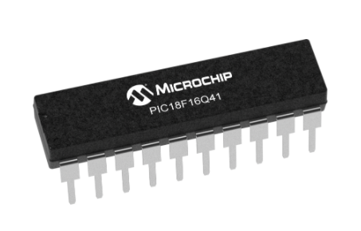
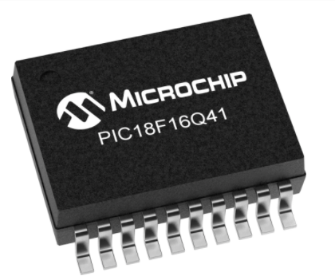
GCBASIC Part 14 - PWM
GCBASIC for the PIC18FxxQ20 chip Family
November 2024
Like and subscribe!
This is mega video

