Slide 1

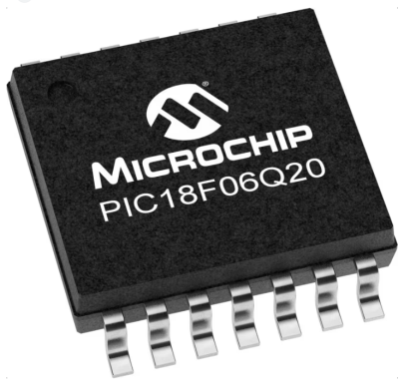
GCBASIC
GCBASIC for the PIC18FxxQ20 chip Family
January 2024

Slide 2

PIC18FxxQ20
PIC18-Q20 is a high performance PIC18
Digital and Analog peripherals
12-bit ADC
Multiple communication interfaces
Serial, I2C, SPI and I3C
PWM – CCP/PWM and 16Bit
Configurable Logic Cells
Multi voltage domains
The PIC18xxQ20 offers 14- and 20-pin products in small footprint packages to support customers in a variety of space constrained and sensor node applications.

Slide 3
Videos...
Install the hardware and make the board work – three LED programs
Make four LEDs flash in a sequence
Set the LEDs to represent the value of ADC
Sequence the LEDs with a delay using the value of ADC
Using an input to set the state of the LEDs
Using the reset switch
Using the switch, ADC – may the LEDs flash in a sequence with reverse
Using the serial to display values
Using the timer0 overflow, 8bit timer, 16bit timer to flash the LEDs
Using CCP/PWM to dim the LEDS
Using I2C with serial to discover I2C devices
Using EEProm – showing values on the serial terminal
Using an I2C GCLD display
Using an SPI GCLD display
Using PWM to dim the LEDS
Using memory within the PIC – Progmem and SAF memory
The GCBASIC tool chain
Assembly and alternatives assemblers
Summary

Slide 4
GCBASIC Compiler
GCBASIC is an Open Source compiler for PIC and AVR microcontrollers
GCBASIC now supports the 18FxxQ20 chip family
GCBASIC Compiler

Slide 5
Basic setup and flash the LED
Installed the GCBASIC software
Installed your programmer software
Test that you have the 18FxxQ20 attached

Slide 6
Hardware
Prototype Board
Power 5v0
Programmer
LEDs & resistors
Hardware
'' -------------------PORTA---------------- '' Bit#: -7---6---5---4---3---2---1---0--- '' IO: --------------------------------- ''----------------------------------------- '' '' -------------------PORTB---------------- '' Bit#: -7---6---5---4---3---2---1---0--- '' IO: --------------------------------- ''----------------------------------------- '' '' ------------------PORTC----------------- '' Bit#: -7---6---5---4---3---2---1---0--- '' IO: LED-LED-LED-LED------------------ ''----------------------------------------- ''

Slide 7
Workshop
Install the hardware
Make the board work
Three LED programs

Slide 9
GCBASIC
GCBASIC for the PIC18FxxQ20 chip Family
January 2021

Slide 10
Videos...
Install the hardware and make the board work – three LED programs
Make four LEDs flash in a sequence
Set the LEDs to represent the value of ADC
Sequence the LEDs with a delay using the value of ADC
Using an input to set the state of the LEDs
Using the reset switch
Using the switch, ADC – may the LEDs flash in a sequence with reverse
Using the serial to display values
Using the timer0 overflow, 8bit timer, 16bit timer to flash the LEDs
Using CCP/PWM to dim the LEDS
Using I2C with serial to discover I2C devices
Using EEProm – showing values on the serial terminal
Using an I2C GCLD display
Using an SPI GCLD display
Using PWM to dim the LEDS
Using memory within the PIC – Progmem and SAF memory
The GCBASIC tool chain
Assembly and alternatives assemblers
Summary

