Slide 1
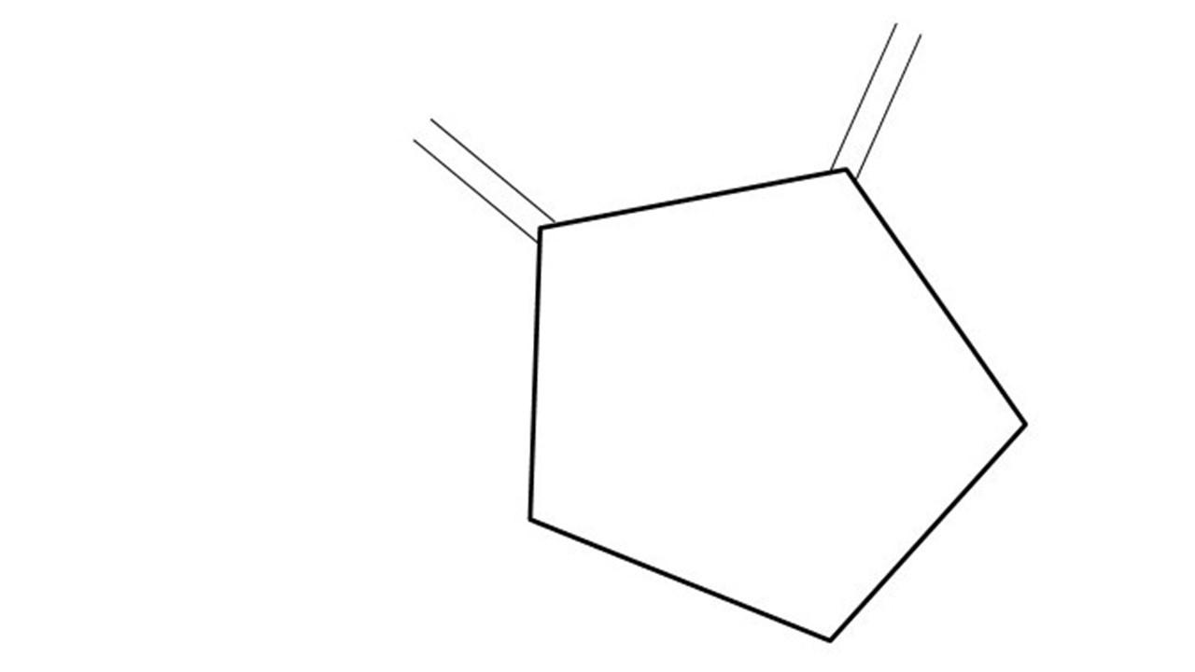
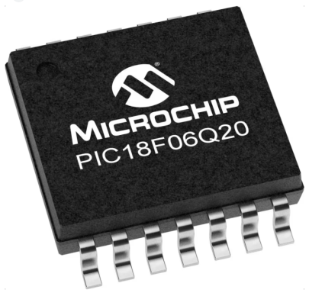
GCBASIC Part 2
GCBASIC for the PIC18FxxQ20 chip Family
February 2024

Slide 2
PIC18FxxQ20
PIC18-Q20 is a high performance PIC18
Digital and Analog peripherals
12-bit ADC
Multiple communication interfaces
Serial, I2C, SPI, I3C
PWM – CCP/PWM and 16Bit
Configurable Logic Cells
Multi voltage domains
The PIC18xxQ20 offers 14- and 20-pin products in small footprint packages to support customers in a variety of space constrained and sensor node applications.

Slide 3
Videos...
Install the hardware and make the board work – three LED programs
Make four LEDs flash in a sequence
Set the LEDs to represent the value of ADC
Sequence the LEDs with a delay using the value of ADC
Using an input to set the state of the LEDs
Using the reset switch
Using the switch, ADC – may the LEDs flash in a sequence with reverse
Using the serial to display values
Using the timer0 overflow, 8bit timer, 16bit timer to flash the LEDs
Using CCP/PWM to dim the LEDS
Using I2C with serial to discover I2C devices
Using EEProm – showing values on the serial terminal
Using an I2C GCLD display
Using an SPI GCLD display
Using PWM to dim the LEDS
Using memory within the PIC – Progmem and SAF memory
The GCBASIC tool chain
Assembly and alternatives assemblers
Summary

Slide 4
GCBASIC Toolchain
GCBASIC is an Open Source compiler for PIC, AVR and LGT microcontrollers
GCBASIC now supports the 18FxxQ20 chip family
GCBASIC
Toolchain

Slide 5
Hardware
Prototype Board
Power 5v0
Programmer
LEDs & resistors
Hardware
-------------------PORTA---------------- Bit#: -7---6---5---4---3---2---1---0--- IO: --------------------------------- ''----------------------------------------- '' -------------------PORTB---------------- Bit#: -7---6---5---4---3---2---1---0--- IO: --------------------------------- ''----------------------------------------- '' ------------------PORTC----------------- Bit#: -7---6---5---4---3---2---1---0--- IO: LED-LED-LED-LED------------------ ''----------------------------------------- ''

Slide 6
Make four LEDs flash in a sequence
Initialise
Set 1st LED
Delay
Rotate the LEDs
Did it overflow ?
No
Yes
Set 1st LED

Slide 7
Rotate with Carry
 | LEDD4 = C.4 | LEDD5 = C.5 | LEDD6 = C.6 | LEDD7 = C.7 | CARRY = SREG.0
Start | 1 | 0 | 0 | 0 | 0
Rotate(shift) | 0 | 1 | 0 | 0 | 0
Rotate(shift) | 0 | 0 | 1 | 0 | 0
Rotate(shift) | 0 | 0 | 0 | 1 | 0
Rotate(shift) | 0 | 0 | 0 | 0 | 1
Restart | 1 | 0 | 0 | 0 | 0
Rotate(shift) | 0 | 1 | 0 | 0 | 0

Slide 8
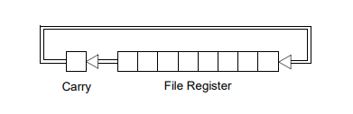
Rotate with Carry
 | LEDD4 = C.4 | LEDD5 = C.5 | LEDD6 = C.6 | LEDD7 = C.7 | CARRY = SREG.0
Start | 1 | 0 | 0 | 0 | 0
Rotate(shift) | 0 | 1 | 0 | 0 | 0
Rotate(shift) | 0 | 0 | 1 | 0 | 0
Rotate(shift) | 0 | 0 | 0 | 1 | 0
Rotate(shift) | 0 | 0 | 0 | 0 | 1
Restart | 1 | 0 | 0 | 0 | 0
Rotate(shift) | 0 | 1 | 0 | 0 | 0

Slide 9
Rotate with Carry
 | LEDD4 = C.4 | LEDD5 = C.5 | LEDD6 = C.6 | LEDD7 = C.7 | CARRY = SREG.0
Start | 1 | 0 | 0 | 0 | 0
Rotate(shift) | 0 | 1 | 0 | 0 | 0
Rotate(shift) | 0 | 0 | 1 | 0 | 0
Rotate(shift) | 0 | 0 | 0 | 1 | 0
Rotate(shift) | 0 | 0 | 0 | 0 | 1
Restart | 1 | 0 | 0 | 0 | 0
Rotate(shift) | 0 | 1 | 0 | 0 | 0

Slide 10
Rotate with Carry
 | LEDD4 = C.4 | LEDD5 = C.5 | LEDD6 = C.6 | LEDD7 = C.7 | CARRY = SREG.0
Start | 1 | 0 | 0 | 0 | 0
Rotate(shift) | 0 | 1 | 0 | 0 | 0
Rotate(shift) | 0 | 0 | 1 | 0 | 0
Rotate(shift) | 0 | 0 | 0 | 1 | 0
Rotate(shift) | 0 | 0 | 0 | 0 | 1
Restart | 1 | 0 | 0 | 0 | 0
Rotate(shift) | 0 | 1 | 0 | 0 | 0

Slide 11
Rotate with Carry
 | LEDD4 = C.4 | LEDD5 = C.5 | LEDD6 = C.6 | LEDD7 = C.7 | CARRY = SREG.0
Start | 1 | 0 | 0 | 0 | 0
Rotate(shift) | 0 | 1 | 0 | 0 | 0
Rotate(shift) | 0 | 0 | 1 | 0 | 0
Rotate(shift) | 0 | 0 | 0 | 1 | 0
Rotate(shift) | 0 | 0 | 0 | 0 | 1
Restart | 1 | 0 | 0 | 0 | 0
Rotate(shift) | 0 | 1 | 0 | 0 | 0

Slide 12
Rotate with Carry
 | LEDD4 = C.4 | LEDD5 = C.5 | LEDD6 = C.6 | LEDD7 = C.7 | CARRY = SREG.0
Start | 1 | 0 | 0 | 0 | 0
Rotate(shift) | 0 | 1 | 0 | 0 | 0
Rotate(shift) | 0 | 0 | 1 | 0 | 0
Rotate(shift) | 0 | 0 | 0 | 1 | 0
Rotate(shift) | 0 | 0 | 0 | 0 | 1
Restart | 1 | 0 | 0 | 0 | 0
Rotate(shift) | 0 | 1 | 0 | 0 | 0

Slide 13
Rotate with Carry
 | LEDD4 = C.4 | LEDD5 = C.5 | LEDD6 = C.6 | LEDD7 = C.7 | CARRY = SREG.0
Start | 1 | 0 | 0 | 0 | 0
Rotate(shift) | 0 | 1 | 0 | 0 | 0
Rotate(shift) | 0 | 0 | 1 | 0 | 0
Rotate(shift) | 0 | 0 | 0 | 1 | 0
Rotate(shift) | 0 | 0 | 0 | 0 | 1
Restart | 1 | 0 | 0 | 0 | 0
Rotate(shift) | 0 | 1 | 0 | 0 | 0

Slide 15
GCBASIC
GCBASIC for the PIC18FxxQ20 chip Family
January 2021

Slide 16
Videos...
Install the hardware and make the board work – three LED programs
Make four LEDs flash in a sequence
Set the LEDs to represent the value of ADC
Sequence the LEDs with a delay using the value of ADC
Using an input to set the state of the LEDs
Using the reset switch
Using the switch, ADC – may the LEDs flash in a sequence with reverse
Using the serial to display values
Using the timer0 overflow, 8bit timer, 16bit timer to flash the LEDs
Using CCP/PWM to dim the LEDS
Using I2C with serial to discover I2C devices
Using EEProm – showing values on the serial terminal
Using an I2C GCLD display
Using an SPI GCLD display
Using PWM to dim the LEDS
Using memory within the PIC – Progmem and SAF memory
The GCBASIC tool chain
Assembly and alternatives assemblers
Summary

