Slide 1
GCBASIC
PIC16F175xx
Part 10 - EEPROM Operations

Slide 2


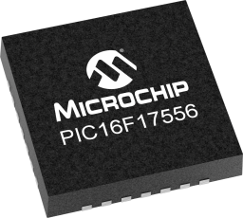
GCBASIC
PIC16F175xx
Part 10 - EEPROM Operations

Slide 3
GCBASIC
Like and subscribe!

Slide 4
PIC16F175xx
PIC16165xx is a high performance PIC16
  Digital and analog peripherals for flexible embedded control
  10-bit ADC for accurate analog signal conversion
  Multiple communication interfaces including UART (serial), I²C, and SPI
  PWM modules with CCP and 16-bit resolution for precise timing and motor control
  Configurable Logic Cells (CLCs) for custom hardware-level logic without external components
  Integrated op amps for onboard analog signal conditioning and amplification
The PIC16175xx offers 14, 20, 28, 40 and 44-pin products in small footprint packages to support customers in a wide variety of applications.

Slide 5
Videos...
Install the hardware and make the board work – three LED programs
Make four LEDs flash in a sequence
Set the LEDs to represent the value of ADC
Sequence the LEDs with a delay using the value of ADC
Using an input to set the state of the LEDs
Using the reset switch
Using the switch, ADC – make the LEDs flash in a sequence with reverse
Using the serial to display values
Using the timer0: 16bit timer, 8bit timer and overflow to flash the LEDs
Using EEProm – showing values on the serial terminal, and more constants insights
Using I2C with serial to discover I2C devices
Using an I2C GCLD display
Using a SPI GCLD display
Using PWM, many ways, to dim the LEDS
Using an external interrupt to control an LED
Using storage within the chip – Progmem, SAF memory, EEPROM and DATA blocks
Using CLC
The GCBASIC tool chain
Assembly , alternatives assemblers and MPLAB-X
Summary

Slide 6
GCBASIC Compiler
GCBASIC Compiler
GCBASIC is an Open Source compiler for PIC and AVR microcontrollers
GCBASIC now supports the 16F175xx chip family

Slide 7
Prerequisites
Assumes you have
  Installed the GCBASIC software
  Installed your programmer software
  Test that you have the 16F175xx attached
  You have the 4 LEDs operating
  You have a POT connected
  You have SWITCHes connected
  You have a USB/TTL converter

Slide 8
Hardware
Hardware
// -------------------PORTA----------------
// Bit#: -7---6---5---4---3---2---1---0---
// IO: -----------------SW----------ADC--
// ----------------------------------------
// -------------------PORTB----------------
// Bit#: -7---6---5---4---3---2---1---0---
// IO: ---------------------------------
// ----------------------------------------
// ------------------PORTC-----------------
// Bit#: -7---6---5---4---3---2---1---0---
// IO: ----TX1--------LED--LED-LED LED--
// ----------------------------------------
//
// ------------------PORTE-----------------
// Bit#: -7---6---5---4---3---2---1---0---
// IO: ----------------MCLR-------------
// ------------------------SW--------------
Prototype Board
Power 5v0
Programmer
LEDs & resistors
Switches & resistors

Slide 9
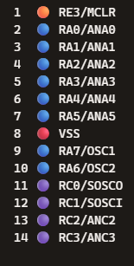
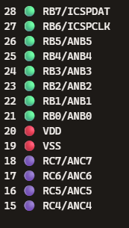
Digital input
SW
ADC
SW
LED
TX1

Slide 10
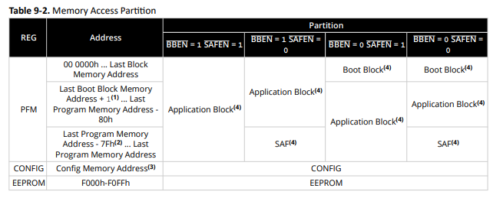
Memory
16 KB of Program Flash Memory
4 KB of Data SRAM Memory
256 Bytes Data EEPROM
Memory Access Partition, the Program Flash Memory Partitioned into:
  Application Block
  Boot Block
  Storage Area Flash (SAF) Block

Slide 11
EEProm
Electrically Erasable Programmable Read-Only Memory
Non-volatile memory to store relatively small amounts of data but allowing individual bytes to be erased and reprogrammed.

Slide 12
EEProm
Type Value Explanation
Prog 16384 Prog is exposed as ChipWORDS
SAFMemWords 128 SAFMemWords exposed ChipSAFMemWords
EEPROM 256 EEPROM is exposed as ChipEEPROM
RAM 2048 RAM is exposed as ChipRAM

Slide 13
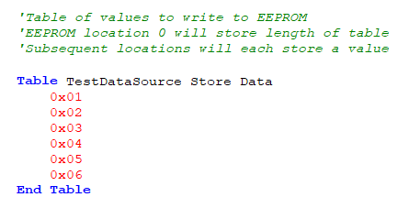
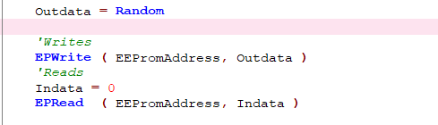
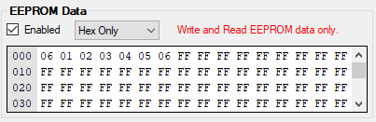
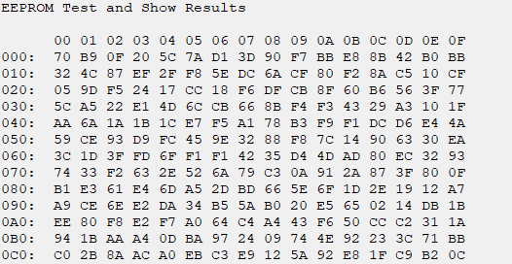
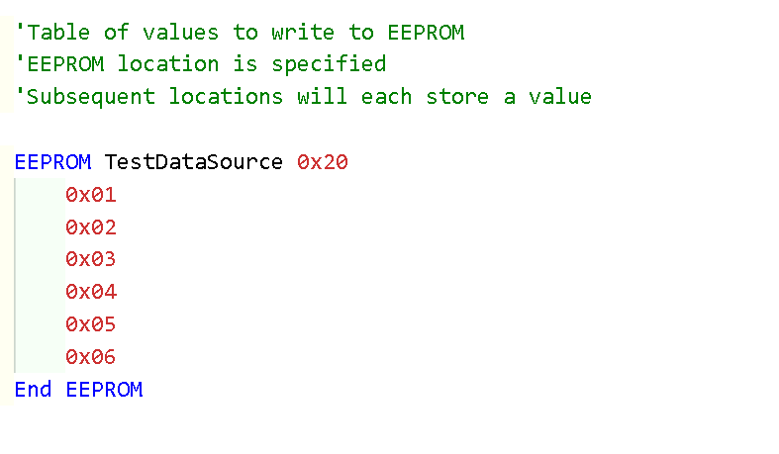
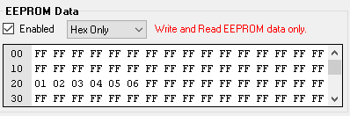
EEProm – 3 ways

Slide 14
Lab
Sample code – write and read via terminal
  Using PPS select the serial USART port
  Write values to EEProm
  Read values to EEProm
  See the results on terminal
Sample code – write with read via programmer
  Write values to EEProm
  See the results within PICKitPlus
Sample code – check the chip specific constant
  See the results on terminal

Slide 16
Videos...
Install the hardware and make the board work – three LED programs
Make four LEDs flash in a sequence
Set the LEDs to represent the value of ADC
Sequence the LEDs with a delay using the value of ADC
Using an input to set the state of the LEDs
Using the reset switch
Using the switch, ADC – make the LEDs flash in a sequence with reverse
Using the serial to display values
Using the timer0: 16bit timer, 8bit timer and overflow to flash the LEDs
Using EEProm – showing values on the serial terminal, and more constants insights
Using I2C with serial to discover I2C devices
Using an I2C GCLD display
Using a SPI GCLD display
Using PWM, many ways, to dim the LEDS
Using an external interrupt to control an LED
Using storage within the chip – Progmem, SAF memory, EEPROM and DATA blocks
Using CLC
The GCBASIC tool chain
Assembly , alternatives assemblers and MPLAB-X
Summary

Slide 17
GCBASIC
PIC16F175xx
Part 10 - EEPROM Operations

