Slide 1
GCBASIC
PIC16F175xx
Part 3 - read the ADC

Slide 2

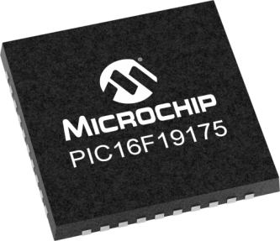

GCBASIC
PIC16F175xx
Part 3 - read the ADC

Slide 3
GCBASIC
Like and subscribe!

Slide 4
PIC16F175xx
PIC16165xx is a high performance PIC16
  Digital and analog peripherals for flexible embedded control
  10-bit ADC for accurate analog signal conversion
  Multiple communication interfaces including UART (serial), I²C, and SPI
  PWM modules with CCP and 16-bit resolution for precise timing and motor control
  Configurable Logic Cells (CLCs) for custom hardware-level logic without external components
  Integrated op amps for onboard analog signal conditioning and amplification
The PIC16175xx offers 14, 20, 28, 40 and 44-pin products in small footprint packages to support customers in a wide variety of applications.

Slide 5
Videos...
Install the hardware and make the board work – three LED programs
Make four LEDs flash in a sequence
Set the LEDs to represent the value of ADC
Sequence the LEDs with a delay using the value of ADC
Using an input to set the state of the LEDs
Using the reset switch
Using the switch, ADC – make the LEDs flash in a sequence with reverse
Using the serial to display values
Using the timer0 overflow, 8bit timer, 16bit timer to flash the LEDs
Using EEProm – showing values on the serial terminal, and more constants insights
Using I2C with serial to discover I2C devices
Using an I2C GCLD display
Using a SPI GCLD display
Using PWM, 7 ways, to dim the LEDS
Using an external interrupt to control an LED
Using storage within the chip – Progmem, SAF memory, EEPROM and DATA blocks
Using CLC
The GCBASIC tool chain
Assembly , alternatives assemblers and MPLAB-X
Summary

Slide 6
GCBASIC Compiler
GCBASIC Compiler
GCBASIC is an Open Source compiler for PIC and AVR microcontrollers
GCBASIC now supports the 16F175xx chip family

Slide 7
Analog-to-Digital
We configure the ADC, run a conversion, read the analog voltage controlled by the potentiometer on the board, and display the results on the LEDs.

Slide 8
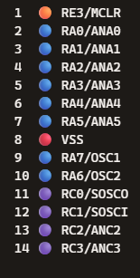
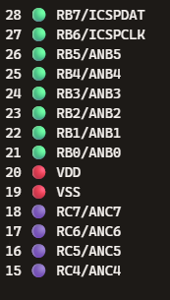
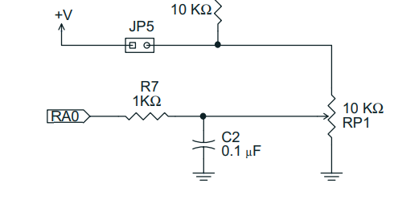
Analog-to-Digital
ADC

Slide 9
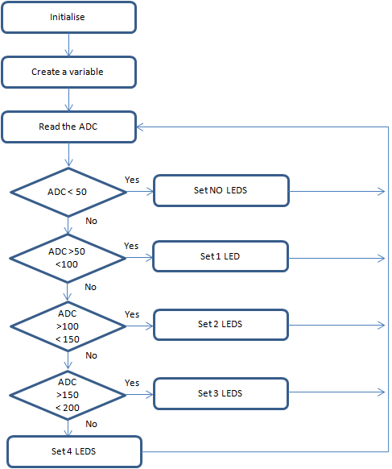
Analog-to-Digital
GCBASIC completes the initialisation
Create a variable to store the ADC results
Read the ADC
  GCBASIC makes the process easy via the ReadADC()
  ReadADC returns a value of 0 to 255
Set the LEDs
Do it again….

Slide 10
Analog-to-Digital

Slide 11
Prerequisites
Assumes you have
  Installed the GCBASIC software
  Installed your programmer software
  Test that you have the 16F175xx attached
  You have the 4 LEDs operating
  You have a POT connected

Slide 12
Hardware
Hardware
'' -------------------PORTA----------------
'' Bit#: -7---6---5---4---3---2---1---0---
'' IO: ----------------------------ADC--
''-----------------------------------------
''
'' -------------------PORTB----------------
'' Bit#: -7---6---5---4---3---2---1---0---
'' IO: ---------------------------------
''-----------------------------------------
''
'' ------------------PORTC-----------------
'' Bit#: -7---6---5---4---3---2---1---0---
'' IO: ---------------LED--LED-LED-LED--
''-----------------------------------------
''
Prototype Board
Power 5v0
Programmer
LEDs & resistors

Slide 13
Workshop
Read the ADC to set the LEDs
Uses
  A Byte variable
  Simple logic

Slide 15
Videos...
Install the hardware and make the board work – three LED programs
Make four LEDs flash in a sequence
Set the LEDs to represent the value of ADC
Sequence the LEDs with a delay using the value of ADC
Using an input to set the state of the LEDs
Using the reset switch
Using the switch, ADC – make the LEDs flash in a sequence with reverse
Using the serial to display values
Using the timer0 overflow, 8bit timer, 16bit timer to flash the LEDs
Using EEProm – showing values on the serial terminal, and more constants insights
Using I2C with serial to discover I2C devices
Using an I2C GCLD display
Using a SPI GCLD display
Using PWM, 7 ways, to dim the LEDS
Using an external interrupt to control an LED
Using storage within the chip – Progmem, SAF memory, EEPROM and DATA blocks
Using CLC
The GCBASIC tool chain
Assembly , alternatives assemblers and MPLAB-X
Summary

Slide 16
GCBASIC
PIC16F175xx
Part 3 - read the ADC

Slide 17
