Slide 1
GCBASIC
PIC16F175xx
Part 5 – a switch sets the LEDs state

Slide 2



GCBASIC
PIC16F175xx
Part 5 – a switch sets the LEDs state

Slide 3
GCBASIC
Like and subscribe!

Slide 4
Videos...
Install the hardware and make the board work – three LED programs
Make four LEDs flash in a sequence
Set the LEDs to represent the value of ADC
Sequence the LEDs with a delay using the value of ADC
Using an input to set the state of the LEDs
Using the reset switch
Using the switch, ADC – make the LEDs flash in a sequence with reverse
Using the serial to display values
Using the timer0 overflow, 8bit timer, 16bit timer to flash the LEDs
Using EEProm – showing values on the serial terminal, and more constants insights
Using I2C with serial to discover I2C devices
Using an I2C GCLD display
Using a SPI GCLD display
Using PWM, 7 ways, to dim the LEDS
Using an external interrupt to control an LED
Using storage within the chip – Progmem, SAF memory, EEPROM and DATA blocks
Using CLC
The GCBASIC tool chain
Assembly , alternatives assemblers and MPLAB-X
Summary

Slide 5
PIC16F175xx
PIC16165xx is a high performance PIC16
  Digital and analog peripherals for flexible embedded control
  10-bit ADC for accurate analog signal conversion
  Multiple communication interfaces including UART (serial), I²C, and SPI
  PWM modules with CCP and 16-bit resolution for precise timing and motor control
  Configurable Logic Cells (CLCs) for custom hardware-level logic without external components
  Integrated op amps for onboard analog signal conditioning and amplification
The PIC16175xx offers 14, 20, 28, 40 and 44-pin products in small footprint packages to support customers in a wide variety of applications.

Slide 6
Prerequisites
Assumes you have
  Installed the GCBASIC software
  Installed your programmer software
  Test that you have the 16F175xx attached
  You have the 4 LEDs operating
  You have a POT connected
  You have a SWITCH connected

Slide 7
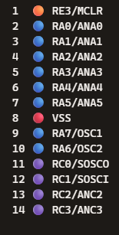
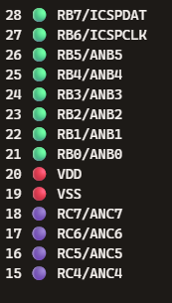
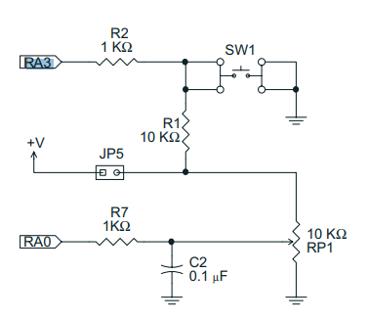
Digital input
ADC
SW
LED

Slide 8
Hardware
Hardware
'' -------------------PORTA----------------
'' Bit#: -7---6---5---4---3---2---1---0---
'' IO: ---------------- SW---------ADC--
''-----------------------------------------
''
'' -------------------PORTB----------------
'' Bit#: -7---6---5---4---3---2---1---0---
'' IO: ---------------------------------
''-----------------------------------------
''
'' ------------------PORTC-----------------
'' Bit#: -7---6---5---4---3---2---1---0---
'' IO: ---------------LED--LED-LED-LED--
''-----------------------------------------
''
Prototype Board
Power 5v0
Programmer
LEDs & resistors
Switch & resistors

Slide 9
Tutorial overview
Initialise
Set LEDs off
Keypressed = TRUE
Initialise microcontroller
Check the switch
  If pushed then toggle LED
  If not pushed then do it again
Checking the switch by using function to inspect the switch state
Repeat
Yes
No
Toggle LEDs
Loop

Slide 10
Lab
Review GCSTUDIO options
Examine the sample code
Review the results

Slide 12
// Function to debounce a switch and return the stable state
Function DebounceSwitch as Bit
// Define variables
Dim CurrentState As Bit
Dim LastState As Bit
Dim StableState As Bit
Dim Counter As Byte
// Initialize states and counter
LastState = SWITCHIN
StableState = LastState
Counter = 0
// Debounce loop: checks the state multiple times to ensure stability
For Counter = 0 To 10
wait 5 ms // Small delay to allow switch to settle
// Read the current state of the switch
CurrentState = SWITCHIN
// If the state is stable (consistent for the duration of the loop)
If (CurrentState = LastState) Then
StableState = CurrentState
Else
// Reset counter if state changes
Counter = 0
LastState = CurrentState
End If
Next
// Return the stable state of the switch
DebounceSwitch = StableState
End Function
Explanation:
Variable Definition:
  CurrentState, LastState, and StableState are declared as Bit to store the current, previous, and stable states of the switch.
  Counter is declared as Byte to act as a loop counter.
Initialization:
  LastState is initialized to the current state of the switch (SWITCHIN).
  StableState is initialized to LastState.
  Counter is initialized to 0.
Debounce Loop:
  The loop runs 10 times, checking the switch state every 5 milliseconds.
  CurrentState is updated with the current state of the switch (SWITCHIN).
  If the CurrentState matches the LastState consistently for the duration of the loop, StableState is set to CurrentState.
  If the state changes, the counter is reset, and LastState is updated with CurrentState.
Return Stable State:
  The function returns the StableState of the switch, which has been debounced.
This function ensures that the state of the switch is stable before returning it, effectively debouncing the switch. If you have any further questions or need more details, feel free to let me know! 😊✨

Slide 13
Videos...
Install the hardware and make the board work – three LED programs
Make four LEDs flash in a sequence
Set the LEDs to represent the value of ADC
Sequence the LEDs with a delay using the value of ADC
Using an input to set the state of the LEDs
Using the reset switch
Using the switch, ADC – make the LEDs flash in a sequence with reverse
Using the serial to display values
Using the timer0 overflow, 8bit timer, 16bit timer to flash the LEDs
Using EEProm – showing values on the serial terminal, and more constants insights
Using I2C with serial to discover I2C devices
Using an I2C GCLD display
Using a SPI GCLD display
Using PWM, 7 ways, to dim the LEDS
Using an external interrupt to control an LED
Using storage within the chip – Progmem, SAF memory, EEPROM and DATA blocks
Using CLC
The GCBASIC tool chain
Assembly , alternatives assemblers and MPLAB-X
Summary

Slide 14
GCBASIC
PIC16F175xx
Part 5 – a switch sets the LEDs state

