Slide 1
GCBASIC
PIC16F175xx
Part 9 - Timers and Timer Interrupts

Slide 2



GCBASIC
PIC16F175xx
Part 9 - Timers and Timer Interrupts

Slide 3
GCBASIC
Like and subscribe!

Slide 4
PIC16F175xx
PIC16165xx is a high performance PIC16
  Digital and analog peripherals for flexible embedded control
  10-bit ADC for accurate analog signal conversion
  Multiple communication interfaces including UART (serial), I²C, and SPI
  PWM modules with CCP and 16-bit resolution for precise timing and motor control
  Configurable Logic Cells (CLCs) for custom hardware-level logic without external components
  Integrated op amps for onboard analog signal conditioning and amplification
The PIC16175xx offers 14, 20, 28, 40 and 44-pin products in small footprint packages to support customers in a wide variety of applications.

Slide 5
Videos...
Install the hardware and make the board work – three LED programs
Make four LEDs flash in a sequence
Set the LEDs to represent the value of ADC
Sequence the LEDs with a delay using the value of ADC
Using an input to set the state of the LEDs
Using the reset switch
Using the switch, ADC – make the LEDs flash in a sequence with reverse
Using the serial to display values
Using the timer0: 16bit timer, 8bit timer and overflow to flash the LEDs
Using EEProm – showing values on the serial terminal, and more constants insights
Using I2C with serial to discover I2C devices
Using an I2C GCLD display
Using a SPI GCLD display
Using PWM, many ways, to dim the LEDS
Using an external interrupt to control an LED
Using storage within the chip – Progmem, SAF memory, EEPROM and DATA blocks
Using CLC
The GCBASIC tool chain
Assembly , alternatives assemblers and MPLAB-X
Summary

Slide 6
GCBASIC Compiler
GCBASIC Compiler
GCBASIC is an Open Source compiler for PIC,AVR and LGT microcontrollers
GCBASIC now supports the 16F175xx chip family

Slide 7
Prerequisites
Assumes you have
  Installed the GCBASIC software
  Installed your programmer software
  Test that you have the 16F175xx attached
  You have the 4 LEDs operating
  You have a POT connected
  You have SWITCHes connected
  You have a USB/TTL converter

Slide 8
Hardware
Hardware
// -------------------PORTA----------------
// Bit#: -7---6---5---4---3---2---1---0---
// IO: -----------------SW----------ADC--
// ----------------------------------------
// -------------------PORTB----------------
// Bit#: -7---6---5---4---3---2---1---0---
// IO: ---------------------------------
// ----------------------------------------
// ------------------PORTC-----------------
// Bit#: -7---6---5---4---3---2---1---0---
// IO: ----TX1--------LED--LED-LED LED--
// ----------------------------------------
//
// ------------------PORTE-----------------
// Bit#: -7---6---5---4---3---2---1---0---
// IO: ----------------MCLR-------------
// ------------------------SW--------------
Prototype Board
Power 5v0
Programmer
LEDs & resistors
Switches & resistors

Slide 9
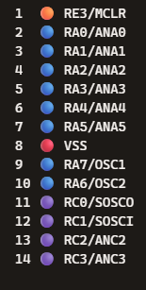
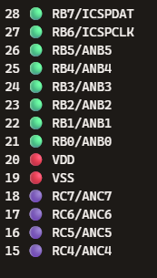
Digital input
SW
ADC
SW
LED
TX1

Slide 10
Timer Primer

Slide 11
Timer Block Diagram
Timers generate the accurate time delays. The microcontroller can also generate/measure the required time delays by running loops, in your program, but the timer/counter relieves the CPU from that operation by using the prescalar and postscalar
A timer is nothing but a simple binary counter that can be configured to count clock pulses(Internal/External). A register increments from a specific value. Once it reaches the maximum value, it will roll back to zero setting up an OverFlow flag and generates the interrupt ... if enabled.

Slide 12
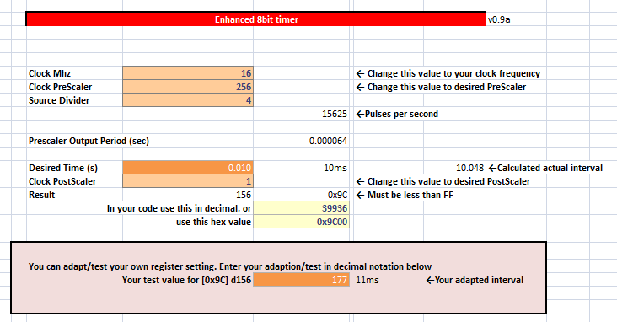
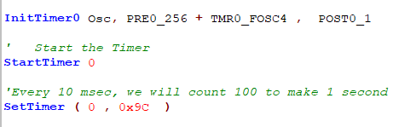
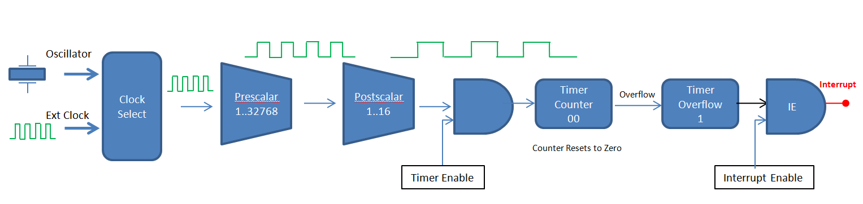
Timer Overview

Slide 13
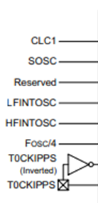
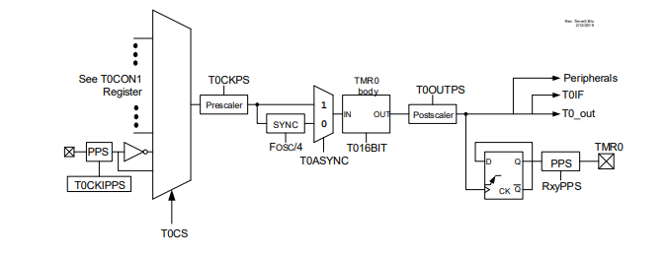
Timer0 block diagram

Slide 14
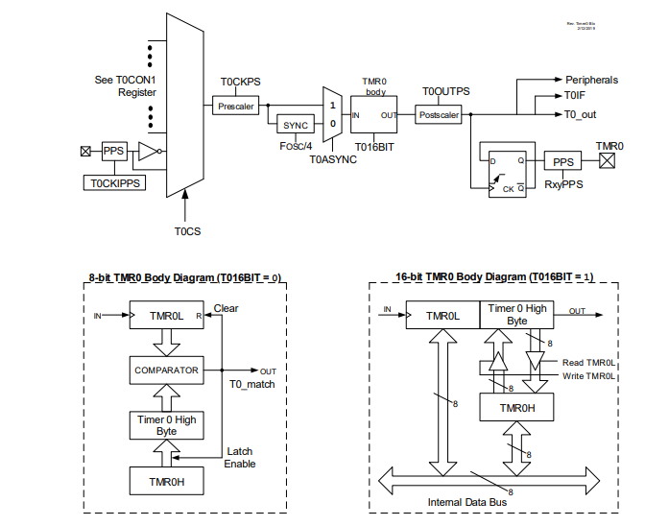
Timer0 block diagram

Slide 15
Timer0 block diagram

Slide 16
Timer Block Diagram
Oscillator
Clock Select
Prescalar
1..32768
Postscalar
1..16
Interrupt
Timer Counter nn..FF.00
Overflow
Timer Overflow
IE
Ext Clock
Counter Resets to Zero
Timer Enable
Interrupt Enable
Timers generate the accurate time delays. The microcontroller can also generate/measure the required time delays by running loops, in your program, but the timer/counter relieves the CPU from that operation by using the prescalar and postscalar
A timer is nothing but a simple binary counter that can be configured to count clock pulses(Internal/External). A register increments from a specific value. Once it reaches the maximum value, it will roll back to zero setting up an OverFlow flag and generates the interrupt ... if enabled.

Slide 17
Timer Block Diagram
Oscillator
Clock Select
Ext Clock

Slide 18
Timer Block Diagram
Oscillator
Clock Select
Ext Clock

Slide 19
Timer Block Diagram
Oscillator
Clock Select
Prescalar
1..32768
Ext Clock

Slide 20
Timer Block Diagram
Oscillator
Clock Select
Prescalar
1..32768
Ext Clock

Slide 21
Timer Block Diagram
Oscillator
Clock Select
Prescalar
1..32768
Postscalar
1..16
Ext Clock

Slide 22
Timer Block Diagram
Oscillator
Clock Select
Prescalar
1..32768
Postscalar
1..16
Ext Clock

Slide 23
Timer Block Diagram
Oscillator
Clock Select
Prescalar
1..32768
Postscalar
1..16
Ext Clock
Timer Enable

Slide 24
Timer Block Diagram
Oscillator
Clock Select
Prescalar
1..32768
Postscalar
1..16
Timer Counter B1
Timer Overflow
0
Ext Clock
Set timer value
Timer Enable

Slide 25
Timer Block Diagram
Oscillator
Clock Select
Prescalar
1..32768
Postscalar
1..16
Timer Counter B1
Timer Overflow
0
Ext Clock
Timer Enable

Slide 26
Timer Block Diagram
Oscillator
Clock Select
Prescalar
1..32768
Postscalar
1..16
Timer Counter B2
Timer Overflow
0
Ext Clock
Timer Enable

Slide 27
Timer Block Diagram
Oscillator
Clock Select
Prescalar
1..32768
Postscalar
1..16
Timer Counter B3
Timer Overflow
0
Ext Clock
Timer Enable

Slide 28
Timer Block Diagram
Oscillator
Clock Select
Prescalar
1..32768
Postscalar
1..16
Timer Counter
..
Timer Overflow
0
Ext Clock
Timer Enable

Slide 29
Timer Block Diagram
Oscillator
Clock Select
Prescalar
1..32768
Postscalar
1..16
Timer Counter FE
Timer Overflow
0
Ext Clock
Timer Enable

Slide 30
Timer Block Diagram
Oscillator
Clock Select
Prescalar
1..32768
Postscalar
1..16
Timer Counter FF
Timer Overflow
0
Ext Clock
Timer Enable

Slide 31
Timer Block Diagram
Oscillator
Clock Select
Prescalar
1..32768
Postscalar
1..16
Timer Counter 00
Timer Overflow
0
Ext Clock
Counter Resets to Zero
Timer Enable

Slide 32
Timer Block Diagram
Oscillator
Clock Select
Prescalar
1..32768
Postscalar
1..16
Timer Counter 00
Overflow
Timer Overflow
1
Ext Clock
Counter Resets to Zero
Timer Enable

Slide 33
Timer Block Diagram
Oscillator
Clock Select
Prescalar
1..32768
Postscalar
1..16
Timer Counter 00
Overflow
Timer Overflow
1
Ext Clock
Counter Resets to Zero
Timer Enable

Slide 34
Timer Block Diagram
Oscillator
Clock Select
Prescalar
1..32768
Postscalar
1..16
Timer Counter 00
Overflow
Timer Overflow
1
IE
Ext Clock
Counter Resets to Zero
Timer Enable
Interrupt Enable

Slide 35
Timer Block Diagram
Oscillator
Clock Select
Prescalar
1..32768
Postscalar
1..16
Interrupt
Timer Counter 00
Overflow
Timer Overflow
1
IE
Ext Clock
Counter Resets to Zero
Timer Enable
Interrupt Enable

Slide 36
Lab
Examine the sample code
Review the results
  Timer0 Overflow
  8 Bit timer
  16 Bit timer

Slide 38
Videos...
Install the hardware and make the board work – three LED programs
Make four LEDs flash in a sequence
Set the LEDs to represent the value of ADC
Sequence the LEDs with a delay using the value of ADC
Using an input to set the state of the LEDs
Using the reset switch
Using the switch, ADC – make the LEDs flash in a sequence with reverse
Using the serial to display values
Using the timer0: 16bit timer, 8bit timer and overflow to flash the LEDs
Using EEProm – showing values on the serial terminal, and more constants insights
Using I2C with serial to discover I2C devices
Using an I2C GCLD display
Using a SPI GCLD display
Using PWM, many ways, to dim the LEDS
Using an external interrupt to control an LED
Using storage within the chip – Progmem, SAF memory, EEPROM and DATA blocks
Using CLC
The GCBASIC tool chain
Assembly , alternatives assemblers and MPLAB-X
Summary

Slide 39
GCBASIC
PIC16F175xx
Part 9 - Timers and Timer Interrupts

