Slide 1
GCBASIC
PIC16F175xx chip Family
Part 1 – the basics – turn on an LED

Slide 2

GCBASIC
PIC16F175xx chip Family
Part 1 – the basics – turn on an LED
November 2025

Slide 3
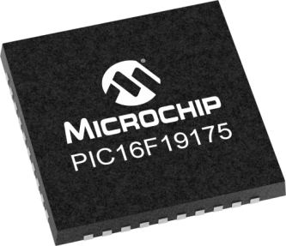

GCBASIC
Like and subscribe!

Slide 4
PIC16F175xx
PIC16165xx is a high performance PIC16
  Digital and analog peripherals for flexible embedded control
  10-bit ADC for accurate analog signal conversion
  Multiple communication interfaces including UART (serial), I²C, and SPI
  PWM modules with CCP and 16-bit resolution for precise timing and motor control
  Configurable Logic Cells (CLCs) for custom hardware-level logic without external components
  Integrated op amps for onboard analog signal conditioning and amplification
The PIC16175xx offers 14, 20, 28, 40 and 44-pin products in small footprint packages to support customers in a wide variety of applications.

Slide 5
Videos...
Install the hardware and make the board work – make LEDs work
Make four LEDs flash in a sequence
Set the LEDs to represent the value of ADC
Sequence the LEDs with a delay using the value of ADC
Using an input to set the state of the LEDs
Using the reset switch
Using the switch, ADC – make the LEDs flash in a sequence with reverse
Using the serial to display values
Using the timer0 overflow, 8bit timer, 16bit timer to flash the LEDs
Using EEProm – showing values on the serial terminal, and more constants insights
Using I2C with serial to discover I2C devices
Using an I2C GCLD display
Using a SPI GCLD display
Using PWM, many ways, to dim the LEDS
Using an external interrupt to control an LED
Using storage within the chip – Progmem, SAF memory, EEPROM and DATA blocks
Using CLC
The GCBASIC tool chain
Assembly , alternatives assemblers and MPLAB-X
Summary

Slide 6
GCBASIC Compiler
GCBASIC Compiler
GCBASIC is an Open Source compiler for PIC and AVR microcontrollers
GCBASIC now supports the 16F175xx chip family

Slide 7
Basic setup and flash the LED
Installed the GCBASIC software
  https://www.youtube.com/watch?v=5yo5poUmnoA
Installed your programmer software
Test that you have the 16F175xx attached

Slide 8
Hardware
Hardware
-------------------PORTA----------------
Bit#: -7---6---5---4---3---2---1---0---
IO: ---------------------------------
----------------------------------------
-------------------PORTB----------------
Bit#: -7---6---5---4---3---2---1---0---
IO: ----------------LED-LED-LED-LED--
----------------------------------------
------------------PORTC-----------------
Bit#: -7---6---5---4---3---2---1---0---
IO: ---------------------------------
----------------------------------------
You must apply correct Voltage
Prototype Board
Power 5v0
Programmer
LEDs & resistors

Slide 9
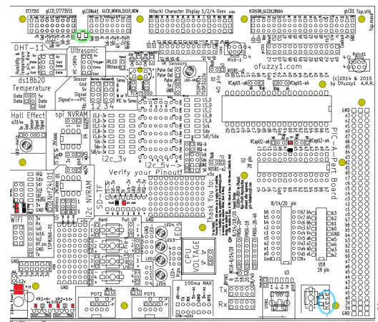

Slide 10
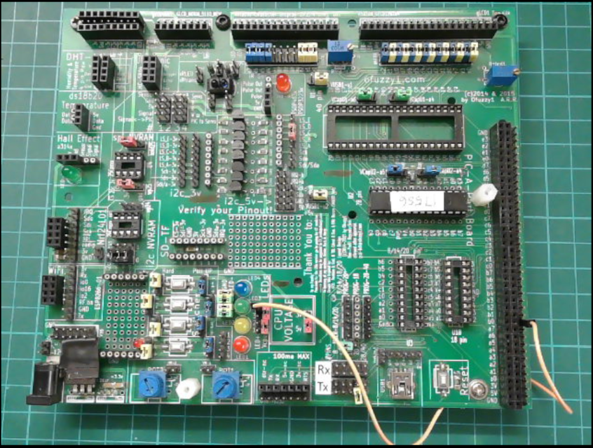

Slide 11
Workshop
C:\GCSTUDIO\GCBASIC\DEMOS\Vendor_Boards\Great_Cow_Basic_Demo_Board\16F175xx_Chiprange_Demonstrations
Blink the LED
  Direct addressing of register
Blink the LED
  Introduce CONSTANTS
    #DEFINE
  GCBASIC commands
    DIR
    WAIT

Slide 13
Videos...
Install the hardware and make the board work – three LED programs
Make four LEDs flash in a sequence
Set the LEDs to represent the value of ADC
Sequence the LEDs with a delay using the value of ADC
Using an input to set the state of the LEDs
Using the reset switch
Using the switch, ADC – make the LEDs flash in a sequence with reverse
Using the serial to display values
Using the timer0 overflow, 8bit timer, 16bit timer to flash the LEDs
Using EEProm – showing values on the serial terminal, and more constants insights
Using I2C with serial to discover I2C devices
Using an I2C GCLD display
Using a SPI GCLD display
Using PWM, many ways, to dim the LEDS
Using an external interrupt to control an LED
Using storage within the chip – Progmem, SAF memory, EEPROM and DATA blocks
Using CLC
The GCBASIC tool chain
Assembly , alternatives assemblers and MPLAB-X
Summary

Slide 14
GCBASIC
GCBASIC for the PIC16F175xx chip Family
November 2025

