Slide 1
GCBASIC
PIC18FxxQ24
Part 4 – sequence the LEDs

Slide 2
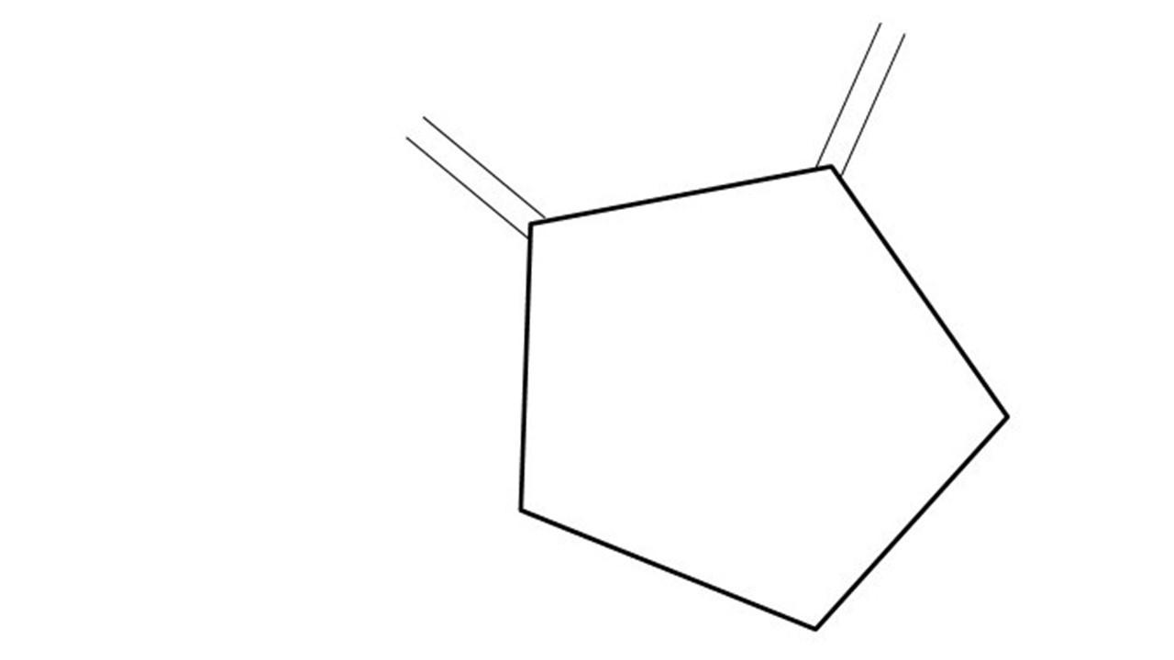
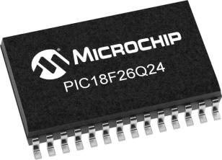
GCBASIC
PIC18FxxQ24
Part 4 – sequence the LEDs

Slide 3
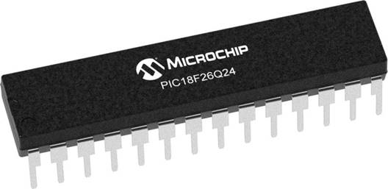
GCBASIC
Like and subscribe!

Slide 4
PIC18FxxQ24
PIC18-Q24 is a high performance PIC18
Digital and Analog peripherals
10-bit ADC
Multiple communication interfaces
Serial, I2C and SPI
PWM – CCP/PWM and 16Bit
Configurable Logic Cells
Multi voltage domains
The PIC18xxQ24 offers 28, 40 and 48-pin products in small footprint packages to support customers in a wide variety of applications.

Slide 5
Videos...
Install the hardware and make the board work – three LED programs
Make four LEDs flash in a sequence
Set the LEDs to represent the value of ADC
Sequence the LEDs with a delay using the value of ADC
Using an input to set the state of the LEDs
Using the reset switch
Using the switch, ADC – make the LEDs flash in a sequence with reverse
Using the serial to display values
Using the timer0 overflow, 8bit timer, 16bit timer to flash the LEDs
Using EEProm – showing values on the serial terminal, and more constants insights
Using I2C with serial to discover I2C devices
Using an I2C GCLD display
Using a SPI GCLD display
Using PWM, 7 ways, to dim the LEDS
Using an external interrupt to control an LED
Using storage within the chip – Progmem, SAF memory, EEPROM and DATA blocks
Using CLC
The GCBASIC tool chain
Assembly , alternatives assemblers and MPLAB-X
Summary

Slide 6
GCBASIC Compiler
GCBASIC Compiler
GCBASIC is an Open Source compiler for PIC and AVR microcontrollers
GCBASIC now supports the 18FxxQ24 chip family

Slide 7
Prerequisites
Assumes you have
Installed the GCBASIC software
Installed your programmer software
Test that you have the 18FxxQ24 attached
You have the 4 LEDs operating
You have a POT connected

Slide 8
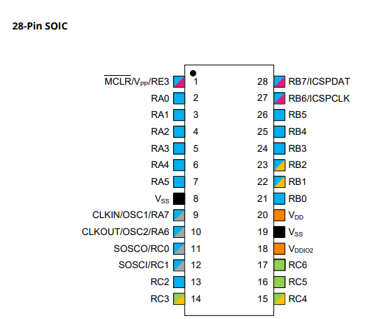
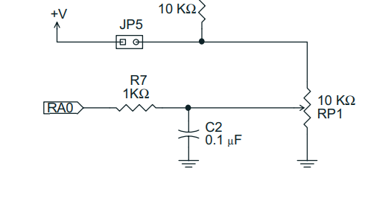
Digital input

Slide 9
Hardware
Hardware
-------------------PORTA----------------
Bit#: -7---6---5---4---3---2---1---0---
IO: ----------------------------ADC--
----------------------------------------
-------------------PORTB----------------
Bit#: -7---6---5---4---3---2---1---0---
IO: ----------------LED-LED-LED-LED--
----------------------------------------
------------------PORTC-----------------
Bit#: -X---6---5---4---3---2---1---0---
IO: -^-------------------------------
-----VDDIO2-----------------------------
You must apply correct Voltage
Prototype Board
Power 5v0
Programmer
LEDs & resistors

Slide 10
Time
The tutoral combines previous tutorials by using the Analog-to-Digital Converter (ADC) to control the speed of rotation.
Where speed is a time delay
us, 10us, ms, 10ms, s, m or h
wait time unit
wait 1 ms

Slide 11
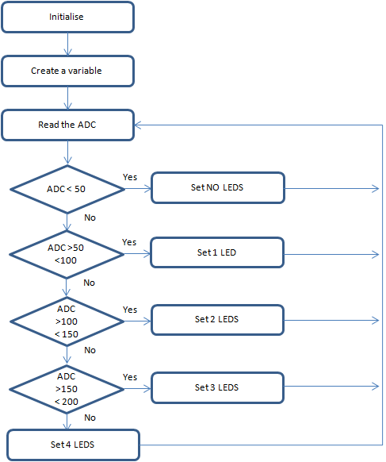
Analog-to-Digital
GCBASIC completes the initialisation
Create a variable to store the ADC results
Read the ADC
GCBASIC makes the process easy via the ReadAD10()
ReadAD10 returns a value of 0 to 1023
Wait for a time period based on returned ADC value
Set the LEDs
Do it again….

Slide 12
Wait
Initialise
Set 1st LED
Read ADC 10 bit
( 0 – 1023 )
Time delays are sometimes key to the operation of a program
Wait for a Delay
Rotate the LEDs
Did it overflow ?
No
Yes
Set 1st LED

Slide 13
Rotate with Carry
 | LEDD3 | LEDD2 | LEDD1 | LEDD0 | CARRY = SREG.0
Start | 1 | 0 | 0 | 0 | 0
Rotate(shift) | 0 | 1 | 0 | 0 | 0
Rotate(shift) | 0 | 0 | 1 | 0 | 0
Rotate(shift) | 0 | 0 | 0 | 1 | 0
Rotate(shift) | 0 | 0 | 0 | 0 | 1
Restart | 1 | 0 | 0 | 0 | 0
Rotate(shift) | 0 | 1 | 0 | 0 | 0

Slide 14
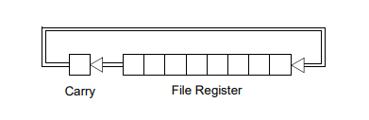
Rotate with Carry
 | LEDD4 = C.4 | LEDD2 | LEDD1 | LEDD0 | CARRY = SREG.0
Start | 1 | 0 | 0 | 0 | 0
Rotate(shift) | 0 | 1 | 0 | 0 | 0
Rotate(shift) | 0 | 0 | 1 | 0 | 0
Rotate(shift) | 0 | 0 | 0 | 1 | 0
Rotate(shift) | 0 | 0 | 0 | 0 | 1
Restart | 1 | 0 | 0 | 0 | 0
Rotate(shift) | 0 | 1 | 0 | 0 | 0

Slide 15
Rotate with Carry
 | LEDD4 = C.4 | LEDD2 | LEDD1 | LEDD0 | CARRY = SREG.0
Start | 1 | 0 | 0 | 0 | 0
Rotate(shift) | 0 | 1 | 0 | 0 | 0
Rotate(shift) | 0 | 0 | 1 | 0 | 0
Rotate(shift) | 0 | 0 | 0 | 1 | 0
Rotate(shift) | 0 | 0 | 0 | 0 | 1
Restart | 1 | 0 | 0 | 0 | 0
Rotate(shift) | 0 | 1 | 0 | 0 | 0

Slide 16
Rotate with Carry
 | LEDD4 = C.4 | LEDD2 | LEDD1 | LEDD0 | CARRY = SREG.0
Start | 1 | 0 | 0 | 0 | 0
Rotate(shift) | 0 | 1 | 0 | 0 | 0
Rotate(shift) | 0 | 0 | 1 | 0 | 0
Rotate(shift) | 0 | 0 | 0 | 1 | 0
Rotate(shift) | 0 | 0 | 0 | 0 | 1
Restart | 1 | 0 | 0 | 0 | 0
Rotate(shift) | 0 | 1 | 0 | 0 | 0

Slide 17
Rotate with Carry
 | LEDD4 = C.4 | LEDD2 | LEDD1 | LEDD0 | CARRY = SREG.0
Start | 1 | 0 | 0 | 0 | 0
Rotate(shift) | 0 | 1 | 0 | 0 | 0
Rotate(shift) | 0 | 0 | 1 | 0 | 0
Rotate(shift) | 0 | 0 | 0 | 1 | 0
Rotate(shift) | 0 | 0 | 0 | 0 | 1
Restart | 1 | 0 | 0 | 0 | 0
Rotate(shift) | 0 | 1 | 0 | 0 | 0

Slide 18
Rotate with Carry
 | LEDD4 = C.4 | LEDD2 | LEDD1 | LEDD0 | CARRY = SREG.0
Start | 1 | 0 | 0 | 0 | 0
Rotate(shift) | 0 | 1 | 0 | 0 | 0
Rotate(shift) | 0 | 0 | 1 | 0 | 0
Rotate(shift) | 0 | 0 | 0 | 1 | 0
Rotate(shift) | 0 | 0 | 0 | 0 | 1
Restart | 1 | 0 | 0 | 0 | 0
Rotate(shift) | 0 | 1 | 0 | 0 | 0

Slide 19
Rotate with Carry
 | LEDD4 = C.4 | LEDD2 | LEDD1 | LEDD0 | CARRY = SREG.0
Start | 1 | 0 | 0 | 0 | 0
Rotate(shift) | 0 | 1 | 0 | 0 | 0
Rotate(shift) | 0 | 0 | 1 | 0 | 0
Rotate(shift) | 0 | 0 | 0 | 1 | 0
Rotate(shift) | 0 | 0 | 0 | 0 | 1
Restart | 1 | 0 | 0 | 0 | 0
Rotate(shift) | 0 | 1 | 0 | 0 | 0

Slide 20
Carry Test
Initialise
Set 1st LED
Read ADC 10 bit
( 0 – 1023 )
Did it overflow ?
If C = 1 then .. Or other test condition
Wait for a Delay
Rotate the LEDs
Did it overflow ?
No
Yes
Set 1st LED

Slide 21
Scale
Initialise
Set 1st LED
Read ADC
Scale transforms an existing value to a new value within a specified scale
Wait for a Delay
Scale()
Rotate the LEDs
Did it overflow ?
No
Yes
Set 1st LED

Slide 22
Workshop
Read the ADC to set the LEDs
Uses
A Byte variable
Simple logic

Slide 24
Videos...
Install the hardware and make the board work – three LED programs
Make four LEDs flash in a sequence
Set the LEDs to represent the value of ADC
Sequence the LEDs with a delay using the value of ADC
Using an input to set the state of the LEDs
Using the reset switch
Using the switch, ADC – make the LEDs flash in a sequence with reverse
Using the serial to display values
Using the timer0 overflow, 8bit timer, 16bit timer to flash the LEDs
Using EEProm – showing values on the serial terminal, and more constants insights
Using I2C with serial to discover I2C devices
Using an I2C GCLD display
Using a SPI GCLD display
Using PWM, 7 ways, to dim the LEDS
Using an external interrupt to control an LED
Using storage within the chip – Progmem, SAF memory, EEPROM and DATA blocks
Using CLC
The GCBASIC tool chain
Assembly , alternatives assemblers and MPLAB-X
Summary

Slide 25
GCBASIC
PIC18FxxQ24
Part 4 – sequence the LEDs

Slide 26
