Slide 1
GCBASIC
PIC18FxxQ24
Part 5 – a switch sets the LEDs state

Slide 2
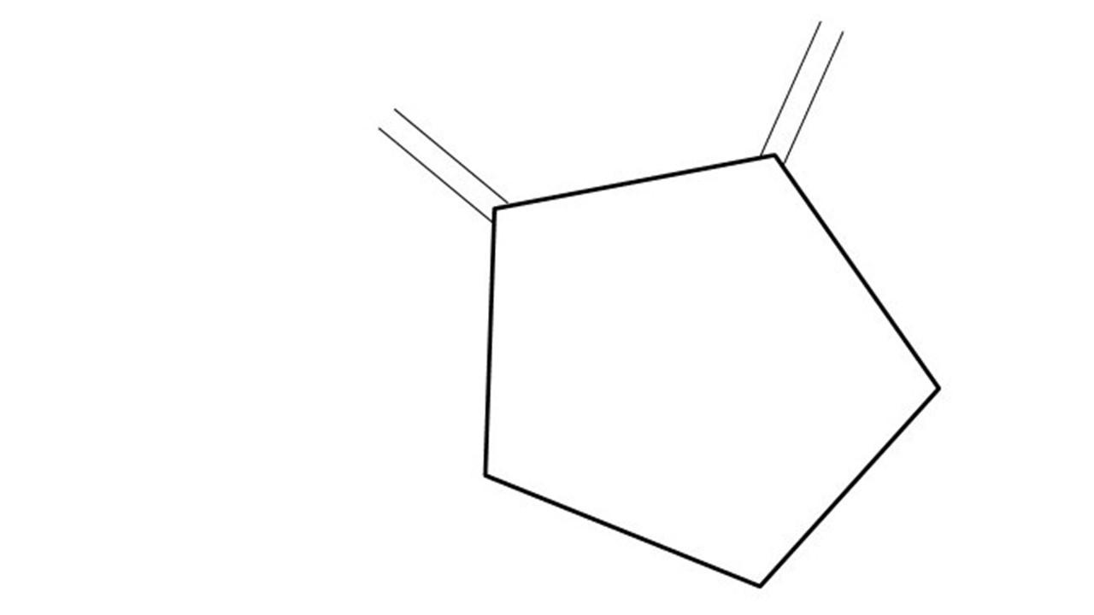

GCBASIC
PIC18FxxQ24
Part 5 – a switch sets the LEDs state

Slide 3
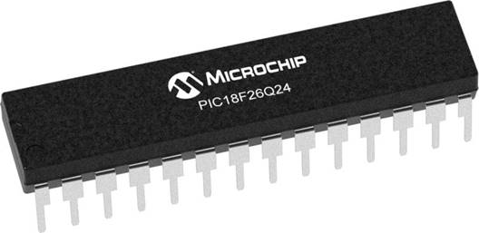
GCBASIC
Like and subscribe!

Slide 4
PIC18FxxQ24
PIC18-Q24 is a high performance PIC18
Digital and Analog peripherals
10-bit ADC
Multiple communication interfaces
Serial, I2C and SPI
PWM – CCP/PWM and 16Bit
Configurable Logic Cells
Multi voltage domains
The PIC18xxQ24 offers 28, 40 and 48-pin products in small footprint packages to support customers in a wide variety of applications.

Slide 5
Videos...
Install the hardware and make the board work – three LED programs
Make four LEDs flash in a sequence
Set the LEDs to represent the value of ADC
Sequence the LEDs with a delay using the value of ADC
Using an input to set the state of the LEDs
Using the reset switch
Using the switch, ADC – make the LEDs flash in a sequence with reverse
Using the serial to display values
Using the timer0 overflow, 8bit timer, 16bit timer to flash the LEDs
Using EEProm – showing values on the serial terminal, and more constants insights
Using I2C with serial to discover I2C devices
Using an I2C GCLD display
Using a SPI GCLD display
Using PWM, 7 ways, to dim the LEDS
Using an external interrupt to control an LED
Using storage within the chip – Progmem, SAF memory, EEPROM and DATA blocks
Using CLC
The GCBASIC tool chain
Assembly , alternatives assemblers and MPLAB-X
Summary

Slide 6
GCBASIC Compiler
GCBASIC Compiler
GCBASIC is an Open Source compiler for PIC and AVR microcontrollers
GCBASIC now supports the 18FxxQ24 chip family

Slide 7
Prerequisites
Assumes you have
Installed the GCBASIC software
Installed your programmer software
Test that you have the 18FxxQ24 attached
You have the 4 LEDs operating
You have a POT connected
You have a SWITCH connected

Slide 8
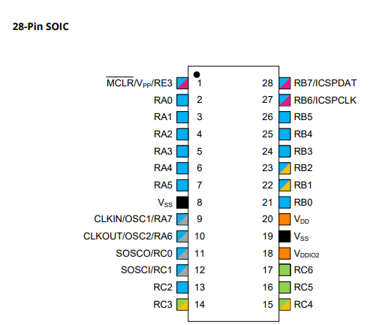
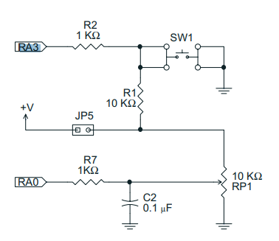
Digital input
Switch

Slide 9
Hardware
Hardware
-------------------PORTA----------------
Bit#: -7---6---5---4---3---2---1---0---
IO: ----------------SW----------ADC--
----------------------------------------
-------------------PORTB----------------
Bit#: -7---6---5---4---3---2---1---0---
IO: ----------------LED-LED-LED-LED--
----------------------------------------
------------------PORTC-----------------
Bit#: -X---6---5---4---3---2---1---0---
IO: -^-------------------------------
-----VDDIO2-----------------------------
You must apply correct Voltage
Prototype Board
Power 5v0
Programmer
LEDs & resistors
Switch & resistors

Slide 10
Tutorial overview
Initialise
Set LEDs off
Keypressed = TRUE
Initialise microcontroller
Check the switch
If pushed then toggle LED
If not pushed then do it again
Checking the switch by using function to inspect the switch state
Repeat
Yes
No
Toggle LEDs
Loop

Slide 11
Lab
Review GCSTUDIO options
Examine the sample code
Review the results

Slide 13
// Function to debounce a switch and return the stable state
Function DebounceSwitch as Bit
// Define variables
Dim CurrentState As Bit
Dim LastState As Bit
Dim StableState As Bit
Dim Counter As Byte
// Initialize states and counter
LastState = SWITCHIN
StableState = LastState
Counter = 0
// Debounce loop: checks the state multiple times to ensure stability
For Counter = 0 To 10
wait 5 ms // Small delay to allow switch to settle
// Read the current state of the switch
CurrentState = SWITCHIN
// If the state is stable (consistent for the duration of the loop)
If (CurrentState = LastState) Then
StableState = CurrentState
Else
// Reset counter if state changes
Counter = 0
LastState = CurrentState
End If
Next
// Return the stable state of the switch
DebounceSwitch = StableState
End Function
Explanation:
Variable Definition:
CurrentState, LastState, and StableState are declared as Bit to store the current, previous, and stable states of the switch.
Counter is declared as Byte to act as a loop counter.
Initialization:
LastState is initialized to the current state of the switch (SWITCHIN).
StableState is initialized to LastState.
Counter is initialized to 0.
Debounce Loop:
The loop runs 10 times, checking the switch state every 5 milliseconds.
CurrentState is updated with the current state of the switch (SWITCHIN).
If the CurrentState matches the LastState consistently for the duration of the loop, StableState is set to CurrentState.
If the state changes, the counter is reset, and LastState is updated with CurrentState.
Return Stable State:
The function returns the StableState of the switch, which has been debounced.
This function ensures that the state of the switch is stable before returning it, effectively debouncing the switch. If you have any further questions or need more details, feel free to let me know! 😊✨

Slide 14
Videos...
Install the hardware and make the board work – three LED programs
Make four LEDs flash in a sequence
Set the LEDs to represent the value of ADC
Sequence the LEDs with a delay using the value of ADC
Using an input to set the state of the LEDs
Using the reset switch
Using the switch, ADC – make the LEDs flash in a sequence with reverse
Using the serial to display values
Using the timer0 overflow, 8bit timer, 16bit timer to flash the LEDs
Using EEProm – showing values on the serial terminal, and more constants insights
Using I2C with serial to discover I2C devices
Using an I2C GCLD display
Using a SPI GCLD display
Using PWM, 7 ways, to dim the LEDS
Using an external interrupt to control an LED
Using storage within the chip – Progmem, SAF memory, EEPROM and DATA blocks
Using CLC
The GCBASIC tool chain
Assembly , alternatives assemblers and MPLAB-X
Summary

Slide 15
GCBASIC
PIC18FxxQ24
Part 5 – a switch sets the LEDs state

Slide 16
// Function to debounce a switch and return the stable state
Function DebounceSwitch as Bit
// Define variables
Dim CurrentState As Bit
Dim LastState As Bit
Dim StableState As Bit
Dim Counter As Byte
// Initialize states and counter
LastState = SWITCHIN
StableState = LastState
Counter = 0
// Debounce loop: checks the state multiple times to ensure stability
For Counter = 0 To 10
wait 5 ms // Small delay to allow switch to settle
// Read the current state of the switch
CurrentState = SWITCHIN
// If the state is stable (consistent for the duration of the loop)
If (CurrentState = LastState) Then
StableState = CurrentState
Else
// Reset counter if state changes
Counter = 0
LastState = CurrentState
End If
Next
// Return the stable state of the switch
DebounceSwitch = StableState
End Function
Explanation:
Variable Definition:
CurrentState, LastState, and StableState are declared as Bit to store the current, previous, and stable states of the switch.
Counter is declared as Byte to act as a loop counter.
Initialization:
LastState is initialized to the current state of the switch (SWITCHIN).
StableState is initialized to LastState.
Counter is initialized to 0.
Debounce Loop:
The loop runs 10 times, checking the switch state every 5 milliseconds.
CurrentState is updated with the current state of the switch (SWITCHIN).
If the CurrentState matches the LastState consistently for the duration of the loop, StableState is set to CurrentState.
If the state changes, the counter is reset, and LastState is updated with CurrentState.
Return Stable State:
The function returns the StableState of the switch, which has been debounced.
This function ensures that the state of the switch is stable before returning it, effectively debouncing the switch. If you have any further questions or need more details, feel free to let me know! 😊✨
CoPilot AI Generated

