Slide 1

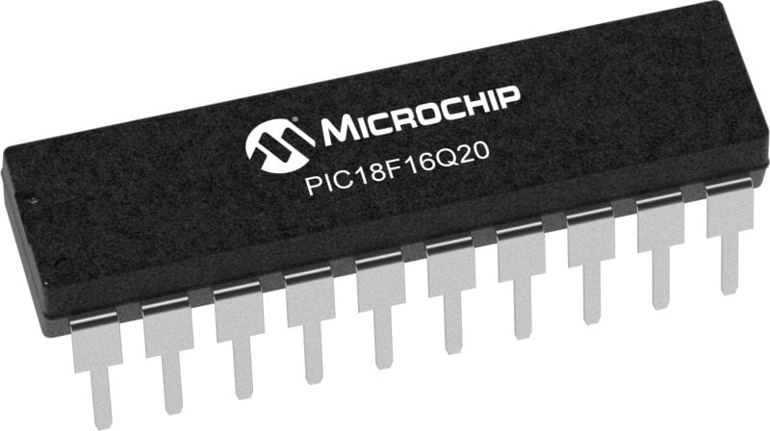
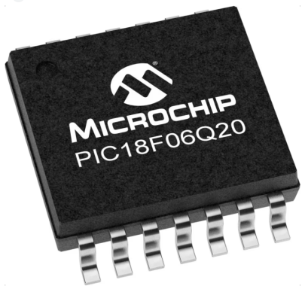
GCBASIC Part 10
GCBASIC for the PIC18FxxQ20 chip Family
October 2024
More … EEPROM operations

Slide 2
Videos...
Install the hardware and make the board work – three LED programs
Make four LEDs flash in a sequence
Set the LEDs to represent the value of ADC
Sequence the LEDs with a delay using the value of ADC
Using an input to set the state of the LEDs
Using the reset switch
Using the switch, ADC – make the LEDs flash in a sequence with reverse
Using the serial to display values
Using the timer0 overflow, 8bit timer, 16bit timer to flash the LEDs
Using EEProm – showing values on the serial terminal, and more constants insights
Using I2C with serial to discover I2C devices
Using an I2C GCLD display
Using a SPI GCLD display
Using PWM, 6 ways, to dim the LEDS
Using an external interrupt to sequence the LEDs
Using memory within the PIC – Progmem and SAF memory
Using CLC
The GCBASIC tool chain
Assembly , alternatives assemblers and MPLAB-X
Summary

Slide 3
PIC18FxxQ20
PIC18-Q20 is a high performance PIC18
Digital and Analog peripherals
10-bit ADC
Multiple communication interfaces
Serial, I2C, SPI, I3C
PWM – CCP/PWM and 16Bit
Configurable Logic Cells
Multi voltage domains
The PIC18xxQ20 offers 14 and 20 pin products in small footprint packages to support customers in a variety of space constrained and sensor node applications.

Slide 4
GCBASIC Toolchain
GCBASIC is an Open Source compiler for PIC, AVR and LGT microcontrollers
GCBASIC now supports the 18FxxQ20 chip family
GCBASIC simplifies the use of EEPROM
GCBASIC
Toolchain

Slide 5
Hardware
Prototype Board
Power 5v0
Programmer
Serial Port
LEDs & resistors
Potentiometer
Switch
Hardware
-------------------PORTA---------------- Bit#: -7---6---5---4---3---2---1---0--- IO: -----------------SW---------ADC-- ----------------------------------------- -------------------PORTB---------------- Bit#: -7---6---5---4---3---2---1---0--- IO: TX-------------------------------- ----------------------------------------- ------------------PORTC----------------- Bit#: -7---6---5---4---3---2---1---0--- IO: LED-LED-LED-LED------------------ -----------------------------------------

Slide 6
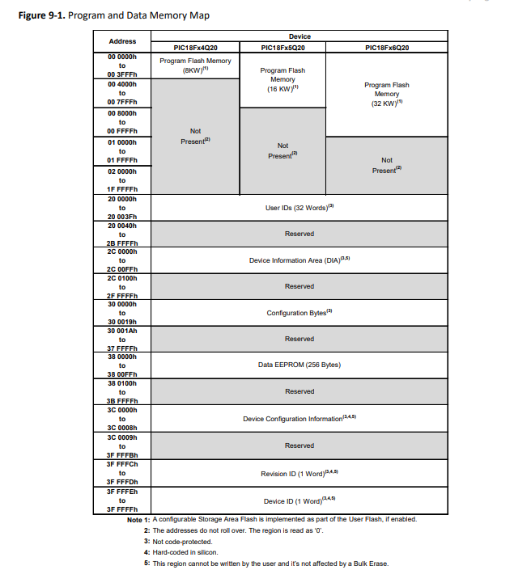
Memory
64 KB of Program Flash Memory
4 KB of Data SRAM Memory
256 Bytes Data EEPROM
Memory Access Partition, the Program Flash Memory Can Be Partitioned into:
– Application Block
– Boot Block
– Storage Area Flash (SAF) Block

Slide 7
EEPROM
Electrically Erasable Programmable Read-Only Memory
Non-volatile memory to store relatively small amounts of data but allowing individual bytes to be erased and reprogrammed.

Slide 8
EEProm
Type Value Explanation
Prog 32768 Prog is exposed as ChipWORDS
SAFMemWords 128 SAFMemWords exposed ChipSAFMemWords
EEPROM 256 EEPROM is exposed as ChipEEPROM
RAM 4096 RAM is exposed as ChipRAM

Slide 9
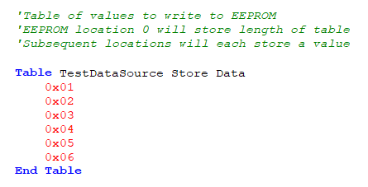
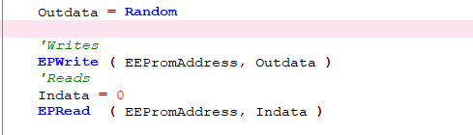
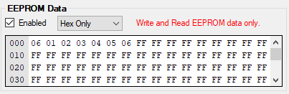
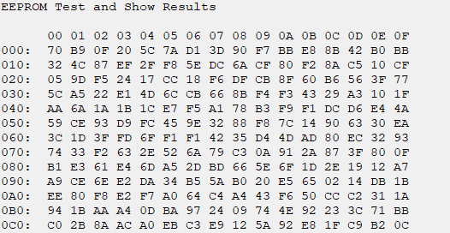
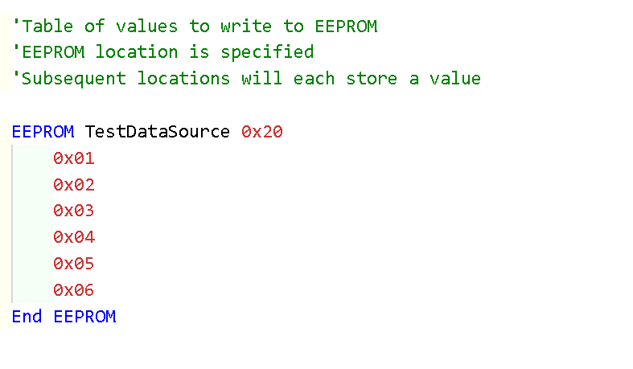
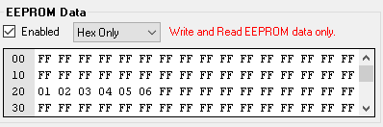
EEProm – 4 ways

Slide 10
Lab
Sample code – write and read via terminal
Using PPS select the serial USART port
Write values to EEProm
Read values to EEProm
See the results on terminal
Sample code – write with read via programmer
Write values to EEProm
See the results within PICKitPlus

Slide 12
Videos...
Install the hardware and make the board work – three LED programs
Make four LEDs flash in a sequence
Set the LEDs to represent the value of ADC
Sequence the LEDs with a delay using the value of ADC
Using an input to set the state of the LEDs
Using the reset switch
Using the switch, ADC – the LEDs flash in a sequence with reverse
Using the serial to display values
Using the timer0 overflow, 8bit timer, 16bit timer to flash the LEDs
Using EEProm – showing values on the serial terminal, and more constants insights
Using I2C with serial to discover I2C devices
Using an I2C GCLD display
Using a SPI GCLD display
Using PWM, 6 ways, to dim the LEDS
Using an external interrupt to sequence the LEDs
Using memory within the PIC – Progmem and SAF memory
Using CLC
The GCBASIC tool chain
Assembly , alternatives assemblers and MPLAB-X
Summary

Slide 13
GCBASIC Part 10
GCBASIC for the PIC18FxxQ20 chip Family
February 2024

Slide 15
Backup Slides

Slide 16
EEProm

