Slide 1
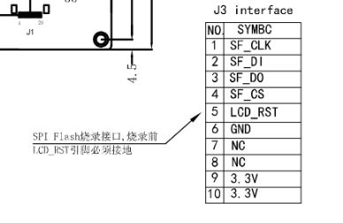
P1 Interface
J3 Interface
SPI FLASH
LCD_RST

