Slide 1
GCBASIC
ADL200 Power Solution

Slide 2
Power Monitoring with ADL200

Slide 3
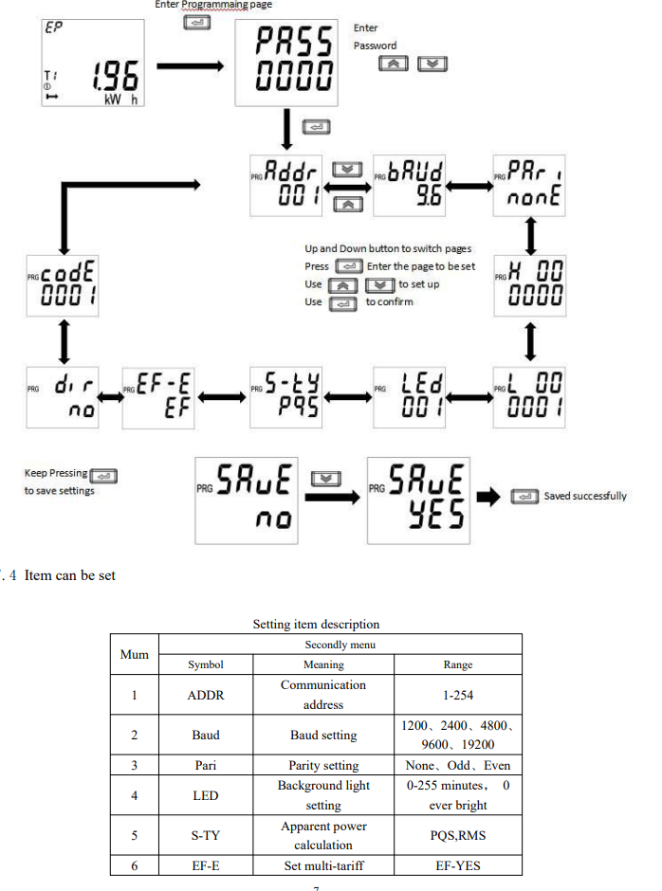

CLrE
Num

