Slide 1
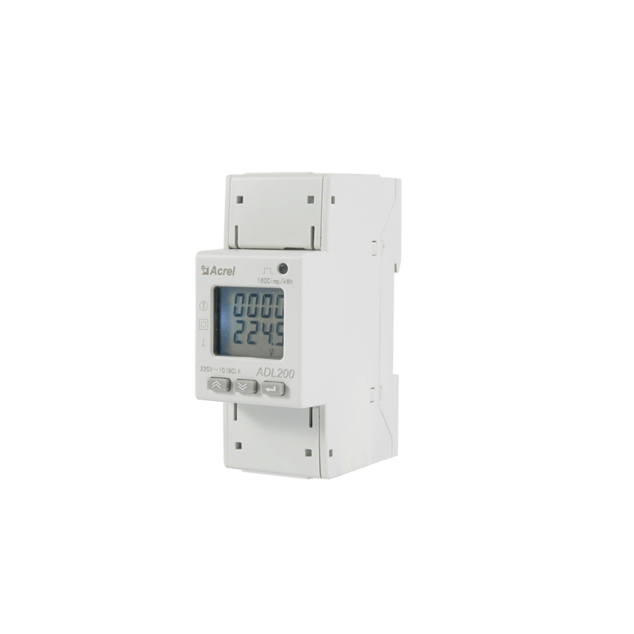
GCBASIC
ADL200 Power Monitoring

Slide 2
Caveat
Danger
  This equipment uses power lines, high risk of electric shock
Safety
  Work with a qualified electrical engineer
Warning
  Do not replicate my bench setup; use proper housing

Slide 3
Safety
Electrical Safety
  Ensure proper insulation when connecting ADL200 to power lines
Voltage Limits
  Verify ATmega328PB and GLCD operate within 5V supply
Modbus Config
  Incorrect settings may cause data display errors or communication failure
Testings
  Always test in a controlled environment to avoid equipment damage

Slide 4
Project Overview
Purpose: Reads and displays power metrics
  Voltage
  Current
  Frequency
Platform: ATmega328PB microcontroller (16 MHz, like Arduino Nano)
Program: Written in GCBASIC

Slide 5
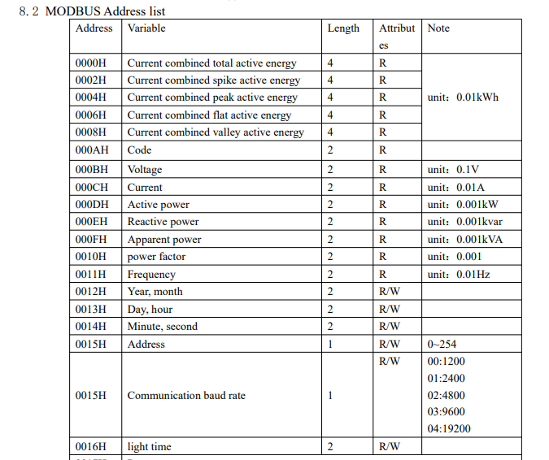
Metrics

Slide 7
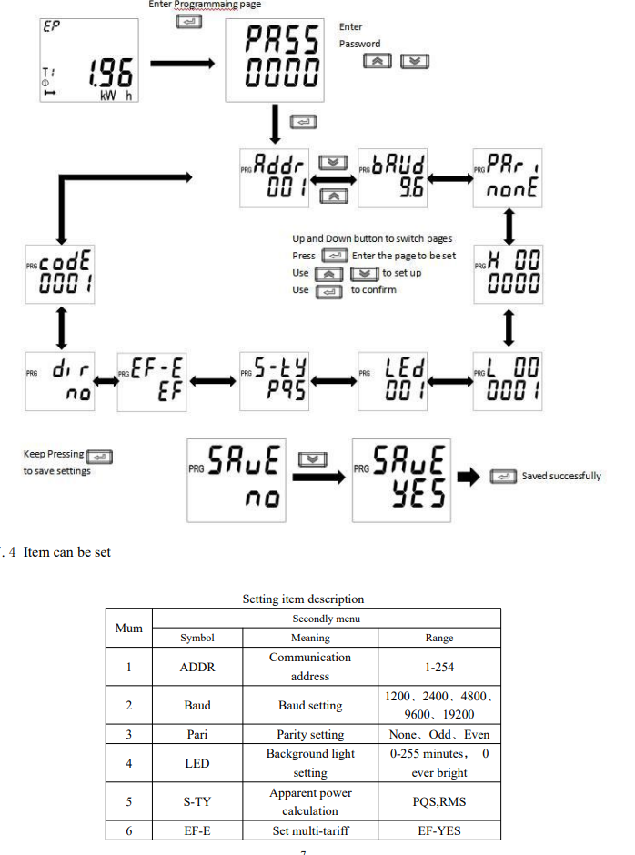

CLrE
Num

Slide 8
Hardware Components
ADL200 Energy Meter: Tracks power metrics
ILI9488 GLCD: Colorful display for data
ATmega328PB: Core microcontroller for processing

Slide 9
Data Display
Output: Metrics shown on GLCD
Format: Two decimal places (e.g., 235.20 V, 50.10 Hz)
Real-Time: Continuous monitoring dashboard

Slide 10
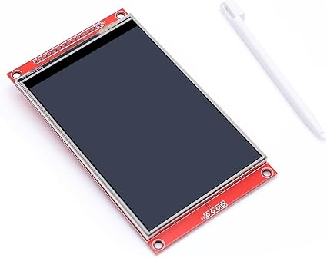
Communication
Protocol: Modbus RTU over serial
Data Handling: Ring buffer for incoming data
Processing: State machine for efficient data management

Slide 11
Debugging
Feature: Software serial for debug output
Benefit: Simplifies troubleshooting and development

Slide 12
Key Files
Scripts: https://github.com/GreatCowBASIC/Power-Monitoring/tree/master/GCBASIC
Headers: ADL200.h, MODBus.h
Docs: Setup guide, adding new values

Slide 13
Getting Started
Steps: Install GCBASIC compiler, connect ADL200 and GLCD, upload 040_mega328pb_ADL200.gcb
Guide: See 2. Getting_started.md

Slide 14
Extending the Project
Add Values: Modify 040_mega328pb_ADL200.gcb
Guide: 3. Howto_add_new_value_040_mega328pb_ADL200.adoc
Features: Add new metrics, update Modbus mappings, adjust GLCD

Slide 15
Architecture
MCU
Request
ADL200
USART
TX
RX
TTL/RS485
adapter
A
B
RS232
RS485
Response

Slide 16
Demonstration

Slide 17
Summary
Outcome: Real-time energy monitoring dashboard
Key Features: Modbus RTU, GLCD display, debug support
Next Steps: Set up hardware, compile code, monitor power!

Slide 18
GCBASIC
ADL200 Power Monitoring

