Slide 1
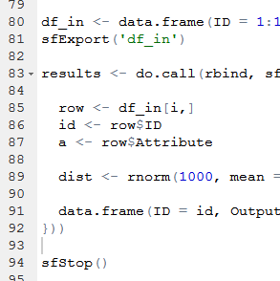

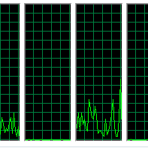

An introduction to parallel programming with R
Benjamin Brede, 2017-05-17

Slide 2
Overview
Functional programming
Implementation PP
Tips

Slide 3
Parallel computation – Requirements
computer with multiple cores
mostly the case today
software that can make use of the cores
R parallel packages
task that benefits from parallising
repeated tasks (e.g. cross-validation)
programmer that can make use of infrastructure
development efficiency!!!

Slide 4
FP – why bother?
x <- 1:10
y <- numeric()
for (i in 1:10)
y <- c(y, x[i] + 1)
x <- 1:10
foo <- function(x) {
x + 1
}
y <- sapply(x, foo)
Processes do not access global variables +
no side-effects
> prevent conflicts

Slide 5
FP – The basics
Functions as objects (with name, class, value)
Lambda = unnamed functions
Immutable state (not strictly implemented in R)
Higher order functions = functions that accept functions as arguments
Basic FP operations
Map ~ apply family
Reduce (special case: filter ~ subset)
Demo: FP

Slide 6
FP – Divide et impera
Parallel programming requires to split work over workers.
Define atomic operations in workflow
Balancing tasks?
Summarize results into 1 output object
know what (type) you aim at
initial
collection
independent
workers
modified (mapped)
collection

Slide 7
Implementation
explicit parallelism
snow & snowfall
foreach
parallel
“implicit” parallelism
caret
CRAN Task View High-Performance and Parallel Computing with R: https://cran.r-project.org/web/views/HighPerformanceComputing.html
Demo: PP

Slide 8
Tips – FP
write down function types (types in/out)
know variable types (and the differences)
know possible target type for collections
vector = same type elements
list = most generic collection
data.frame = handy for analysis (statistics, plotting)
FP MOOC
Functional Programming Principles in Scala: https://www.coursera.org/learn/progfun1
Specialisation (Scala, FP, PP, Big Data): https://www.coursera.org/specializations/scala

Slide 9
Tips – PP
learn package specific behaviour
how do workers share variables?
package for Linux/Windows?
monitor the process
CPU and RAM
killing processes/keeping control
Windows: Task Manager
Linux: top/htop

Slide 10
Tips – PP
bottleneck I/O
more cores not always better
overhead management
unbalanced tasks
I/O
test single cases for loops

