Slide 1
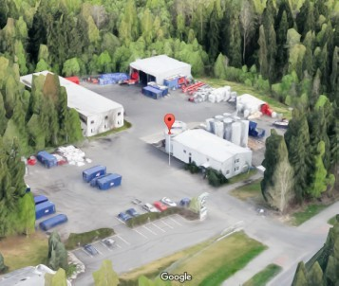
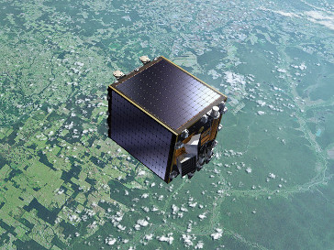

Fuzzy land cover classification method assessment using PROBA-V satellite data
Dainius Masiliūnas
Master thesis colloquium presentation
Supervisors:
Dr Jan Verbesselt
Dr Nandin-Erdene Tsendbazar
Wageningen, 2017

Slide 2
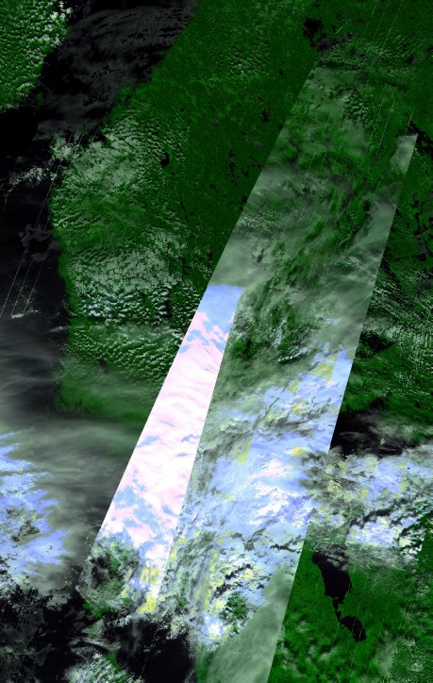
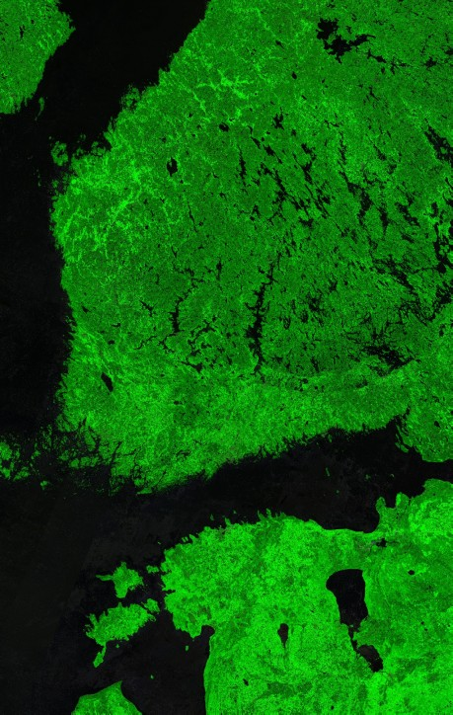
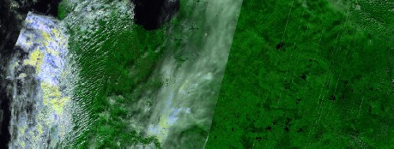
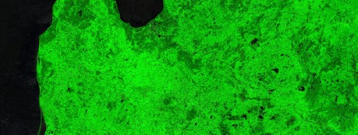
Introduction
Global land cover (GLC) classification maps: used by climate models, carbon sequestration and deforestation monitoring etc.
Problem: existing GLC maps have limited accuracy, spatial and temporal resolution, lots of mosaic classes
Solution: fuzzy GLC using PROBA-V data
  2-day revisit time, 100 m spatial resolution
  Area of interest is the gradient between coniferous and deciduous forests and includes a lot of wetlands
Notes:
At the moment, land cover classification is one of the most common applications of remote sensing. Global land cover maps are used in climate models, for carbon sequestration and deforestation monitoring, and even for predicting air quality. However, the existing global land cover maps have limited accuracy, spatial and temporal resolution, and involves a lot of mosaic classes for expressing mixed pixels.

Slide 3
Introduction
Global land cover (GLC) classification maps: used by climate models, carbon sequestration and deforestation monitoring etc.
Problem: existing GLC maps have limited accuracy, spatial and temporal resolution, lots of mosaic classes
Solution: fuzzy GLC using PROBA-V data
  2-day revisit time, 100 m spatial resolution
  Area of interest is the gradient between coniferous and deciduous forests and includes a lot of wetlands
Notes:
One possible solution to these issues is to make use of data from the PROBA-V satellite and perform fuzzy, rather than hard, land cover classification. PROBA-V has a 2-day revisit time and provides 100 m resolution imagery, which is useful for time series analysis.
In my thesis work I focused on the area between the middle of Finland, known for its evergreen forests, and the middle of Lithuania, known for its deciduous and mixed forests, so that I could see whether fuzzy classification can predict mixed forests well. This area also has a large number of protected wetlands, which are important to monitor.

Slide 4
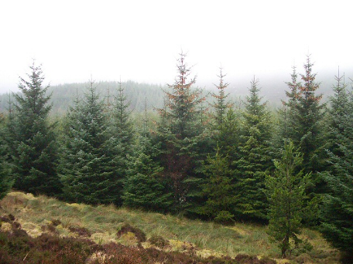
Introduction
Global land cover (GLC) classification maps: used by climate models, carbon sequestration and deforestation monitoring etc.
Problem: existing GLC maps have limited accuracy, spatial and temporal resolution, lots of mosaic classes
Solution: fuzzy GLC using PROBA-V data
  2-day revisit time, 100 m spatial resolution
  Area of interest is the gradient between coniferous and deciduous forests and includes a lot of wetlands

Slide 5
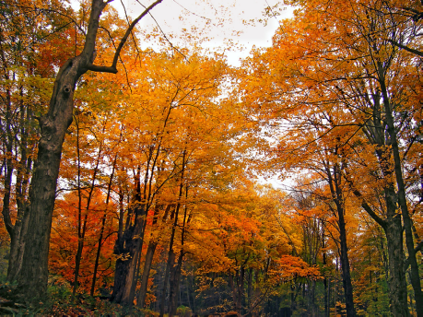
Introduction
Global land cover (GLC) classification maps: used by climate models, carbon sequestration and deforestation monitoring etc.
Problem: existing GLC maps have limited accuracy, spatial and temporal resolution, lots of mosaic classes
Solution: fuzzy GLC using PROBA-V data
  2-day revisit time, 100 m spatial resolution
  Area of interest is the gradient between coniferous and deciduous forests and includes a lot of wetlands

Slide 6
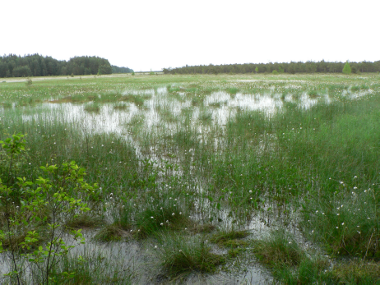
Introduction
Global land cover (GLC) classification maps: used by climate models, carbon sequestration and deforestation monitoring etc.
Problem: existing GLC maps have limited accuracy, spatial and temporal resolution, lots of mosaic classes
Solution: fuzzy GLC using PROBA-V data
  2-day revisit time, 100 m spatial resolution
  Area of interest is the gradient between coniferous and deciduous forests and includes a lot of wetlands

Slide 7
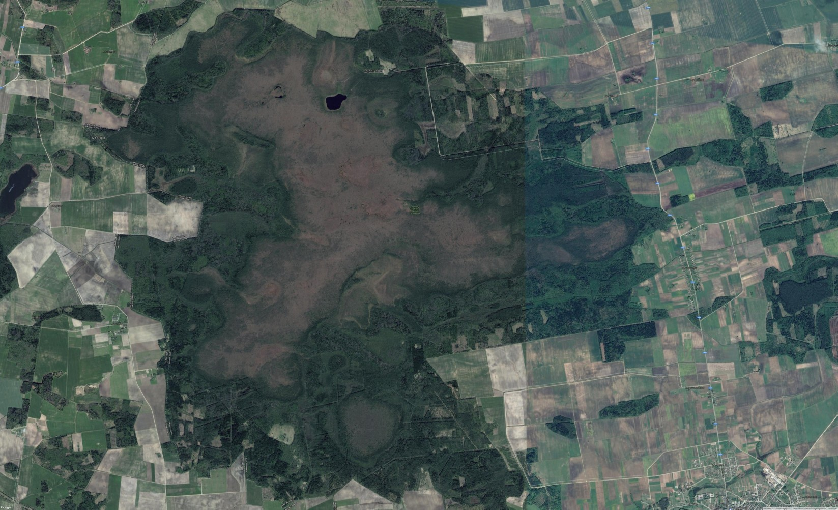
Hard vs fuzzy classification
N
1
0
1
2
3
4 km
Notes:
To better illustrate the difference between fuzzy and hard classification, in this example you can see a true colour image of Kamanos, one of the largest wetlands in Lithuania.

Slide 8
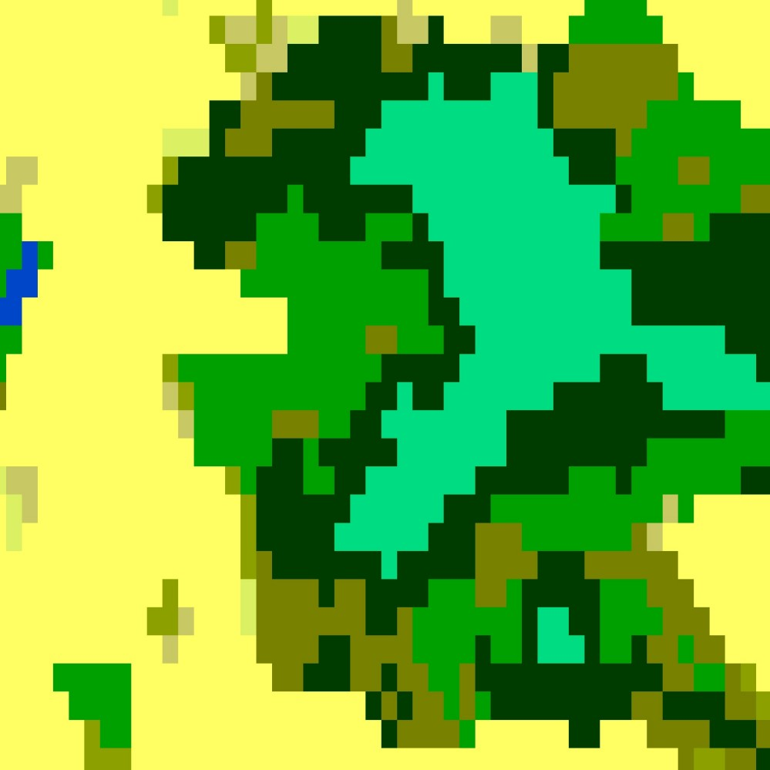
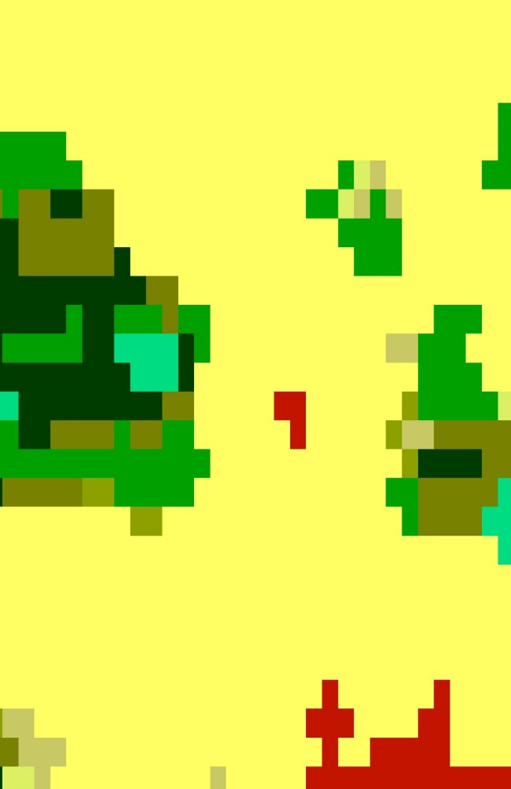
Hard vs fuzzy classification
N
ESA LC-CCI 2010
Cropland rainfed
Mosaic natural vegetation
(tree/shrub/herbaceous cover) (>50%)
/ cropland (<50%)
Tree cover broadleaved deciduous
closed to open (>15%)
Tree cover needleleaved evergreen
closed to open (>15%)
Tree cover mixed leaf type
(broadleaved and needleleaved)
Mosaic tree and shrub (>50%)
/ herbaceous cover (<50%)
Shrub or herbaceous cover ﬂooded
fresh/saline/brakish water
1
0
1
2
3
4 km
Urban areas
Water bodies
Notes:
Here is what the Climate Change Initiative hard land cover classification of it looks like. Teal is wetland, yellow is crops, dark green is evergreen trees, light green is deciduous trees, and shades of brown represent various mosaic classes that indicate mixed land cover. It’s a nice schematic representation of reality, but it has sharp transitions between classes and doesn’t capture the heterogeneity of the real land cover.

Slide 9
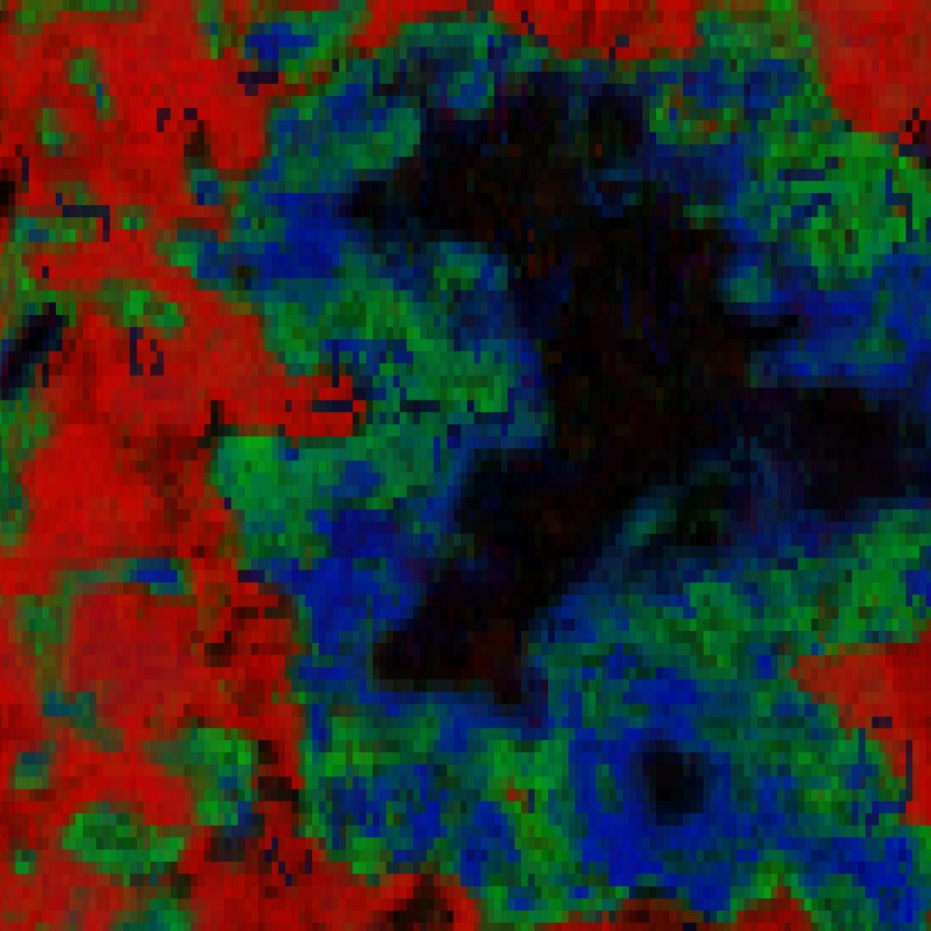
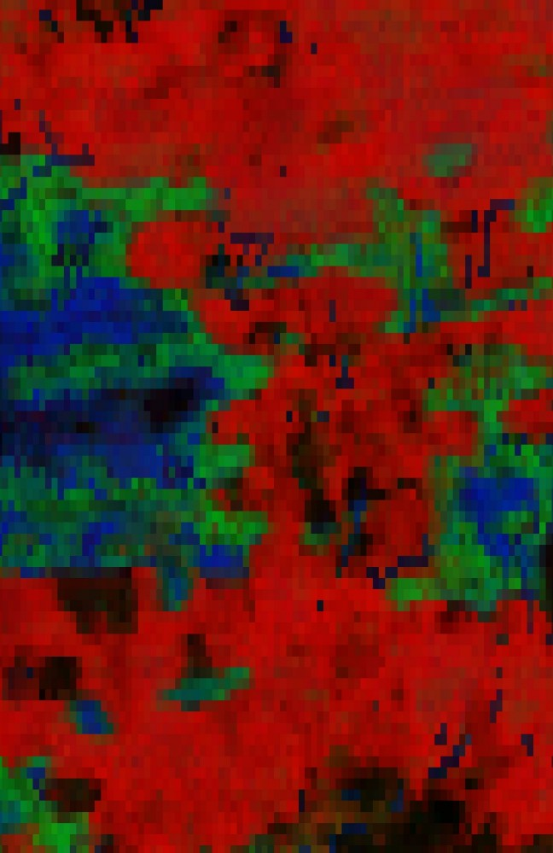
Hard vs fuzzy classification
N
Random forest prediction
Cultivated land
1
0
1
2
3
4 km
Deciduous trees
Evergreen trees
Notes:
This is how one of my fuzzy classification results looks like. It shows the proportions of crops in red, deciduous trees in green and evergreen trees in blue. You can see smooth transitions between classes and how exactly they mix.

Slide 10
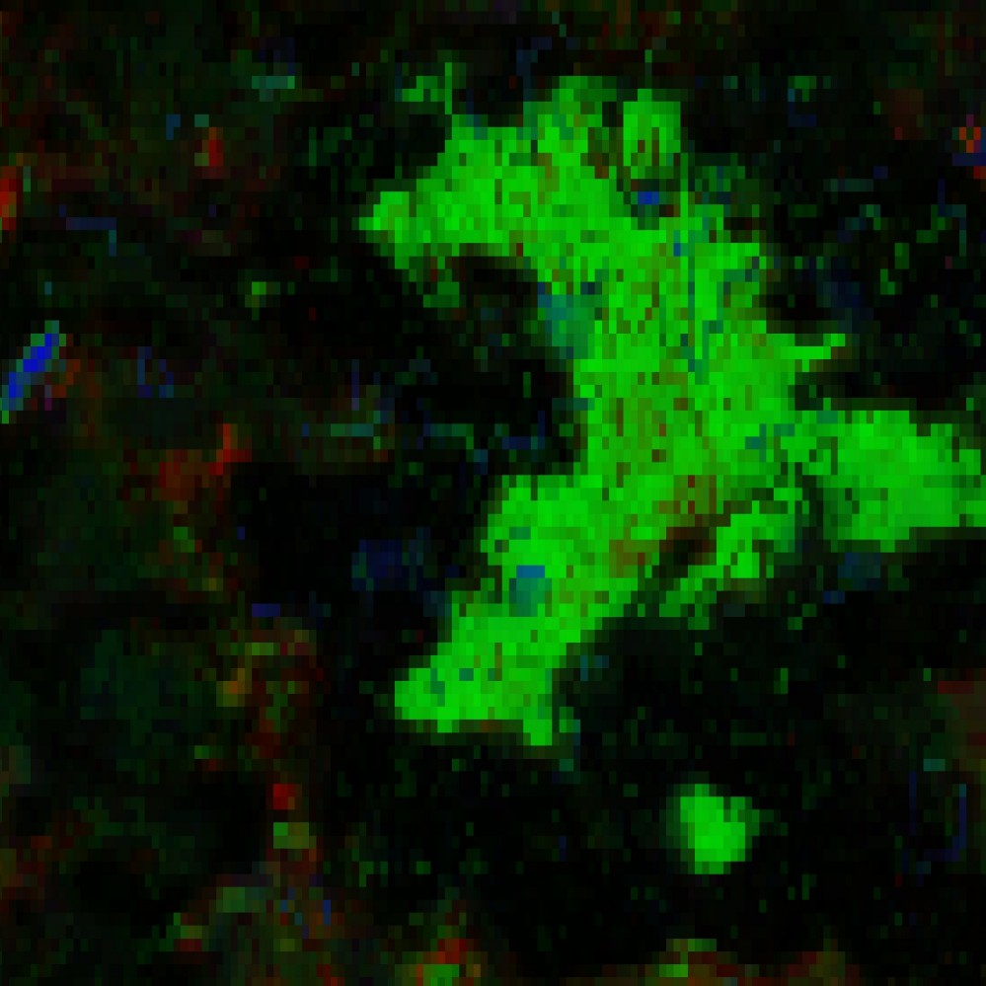
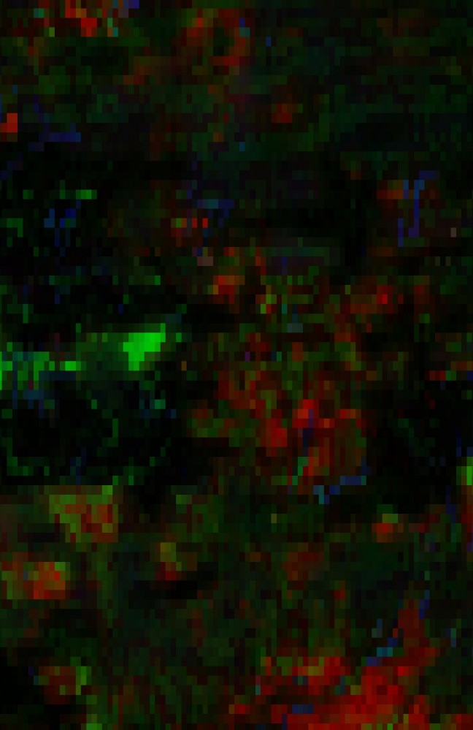
Hard vs fuzzy classification
N
Random forest prediction
Built-up areas
1
0
1
2
3
4 km
Wetlands
Water
Notes:
This is the same fuzzy classification, showing wetlands in green, water in blue and built-up areas in red.

Slide 11
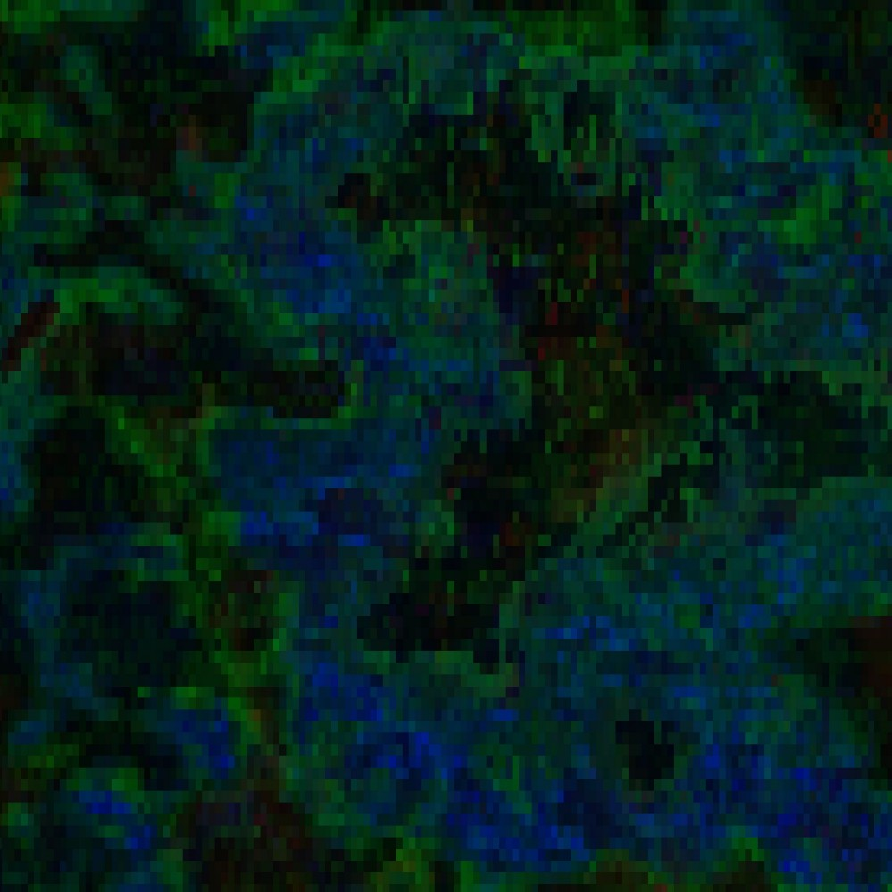
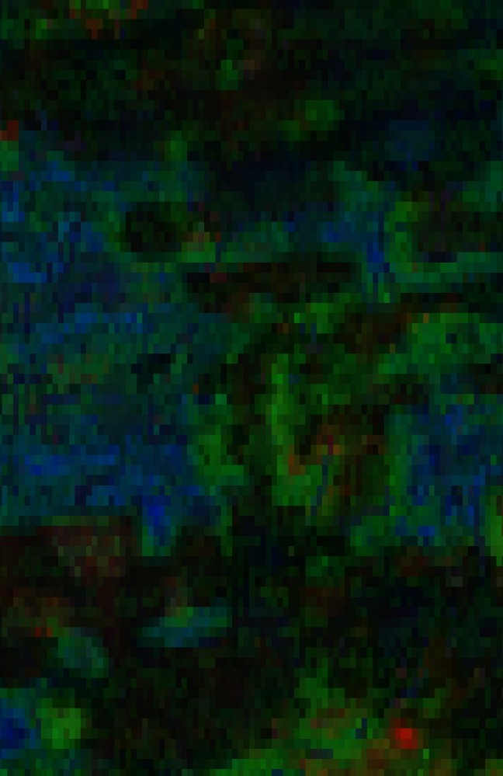
Hard vs fuzzy classification
N
Random forest prediction
Barren areas
1
0
1
2
3
4 km
Grass
Shrubs
Notes:
And barren land in red, grass in green, shrubs in blue.

Slide 12
Research questions
Which fuzzy classification method (fuzzy c-means, neural networks, random forest regression, multiclass gradient boosting) gives the highest per-class and overall classification accuracies?
What is the difference in processing speed between the different methods?
Which covariates are most important for fuzzy classification?
Notes:
Fuzzy classification can be achieved by using a variety of different methods, so the goal of my thesis was to investigate which...

Slide 13
Classification methods
Fuzzy c-means (FCM; GSIF package)
  Find mean of each class in feature space
  Determine class membership by distance
Neural networks (NN; neuralnet package)
  Machine learning by defining a network of nodes and optimising path weight
  Fully fuzzy: multiple input, multiple output
Random forest regression (RFR; ranger package)
  Machine learning by creating random decision trees
  Binary relevance: separate model for each class, scaled in the end
Multiclass gradient boosting (MGB; xgboost package)
  Machine learning by choosing and optimising best decision trees
  Class probabilities used as membership indicator, only pure pixels used for training
Notes:
I chose four classification methods that were available as R packages.

Slide 14


Methods: ground truth data collection
Methods: ground truth data collection
Model training and validation requires ground truth about proportion of each class in a pixel
Had to collect the ground truth data manually using visual interpretation
Done in QGIS, 480 pixels total
Sampled pixel
Notes:
In order to train the algorithms, I needed to have ground truth data. I manually collected information on class proportions in PROBA-V pixels using visual interpretation in QGIS. I collected 480 pixels in total, around half of which were pure pixels.

Slide 15
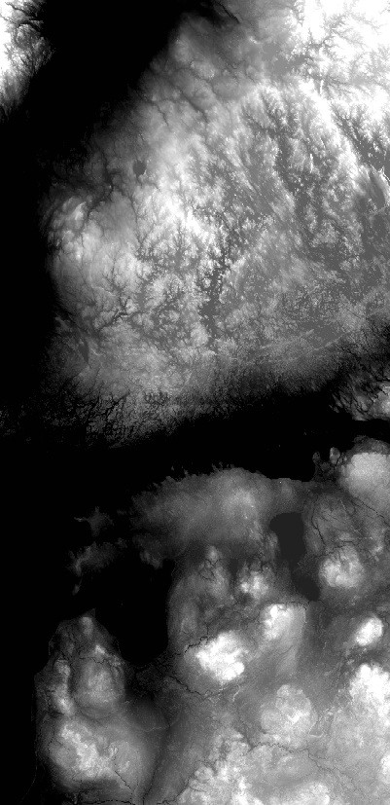
Methods: covariates
PROBA-V composite of summer 2016 (maximum NDVI):
  Blue
  Red
  NIR
  SWIR
NDVI time series of 3 years, 2nd order harmonics:
  Amplitude (x3)
  Phase (x2)
Vegetation indices:
  NDVI
  OSAVI
  LSWI
Digital Elevation Model:
  Elevation
  Slope
  Aspect
  Terrain Position Index
Water mask from PROBA-V QC
Elevation, combined EU-DEM and GLSDEM
214 m
Notes:
In order to predict land cover proportions, various covariates were given to the algorithms. First, PROBA-V spectral bands from a composite of summer 2016; then, NDVI time series metrics: amplitude and phase of two orders, plus mean NDVI; some vegetation indices, namely NDVI, OSAVI and LSWI; digital elevation model parameters: height, slope, aspect and terrain position index; and a water mask, extracted from the quality control layer of PROBA-V. On the right you can see how the elevation covariate looks like.

Slide 16
Results: classification accuracy
4-fold cross-validation
Trained on endmember,
validated on mixed pixels
Unoptimised model
Optimised model
Notes:
Results show that there is no big difference in classification accuracy, after the models are optimised by dropping covariates and adjusting model parameters. Optimised models are in yellow. On the left you can see 4-fold cross-validation results, and on the right side the results when models are trained on all pure pixels and validated on mixed pixels. Left panels show mean absolute error, right panels show root mean squared error.
Random forest regression (marked “RFR”), achieved the highest classification accuracy, but insignificantly higher than that of the other tested methods. In the case of 4-fold cross-validation, all methods performed significantly better than the control, which was a simple prediction that every pixel has equal proportions of every class.

Slide 17
Results: Per-class accuracy
Random forest regression
Fuzzy c-means
Notes:
Looking at per-class errors, there is likewise little difference between the classification methods. Random forest regression achieved mean errors closest to 0, which means it was least biased, whereas fuzzy c-means was the most biased. Neural networks were in between. In all cases water proportion was predicted most accurately, whereas grass, shrub and wetland proportions tended to be predicted the least accurately.

Slide 18
Results: visual comparison
Google true colour
Notes:
Next, I did a visual comparison between full tile predictions of each classification method. Here I’ll show two examples.

Slide 19
Results: visual comparison
Google true colour
Notes:
On the left is the surroundings of the city of Riga, Latvia. You can see it in the east, with the river Dauguva flowing through it. In the west is lake Babites, which is dystrophic and its banks are overgrown with vegetation. In the south are a number of wetlands. In the right panel you can see the grey dunes of the Curonian Spit, Lithuania. These are sand dunes that are in the process of being overgrown with herbaceous vegetation.

Slide 20
Results: visual comparison
Random forest regression
Built-up
Barren
Wetland
Grass
Water
Evergreen trees
Notes:
Here are the results of random forest regression. The accuracy is overall pretty good, we can see the city of Riga in red. Lake Babites is outlined in green, which is wetlands; this makes sense. The wetlands themselves are outlined properly. The largest flaw in random forest regression predictions is that it tends to overestimate wetland areas, as a part of Riga is shown in green. On the right, dunes are predicted to be mostly barren (red), although it’s not quite accurate given that much of the dunes are overgrown with vegetation. Water is also shown to have some barren class in it.

Slide 21
Results: visual comparison
Fuzzy c-means
Built-up
Barren
Wetland
Grass
Water
Evergreen trees
Notes:
Fuzzy c-means predictions are similar, but it tends to confuse built-up and water classes: we can see red in lake Babites and there is too much water predicted in Riga. Both built-up and water are predicted in wetlands as well. The grey dunes are predicted better, water is accurately displayed as black and there is a mix of grass and barren classes in the dunes.

Slide 22
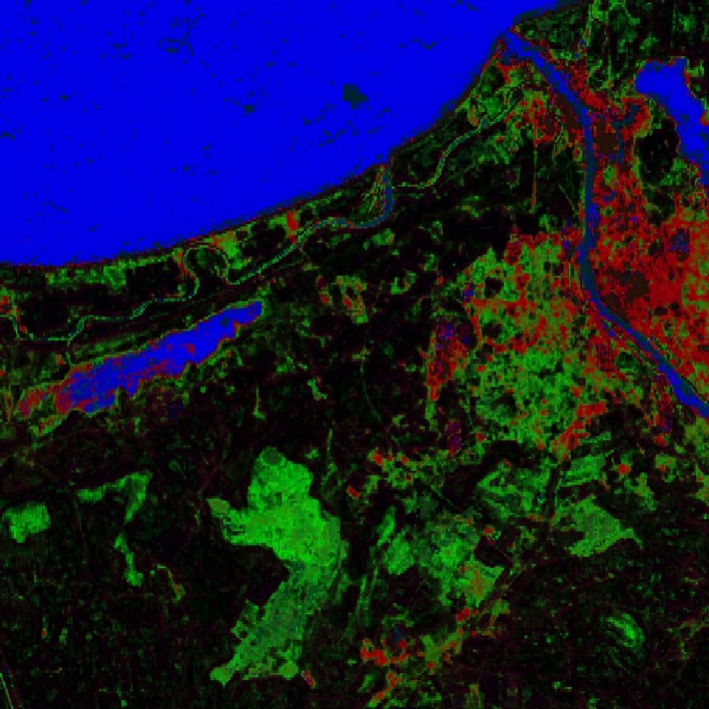
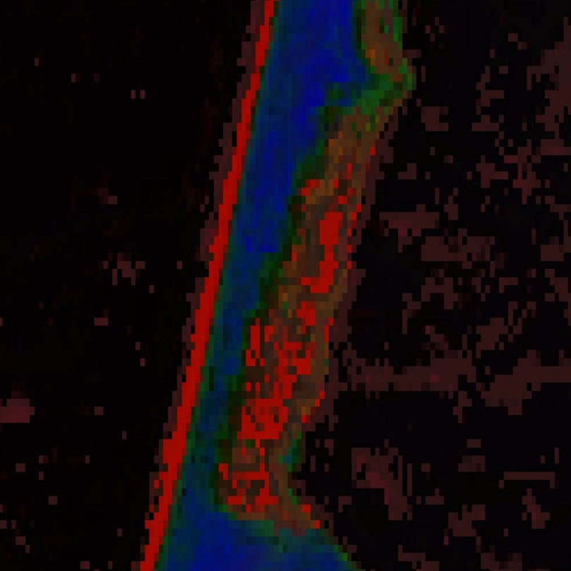
Results: visual comparison
Neural networks
2.5
0
2.5
5
7.5
10 km
1
0
1
2
3
4 km
N
Built-up
Barren
Wetland
Grass
Water
Evergreen trees
Notes:
Neural networks tend to overestimate wetlands even more so than random forest, and also predicts built-up areas within water. In the grey dunes, it predicts sudden changes in class, which is more true to reality. However, water has clear artefacts in it.

Slide 23
Results: visual comparison
Multiclass gradient boosting
Optimised
Unoptimised
Built-up
Barren
Wetland
Grass
Water
Evergreen trees
Notes:
Lastly, multiclass gradient boosting could not be compared directly, as it can only be trained on half of the ground truth dataset (pure pixels). When optimised, the predictions look inaccurate and very fuzzy; however, when not optimised, the predictions seem to be similar to those of neural networks, except with sudden transitions between classes. This shows that if the algorithm is trained only on pure pixels, it cannot deduce how fuzzy the reality actually is.

Slide 24
Results: prediction time
Varying colours in random forest regression case indicate time spent predicting each class separately.
All models were unoptimised.
Notes:
Next, here is a look at the prediction time of each method. Random forest regression took a lot more time to predict than the other methods: 20.5 hours instead of around half an hour. This is because binary relevance requires building separate models for every class (here indicated by varying colours), and random forest has to execute 500 trees for each pixel that it needs to predict. This is why even a single class took longer to predict than all nine classes for other methods.

Slide 25
Results: covariate importance
Holdout random forest permutation importance. Values are the change in per-class RMSE when the covariate values are shuffled, standardised by dividing by per-class standard error.
Notes:
Lastly, a look at which covariates were important, and which were not. Mean NDVI was the most important covariate, followed by near infrared. Some covariates were important for particular classes: 2nd order amplitude was important for crop prediction, 2nd order phase and slope were important for wetland prediction. The water mask was the least important, and so was aspect.

Slide 26
Results: covariate importance
Holdout random forest permutation importance. Values are the change in per-class RMSE when the covariate values are shuffled, standardised by dividing by per-class standard error.
Notes:
Lastly, a look at which covariates were important, and which were not. Mean NDVI was the most important covariate, followed by near infrared. Some covariates were important for particular classes: 2nd order amplitude was important for crop prediction, 2nd order phase and slope were important for wetland prediction. The water mask was the least important, and so was aspect.

Slide 27
Results: covariate importance
Holdout random forest permutation importance. Values are the change in per-class RMSE when the covariate values are shuffled, standardised by dividing by per-class standard error.
Notes:
Lastly, a look at which covariates were important, and which were not. Mean NDVI was the most important covariate, followed by near infrared. Some covariates were important for particular classes: 2nd order amplitude was important for crop prediction, 2nd order phase and slope were important for wetland prediction. The water mask was the least important, and so was aspect.

Slide 28
Results: covariate importance
Holdout random forest permutation importance. Values are the change in per-class RMSE when the covariate values are shuffled, standardised by dividing by per-class standard error.
Notes:
Lastly, a look at which covariates were important, and which were not. Mean NDVI was the most important covariate, followed by near infrared. Some covariates were important for particular classes: 2nd order amplitude was important for crop prediction, 2nd order phase and slope were important for wetland prediction. The water mask was the least important, and so was aspect.

Slide 29
Results: covariate importance
Holdout random forest permutation importance. Values are the change in per-class RMSE when the covariate values are shuffled, standardised by dividing by per-class standard error.
Notes:
Lastly, a look at which covariates were important, and which were not. Mean NDVI was the most important covariate, followed by near infrared. Some covariates were important for particular classes: 2nd order amplitude was important for crop prediction, 2nd order phase and slope were important for wetland prediction. The water mask was the least important, and so was aspect.

Slide 30
Results: covariate importance
Holdout random forest permutation importance. Values are the change in per-class RMSE when the covariate values are shuffled, standardised by dividing by per-class standard error.
Notes:
Lastly, a look at which covariates were important, and which were not. Mean NDVI was the most important covariate, followed by near infrared. Some covariates were important for particular classes: 2nd order amplitude was important for crop prediction, 2nd order phase and slope were important for wetland prediction. The water mask was the least important, and so was aspect.

Slide 31
Results: covariate importance
Holdout random forest permutation importance. Values are the change in per-class RMSE when the covariate values are shuffled, standardised by dividing by per-class standard error.
Notes:
Lastly, a look at which covariates were important, and which were not. Mean NDVI was the most important covariate, followed by near infrared. Some covariates were important for particular classes: 2nd order amplitude was important for crop prediction, 2nd order phase and slope were important for wetland prediction. The water mask was the least important, and so was aspect.

Slide 32
Discussion
All the methods were accurate, also for determining wetlands and mixed tree stands: covariate selection more important than algorithms
Random forest regression: slow but more accurate
  Binary relevance can be optimised per class
  Would take 2 weeks for GLC prediction on PROBA-V MEP
Fuzzy c-means: a good compromise?
  Depends on the use case
  The gsif R package needs Raster support
Methods that cannot be trained on mixed pixels cannot determine how fuzzy the reality is

Slide 33
Conclusion
All tested methods had good accuracy when optimised. Random forest regression was the most accurate (RMSE: 20.8, MAE: 11.7), but insignificantly more than the others.
Random forest regression was much slower to predict (20.5 h) than the other fuzzy classification methods (25-49 min).
Mean NDVI was the most important covariate, aspect and the water mask were least important.

Slide 34

Thank you for listening

