Slide 1
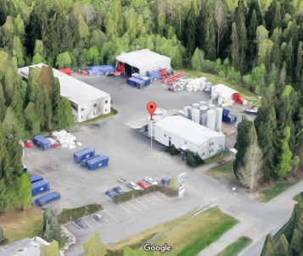
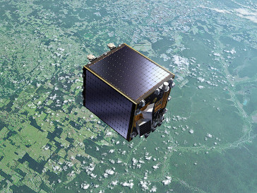
Fuzzy land cover classification method assessment using PROBA-V satellite data
Midterm presentation
Dainius Masiliūnas
Supervisors:
Jan Verbesselt
Nandin-Erdene Tsendbazar
Wageningen, 2016

Slide 2
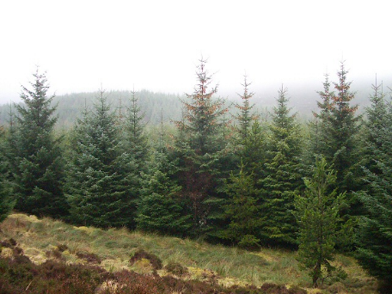
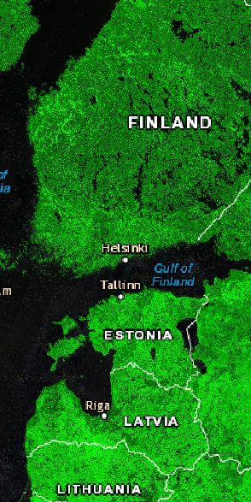
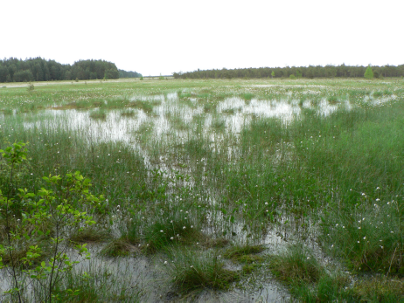
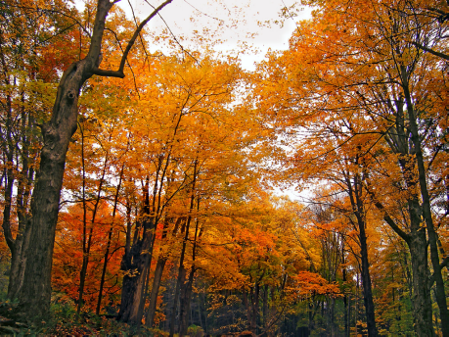
Introduction
Global land cover (GLC) classification maps are used by climate models, carbon sequestration and deforestation monitoring etc.
Problem: existing GLC maps have limited accuracy, spatial and temporal resolution, lots of classes
Solution: fuzzy GLC using PROBA-V data
  2-day revisit time, 100 m spatial resolution
  Fuzzy: predict proportions of each class within a pixel
  Area of interest is the gradient between coniferous and deciduous forests and includes a lot of wetlands

Slide 3
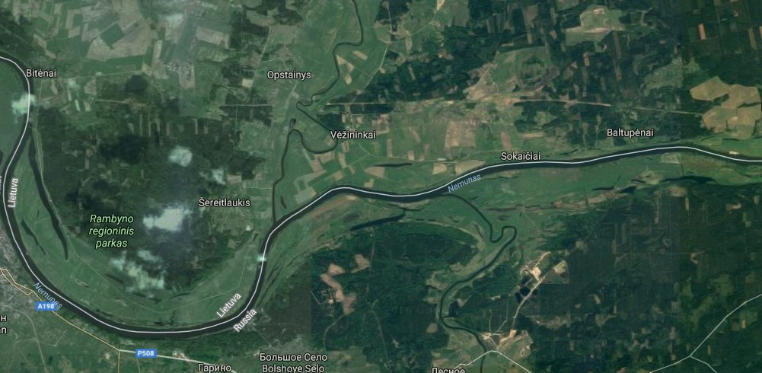
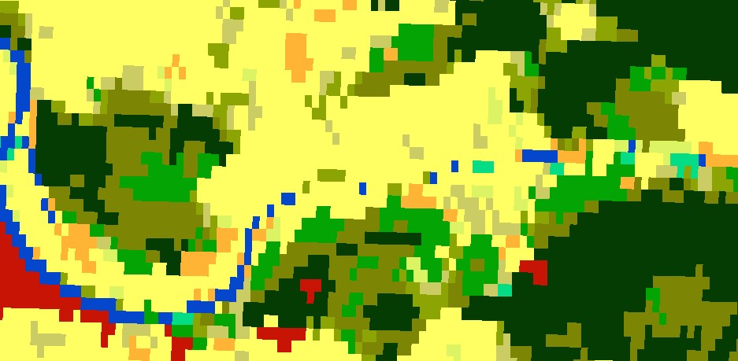
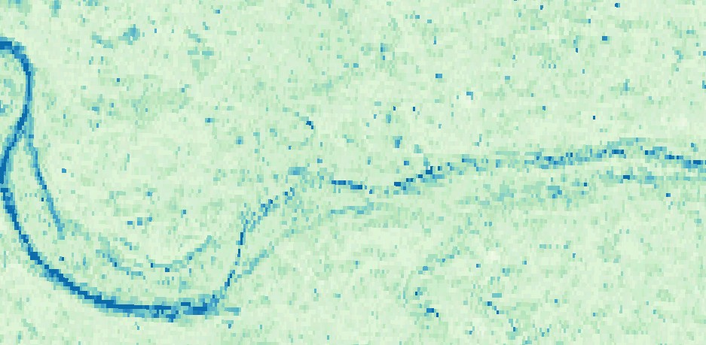
Hard and fuzzy classification
N
Water
High water proportion
2 km

Slide 4
Research questions
Which fuzzy classification algorithm (fuzzy c-means, random forest regression, multiclass gradient boosting, neural networks) gives the highest classification accuracy?
Which variables are most important for classification?
What is the difference in processing speed between the algorithms?

Slide 5
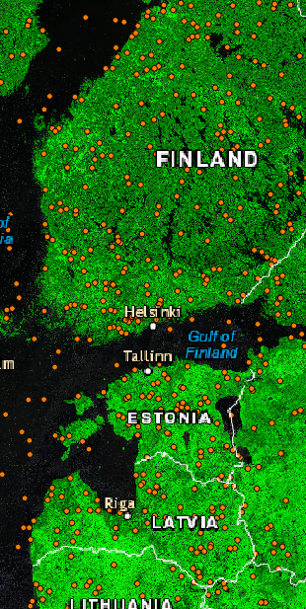
Methods: ground truth data collection
Model training and validation requires ground truth about proportion of each class in a pixel
  9 classes: deciduous and evergreen trees, wetlands, water, shrubs, grass, crops, urban, bare
Had to collect the ground truth data manually using visual interpretation
Done in QGIS, 480 pixels total
Sampled pixel

Slide 6
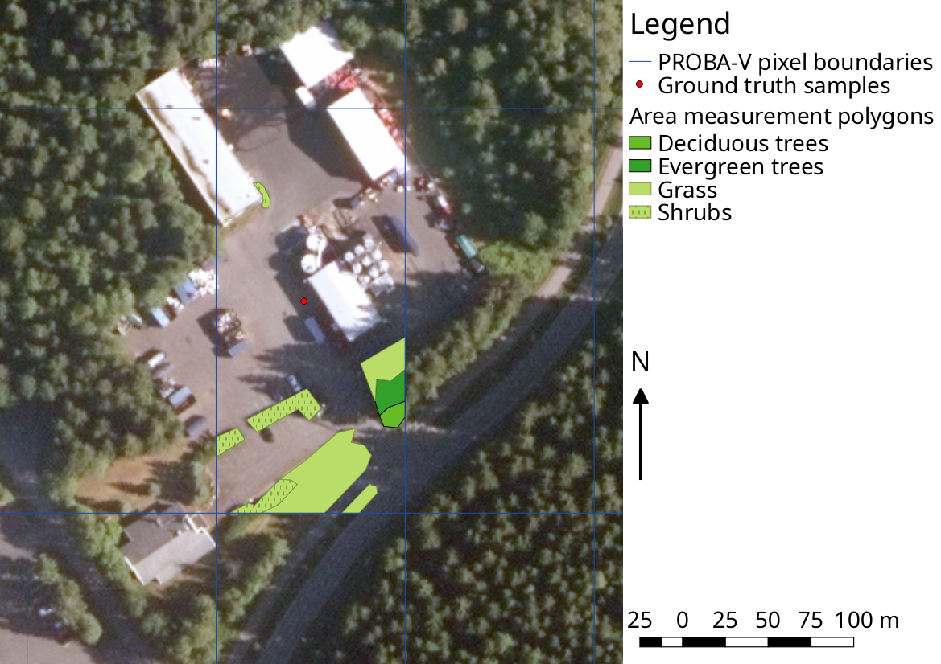
Gathered validation data example

Slide 7
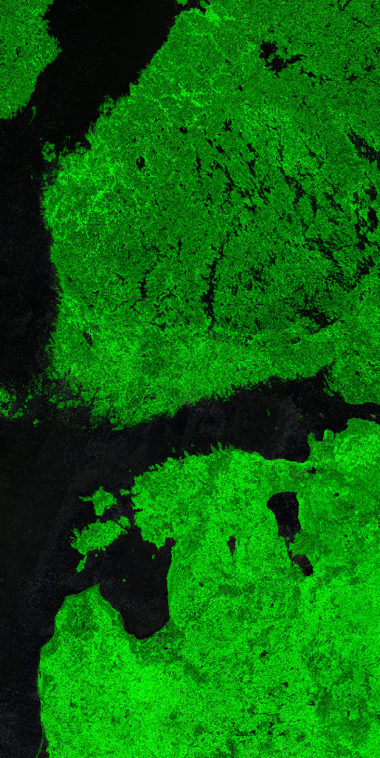
Methods: covariates
PROBA-V composite of summer 2016 (maximum NDVI):
  Blue
  Red
  NIR
  SWIR
NDVI time series of 3 years, 2nd order harmonics:
  Amplitude (x3)
  Phase (x2)
Vegetation indices:
  NDVI
  OSAVI
  LSWI
Digital Elevation Model:
  Height
  Slope
  Aspect
  Terrain Position Index
Water mask from PROBA-V QC
False-colour (red, NIR, blue) composite of summer 2016

Slide 8
Methods: algorithms
Fuzzy c-means (GSIF package)
  Find mean of each class in feature space
  Determine class membership by distance
Random forest regression (ranger package)
  Machine learning by creating random decision trees
  Separate model for each class, scaled in the end
Multiclass gradient boosting (xgboost package)
  Machine learning by choosing and optimising best decision trees
  Class probabilities used as membership indicator, only pure pixels used for training
Neural networks (neuralnet package)
  Machine learning by defining a network of nodes and optimising path weight
  Fully fuzzy: multiple input, multiple output

Slide 9
Preliminary results

Slide 10
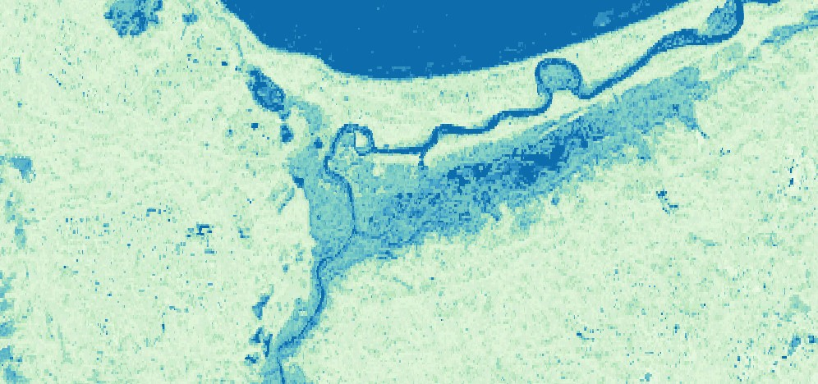
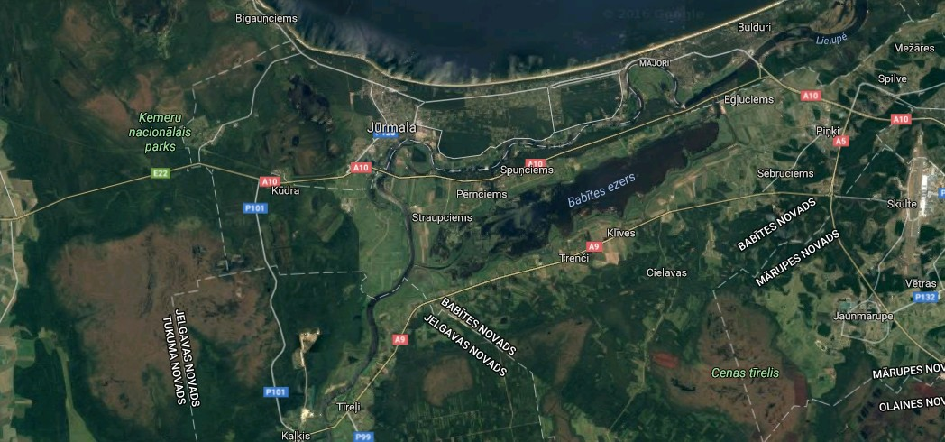
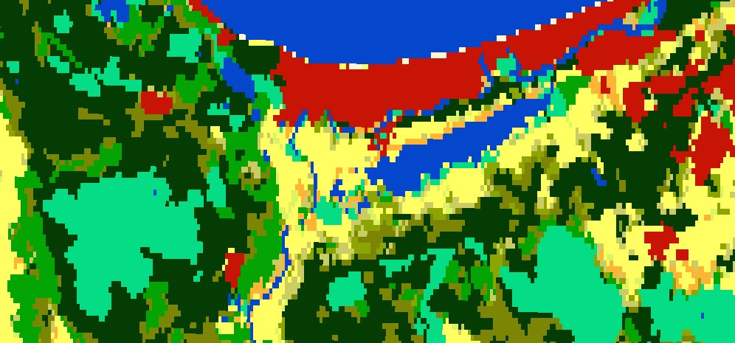
Random Forest water class output
N
Water
High water proportion
Urban
2 km

Slide 11
Challenges
Measuring classification method performance
  Gradient boosting uses multiple cores by default, others do not. Fair to compare?
  Gradient boosting and neural networks can optimise themselves indefinitely
  Resources (RAM, CPU) have to be consistent for each test
Big data
  10080x10080 pixel rasters take hours to process
  Cloudy, cloud masking is poor: takes extra time to clean
  Processing tools still under development and have bugs

Slide 12
Summary
Fuzzy classification expresses gradients and mixed pixels more realistically than hard classification
Choice of algorithm is very important for classification accuracy
Random forest regression works the best so far
Need for better cloud masking, processing tools handling big data

Slide 13

Thank you for listening

Slide 14
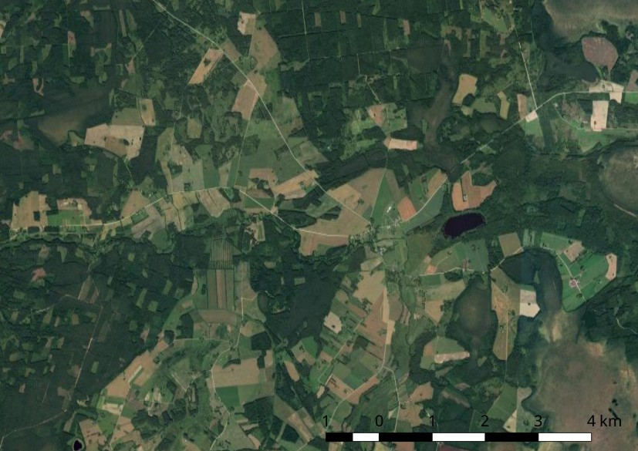
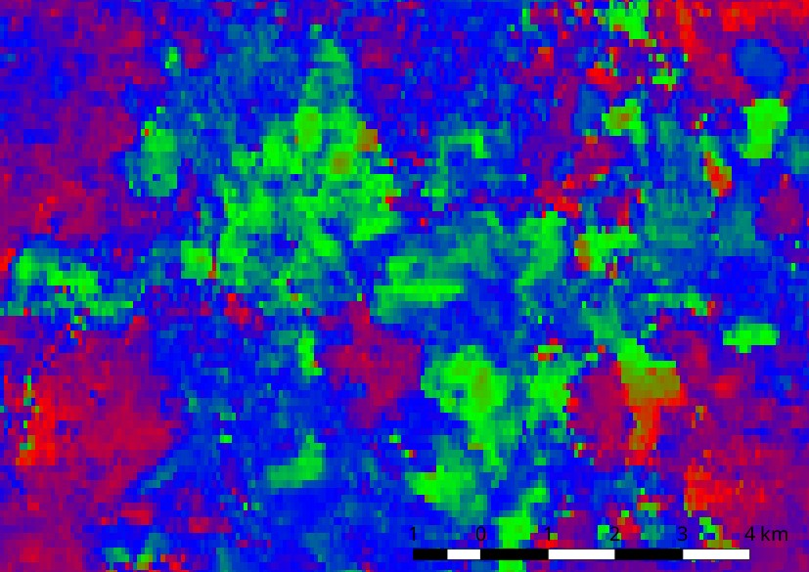
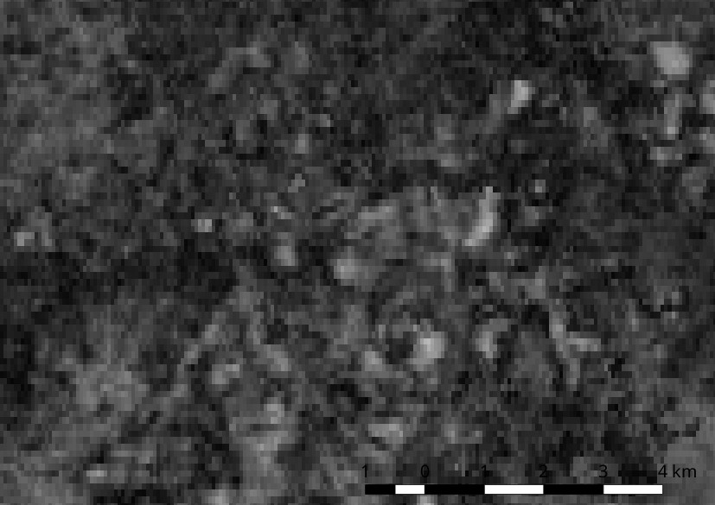
Time series parameters

Slide 15
Challenges
Interpretation of classes (deciduous vs evergreen, grass vs crops, bare soil vs urban)
Big data
  160 5-day composites of 10080x10080 pixels each
  Using a VM provided by PROBA-V Mission Exploitation Platform: 32 cores, 32 GiB RAM, 300 GiB HDD; still takes days and often runs out of memory
  The probaV R package by Johannes Eberenz and Jorn Dallinga is still a work-in-progress, has bugs and inefficiencies

Slide 16
Challenges
Cloudy imagery and poor quality control layer
  VITO acknowledges that and is currently running a reprocessing campaign for Collection 1
  At the moment, time-series-based cloud masking is needed, which is resource-intensive but gives good results
Poor DEM quality
  GLSDEM: 10 times worse resolution beyond 60°N, unusable for slope calculation
  EU DEM: good resolution, but does not cover Russia and Belarus

