Slide 1
Reciprocal n-body Collision Avoidance
Jur van den Berg Stephen J. Guy
Ming Lin

Slide 2
Development
1998: Motion planning in dynamic environments using velocity obstacles(VO)
2008: Reciprocal velocity obstacles for real-time multi-agent navigation(RVO)
2012: Reciprocal n-body Collision Avoidance(ORCA)
2015:Generalized Reciprocal Collision Avoidance(GRCA)
2018: Adaptive learning for multi-agent navigation(ALAN)

Slide 3
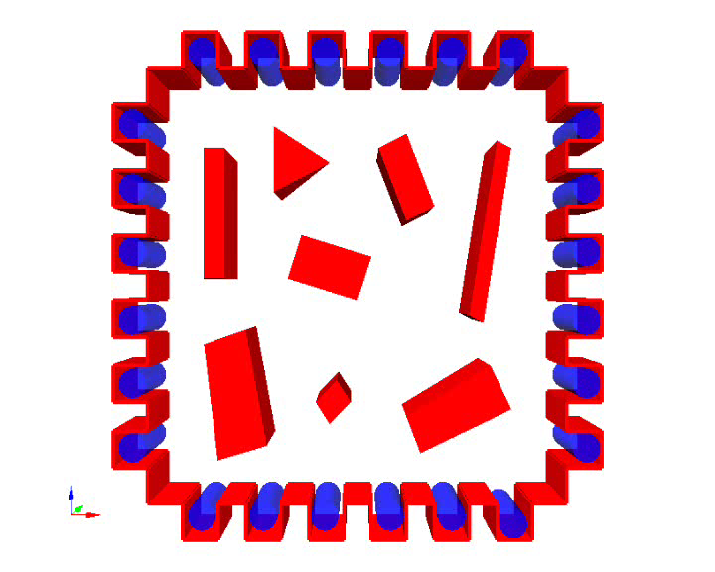
Multi-Agent Navigation
N agents share an environment
Move to goal without collisions (including collisions with obstacles & other agents )

Slide 4
Reciprocal Velocity Obstacle
RVO^{A}_{B}(v_{B}, v_{A}) = {v'_{A} | 2v'_{A} – v_{A} ∈ VO^{A}_{B}(v_{B})}
The points in ROV is the midpoints of vA and the points in the original VO.

Slide 5
Multi-Agent Navigation
N agents A₁, …, A_{N}
positions p₁, …, p_{N}
velocities v₁, …, v_{N}
preferred speeds v^{pref}₁, …, v^{pref}_{N}
goals g₁, …, g_{N}
Time step Δt
Each time step: for each agent:
Compute preferred velocity
Select new velocity
Update position of agent according to new velocity

Slide 6
Optimal Reciprocal Collision Avoidance
Select the pair that maximizes the amount of
permitted velocities “close” to optimization velocities

Slide 7
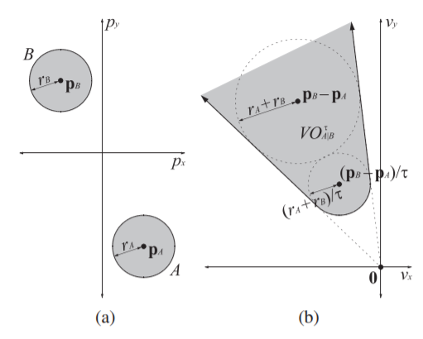
Optimal Reciprocal Collision Avoidance
(a) Position of A and B
(b) If Va∈VO^{At}_{B} , A and B will have collision in t time.

Slide 8
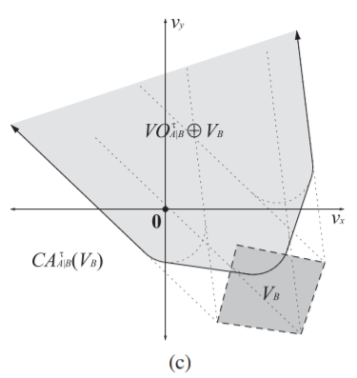






Optimal Reciprocal Collision Avoidance
The set of collision-avoiding velocities for robot A given that robot B selects its velocity from some set (dark gray) is the complement of the Minkowski sum (light gray) of and

Slide 9
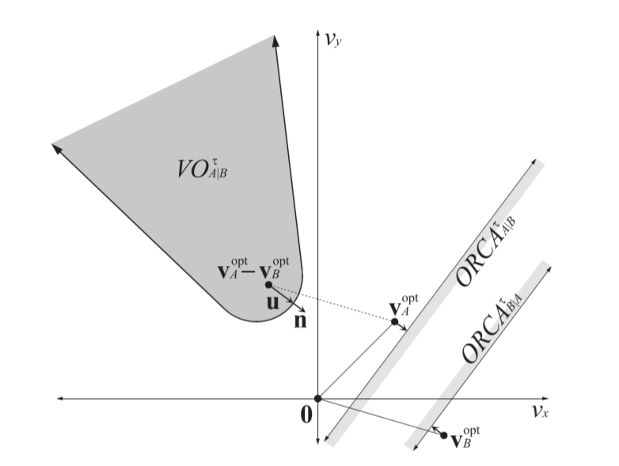
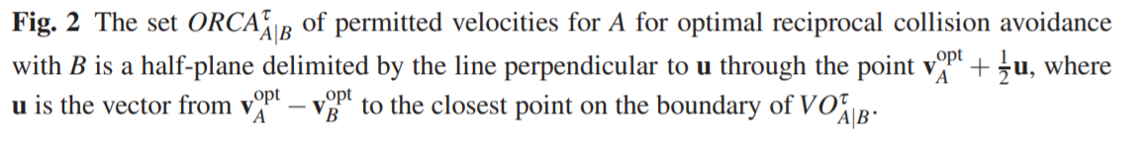
Optimal Reciprocal Collision Avoidance
Nominally, the optimization velocities are equal to the current velocities, such that the robots have to deviate as little as possible from their current trajectories to avoid collisions.

Slide 10
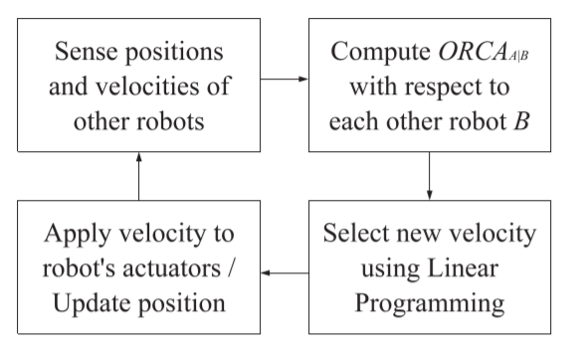
Apply ORCA to multi-agents

Slide 11
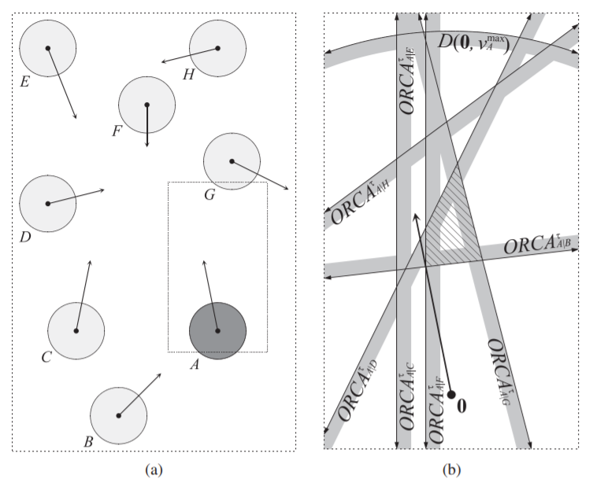
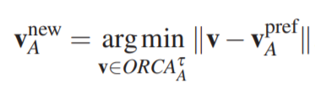

Apply ORCA to multi-agents

Slide 12
Increase the Efficiency
Selecting velocities by not including the constraints of all other robots
Only of those that are close will be included and calculated
I.e. Robots B that are farther away from robot A than (VA +VB )t will never collide with Robot A in t time.

Slide 13
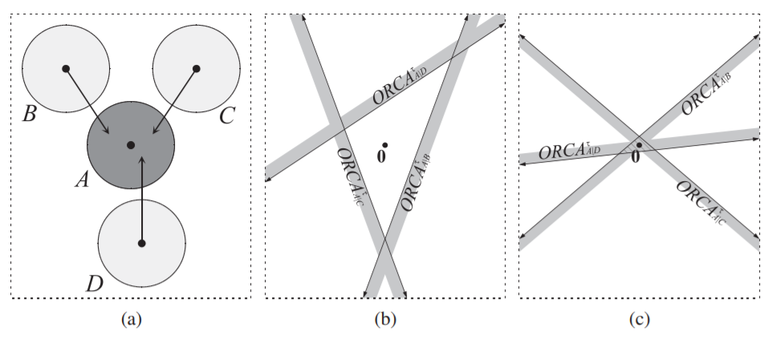
Dense Configuration
A dense configuration with three robots moving towards robot A.
No region of ORCA, avoiding collisions within τ time cannot be guaranteed. V*opt = V*
V*opt = 0, then the region of ORCA will always exist.

Slide 14
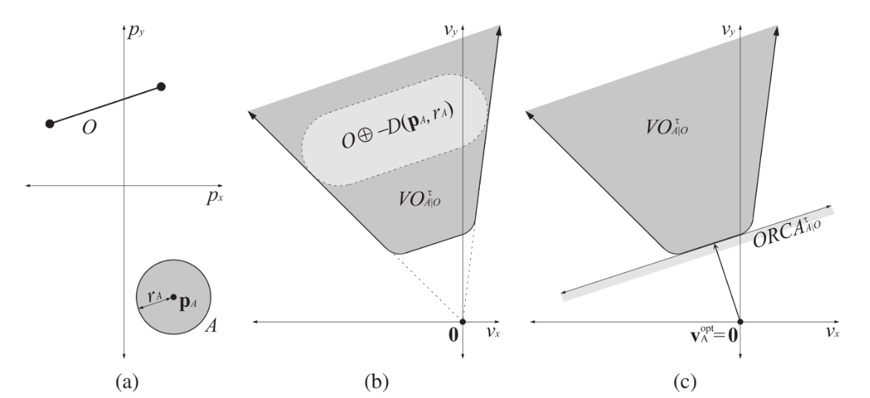
Choosing the Velocity
Select the ‘safest possible’ velocity for the robot.
Use 3-d linear program to find the new velocity.
Static Obstacles
Consider their shapes and use the similar method.
The velocity of static obstacles is 0.

Slide 15
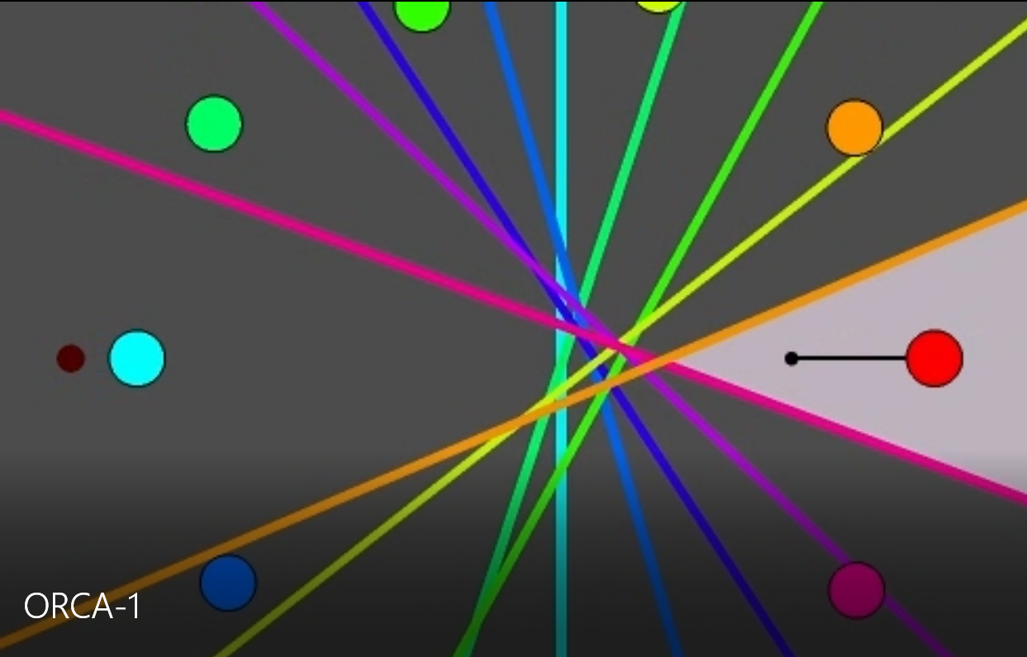
Experiments

Slide 16
Future Works
Most of multi-agents navigation methods focus on the local planner.
The combination of local and global planner can be improved. i.e. If we get the map of a scene, then the global planner can be more detailed.
The static obstacles avoiding methods can be improved.

