Slide 1
Reciprocal Velocity Obstacles for Real-Time Multi-Agent Navigation
Jur van den Berg Ming Lin Dinesh Manocha

Slide 2
Development
1998: Motion planning in dynamic environments using velocity obstacles(VO)
2008: Reciprocal velocity obstacles for real-time multi-agent navigation(RVO)
2011: Reciprocal n-body Collision Avoidance(ORCA)
2018: Adaptive learning for multi-agent navigation(ALAN)

Slide 3
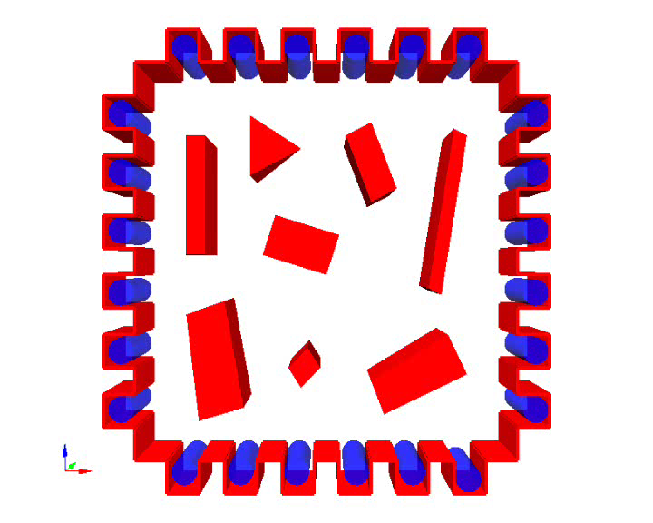
Multi-Agent Navigation
N agents share an environment
Move to goal without collisions (including collisions with obstacles & other agents )

Slide 4
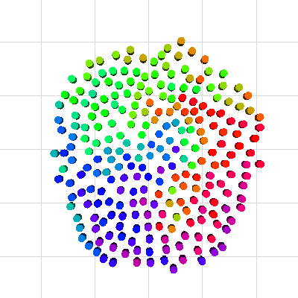
Multi-Agent Navigation
Decoupled
Simultaneous independent navigation for each agent
Global path planning and local collision avoidance decoupled
Centralized
Path planned in composite configuration space

Slide 5
Main Problems in Multi-agents navigation
Independent Navigation
Continuous cycle of sensing and acting
Global path planning vs. local navigation
Each cycle: each agent observes other agents (position, velocity)
How should one agent act to others?

Slide 6
Velocity Obstacle
VO^{A}_{B}(v_{B}) = {v_{A} | γ(p_{A}, v_{A} – v_{B}) ∩ B ⊕ –A ≠ ∅}

Slide 7
Using Velocity Obstacles
In each cycle, select velocity outside velocity obstacle of any moving obstacle
For multi-agent navigation?
Agents are not passively moving, but react on each other
Result: oscillations

Slide 8
Oscillations
Two agents with opposite directions

Slide 9
Oscillations

Slide 10
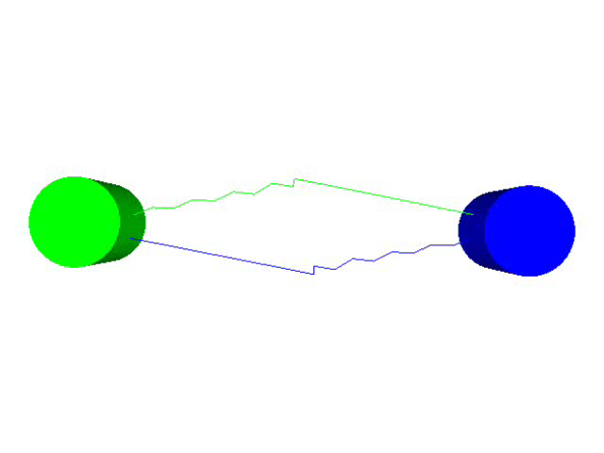
Oscillations
Oscillations happen

Slide 11
Approach of RVO
Prevent oscillations
No communication among agents or global coordination
Simple idea: instead of choosing a new velocity outside the velocity obstacle, take the average of a velocity outside the velocity obstacle and the current velocity
Formalized into Reciprocal Velocity Obstacle

Slide 12
Reciprocal Velocity Obstacle
RVO^{A}_{B}(v_{B}, v_{A}) = {v'_{A} | 2v'_{A} – v_{A} ∈ VO^{A}_{B}(v_{B})}
The points in ROV is the midpoints of vA and the points in the original VO.

Slide 13
Oscillations

Slide 14
Oscillations

Slide 15
Oscillations

Slide 16

Oscillations
No oscillations

Slide 17
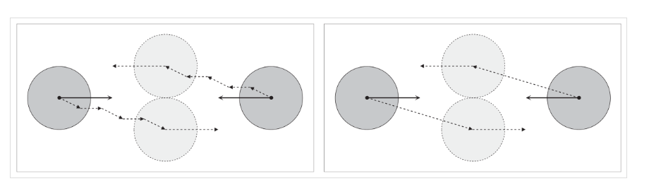
Oscillations
VO: Oscillations
RVO: No oscillations

Slide 18
Generalized RVOs
Different distribution of effort in avoiding each other than 50%-50%

Slide 19
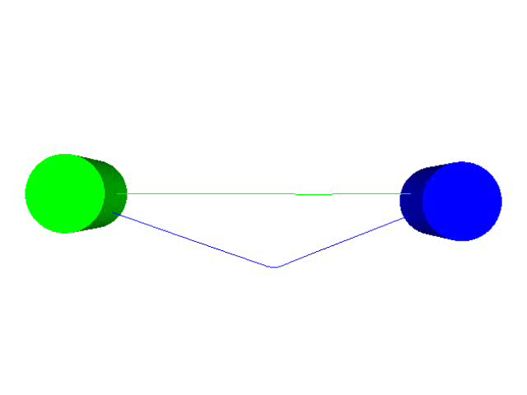
Generalized RVOs
0% - 100%

Slide 20
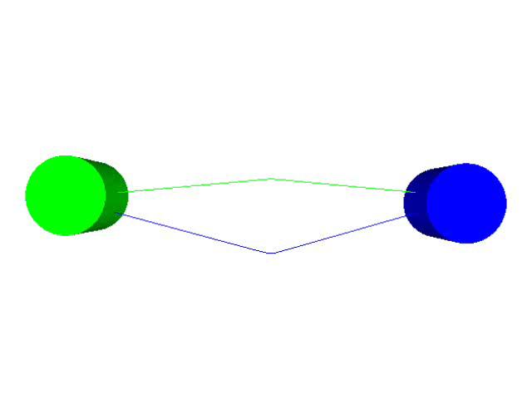
Generalized RVOs
25% - 75%

Slide 21
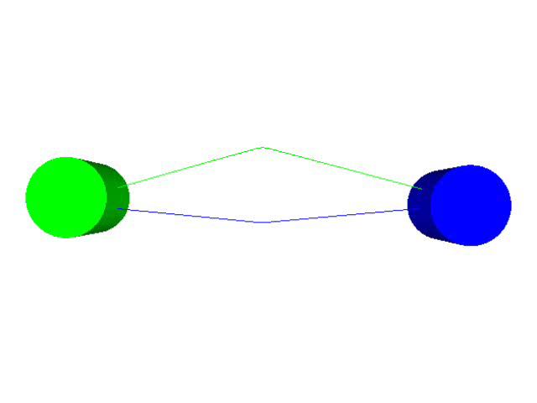
Generalized RVOs
75% - 25%

Slide 22

Generalized RVOs
100% - 0%

Slide 23
Multi-Agent Navigation
N agents A₁, …, A_{N}
positions p₁, …, p_{N}
velocities v₁, …, v_{N}
preferred speeds v^{pref}₁, …, v^{pref}_{N}
goals g₁, …, g_{N}
Time step Δt
Each time step: for each agent:
Compute preferred velocity
Select new velocity
Update position of agent according to new velocity

Slide 24
Select New Velocity
Outside of RVO
Close to the preferred velocity

Slide 25
Select New Velocity
Environment may become crowded: no valid velocity
Solution: select velocity inside RVO but penalize
Expected time to collision
Distance to preferred velocity
Select velocity with minimal penalty

Slide 26

Experiments

