Slide 1
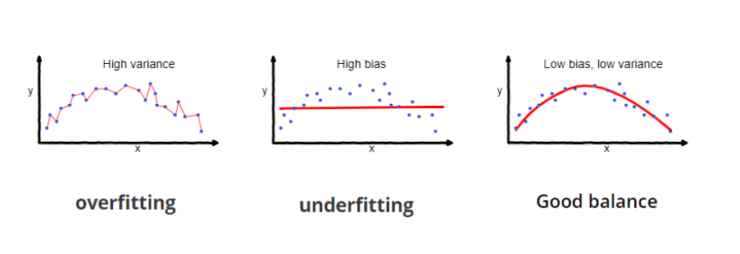
“Bias is the algorithm’s tendency to consistently learn the wrong thing by not taking into account all the information in the data (underfitting).”
The predictions will be similar to one another but on average, they are inaccurate
“Variance is the algorithm’s tendency to learn random things irrespective of the real signal by fitting highly flexible models that follow the error/noise in the data too closely (overfitting).”
Different data sets are depicting insights given their respective dataset. Hence, the models will predict differently.

Slide 2
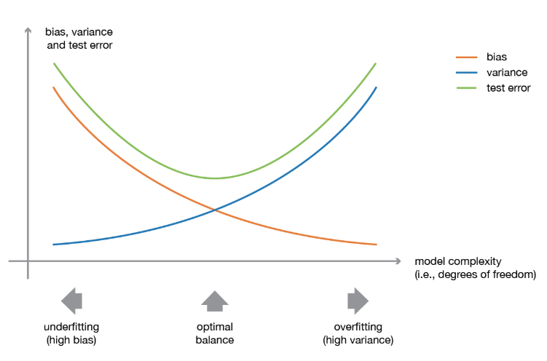
The idea of ensemble methods is to try reducing bias and/or variance of individual algorithms and create a strong learner (or ensemble model) that achieves better performances

Slide 3
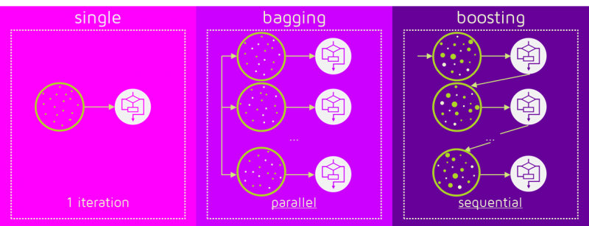

Slide 4
Decision tree
Random Forest
Bagging
Adaboost
Gradient Boost

