Slide 1
OneOklahoma Friction Free Network (OFFN) Update

Slide 2
OFFN Overview
OFFN Objectives
Build a research-only network consisting of institutional last mile components that are independent of enterprise networks.
Enterprise networks are amazing, but slow because of security (e.g., firewalls).
4 original institutions: OU, OSU, Langston U(Oklahoma’s only Historically Black College/University), Oklahoma Innovation Institute (Tulsa nonprofit)
Dedicated 10Gbps per site for research-only workloads
NSF Campus Cyberinfrastructure (CC*) grant awarded in Oct 2013
Very few CC* grants are for multi-institution collaborations: We’re doing for $1.23M what anyone else would need $4M to do -- 1/3 the cost!
OFFN research-only network operational in December 2017
Site Changes
OU, OSU connectivity increased to 100 Gbps (via OneNet funds)
OII decommissioned (lost their HPC operation funds), equipment relocated to OU
Added U Tulsa and U Central Oklahoma (both have NSF MRI grants for supercomputers)

Slide 3
OFFN Science Drivers
Geosciences
Weather forecasting (OU CAPS)
Weather Radar (OU ARRC)
AI Deep Learning for Predicting Tornados (OU IDEA)
Warn-on-Forecast (OU CIMMS/NOAA NSSL)
Ecological Informatics (OU EOMF)
High Energy Physics (OU, OSU, Langston U)
Bioinformatics (OSU)

Slide 4
MORe-OFFN: Broader Impacts Thru the Roof!
OFFN Connectivity Extended By the MORe-OFFN Grant
Multiple Organization Regional One Oklahoma Friction Free Network
Lead institution: Northeastern State U (#1 in US for bachelors degrees to Native Americans)
NSU CIO Richard Reif PI with Co-PI’s at the other Institutions
OU in an advisory role (“leadership institution”)
OU’s Campus CI Engineer (Younkins) is mentoring them on research networking
OU’s Asst VP IT Research Strategy Advisor (Neeman) is mentoring them on grantsmanship
More-OFFN Objectives
Extend the original OFFN Research Network
4 Additional Institutions: (Northeastern State U, Southeastern Oklahoma State U*, Southwestern Oklahoma State U*, Rogers State U)
* Native American Serving Non-tribal Institution (minority serving)
Dedicated 1 Gbps per site for research-only workloads
Grant awarded in June 2017
Site Status
Server equipment ordered, network equipment order in process
SWOSU and RSU already have at least 1 connected device

Slide 5
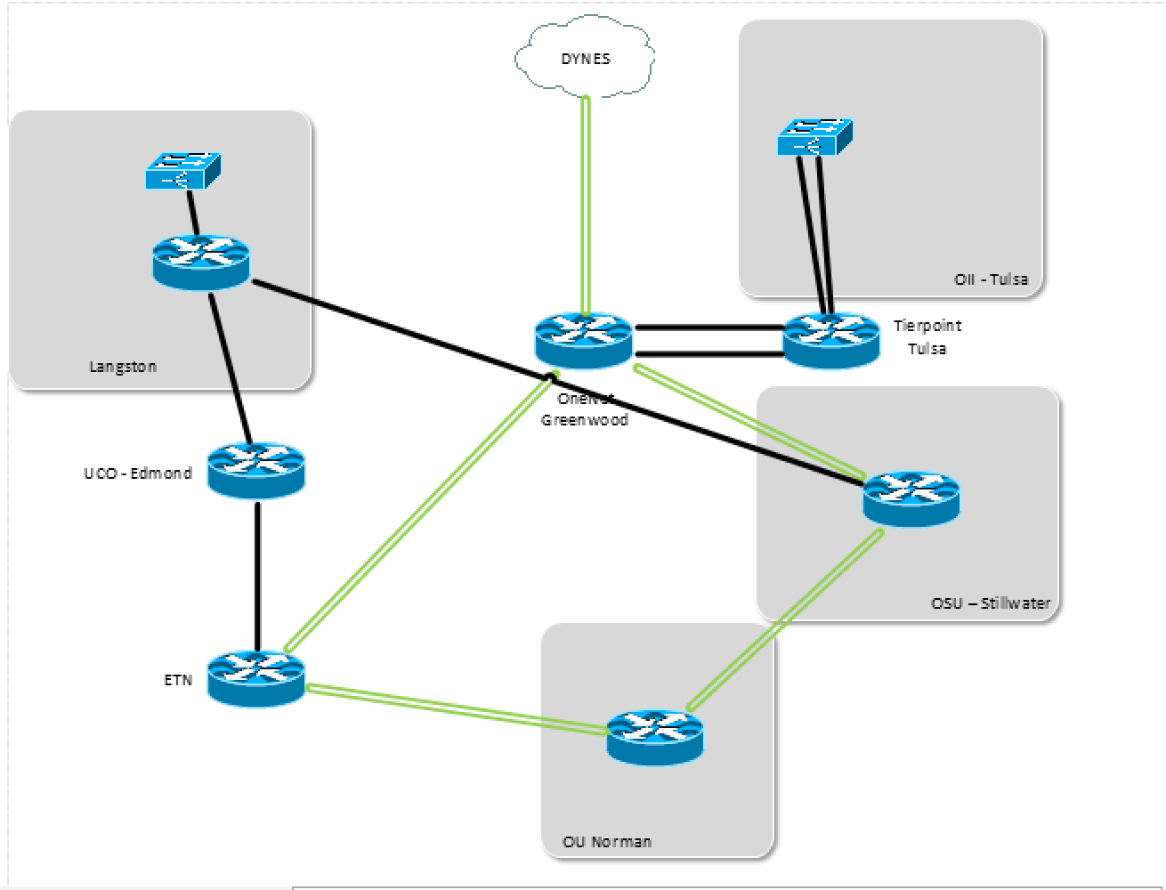
OFFN Wide-Area Topology

Slide 6
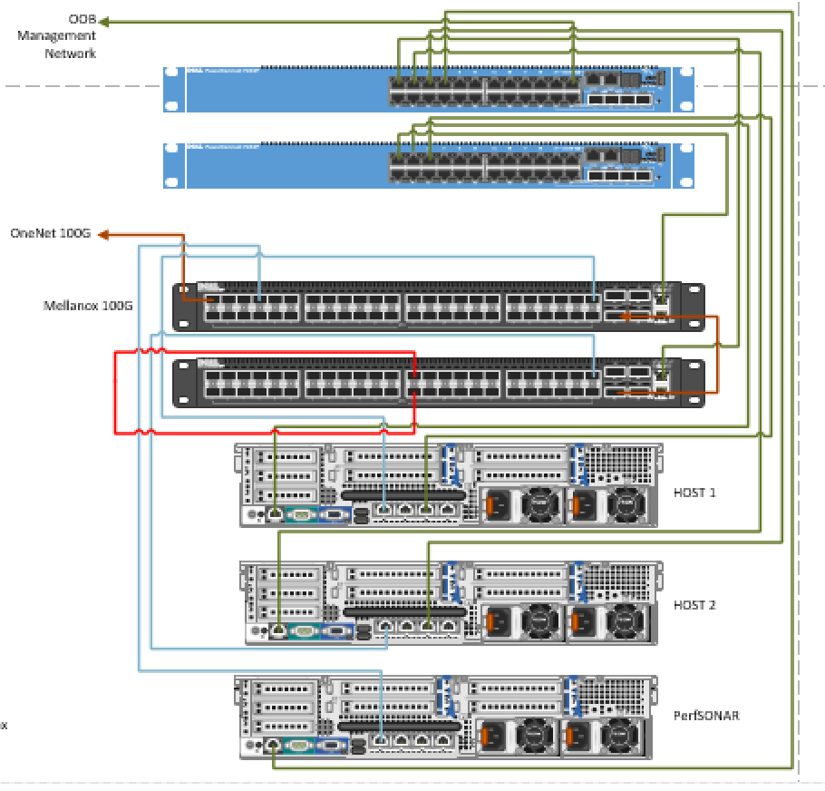
OFFN Typical Equipment Layout

Slide 7
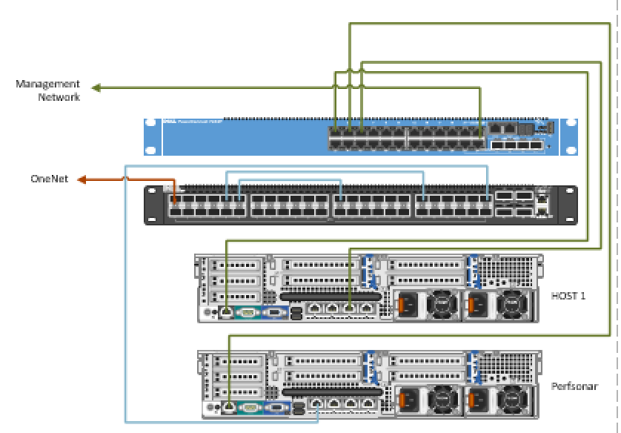
MORe-OFFN Typical Equipment Layout

Slide 8
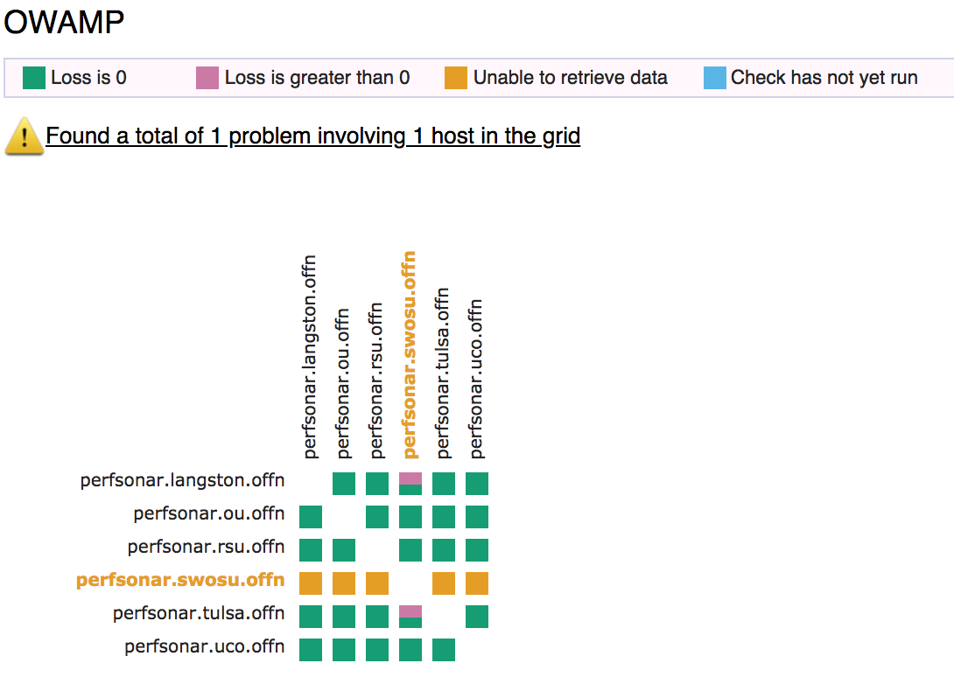
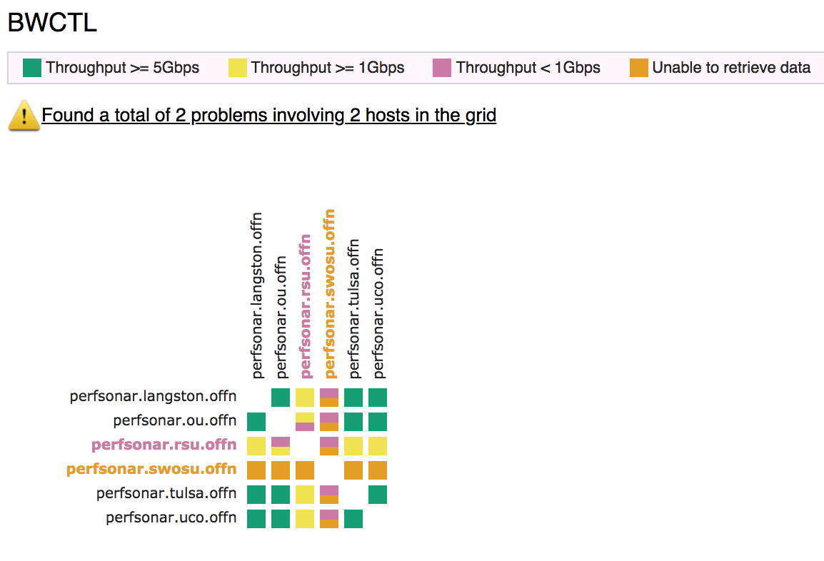
OFFN Monitoring

Slide 9
What’s Next for OFFN?
Extend OFFN Research Services to include Internet2 Access
Complete MORe-OFFN Deployment: The NSF loves this!
Deploy GPN FIONA Nodes
Pacific Research Platform is now becoming the National Research Platform: Oklahoma (and Great Plains Network) are among the leaders/early adopters.
PRP PI Larry Smarr loves us!

