Slide 1
HIDDEN SLIDE – Summary
These slides are meant to be used ‘as is’ to give an upper level view of perfSONAR for an audience that is not familiar with the concept.
You *ARE* allowed to delete things you don’t understand ,or modify the message to fit a specific group
You *ARE* allowed to add more if the audience is more technical
Presentation styles vary – please study up before presenting

Slide 2
HIDDEN SLIDE – About
Title: perfSONAR-10-Hardware-Small_Nodes
Expected Presentation Time: These slides should take 40 minutes to present.
Exec Summary: This is a talk created by the small node research group @ IU International networking. It talks about the emerging work on small nodes.
Expected Audience: Engineers (low to mid level)
Audience Skill Level: Knowledge of perfSONAR at a basic to intermediate level
Last Reviewed: June 1, 2018
This edition uses screenshots from perfSONAR version: no screenshots used

Slide 3
HIDDEN SLIDE – Content Outline
Outline: a
Overview of the project
The evaluation criteria
Results of evaluation
What Can be Cut:
There is a lot of detail on the specifics of some of the machines. Cut this down to save time

Slide 4
perfSONAR Low-Cost Hardware
GPN Member’s Meeting 2018
Scott Chevalier — schevali@iu.edu
George Robb — robbg@missouri.edu
Matt Younkins - younkinsm@ou.edu
June 1, 2018
This document is a result of work by the perfSONAR Project (http://www.perfsonar.net) and is licensed under CC BY-SA 4.0 (https://creativecommons.org/licenses/by-sa/4.0/).

Slide 5
HIDDEN SLIDE
Small nodes are a constant moving target – ask the small node group for updated info before you present these
This talks about some early work on finding an accurate platform
General thoughts:
ARM chips vary in performance
Its hard to get timing right
Low cost usually means questionable QA

Slide 6
Outline
Problem statements
Limited budgets for perfSONAR deployments
Need many boxes for mobile, adhoc test-points
One possible solution: Low-cost, Small-form Nodes
Primary Benefits and Use Cases
Low-cost nodes for multiple, meshed testpoints
Small-form for easy transport as adhoc testers
Installation and Configuration
Next steps…

Slide 7
The Beginning
Many people experimenting with and deploying perfSONAR on low cost / small form factor nodes
perfSONAR project committed to officially test/support small number of configurations as part of roadmap
Community survey undertaken to determine what node characteristics were most important to the community

Slide 8
Initial Assumptions
Initially shooting for “very low price” nodes
ARM based solutions investigated
Cubox/perfCube (Brian Tierney, etc.)
Beaglebone / Raspberry Pi (Alan Whinery, etc.)
Great for some use cases
Can not support 1Gbps testing, challenges in supporting ARM
Cost profile could allow very large deployment

Slide 9
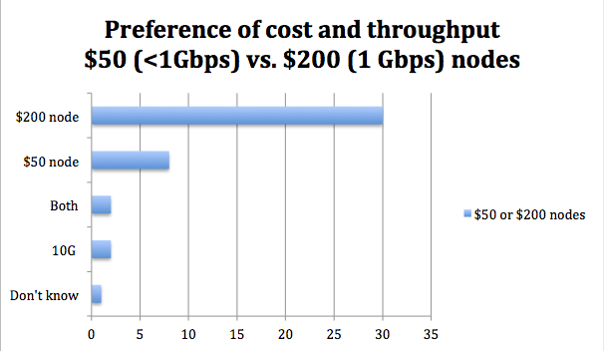
Survey Surprise
Survey respondents generally preferred slightly higher cost and the ability to test at 1Gbps

Slide 10
A Course Change
Began investigating slightly higher cost/performance nodes
Targeting around $200 per node
Capable of achieving 1Gbps BWCTL throughput
Easy to install
Intel CPUs to avoid complications with supporting ARM builds

Slide 11
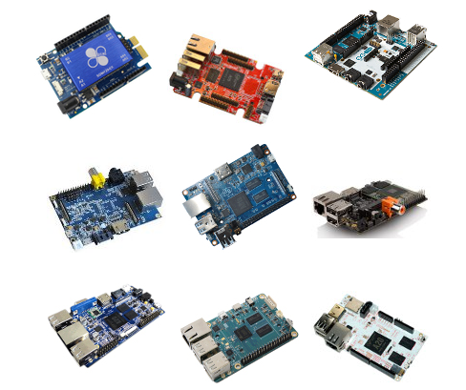
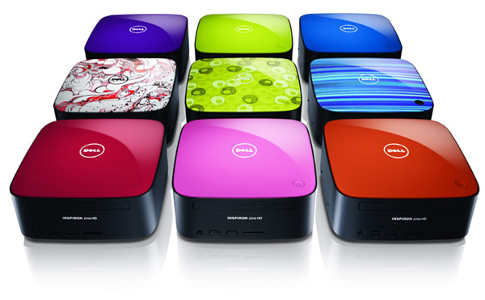
“Problem” Statement
First world problem: there are now dozens and dozens of small nodes on the market
Many groups/institutions have very specific needs or goals which may require odd/interesting choices of gear.

Slide 12
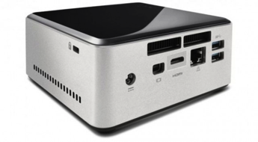
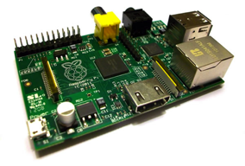
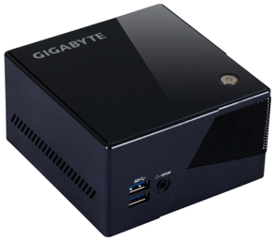
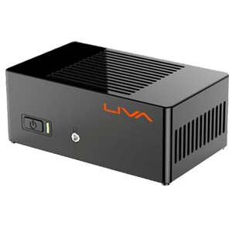
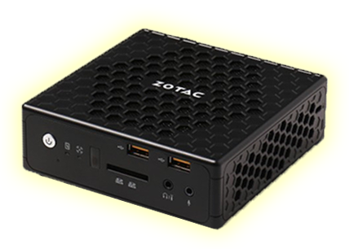
Possible Solutions
…

Slide 13
HIDDEN SLIDE
The LIVA (as of Fall 2015) was what we were recommending. This has changed – so ask questions on perfSONAR-dev for current thoughts
Since this time “we” have developed more of a test and review format for recommendation to avoid supporting a single selection which only works for certain applications

Slide 14
Possible Solutions – LIVA by ECS
Pros:
Cost
Sold as complete kit
Cons:
Reports of CPU bottlenecking in testing
EMMC drive requires Debian/Ubuntu
“Headless” operation issues

Slide 15
LIVA/Debian Installation
Ubuntu 12.04.5 Desktop
Server doesn’t have proper EMMC driver
Debian (Ubuntu) perfSONAR packages: http://docs.perfsonar.net/install_debian#configuration
Using EXAMPLE script log found at: http://download-test.odi.iu.edu/liva-ps/go http://download-test.odi.iu.edu/liva-ps/foo
And associated files on the USB drive (ntp10 and conf10)
More instructions for LIVA installation: http://docs.perfsonar.net/low_cost_nodes_configuration.html

Slide 16
Possible Solutions – GigaByte BRIX
Price-point: $150-200 (all pieces)
Supported Build: CentOS Toolkit
1GE tested
2/4/8G memory
Recommend 32G SSD
Requires memory/drive purchase separately (price at top includes)

Slide 17
Possible Solutions – GigaByte BRIX
Pros:
Supported Build: CentOS Toolkit
1GE tested
Cons:
Power button on top
Bulky power brick
Single NIC

Slide 18
Possible Solutions – Zotac
Price-point: $150-200 (all pieces)
Supported Build: CentOS Toolkit
1GE tested
2/4/8G memory
Recommend 32G SSD
Requires memory, drive purchase separately (price at top includes)

Slide 19
Possible Solutions – Zotac
Pros:
Quad-core CPU
Front-facing power indicator/button
And more small touches like this
Ports, ports, ports!
Tool-less case dis/assembly
Cons:
Single NIC

Slide 20
Possible Solutions – Intel NUC
Price-point: $150-200 (all pieces)
Supported Build: CentOS Toolkit
1GE tested
2/4/8G memory
Recommend 32G SSD (Requires mSATA)
Requires memory, drive, and (sometimes) power cord purchase separately (price at top includes)

Slide 21
Possible Solutions – Intel NUC
Pros:
Supported Build: CentOS Toolkit
1GE tested
Cons:
Some early versions still sold without power cord, and require mSATA
Bulky power brick

Slide 22
Possible Solutions – NUC7i3BNH/K
Price-point: $350-400 (all pieces)
Supported Build: CentOS Toolkit
1GE tested; 3.4Ghz proc. <!>
Up to 32G memory
Requires memory, drive purchase separately (price at top includes)

Slide 23
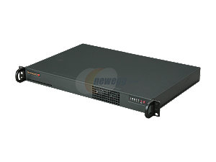
Possible Solutions – SuperMicro by Servers Direct
Price-point: $600-1000 (all pieces)
Supported Build: CentOS Toolkit
Rack-mounted
1GE/10GE tested
Customizable builds

Slide 24
Possible Solutions – gigabyte EL-20-3700-32GB
Price-point: $250 (no assembly; firmware flash required)
Supported Build: CentOS Toolkit
1GE tested
FIONA-ette PRP-recommended
What you’re using today.

Slide 25

Passive Cooling (possible issue)
Most of the above include no fan in the box for cooling
No direct issues with this were found during testing, but it is definitely worth considering when placing in warmer spaces.

Slide 26
Things to Keep in Mind
You get what you pay for… mostly
Prices vary widely and often
Most of these options are Single NIC
pS PTB recommend Dual NIC systems to test OWAMP and throughput on unique interfaces
Read the fine print
Most of these come as barebones systems, but the descriptions can be misleading
Newer, better always coming Soon™

Slide 27
So this replaces large servers?
No, not really.
There is still a need to have larger boxes with more memory, higher speeds, warranties, stability, etc.
BUT there are niches where these are really useful and the cost makes them easy “starter” boxes
Limited to 1GE (currently)
Fragile and possibly “Leggy” (not easily mounted into existing rack structures)

Slide 28

Low-cost, Small Nodes in the Wild
Raspberry Pi deployment (Alan Whinery - University of Hawaii)
ultra-low-cost (30 USD), ultra-small size, USB hub power capable
Low-speed Ethernet, not as useful for bwctl (throughput); fine for OWAMP
LIVA deployment beginning (IN@IU/APAN/Esnet/IU GlobalNOC)
100-125 USD, small form factor, 15 watts usb micro
No fan, cannot support CentOS 6/Toolkit build on native drive (Ubuntu 12.04/Debian build)
NUC/GigaByte/Zotac (in testing IN@IU/SCInet15 Flock)
Servers Direct deployment (KENET - NSRC and IN@IU)
1 RU rack-mounted server, 600-1000 USD
Know of Another?
Strengths?
Limitations?

Slide 29
So is that it?
No
We as a community should continue to investigate and test new technology/options as they become available.
Try new ways to use older ideas
Research: Faster, smaller, cheaper, better. When we can get all of these we can stop. (no, not really)
Small node prices and models are constantly fluctuating; next time we talk there will be something new to evaluate.
Trials and test meshes exist in several institutions to continue evaluating boxes in the $100-$200 range for both CentOS and Debian distributions

Slide 30
So is that it?
As small nodes improve, and costs decrease, even more options will become viable
While the initial tests can be good reference, the perfSONAR Dev group isn’t in the full time business of defining all variables on all devices. Which is where the community comes in!
“We” are working to make it easier for the pS Community to share their reviews of devices, experiments in the works, and use cases from the field.

Slide 31
What’s Next?
Develop flashable images
More HOWTOs for setting up nodes
Scripts to make setup easier
Post results and information to perfSONAR website: https://github.com/perfsonar/project/wiki/perfSONAR-Endpoint-Node-Project

Slide 32
In Closing…
More nodes equals more data for troubleshooting
Lower cost = more possible nodes
Small size means they can ride along in backpacks for adhoc testing
Other possible benefits:
Power over Ethernet (POE), Fit in places where space is at a premium

Slide 33

Resources
Low-cost Nodes Primer - https://www.perfsonar.net/deploy/hardware-selection/low-cost-hardware/
Finding the right Installation - http://docs.perfsonar.net/install_options.html

Slide 34
perfSONAR Low-Cost Hardware
GPN Member’s Meeting 2018
Scott Chevalier — schevali@iu.edu
George Robb — robbg@missouri.edu
Matt Younkins - younkinsm@ou.edu
June 1, 2018
This document is a result of work by the perfSONAR Project (http://www.perfsonar.net) and is licensed under CC BY-SA 4.0 (https://creativecommons.org/licenses/by-sa/4.0/).

