Slide 1
HIDDEN SLIDE – Summary
These slides are meant to be used as a guide for those installing perfSONAR for the first time.
You *ARE* allowed to delete things you don’t understand ,or modify the message to fit a specific group
You *ARE* allowed to add more if the audience is more technical
Presentation styles vary – please study up before presenting

Slide 2
HIDDEN SLIDE – About
Title: perfSONAR-2-Installation_and_Basic_Configuration
Expected Presentation Time: These slides should take 60 minutes to present (if you assume pauses for hands on).
Exec Summary: These slides are meant to serve as a pictoral ‘how to’ for installing and configuring basic aspects of a *toolkit* instance.
Expected Audience: Engineering (low and middle level). Those who still touch equipment.
Audience Skill Level: Little knowledge of perfSONAR (e.g. know what it is from high level talks)
Last Reviewed: January 2nd 2018
This edition uses screenshots from perfSONAR version: 4.0.1

Slide 3
HIDDEN SLIDE – Content Outline
Outline:
Hardware Choice (basic)
Software (toolkit installation only)
Installation (steps that you see)
Configuration (steps that you take for basic operation)
The Consequences – describe what comes ‘after’ this
What Can be Cut:
Note that this slide deck is a lot of pictures of things to do – really this serves as documentation for someone doing it ‘later’
The presenter will ideally be using this during hands on, and will show the same things live.
Nothing really should be ‘cut’ since its documentation.

Slide 4
Installation & Basic Configuration
GPN Member’s Meeting 2018
Scott Chevalier, IN@IU, schevali@iu.edu
George Robb — robbg@missouri.edu
Matt Younkins - younkinsm@ou.edu
June 1, 2018
This document is a result of work by the perfSONAR Project (http://www.perfsonar.net) and is licensed under CC BY-SA 4.0 (https://creativecommons.org/licenses/by-sa/4.0/).

Slide 5
Overview
Hardware
Software
Installation
Configuration
The Consequences

Slide 6
HIDDEN SLIDE – Slides 7-9
There is an entire other hardware deck – look in the rest of the materials for it.
Perhaps stick some things from that in here, if you need them.
Otherwise, summarize hardware as ‘use server hardware for best results’. If someone presses you, go into detail about virtualization and micro-machines. The best retort is ‘for real network performance, use real machines’ For fake network performance, use fake machines’.

Slide 7
Hardware Considerations
http://docs.perfsonar.net/install_hardware.html
Dedicated perfSONAR hardware is best
Server class is a good choice
Desktop/Laptop/Mini (Mac, Shuttle, ARM) can be problematic, but work in a diagnostic capacity
Other applications running may perturb results (and measurement could hurt essential services)
Running Latency and Throughput on the Same Server
If you can devote 2 interfaces – version 3.4 and above of the toolkit will support this.
If you can’t, note that Throughput tests can cause increased latency and loss (latency tests on a throughput host are still useful however)
Notes:
Remind everyone that we do update the web site regularly.
Takeaways – ‘real’ hardware (not virtual, avoid super small machines until the small node effort has data)

Slide 8
Hardware Considerations
http://docs.perfsonar.net/install_hardware.html
1Gbps vs 10Gbps vs 40Gbps vs 100Gbps testers
There are a number of problem that only show up at speeds above 1Gbps – both are still super useful
Virtual Machines do not always work well as perfSONAR hosts (use specific)
Clock sync issues are a bit of a factor
throughput is reduced significantly for 10G hosts
VM technology and motherboard technology has come a long way, YMMV
NDT/NAGIOS/SNMP/1G BWCTL are good choices for a VM, OWAMP/10G BWCTL are not
Docker containers being tested for performance as well; TBD
Notes:
Remind everyone that we do update the web site regularly.
Takeaways – ‘real’ hardware (not virtual, avoid super small machines until the small node effort has data)

Slide 9
Overview
Hardware
Software
Installation
Configuration
The Consequences

Slide 10
HIDDEN SLIDE – Slide 11-14
2 different installation paths: classic or advanced
Also note that we support CentOS, Debian and Ubuntu (with corresponding versions). RHEL, SL and other derivatives ‘may’ work. Anytime someone goes against the grain, it leads to trouble.
Flowchart is there to aid choosing which option to choose depending on use case.

Slide 11
Preparing The Software
The best source of information is here:
http://docs.perfsonar.net
Note that if you are still using 3.5.x … it’s PAST time to upgrade!
yum update will get you 4.0.3
rebuild required for upgrade to RHEL7 from RHEL6
3.5.x/bwctl will become unsupported with the release of 4.1
The two viewpoints of the perfSONAR Owner:
Cattle, not pets: it’s an expendable server that is not tightly integrated (e.g. if it is owned or dies, remove the carcass and reprovision)
Pets - Treasured members of the family: each is integrated into configuration and user management (e.g. secured and watched like a child)
Either viewpoint can be supported, know the tools and what you want (e.g. are willing to put into the task)
Notes:
Machines must be maintained in some way – if they aren’t, they become a security risk

Slide 12
Install Options: Classic or Advanced
CentOS 7 ISO image
Full toolkit install
Easy, all contained
Want more control? Bundle of packages
perfsonar-tools
perfsonar-testpoint
perfsonar-core
perfsonar-toolkit
perfsonar-centralmanagement
+ optional packages
CentOS 6 – 7, Debian 7 – 8 – 9, Ubuntu 14 – 16

Slide 13
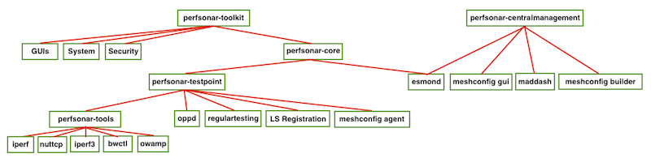
Package bundles structure

Slide 14
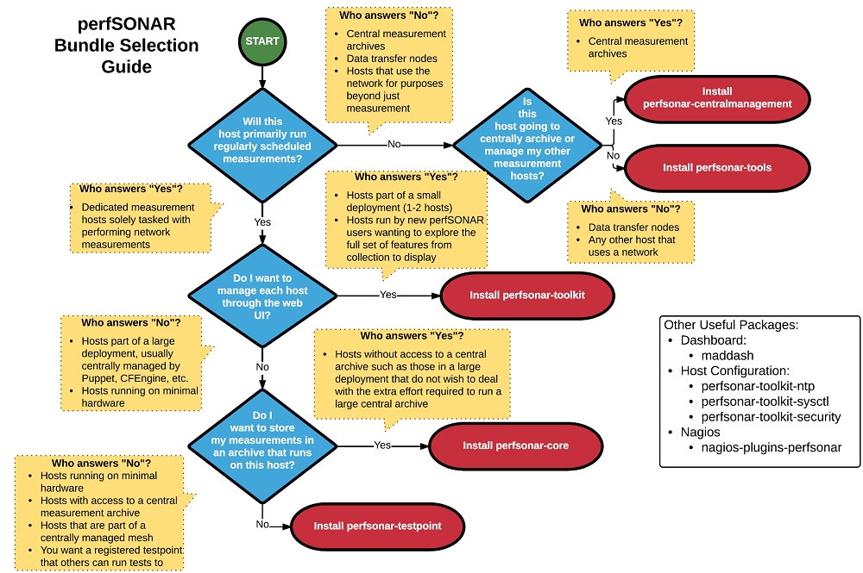

Slide 15
Overview
Hardware
Software
Installation
Configuration
The Consequences

Slide 16
HIDDEN SLIDE – Slides 17-20
Another set of slides that doesn’t matter – if the person knows linux, they will know this.
Basically assure them that the process is designed to ensure success on most forms of hardware. Follow defaults.
Note – this assumes The CentOS ISO install. This is not the ‘Debian’ deck, and this isn’t the ‘Bundle’ deck. If you want to insert that info, you can.

Slide 17
Installation
N.B. This assumes CentOS Linux ISO installation (Debian/Ubuntu and CentOS bundles are available, but will not be discussed)
The boring first part:
Download the software (http://docs.perfsonar.net/install_options.html)
Which to pick (outcome is the same in both cases)
ISO and bundles = Fullinstall image = all packages on a single DVD/USB that does not require a network connection to install
Burn to installation media (USB, Optical Drive)
“iso to bootable usb”

Slide 18
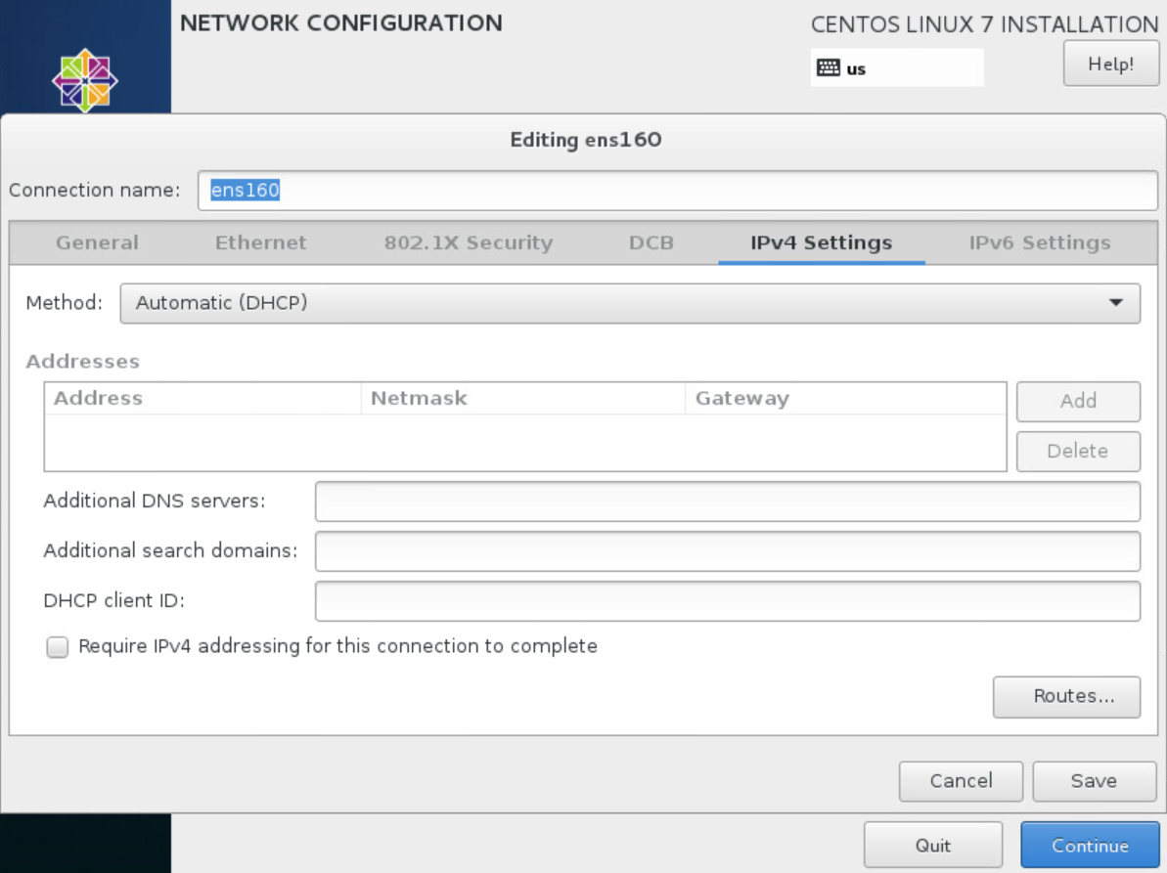
Installation
Boot and follow the nice prompts, just like Linux (because it *IS* Linux):
This can take 15min to an hour depending on the speed of your machine and network. No hard questions, defaults are normally sufficient

Slide 19
Installation
Some things to be aware of:
The network options you set during installation are just for installation (e.g. if you set a static address, be prepared to do it again when the host comes online)
CentOS/RHEL knows what it wants to do with the disk better than you do. It doesn’t give many ways to slice and dice partitions, so just be aware of this.
If you don’t see a package you want, its often easier to just use ‘yum’ after the fact to find it than using the curses interface to select it.

Slide 20
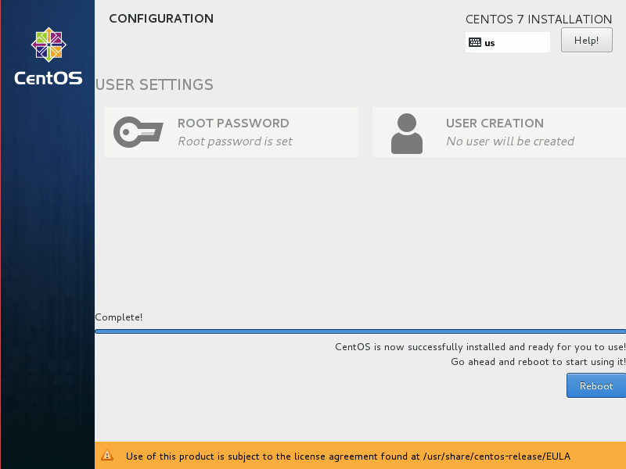
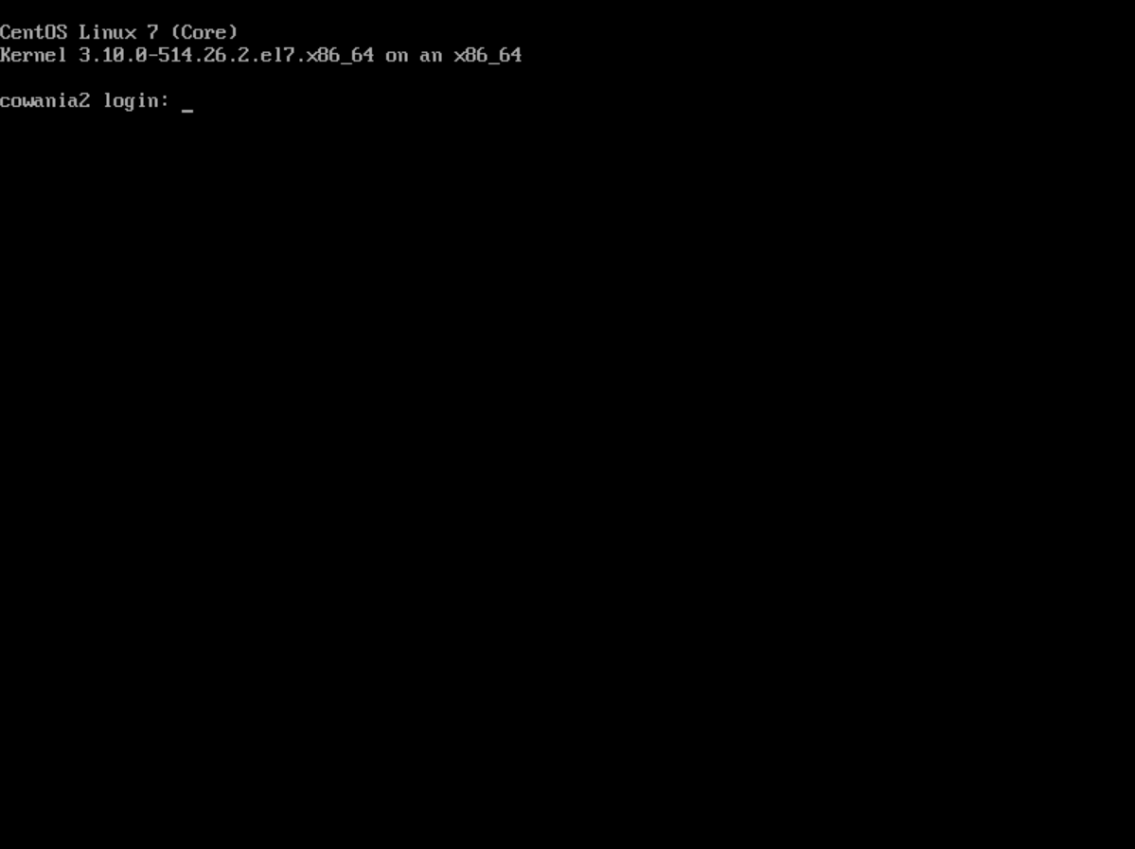
Installation
When its done, reboot and come back to a prompt (note – you set a root account during the install)

Slide 21
Overview
Hardware
Software
Installation
Configuration
The Consequences

Slide 22
HIDDEN SLIDE – Slides 23-42
There are lots and lots of screen shots. The next section is typically only used if you can’t do a hands on (and for reading later).
Also remember this is assuming a ‘toolkit’, not something custom (Debian/CentOS bundles)
Also – this is about ‘how to install’, not necessarily ‘how to use’. The later is addressed in other presentations.

Slide 23
Configuration
The toolkit is ‘almost’ ready to use after installation.
Many services will start without your direct intervention
Others need some minor config
When logging in for the first time, you will have to do a couple of quick things:
Set an administrator (its not safe to use root for web things …)
Enable SSH for the user
Notes:
Note – machine will function mostly fine in a diagnostic role without config. Config is needed to use regular testing, and register to LS infrastructure

Slide 24
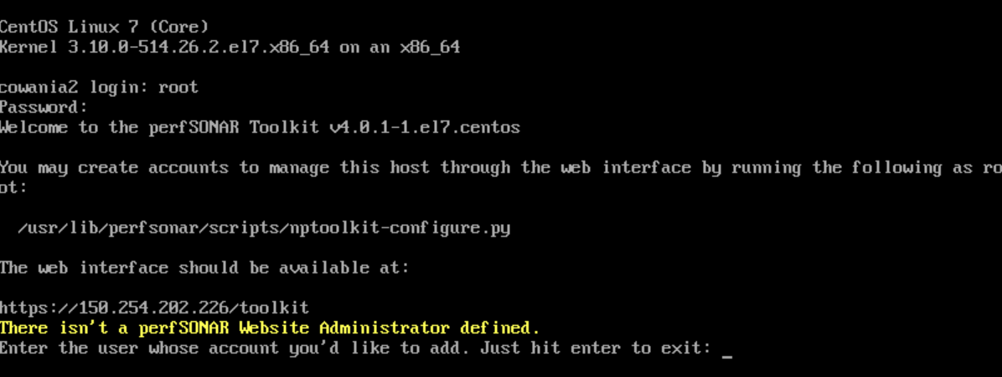
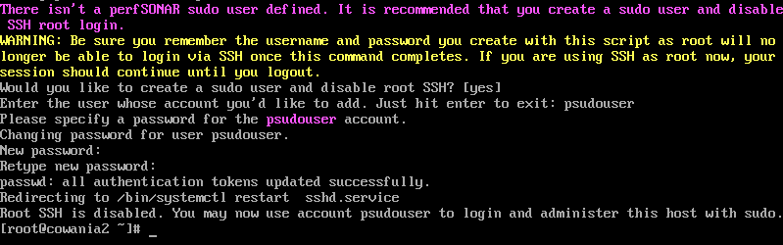
Configuration

Slide 25
Configuration - Web
We can do most other things via the web interface once we have a user that can auth against it (do-it-yourselfers can still hand edit config – we just won’t deal with that here)
Some things we care about:
Administrative info
NTP (time keeping)
Turning on/off services
Configuring some tests (directly)
Some additional features to be aware of:
Reverse CGIs
Log Analysis

Slide 26
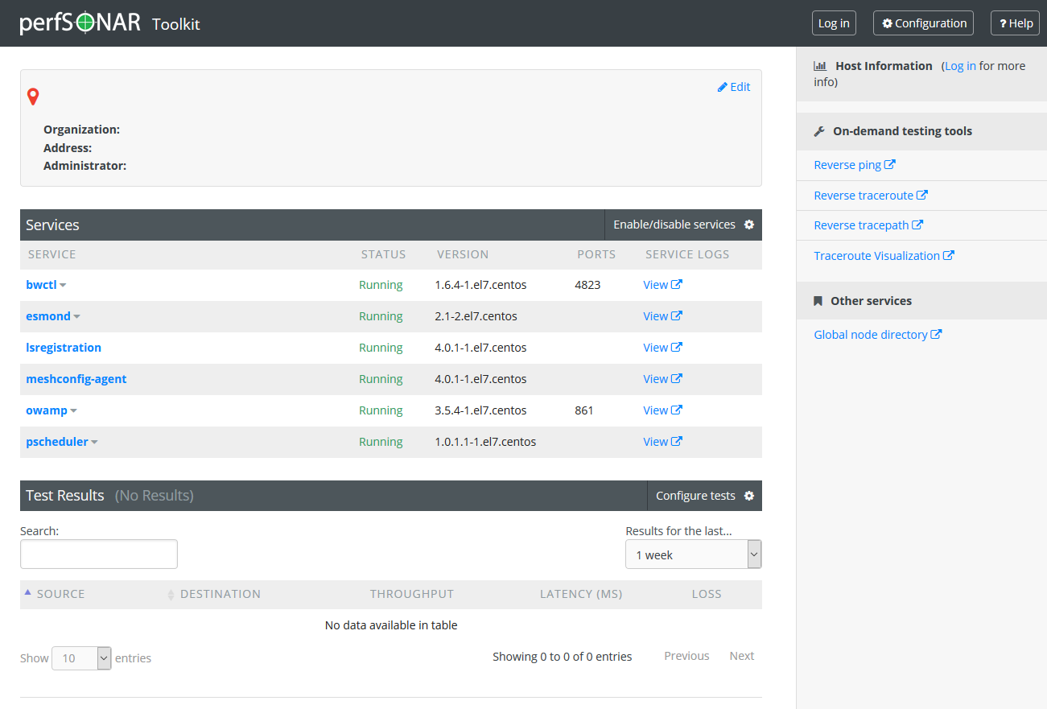
Configuration - Web

Slide 27
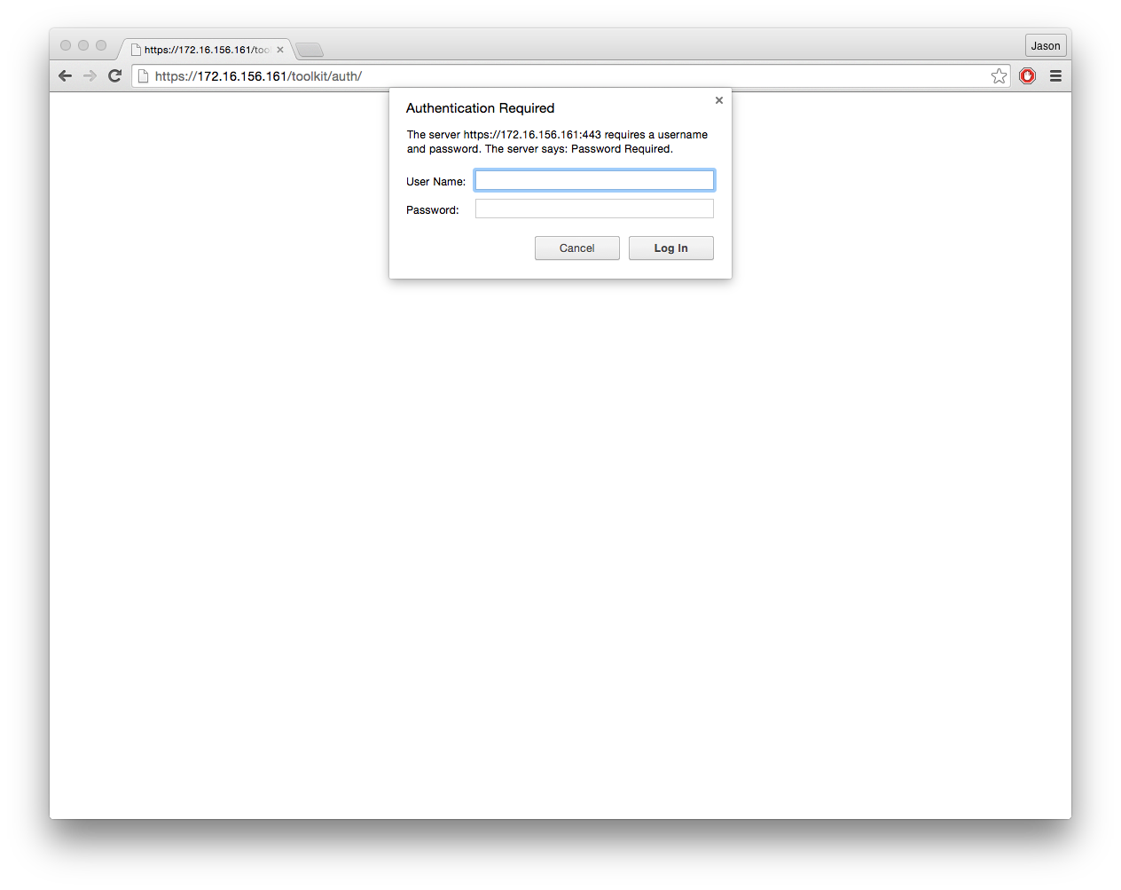
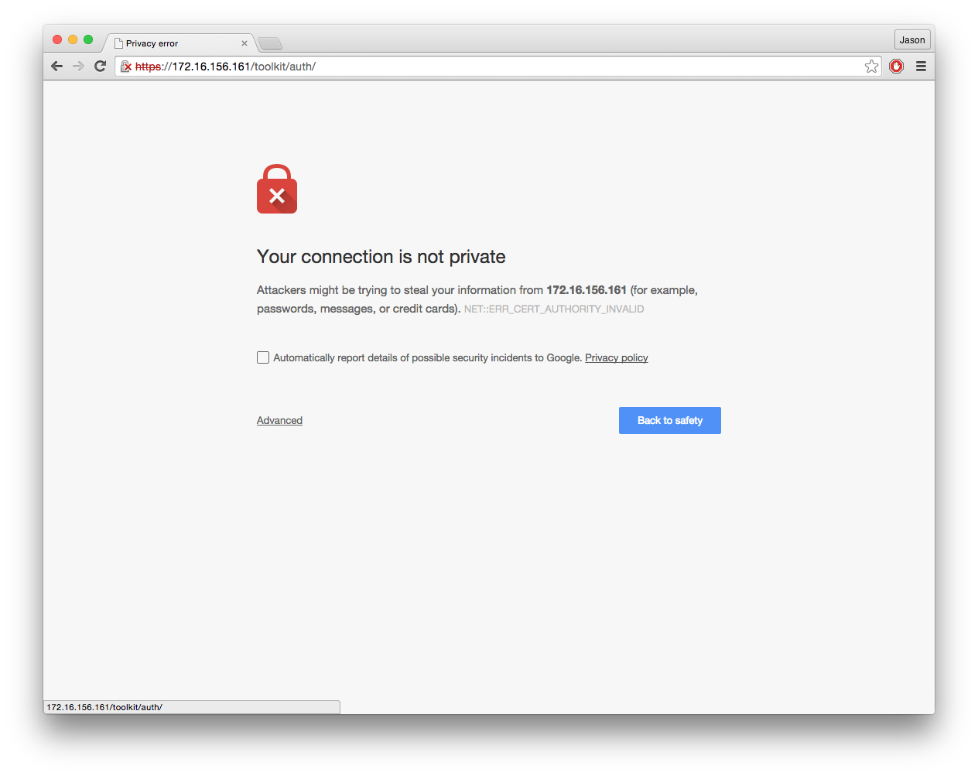
Authentication
The user you created will need to authenticate to make system level changes.
The machine has a self-signed (e.g. ‘lame’) certificate, so be aware of that:
27 – 6/1/18, © 2013 ESnet, Internet2
J. Zurawski – zurawski@es.net

Slide 28
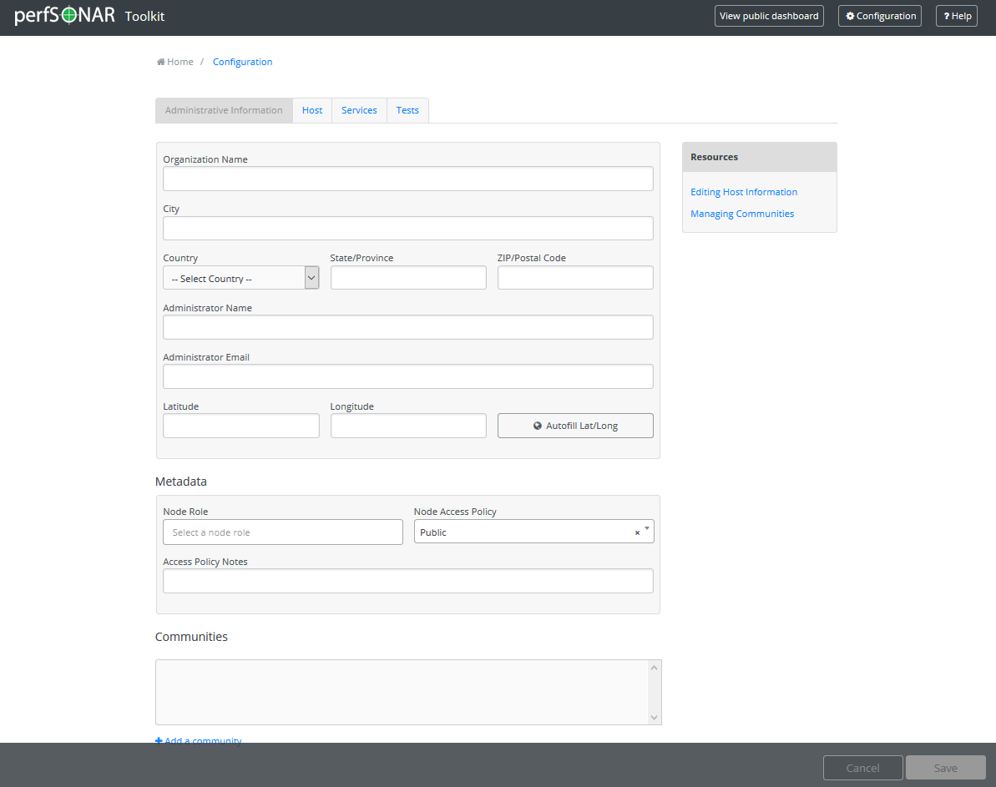
Administrative Info
For the most part this is point and click – the system needs this so that it can be located, and so that certain services will start.
Notes:
Everyone should do this, and be sure to enter lat/long info
Note that after this occurs – LS registration happens ‘automatically’ as long as the host is not in private space

Slide 29
Lookup Service Integration
Once you complete the administrative info – your host will attempt to register with the “Lookup Service”
This is a global directory that makes it easier to find perfSONAR nodes.
If your host as the admin info present, and isn’t a private IP, it will do this automatically
Notes:
Everyone should do this, and be sure to enter lat/long info
Note that after this occurs – LS registration happens ‘automatically’ as long as the host is not in private space

Slide 30
NTP
Note that it may take a day to fully stabilize the clock
Pick 4 – 5 Close servers for NTP
We have a fast way to do this, or you can manually select
Can also add your own servers if you don’t like ours
Notes:
Also a requirement. If your site is blocking NTP, use internal servers

Slide 31
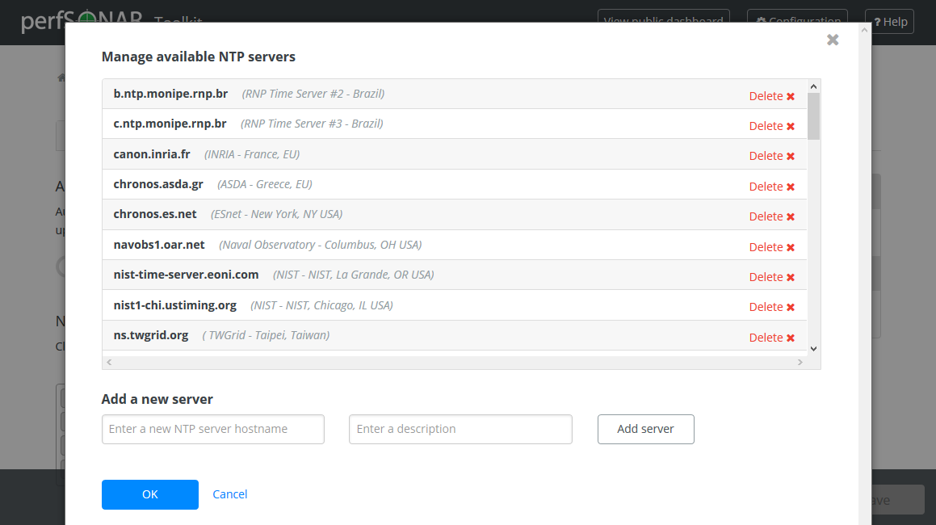
NTP
Services like BWCTL/pScheduler and OWAMP require a stable time source.
The toolkit interface allows you to configure your own host, or choose a public one we know of.

Slide 32
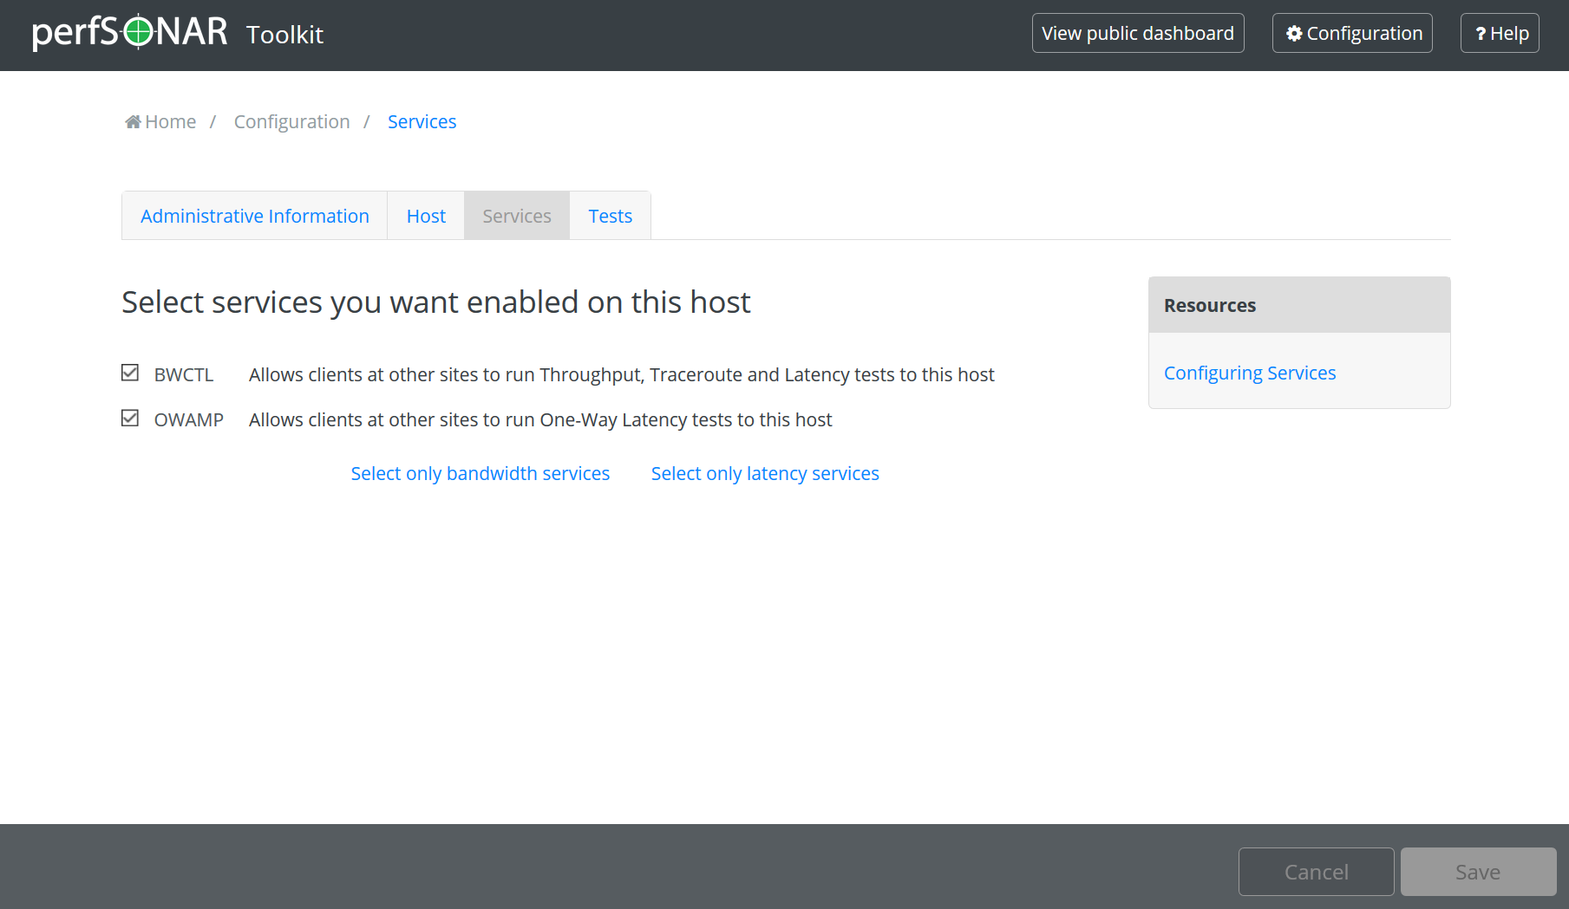
Services
Many of the measurement services on the toolkit can be enabled/disabled via the web interface.
Other system services should be managed the ‘Linux Way’ via chkconfig.
Notes:
Default use case should not need to touch any of these

Slide 33
Regular Testing
There are a couple of ways to do this.
Beacon: Let others test to you (e.g. no regular configuration is needed)
Island: Pick some hosts to test to – you store the data locally. No coordination with others is needed
Mesh: full coordination between you and others (e.g. consume a testing configuration that includes tests to everyone, and incorporate into a visualization)
Examples follow, for now we will focus on case number 2 for now
Notes:
Most people will use this way of testing instead of the mesh

Slide 34
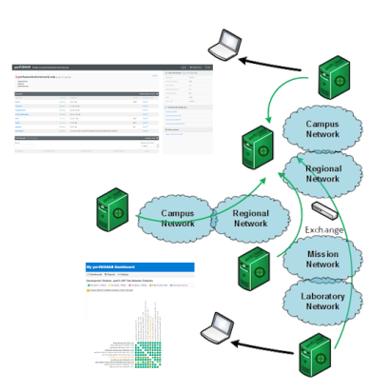
Regular Testing - Beacon
The beacon setup is typically employed by a network provider (regional, backbone, exchange point)
A service to the users (allows people to test into the network)
Can be configured with Layer 2 connectivity if needed
If no regular tests are scheduled, minimum requirements for local storage.
Makes the most sense to enable all services (bandwidth and latency)

Slide 35
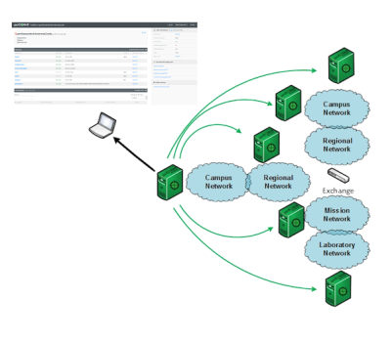
Regular Testing - Island
The island setup allows a site to test against any number of the 1200+ perfSONAR nodes around the world, and store the data locally.
No coordination required with other sites
Allows a view of near horizon testing (e.g. short latency – campus, regional) and far horizon (backbone network, remote collaborators).
OWAMP is particularly useful for determining packet loss in the previous cases.
Throughput will not be as valuable when the latency is small

Slide 36
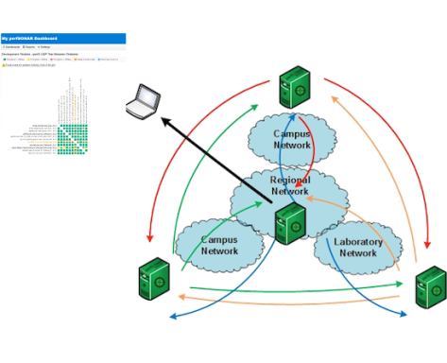
Regular Testing - Mesh
A full mesh requires more coordination:
A full mesh means all hosts involved are running the same test configuration
A partial mesh could mean only a small number of related hosts are running a testing configuration
In either case – bandwidth and latency will be valuable test cases

Slide 37
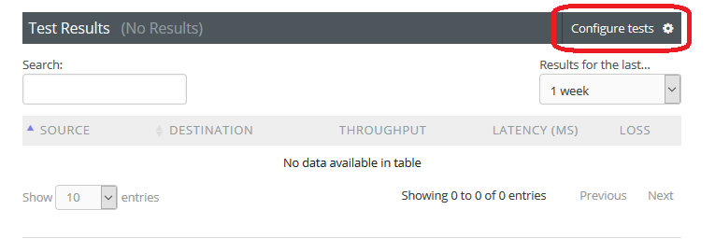
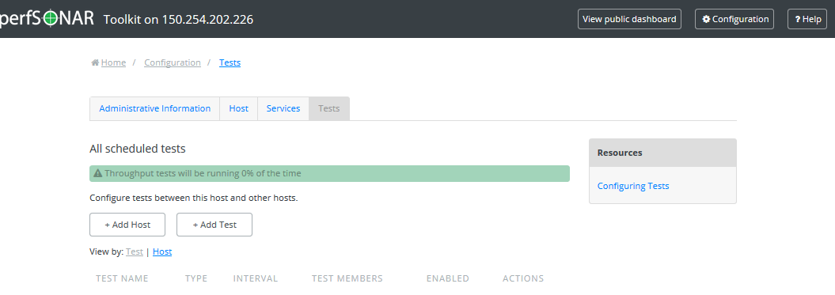
Regular Testing - Island
Get into the Interface this way, and then note you have nothing going if this is a new install
For the sake of argument, we will walk through a throughput test. See the docs for other examples

Slide 38
Regular Testing – Testing Types
Types of testing:
Throughput
“How Much” of the network can I achieve in a set amount of time. Can be TCP or UDP based, typically uses iperf3 as the testing tool via pScheduler
One Way Delay
Latency, duplication, loss, and ordering information for a one way stream of UDP packets. Uses the OWAMP tool
Network Route
Path traveled (layer 3) between source and destination. Uses the traceroute and tracepath tools via pScheduler
Round Trip Delay
Latency and loss from source, to destination, and back. Uses the Ping tool via pScheduler.

Slide 39
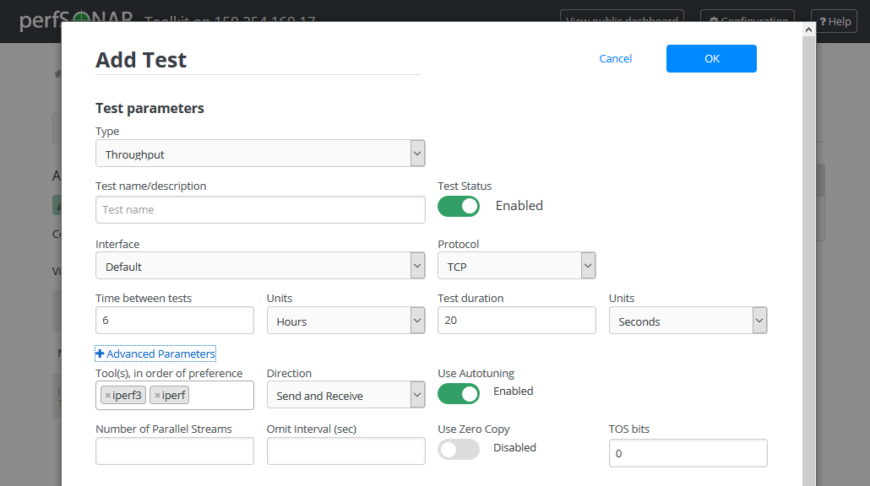
Regular Testing - Island
Add a new test, and be faced with a new dialog
The important things are to decide what you want to do:
How long will the test be (Test duration)
How many times a day will it occur (Time between tests)
For many people, a 20 second TCP test, run every 4-6 hours, is sufficient.

Slide 40
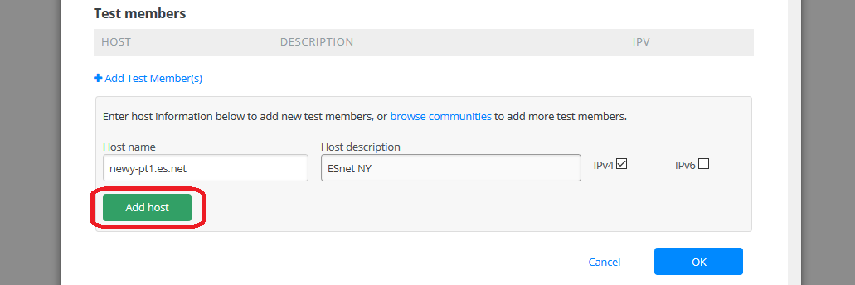
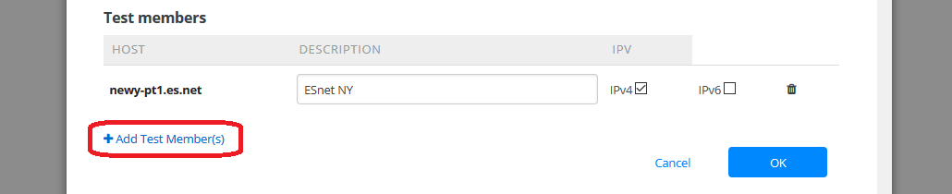
Regular Testing - Island
One we establish the parameters, we need things to test to. Either manually enter a host, or choose them from our directory service.

Slide 41
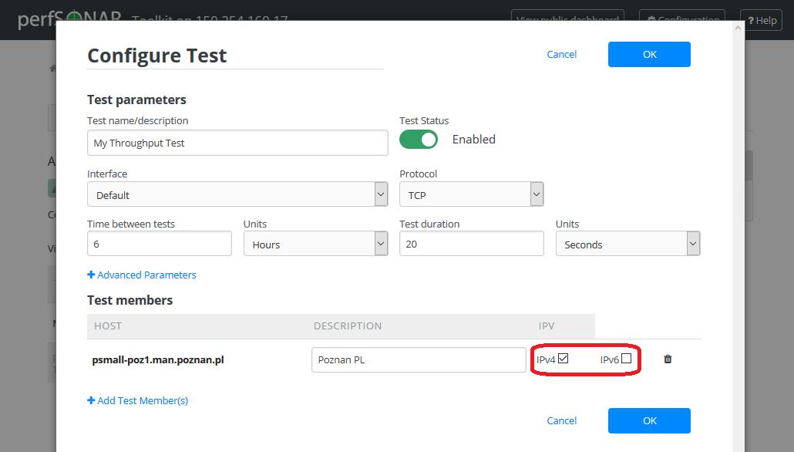
Address Families
Note that the tools are IPv4 and IPv6 capable. If a functional IPv6 address is available, that will be the default chosen. To force one or the other in the test interface, pay attention to the test members
To truly force one or the other, enter the address for a host, instead of a hostname.
Notes:
IF you want to do all IPV6, set it up using that. If you have dual stacked your hosts, they will default to IPV6

Slide 42
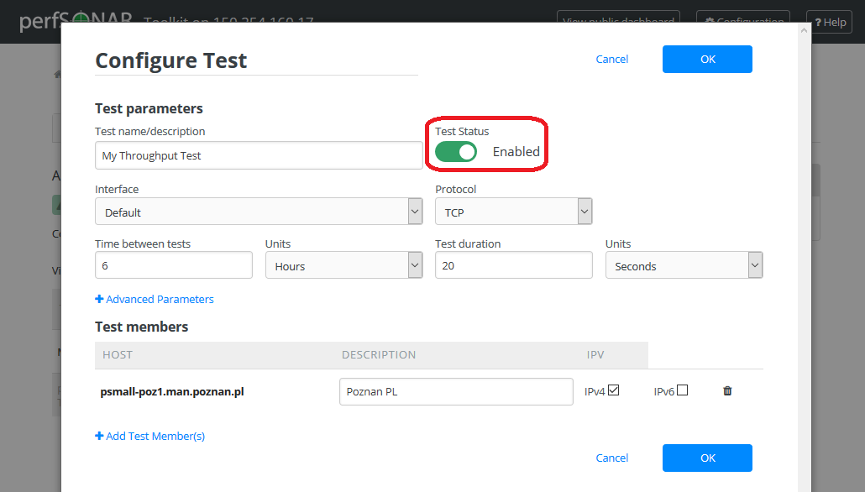
Disabling
Lets say you need to quiet the noise of regular testing – disable the test

Slide 43
Overview
Hardware
Software
Installation
Configuration
The Consequences

Slide 44
HIDDEN SLIDE – Slides 45-47
Summarize what you are doing – getting measurements of course.
This is just the first step, the other decks will expand on these ideas.

Slide 45
Transition – What did we just do?
perfSONAR interface is meant to be simple
Enabling this on campus is the first step to seeing a simulation of performance for a bulk data tool. Ideally you would place the perfSONAR server where the users are (e.g if they are traversing a firewall still, why don’t you learn their pain)?
Configuring regular tests is systematic – pick regional and far away destinations.
Dust off netflow, and see where the data is going – configure tests to those locations too.

Slide 46
The Metrics
Use the correct tool for the Job
To determine the correct tool, maybe we need to start with what we want to accomplish …
What do we care about measuring?
Packet Loss, Duplication, out-of-orderness (transport layer)
Achievable Bandwidth (e.g. “Throughput”)
Latency (Round Trip and One Way)
Jitter (Delay variation)
Interface Utilization/Discards/Errors (network layer)
Traveled Route
MTU Feedback

Slide 47
Regular Use
The best way to get buy in (at all levels) is to use the machines:
Encourage 1st line network support/help desk techs to see what the tools do.
Useful for basic things:
Traceroute beacon
Visualization of existing regular tests
Encourage 2nd line support to experiment with the command line tools.
Develop reports of performance (e.g. query data from the archive and create an XLS spreadsheet/chart)

Slide 48
Installation & Basic Configuration
GPN Member’s Meeting 2018
Scott Chevalier, IN@IU, schevali@iu.edu
George Robb — robbg@missouri.edu
Matt Younkins - younkinsm@ou.edu
June 1, 2018
This document is a result of work by the perfSONAR Project (http://www.perfsonar.net) and is licensed under CC BY-SA 4.0 (https://creativecommons.org/licenses/by-sa/4.0/).

