Slide 1

ZFS
Using ZFS in a “Research Grade” environment

Slide 2
ZFS – What is it?
Volume and file system management all in one.
Excellent feature sets including data integrity, performance, and native administration tools.
Released in 2005 (Solaris) and in 2013 ZFS open source project begins.
Eliminates need for RAID hardware (recommended: pass-through or direct spindle connections!)
Online: “scrub”, exports, snapshots, expansion and tuning.
Self healing (sha256 block and block tree hashed check-sums)
Copy on write with error detection.

Slide 3
ZFS – Discussion Outline
Zpool
  VDEV
  RAIDZ
  ZIL on the SLOG
  ARC / L2ARC “cache” / Spinning Rust
  Select zpool Properties
  Care and feeding
ZFS Datasets
  Cow and Cryptographic data integrity
  Capacity
  Compression vs De-duplication
  Snapshots, shipping and receiving.
  NFS
  ZFS properties
RCSS Build
Future
Links and Q&A

Slide 4
ZPOOL
A zpool is the resulting object from the assembly of the disks.
/dev/md0 – software raid
/dev/sda – hardware raid
/zpool – the volume or zfs dataset pool
The overall container that zfs file systems will reside inside of.

Slide 5
ZPOOL - RAIDZ
RAID-0 (stripe) - “cache”
RAID-1 (mirror) - “log”
RAIDz-1 (raidz) – can be though of as raid5 without the write hole or data loss problems.
RAIDz-2 (raidz2) - more parity more failure)
RAIDz-3 (raidz3) - even more parity and more failure)
RAIDz-(zpool create raidz sda sdb raidz sdc sdd) – a hybrid pool and moves towards raid 1+0 analogies.
Hotspare / autorebuild / autoexpand

Slide 6
ZPOOL - ZIL on the SLOG
A Latency Destroyer (a write cache that is frequently flushed)
Quick win for performance and way to remove excessive I/O load from inside the pool
Should be “fast” compared to the pool (ssd)
Does not need to be large (8GiB is almost overkill)
Mirroring is a great idea
Should be able to persist state through reboot.

Slide 7
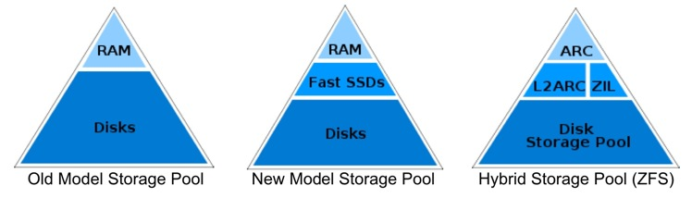
ZPOOL – ARC
Adjustable Replacement Cache (ARC), part of the ZFS “magic”
Caches recent AND frequent blocks
Easy to augment with SSD (stripes)
Augments the overall performance and helps RAM.

Slide 8
ZPOOL – Select Properties
ashift - take advantage of advanced format 4KiB sector drives
autoexpand – replace drives 1 by one and overall pool expands. 3 TiB → 10 TiB drives.
autoreplace – what, drives fail?
Test and understand before using (e.g. autoexpand could be very time consuming if not set at pool creation time)

Slide 9
ZPool – Care and feeding
ECC RAM!
64-bit system (its a 128-bit file system)
RAM, more RAM
SSD(s)
Spindle counts and logical expansion
Occasional scrub and status
Tuning (compression, disk layout, benchmarks).

Slide 10
ZFS – Datasets
Main file system that lives in the zpool
Full feature copy on write (COW) file system
COW is similar to virtual file systems (vmdk and qcow2)
Enables snapshots and in place activity

Slide 11
ZFS – Cryptographic Hash
Cryptographic data integrity for blocks and block trees.
Scrubs will check (sha256) all data block up the tree to the super block.
Allows for dynamic self healing
Faster than hardware RAID controllers which scan entire disk vs consumed data.
More reliable than a generic fsck.
Done online!

Slide 12
ZFS – Capacity
The limitations of ZFS are designed to be so large that they should never be encountered in practice. For instance, fully populating a single zpool with 2^128 bits of data would require 10^24 3 TB hard disk drives.
https://blogs.oracle.com/dcb/entry/zfs_boils_the_ocean_consumes
"In reality, the latest Seagate 300GB disk weighs 1.6 lbs. You'd need 1E27 of these, or 1.6E27 lbs. The moon weighs 1.6E24 lbs. So you'd need the weight of 1000 moons!! And that's just in the spindles (sans racks, air handlers, etc).”

Slide 13
ZFS – Compression vs Deduplication
Compression is an easy, transparent, performance and space savings win
Deduplication RAM expensive (12 TiB array needs ~240GiB of RAM for the deduplication table to fit), crypto block hashes are used. (Block level de-dupe only!)
L4z in our environment, lzjb, gzip{1..9}, and zle are all supported.
Again, enable at creation time

Slide 14
ZFS - Snapshots
Enabled via the COW features
Is a copy of the crypto tree and can be extremely cheap.
Are instant and can have up to 2^64 of them!
Do not store data until the source begins to change. (fast, again based on crypto tree).
Easy to roll back or clone.

Slide 15
ZFS – NFS
Limiting factor is NFS engine.
Can be used over RDMA (more on this as we finish benchmarks).
For performance we suggest client mount options of: noatime,nodiratime,async
Exports are as easy as:
  zfs set sharenfs=”rw@10.46.0.0/16” tank/DATA

Slide 16
ZFS - Properties
sharenfs – used to control the NFS export of the dataset
atime – suggested off
compression=l4z
Quotas
  Zfs set groupquota@<groupname> size
  Zfs set userquota@<username> size
Online changes

Slide 17
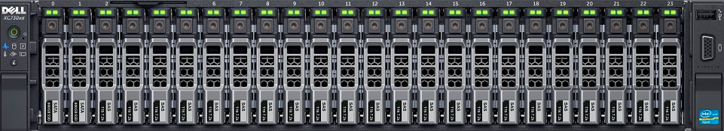
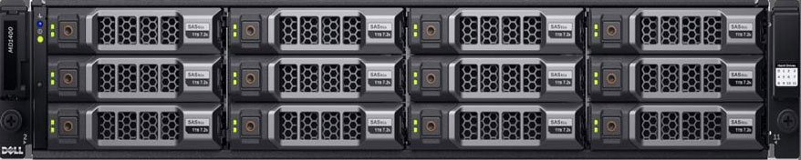
ZFS - current build
High Throughput
Endpoints
Dell R730xd
Dual 40 GigE
Dell MD1400
Dell MD1400
Dell MD1400
318 TiB RAW
10 TiB Spindles
1.6 TiB SSD
2 - SSD per MD1400
3 - MD1400

Slide 18
ZFS – Build command
#!/bin/bash
zpool create tank -f -o ashift=12 -o autoreplace=on -o autoexpand=on \
raidz \
scsi-35000cca2510a7990 \
scsi-35000cca2510a84ac \
scsi-35000cca25111c38c \
scsi-35000cca25111cd58 \
scsi-35000cca25111edb4 \
scsi-35000cca251124ed8 \ #12 disks per raidz (hybrid pool 1+3)
scsi-35000cca25112635c \
scsi-35000cca25112643c \
scsi-35000cca2511273e0 \
scsi-35000cca2511e740c \
scsi-35000cca2511fca10 \
scsi-35000cca25120a1e0 \
raidz \
scsi-35000cca25120c33c \
#.. ## 10 more disks here
scsi-35000cca251241004 \
raidz \
scsi-35000cca251241020 \
#.. ## 10 more disks here
scsi-35000cca251245280 \
zfs create tank/DATA
zfs set compression=lz4 tank/DATA
zfs set sharenfs=rw=@10.46.0.0/16 tank/DATA

Slide 19
ZFS - Performance
Tests using ioping over NFS mounts.
  Name Brand Enterprise NAS - 4.47 k requests completed in 3.00 s, 1.59 k iops, 398.4 MiB/s
  RCSS ZFS (lightly tuned) - 5.21 k requests completed in 2.88 s, 1.27 GiB read, 1.81 k iops, 452.1 MiB/s
Using it with ELK / Bro on a 10GigE stream. (disks “yawn”)
Tested it as shared cluster storage for software (RC4)
Tuning can be “chasing a parked car”

Slide 20
RCSS – Future Ideas
ZFS + Luster
ZFS + GlusterFS
ZFS as shards (/home, /data, /scratch)
Bigger NICs (100GigE)
NVMe for SLOG / L2ARC (toyed with FusionIO)

Slide 21
Links with Q&A
Aaron Toponce – Wonderful blog and excellent YouTube LUG demo.
  https://pthree.org/2012/12/04/zfs-administration-part-i-vdevs/
  https://youtu.be/ny6N8RHX1lQ?list=WL
GitHub / zfsonlinux.org
  https://github.com/zfsonlinux/zfs/wiki/RHEL-%26-CentOS
Dell Hardware Specs:
  http://dell.com search for R730xd and MD1400
Wikipedia – The basics as quick reference.
  https://en.wikipedia.org/wiki/ZFS
Oracle Solaris ZFS Administration Guide
  http://docs.oracle.com/cd/E19253-01/819-5461/index.html

