Slide 1

Puppeting the Cluster
Automation in a “Research Grade” setting.

Slide 2
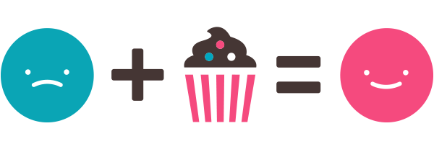
Delight Through Service.

Slide 3
Puppet – What is it…
A platform for automatically delivering, operating and securing your infrastructure – no matter where it runs.
  --[http://puppet.com/product]
Configuration management at scale.
    “class {'ntp': servers => [ 'time-c.nist.gov' ],”
Ability to comfortably run the command:
    “service sshd disable && service sshd stop”

Slide 4
Puppet – Where it is great.
Enforcement of:
  Package installations.
  Configurations.
  Services.
  Firewalls.
  Network fabric management (more on this soon).
  Storage - local and remote.
  HPC day to day...

Slide 5

Puppet – Where it is horrible
Acting like as a remote terminal, instead try:
    Fabric – Python with exec hooks.
    cssh – WYSIWYG
Very complex logic, instead try:
    Sticking with simple tests (that will fail gracefully).
    Using Unless => , require => , case $default_value {}
User management, instead try:
    Other better solutions (LDAP)
    Unix philosophy, one task to do one job well.

Slide 6
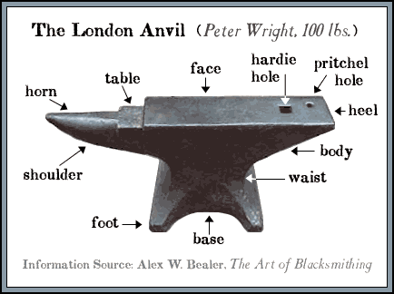
Puppet – the Puppet Forge
Easy to collaborate.
Tons of already written and reviewed modules.
Save time.
  https://forge.puppet.com

Slide 7
Puppet -example – node definition.
node default {
## NTP from - puppet module install puppetlabs-ntp
class { 'ntp':
servers => [
'time-c.nist.gov',
'0.ntp.umsystem.edu',
'1.ntp.umsystem.edu',
'2.ntp.umsystem.edu',
'3.ntp.umsystem.edu'
],
}
## End NTP
}

Slide 8
Puppet - the Puppet Forge
puppet module search ntp
puppet module list
puppet module install puppetlabs-ntp
puppet apply demo1.pp
ntpq -p

Slide 9
Puppet – custom module
$(gitrepo)labs/files/puppet/modules/esnet_tuning

Slide 10
Puppet – custom module breaking it apart
contents of /etc/puppet/modules/
  esnet_tuning/
    manifests/
      init.pp
    files/
      98-sysctl.conf

Slide 11
Puppet – custom module init.pp
class esnet_tuning {
file { '/etc/sysctl.d/98-sysctl.conf' :
ensure => present,
owner => 'root',
group => 'root',
mode => '644',
source => "puppet:///modules/${module_name}/98-sysctl.conf",
}
exec { 'sysctl --system':
subscribe => File['/etc/sysctl.d/98-sysctl.conf'],
refreshonly => true,
path => ["/usr/sbin"],
}
}

Slide 12
Puppet – custom module
98-sysctl.conf
## Source http://fasterdata.es.net/host-tuning/linux/
# allow testing with buffers up to 128MB
net.core.rmem_max = 134217728
net.core.wmem_max = 134217728
# increase Linux autotuning TCP buffer limit to 64MB
net.ipv4.tcp_rmem = 4096 87380 67108864
net.ipv4.tcp_wmem = 4096 65536 67108864
# increase the length of the processor input queue
net.core.netdev_max_backlog = 250000
# recommended default congestion control is htcp
net.ipv4.tcp_congestion_control=htcp
# recommended for hosts with jumbo frames enabled
net.ipv4.tcp_mtu_probing=1
# Get rid of TIME_WAIT based on RFC 1323 expansion.
net.ipv4.tcp_tw_reuse=1

Slide 13
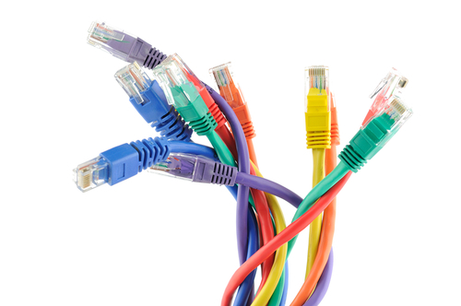
A cupcake driven Network

Slide 14
Cupcake in production
(a “Research Grade” Network)
Its a strange non-enterprise place inside the research network.
  DHCP - on
  DNS - dynamic
  TFTP - enabled
  PXE – yes please
  iPXE – even better yet.
Speeds
  10/100 – wut
  1GigE – gets the job done
  10GigE – candy
  40GigE – better
  100GigE – ludicrous speed go.
Security
  Firewall = network inhibitor device. (Ask about OIN)

Slide 15
Research Network - DHCP
Large blocks per purpose using RFC 1918 space
  Black – IPMI /16
  Red – Management /16
  Cobalt – Storage, SLURM /16
  Orange – IPoIB /16
  Purple – anything goes /16

Slide 16
Research Network - DNS
Zone files for each fabric
  Are dynamically updated via DHCP
Black.lan
Red.lan
Cobalt.lan
Orange.lan
Purple.lan

Slide 17

DHCP + DNS = DDNS
Changed our lives
  No more internal cluster IP address spreadsheets.
  Can we do it on “all the things”?
  YES: BMC, PDU, OOB, Switches, what else?

Slide 18
PXE, iPXE, and TFTP
Preboot Execution Environment (PXE)
  All nodes that can are set to boot from RED
  Allows a node to grab a kernel and “do”
iPXE all PXE and more
  Boot from http, wan, IB, wireless.
TFTP
  Place to get a kernel, boot image, or further instructions.

Slide 19
DHCP subnet
/etc/dhcp/dhcpd.conf
Subnet definition – DDNS here.
zone cupcake.lan. { primary 172.22.2.1; }
zone 0.2.22.172.in-addr.arpa. { primary 172.22.2.1; }
subnet 172.22.2.0 netmask 255.255.255.0 {
range 172.22.2.200 172.22.2.250;
option subnet-mask 255.255.255.0;
if exists user-class and option user-class = "iPXE" {
filename "bootstrap.ipxe"; }
else { filename "undionly.kpxe"; }
next-server 172.22.2.1;
}

Slide 20
DNS zone file
/etc/named.conf
zone "cupcake.lan" IN {
type master;
file "dynamic/cupcake.lan.fw";
allow-update { 172.22.2.0/24; };
};
zone "22.172.in-addr.arpa" IN {
type master;
file "dynamic/cupcake.lan.rev";
allow-update { 172.22.2.0/24; };
};

Slide 21
RCSS- Research Network – All together.
Need OS
An Example (much more on this in a second):
  Node boots to network
    DHCP to find TFTP
  Receives OS overlay instructions
    DHCP for address and DNS resolution
    TFTP for kernel
  OS installed
    Pulls DHCP address
    DHCP reports hostname to DNS
    DNS updated with node name per fabric
L4-x8dtt-node3.{red,cobalt,orange}.lan
BONUS (did we mention DDNS changes our lives):
  ilo-HM138A.black.lan
  idrac-7XC7C1.black.lan
  Apc-pdu-c11-1.black.lan
DHCP / DNS
Proxy / Repo
Clean OS
Puppet

Slide 22

Razor

Slide 23

Razor – The missing link
Owns and maintains bare metal or virtual containers using:
  Generated kickstart files
  Generated iPXE/PXE configurations
  Microkernel ← [The “secret sauce”]
  Discovery of base inventory and facts (facter based)
  Sets (policy) node hostname patterns
  Sets metadata to allow for static or dynamic disk layouts
  Node history logs (boot, provision, re-provision, etc...)

Slide 24

Razor – basic building blocks
razor
Brokers
Repos
Tags
Policies
Nodes

Slide 25
Razor - commands
razor
  Base command
  Elegant help system
  Example - Razor nodes node1 facts
Razor provides path to nodes [and inventory vector]
  Idrac/ilo (DDNS) + serial number + black.lan = IPMI address.
  e.g. - idrac-8K2F4Q1.black.lan

Slide 26
Razor – commands
Brokers
  Puppet masters or configuration management system.
Repos
  Online media

Slide 27
Razor – taxonomy
Tags
  Node level details
  Based on facts
  KEY: this ties directly into cluster or cluster partition grouping
Policies
  Collections of tags into units
  KEY: this ties directly into node definitions.

Slide 28
Razor - Tags, and Policy
Tag Tips:
  Avoid blanket or “catch all” policies.
  Have at least two immovable facts to a Tag.
    Serial number, and board mac address (NICs are movable).
    Make and model, serial number.
Policy Tips:
  Try to stay descriptive
    Test1-policy vs r630_large_sdb
    co_proc vs r730_dual_K40
  Can always change.
  Names, meaningful, not pets… cattle.
    L4-x8dtt-{124..151} vs Larry, Curly, Moe, Zod.

Slide 29
Puppet in Concert with Razor.
Build nodes from a simple network boot.
Check in with proper hostname pattern.
Apply configuration.
Get into the cluster and get to work.

Slide 30
Puppet in Concert with Razor –
All Together Now
Razor provides network boot target (PXE, iPXE)
Microkernel reports back facts and inventory
Facts can be collected into Tags
Tags help define Policies
Policies establish hostname pattern
Hostname is set and reported via DHCP
DHCP updates DNS
DNS hostanme pattern is “key” to node definition in puppet

Slide 31
Process DIAGRAM
Network Boot
DHCP / DNS
Razor
CleanOS?
Microkernel
Yes
No
Clean OS!
Yes
Purpose?
Puppet
Proxy

Slide 32
RCSS maintained clusters
All live on BLACK
All live on RED
All are on COBALT
A basic HTC cluster needs
  Management network to report to a head node
  Shared storage

Slide 33
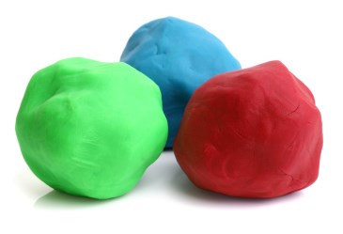
RCSS Clusters – Node migration
Validate target that will be moving
Update tag
“razor reinstall-node --name node${id}”
puppet cert clean old-nodename-here
Welcome to the proper cluster.

Slide 34

RCSS Cluster – Bad node
Validate the target that is misbehaving.
Drain the node from cluster.
Nuke it from orbit
    razor reinstall-node --name node${id} --same-policy
Puppet cert clean bad-node-name
Fix the hardware
Put the node back into production

Slide 35
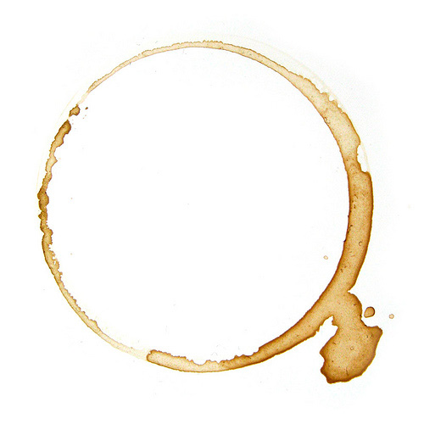
RCSS Clusters - maintenance
Drain nodes
Clean puppet
Re-install
Drink Coffee

Slide 36
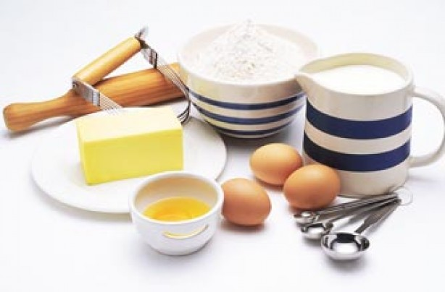
RCSS Clusters – The Quad
Assumptions
  CentOS / RHEL media
  Some form of network
Our Quad
  git
  proxy
  razor
  puppet

Slide 37
Cupcake – Destroyer of Worlds
Secure4 cluster.
Needed the toolkit.
No Network?!?

Slide 38
Thank You!

