Slide 1
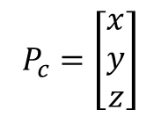


$$(R, \vec{t} )$$
$$P_{c}=\left[\begin{aligned}x \\ y \\ z\end{aligned}\right]$$
C
O
$$P_{o}=R∙P_{c}+\vec{t}$$
Object Coordinates
Camera Coordinates

Slide 2
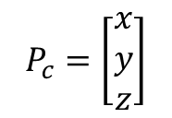



$$T_{c}=(R_{c}, \vec{t_{c}} )$$
$$P_{c}=\left[\begin{aligned}x \\ y \\ z\end{aligned}\right]$$
C
O
$$P_{b}=T_{b}^{−1}∙T_{c}∙P_{c}$$
B
$$T_{b}=(R_{b}, \vec{t_{b}} )$$

Slide 3
C
O
B

Slide 4
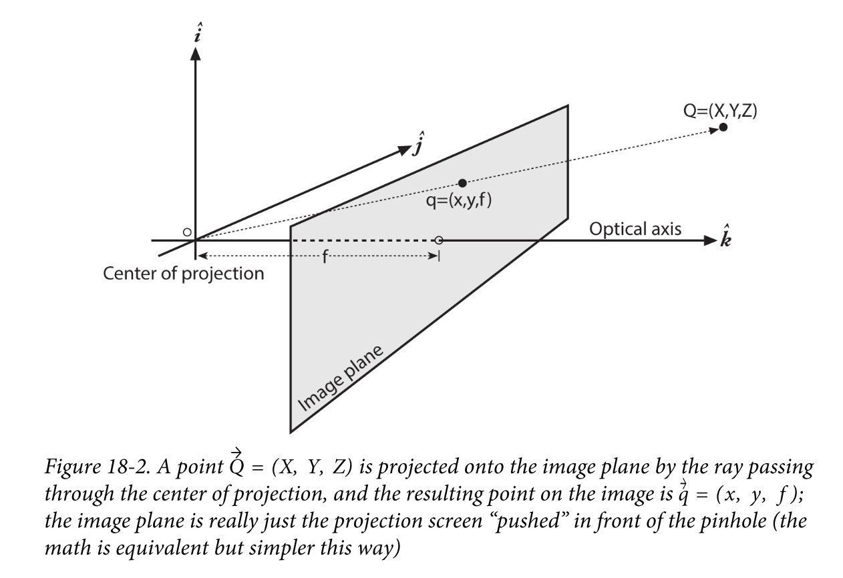
u
v

