Slide 1
Getting Started 🚀
Notes:
Introduction:
Good [morning/afternoon/evening], everyone! My name is [Your Name], and I’m excited to be here with you today.
Today, we’re going to talk about something that’s all around us—statistics and mathematics.
Engaging the Audience:
Now, math and statistics aren’t just about numbers on a page. They help us understand patterns, make predictions, and solve real-world problems.
Some people find math fascinating and fun, while others might think it’s boring. And let’s be honest—it can feel that way if we don’t understand it!
Real-World Applications:
But think about this: math is everywhere!
It’s in sports, helping teams analyze player performance.
It’s in weather forecasts, predicting whether we need an umbrella tomorrow.
It’s even in the apps we use every day, from social media to online shopping.
Making Math Fun:
When we start seeing math as a tool for discovery, it becomes exciting. It’s like solving a puzzle, uncovering patterns, and making sense of the world.
And when we understand it, it brings a smile to our faces! But if we don’t, it can be frustrating.
Closing:
So, let’s embrace the challenge, explore the possibilities, and make this journey of learning math an enjoyable one!

Slide 2
Data Foundations
Real Industry Tools
Program details
Tips and QA
Notes:
Welcome everyone to Dataskools, and congratulations on taking the first step into the world of Data Engineering and AI Cloud. Today is just about getting started and also about understanding the journey you’re about to begin. Over the coming months, we’ll explore how modern companies work with data, how AI is changing the technology landscape, and why data engineering has become one of the most valuable skills in today’s job market. You’ll gradually learn the foundations of data, analytics, SQL, Power BI, Python, cloud concepts, and real-world workflows used in industry. But more importantly, this program is designed to help you think like a problem solver, not just someone who watches tutorials. We’ll work through projects, practical exercises, and business-style thinking so you can connect concepts to real applications. Don’t worry if some topics feel new or overwhelming right now — that’s completely normal on day one. The goal today is simply to get familiar with the roadmap, understand what lies ahead, and start building confidence step by step. By staying consistent throughout this journey, you’ll be surprised at how much you can grow in just a few months. So for now, relax, stay curious, ask questions freely, engage , and enjoy the beginning of this learning experience together.

Slide 3
Welcome to Dataskools

Slide 4

24 weeks. One structured program. One clear goal.
Learn data engineering the way professionals actually work — with AI, cloud tools, and real projects
No CS degree needed. No prior coding required.
What you need: consistency, curiosity,
and a willingness to show up every week
Notes:
When we designed this program, we kept one important thing in mind — most people never start because they think they are “not technical enough” or that they need years of coding experience before entering the data field. But the reality is very different. The hardest part is simply showing up and committing to the process, and by being here today, you’ve already crossed that first barrier. Over the next 24 weeks, we’re going to follow one clear and structured roadmap that takes you from beginner concepts to real-world data engineering workflows. You’ll learn how modern teams work with data using cloud tools, AI-assisted workflows, dashboards, databases, and automation. We are not expecting perfection from day one, and you do not need a computer science degree to succeed here. What matters much more is consistency, curiosity, and the willingness to keep learning even when topics feel unfamiliar at first. Some concepts may take time to click, and that is completely normal. This program is designed to help you build confidence gradually through hands-on work, projects, and guided practice. So focus less on trying to know everything immediately, and more on showing up every week and progressing one step at a time.

Slide 5

Who This Program Is For
This program is for you if:
✓ You work in admin, finance, operations, or any field that touches data ✓ You're a newcomer to Germany and want a career with real demand ✓ You've tried online courses but lost momentum without structure ✓ You want a job — not just a certificate ✓ You can commit 30–40 hours a week for 24 weeks
Notes:
This program is designed for people who want a practical and structured path into the data industry, especially those who may not come from a traditional tech background. Many of our students are already working in areas like administration, finance, operations, logistics, support, or business roles where data is part of daily work, even if they don’t realize it yet. Some are newcomers to Germany looking for stable and future-oriented career opportunities in a market where demand for data skills continues to grow. Others have already tried learning online through YouTube videos or random courses but struggled because there was no roadmap, accountability, or support system to keep them moving forward. This program is different because the goal is not simply to complete lessons or collect certificates — the goal is to build real, job-relevant skills that can help you transition into professional opportunities. At the same time, we want to be realistic and transparent: this journey does require commitment and consistency. You do not need to study full-time, but you should be ready to dedicate around 8 to 10 focused hours each week to practice, projects, and learning. If you can stay consistent with that effort over 24 weeks, the transformation can be significant.

Slide 6

Am I the right person

Slide 7
I'm not technical enough
Most students start with zero coding experience. The program builds from the ground up — tools first, logic second, code third. By Week 4 you'll be comfortable. By Week 15 you'll be writing Python.
Notes:
A lot of people entering this program feel nervous because they think everyone else already knows coding or comes from a technical background. But in reality, many students begin with absolutely zero experience in programming, databases, or cloud tools. That’s why this program is intentionally structured to start with foundations and build confidence gradually. We focus first on understanding concepts and logic before expecting you to write code independently. In the early weeks, the goal is simply to become comfortable with tools, workflows, and the language of data. You are not expected to become an expert overnight. Step by step, you’ll start recognizing patterns, understanding how systems connect, and eventually writing your own SQL and Python confidently. Most students are surprised by how much progress they make within just a few months. The important thing is to stay patient with yourself and trust the learning process instead of comparing yourself to others.

Slide 8
I'm too old/late to switch careers
The average age of our students is 28–45. German employers hire for skill and reliability — not age. Data is one of the few fields where a professional background is actually an advantage.
Notes:
This is one of the most common fears people have when entering the tech industry, especially if they are transitioning from another profession. But the reality is that the data field values practical thinking, reliability, communication, and business understanding just as much as technical skills. Many professionals actually transition into data roles in their late twenties, thirties, or even later. Your previous experience is not wasted — it often becomes an advantage because you already understand teamwork, responsibility, business operations, or industry-specific problems. Companies are increasingly looking for people who can combine technical skills with professional maturity. In Germany especially, employers care a lot about consistency, dependability, and the ability to learn continuously. Technology changes fast for everyone, even experienced engineers, so learning never really stops in this field. This means you are not “behind” — you are simply starting a new direction with a different set of strengths.

Slide 9
What if I fall behind or lose motivation?
his program has weekly structure, cohort support, and a mentor layer built in. You're not watching videos alone at midnight. Falling behind is normal. Dropping out is what we're designed to prevent. The doubt is normal. The program was built knowing you'd feel it.
Notes:
Almost everyone struggles with motivation at some point during a long learning journey, especially while balancing work, family, or other responsibilities. That’s exactly why this program is designed around structure, accountability, and community instead of isolated self-study. You are not expected to sit alone watching random tutorials late at night trying to figure everything out yourself. The weekly roadmap gives you a clear direction so you always know what to focus on next. You’ll also have peers, mentors, and support systems around you throughout the journey. Falling behind occasionally is completely normal and happens to almost every learner at some stage. What matters is getting back on track instead of disappearing after one difficult week. The program is intentionally built to reduce overwhelm and keep momentum steady over time. Learning complex skills is never about perfection — it’s about consistency and continuing forward even when progress feels slow.

Slide 10
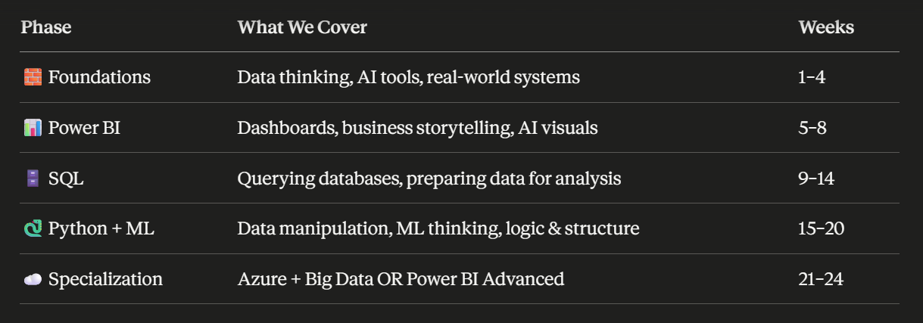
Data Engineering with AI Cloud Program
Notes:
Over the next 24 weeks, the program is divided into clear learning phases so that you can build skills gradually without feeling overwhelmed. In the first phase, we focus on foundations — understanding how data is used in real businesses, how modern systems work, and how AI tools can improve productivity and problem solving. Once that base is strong, we move into Power BI, where you’ll learn how to create dashboards, visualize insights, and communicate business stories through data in a way decision-makers actually understand. After that, we enter the SQL phase, which is where you’ll start thinking like a real data professional by learning how databases work, how to query information, clean datasets, and prepare data for analysis. Then comes Python and machine learning fundamentals, where you’ll work with data manipulation, automation logic, and the mindset behind machine learning systems without making it unnecessarily complex for beginners. Finally, in the last phase of the program, you’ll move into your specialization path — either focusing more on Azure and Big Data workflows or advancing further into Power BI and analytics engineering concepts. Each phase is intentionally connected so that every new skill builds on the previous one instead of feeling disconnected or random.

Slide 11
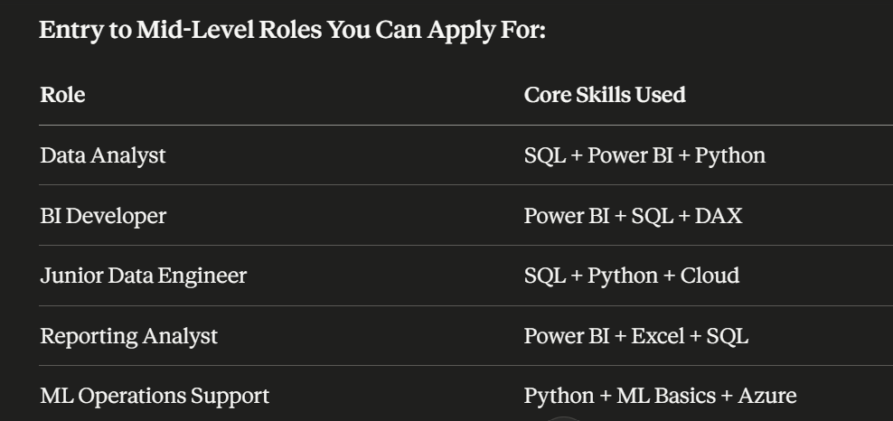
Roles you can Target after this Program
Notes:
This program is not just built around learning tools— it is designed around real job roles that companies actively hire for. Different roles in the data ecosystem require different combinations of skills, and throughout this journey you’ll gradually build those combinations step by step. For example, a Data Analyst typically works heavily with SQL, Power BI, and Python to analyze business data and create insights for decision-making. A BI Developer focuses more deeply on dashboards, reporting systems, data modeling, and DAX logic inside Power BI environments. If you move toward a Junior Data Engineer path, the work becomes more focused on databases, pipelines, Python workflows, and cloud systems that move and prepare data behind the scenes. Reporting Analysts often combine business understanding with Excel, SQL, and visualization tools to support operations and management reporting. We also introduce foundational machine learning and Azure concepts because many modern companies now expect teams to understand AI-assisted workflows and automation support. The goal is not to force everyone into one narrow path, but to help you discover which direction fits your interests and strengths while still building a strong common foundation across the data field.

Slide 12


Roles you can Target after this Program
Consulting firms — Capgemini, Accenture, KPMG
Tech companies — SAP, Deutsche Telekom, Zalando
Banks & fintech — Deutsche Bank, N26, ING
Mid-sized German Mittelstand companies Startups scaling their data teams
Notes:
The skills you build in this program are relevant across many industries and company types in Germany. Large consulting firms like Capgemini, Accenture, and KPMG regularly hire data professionals for analytics, reporting, and cloud transformation projects. Major tech companies such as SAP, Deutsche Telekom, and Zalando also depend heavily on data-driven systems and business intelligence teams. The banking and fintech sector — including Deutsche Bank, N26, and ING — continues investing heavily in analytics, automation, and cloud infrastructure. Beyond big brands, many mid-sized German Mittelstand companies are modernizing their operations and searching for professionals who understand data workflows. Startups are also rapidly building data teams to support growth, reporting, AI integration, and product decision-making.

Slide 13
Why Data Engineering
What most people picture when they hear "data career":
Building AI models
Predicting the future with algorithms
Becoming the next Kaggle grandmaster
What the job market actually needs:
People who can move, clean, store, and structure data reliably
Professionals who build the pipelines that models and dashboards depend on
Engineers who understand both the business and the system
Notes:
When many people hear the term “data career,” they immediately imagine advanced AI models, complex algorithms, or becoming a machine learning expert solving futuristic problems. Social media and online content often make it seem like everyone in tech is building cutting-edge AI systems all day long. But the reality of the job market is very different. Most companies are not struggling because they lack fancy algorithms — they struggle because their data is messy, disconnected, unreliable, or difficult to access. Before dashboards, AI systems, or machine learning models can work properly, someone has to collect the data, organize it, clean it, store it correctly, and move it between systems reliably. That is where data engineering and modern analytics roles become incredibly valuable. Companies need professionals who can build pipelines, automate workflows, maintain reporting systems, and ensure that business teams can actually trust the data they use every day. They also value people who understand both the technical side and the business context behind the numbers. This is why data engineering has become one of the strongest and most practical entry points into the modern data industry.

Slide 14

Why Data Engineering
A data scientist is the chef. A data engineer built the kitchen. No kitchen — no meal. ✓ Faster to get hired — junior roles exist and are funded ✓ Every data science team needs engineers underneath them ✓ Skills transfer — SQL, Python, cloud work everywhere ✓ Once you're in, you can specialise toward ML later ✓ Germany specifically has a shortage of people who can do this work
Notes:
A simple way to understand the difference is this: a data scientist may be the chef creating advanced models and insights, but the data engineer is the person who built the kitchen that makes everything possible in the first place. Without reliable systems, clean data pipelines, and proper infrastructure, even the best AI models cannot function effectively. That’s why companies consistently invest in data engineering and analytics infrastructure before expanding advanced AI initiatives. From a career perspective, this path is also often faster and more practical for entering the industry because junior-level opportunities already exist and companies actively budget for these roles. Almost every modern data science or analytics team depends on engineers who can move, structure, and prepare data correctly behind the scenes. Another major advantage is that the core skills you learn — SQL, Python, cloud workflows, automation, and data systems — are transferable across industries and technologies. And once you gain industry experience, you can always move further toward machine learning, AI engineering, or advanced analytics later on. Especially in Germany, there is a strong demand for professionals who can bridge the gap between business operations and technical data infrastructure.

Slide 15

AI Layer
What changed in the last 2 years:
AI entered every major data tool — Power BI, Excel, Azure, Python IDEs
Writing SQL from scratch is now optional — understanding it is not
Dashboards that used to take 3 days now take 3 hours
Junior professionals with AI fluency are outperforming seniors without it
Notes:
The data industry has changed dramatically in just the last couple of years because AI is no longer a separate niche skill — it is now built directly into the tools professionals use every single day. Platforms like Power BI, Microsoft Excel, Microsoft Azure, and modern Python development environments now include AI-assisted features that speed up analysis, coding, reporting, and automation. This means the role of a professional is changing from “memorizing syntax” to understanding systems, logic, and how to work effectively with AI tools. For example, writing every SQL query completely from scratch is becoming less important than understanding what the query should do and how to validate the results correctly. Tasks that previously took days — like building dashboards, cleaning data, or generating reports — can now often be completed in a fraction of the time with the right AI workflows. Because of this shift, junior professionals who know how to use AI productively are sometimes able to work faster and more efficiently than experienced professionals who resist these tools. The companies that are hiring today are increasingly looking for people who can combine technical understanding with AI fluency, adaptability, and practical business thinking.

Slide 16
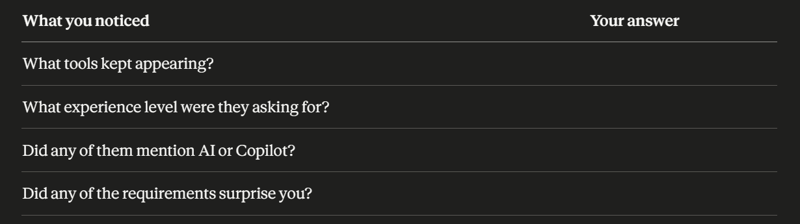
Data engg. jobs Germany 2026
Notes:
For the next 5 minutes, I want you to do something simple but important. Open Google and search this exact phrase: “Data engg. jobs Germany 2026.” Don’t overthink it — just open the first 2 or 3 job postings you see. As you read them, try to notice patterns instead of understanding every technical word. What tools kept appearing again and again? Were companies asking for senior experts, or were there junior and entry-level roles too? Did you notice mentions of AI tools, Copilot, automation, or cloud platforms? And most importantly, did anything surprise you about what companies are actually looking for today? This small exercise is meant to help you connect this program to the real job market from day one.

Slide 17

German Tech Job Market Is Shifting
What was true 5 years ago:
SAP knowledge alone could get you hired
Excel was the primary reporting tool in most companies
Data roles were mostly IT-adjacent, not business-facing
Coding was for developers — not analysts or engineers
AI was a research topic, not a workplace tool
Notes:
Just a few years ago, the data industry looked very different from what it does today. In many companies, simply having experience with SAP systems or strong Excel skills was often enough to secure reporting or analytics-related roles. Most reporting workflows were heavily spreadsheet-based, and data work was usually seen as something closely tied to IT departments rather than core business decision-making. Analysts were often expected to work mainly with reports and dashboards, while coding was considered the responsibility of software developers or technical engineers. AI existed mostly in research labs, academic discussions, or experimental projects — not as a practical workplace tool used daily by regular professionals. Today, however, the expectations have shifted significantly, and modern data roles now combine business understanding, automation, cloud systems, analytics, and AI-assisted workflows together.

Slide 18
German Tech Job Market Is Shifting
What is true right now:
SAP is migrating to cloud — Azure, Databricks, Microsoft Fabric
Power BI has replaced Excel dashboards in most modern teams
Data roles now sit between IT and business — hybrid by default
SQL and Python are expected at analyst level, not just engineer level
AI Copilot is live inside Power BI, Excel, and Azure today
Notes:
The modern data landscape today is far more cloud-driven, AI-assisted, and business-integrated than it was just a few years ago. Traditional enterprise systems like SAP are increasingly moving toward cloud ecosystems built around platforms such as Microsoft Azure, Databricks, and Microsoft Fabric. In many organizations, Power BI has now replaced static Excel reporting with interactive dashboards and live business intelligence workflows. Data professionals are no longer sitting only inside IT departments — they now operate in hybrid roles that connect technical systems directly with business decision-making. Because of this shift, skills like SQL and Python are increasingly expected even for analyst-level positions, not only engineering roles. At the same time, AI assistants and Copilot-style tools are already integrated into platforms like Power BI, Excel, and Azure, changing how professionals build reports, analyze data, and automate tasks on a daily basis.

Slide 19
What Makes This Program Different
✓ German job market focus — every skill maps to a real role requirement here ✓ AI from Week 1 — not a bonus module, embedded in how we teach everything ✓ Engineering + BI together — the combination employers actually want ✓ Weekly structure — you always know what you're doing and why ✓ Cohort model — you learn alongside people on the same journey ✓ Capstone project — you finish with something real to show, not just a certificate ✓ Specialization — you graduate with a direction, not just general knowledge
Notes:
What makes this program different is that it was designed around the realities of the German job market instead of generic online learning content. Every major skill you learn connects directly to actual role requirements companies are hiring for today. AI is also not treated as an optional extra topic at the end of the course — it is integrated into the way we learn, practice, and solve problems from the very beginning. Another important difference is that we combine both engineering and business intelligence skills together, because modern employers increasingly want professionals who can understand both the technical and business sides of data. The program is also highly structured, so you always know what to focus on each week instead of feeling lost between random tutorials and disconnected topics. You’ll be learning alongside a cohort of people on a similar journey, which creates accountability, motivation, and a stronger learning environment. And by the end of the program, you won’t just leave with theoretical knowledge or a certificate — you’ll complete a real capstone project and graduate with a clearer specialization direction for your career path.

Slide 20
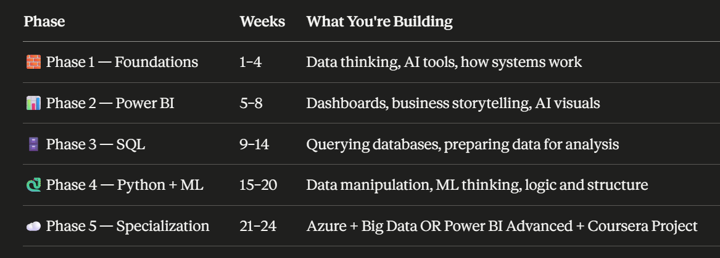
24-Week Learning Roadmap
Notes:
The program is divided into five structured phases, with each phase building a different layer of your data skillset step by step. In the beginning, during the Foundations phase, you’ll focus on understanding how data systems work, how businesses use data, and how AI tools fit into modern workflows. Once that foundation is in place, we move into Power BI, where you’ll learn dashboards, storytelling with data, visualization design, and AI-assisted reporting. After that comes the SQL phase, where you’ll begin querying databases, filtering information, joining tables, and preparing data for analysis like real analysts and engineers do every day. In the Python and ML phase, the focus shifts toward data manipulation, automation logic, and understanding machine learning concepts in a practical and approachable way. Finally, the specialization phase allows you to go deeper either into cloud and big data workflows using Microsoft Azure or into advanced Power BI and analytics projects.
Each phase also follows a consistent weekly structure so learning stays manageable and predictable. At the start of the week, new concepts are introduced with business context and practical explanations. Mid-week, you’ll work on hands-on exercises using real datasets and realistic scenarios instead of only theoretical examples. Toward the end of the week, you’ll submit assignments and receive feedback to help strengthen your understanding. Then, at the end of every phase, you’ll complete a mini-project that brings together everything you learned into one practical outcome.

Slide 21
How We Teach: Projects, Tools & Real-World Thinking
The problem with most programs:
You watch someone else solve a problem. You feel like you understand it. You open a blank file and freeze.
That gap — between watching and doing — is what we are designed to close.
Notes:
One of the biggest problems with many online programs is that they create the illusion of learning without building real confidence. You watch an instructor solve a problem step by step, and in the moment it feels clear and easy to follow. But then you open a blank file on your own, try to start from scratch, and suddenly everything feels confusing again. That gap between “I understood the video” and “I can actually do this myself” is where many learners lose momentum and begin doubting themselves. This program is specifically designed to close that gap through repetition, guided practice, hands-on exercises, and project-based learning. Instead of only watching concepts, you’ll actively work with tools, datasets, dashboards, queries, and workflows yourself. The goal is not passive familiarity — it’s building the confidence to solve problems independently, even when the solution is not already shown on the screen.

Slide 22
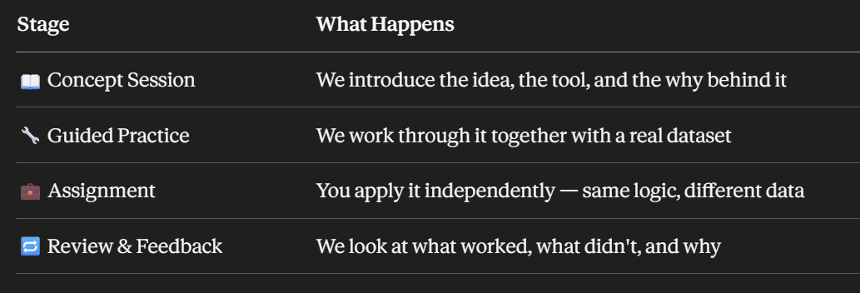
How a typical week works
Notes:
Every week in this program follows a clear structure so that learning feels organized instead of overwhelming. We begin with a concept session where we introduce the topic, explain the tool, and most importantly discuss why it matters in real business environments. After that comes guided practice, where we work through exercises together using realistic datasets and workflows rather than isolated textbook examples. Once you become familiar with the logic, you’ll move into the assignment phase where you apply the same concepts independently on different data and scenarios. This is where real learning starts to happen because you begin making decisions and solving problems on your own. Finally, we end the week with review and feedback sessions where we discuss what worked well, where people got stuck, and how to improve the thought process behind the solution. The goal is to create a cycle of learning, practice, application, and reflection every single week so that your confidence builds steadily over time.

Slide 23

The tools you will actually use
Power BI — dashboards, reports, AI visuals, DAX
SQL — PostgreSQL, real database environments
Python — VS Code, Pandas, Scikit-learn
Azure — cloud fundamentals, data factory basics (Track A)
AI tools — ChatGPT, Copilot, Claude — used throughout as a co-pilot
Coursera — supplementary modules aligned to each phase
Notes:
Throughout this program, you’ll work with the same kinds of tools that modern data teams use in real companies today. In Power BI, you’ll build dashboards, reports, interactive visuals, and learn core concepts like DAX and business storytelling with data. For databases and querying, you’ll use SQL in practical environments with systems like PostgreSQL instead of only theoretical examples. In the Python phase, you’ll work inside Visual Studio Code while learning libraries such as Pandas and Scikit-learn for data manipulation and machine learning fundamentals. Those choosing the cloud specialization track will also explore core concepts inside Microsoft Azure, including cloud workflows and introductory data factory concepts. AI tools like ChatGPT, Microsoft Copilot, and Claude will be used throughout the program as productivity and learning co-pilots rather than treated as separate topics. In addition, curated Coursera modules will support each phase to reinforce concepts and give you additional guided practice outside live sessions.

Slide 24

Real-world thinking
Most courses give you clean, perfect datasets and simple questions.
We give you:
✓ Messy data that needs cleaning before it can be used ✓ Business scenarios where the question is not obvious ✓ Stakeholder context — who is asking, why, and what decision depends on it ✓ Constraints — limited time, incomplete data, a deadline ✓ AI as a collaborator — not a shortcut that bypasses understanding
Notes:
Most learning platforms teach with perfect datasets and neatly defined problems where the answer is already obvious. But real-world data work rarely looks like that. In this program, you’ll work with messy and incomplete datasets that often need cleaning and restructuring before analysis can even begin. You’ll also face business scenarios where the challenge is not just finding an answer, but first understanding what question should actually be asked and why it matters. We introduce stakeholder context as well, because in real companies every dashboard, report, or pipeline exists to support a decision made by someone in the business. You’ll learn how to work under realistic constraints too — limited time, missing information, changing requirements, and deadlines that force prioritization. And throughout the process, AI tools will be used as collaborators that help speed up workflows and improve productivity, while still requiring you to understand the logic and reasoning behind the work itself.

Slide 25
What we expect from you
✓ Show up to sessions — presence is not optional ✓ Submit assignments — feedback only works if there is work to review ✓ Use AI as a tool — not as a way to avoid thinking ✓ Ask questions — the only bad question is the one that stays in your head
Notes:
This program is designed to support you, but your growth will also depend on the effort and consistency you bring into the process. The first expectation is simple: show up regularly, because learning complex skills becomes much harder when sessions are skipped repeatedly. We also expect you to complete and submit assignments, since feedback only becomes meaningful when there is actual work to review and improve together. Throughout the course, you’ll use AI tools frequently, but the goal is to use them as assistants that help you think faster and work smarter — not as shortcuts that replace understanding. Struggling with a problem for a while is often part of real learning, and that process matters. Finally, ask questions whenever something feels unclear, confusing, or unfamiliar. In this environment, questions are encouraged because curiosity and communication are essential skills in every modern data role.

Slide 26
What you can expect from us
✓ Structured sessions — you always know what is coming and why ✓ Real feedback — not just "good job" ✓ Honest guidance on your progress and your job readiness ✓ Support when you fall behind — because it will happen to someone
Notes:
What you can expect from us is a learning environment that is structured, practical, and focused on real growth rather than passive content consumption. Every session is planned with a clear purpose, so you’ll always understand what you are learning, why it matters, and how it connects to future roles in the industry. When you submit work, the feedback will go beyond simple encouragement — we’ll focus on what is working, what needs improvement, and how to strengthen your thinking and problem-solving process. We’ll also be honest about your progress and your level of job readiness, because the goal is to prepare you for real opportunities, not just course completion. And importantly, if you fall behind at some point, support will still be available. Almost every learner struggles during a long program at least once, and part of our role is helping people regain momentum instead of quietly dropping out when things become difficult.

Slide 27
Next steps..
Three things before our next session:
1. Join the cohort group Introduce yourself — name, where you're from, one thing you're hoping to get out of this program.
2. Star the GitHub repository ⭐ All course materials, datasets, assignments, and resources live on GitHub. This is your home base for the next 24 weeks — bookmark it and get familiar with it.
3. Write down your why One sentence. Why are you doing this? Keep it somewhere you'll find it on a tough week.
Notes:
Before our next session, there are three simple but important things we’d like everyone to do. First, join the cohort group and introduce yourself — share your name, where you’re from, and one thing you hope to gain from this program. Building connections early helps create a stronger learning environment and reminds you that you’re not doing this journey alone. Second, make sure to star the GitHub repository and spend a little time exploring it, because this will become your central workspace for course materials, assignments, datasets, and resources throughout the next 24 weeks. Getting comfortable with GitHub early is also valuable because it’s widely used in real technical teams and projects. And finally, take a moment to write down your reason for starting this journey. Keep it short and honest — maybe it’s a career switch, financial growth, confidence, stability, or proving something to yourself. On difficult weeks, that small reminder can help you stay focused and keep moving forward.

Slide 28
Next steps..
📁 Weekly materials and slides
📊 Datasets for every assignment
🗂️ Project templates
🔗 Coursera module links per phase
Notes:
From this point onward, GitHub will become your main learning hub throughout the program. Every week, you’ll find the session materials, slides, and learning resources organized clearly so you always know where to continue from. All assignment datasets will also be available there, which means you’ll be working with the same files and project structures used during practice sessions. As the program progresses, you’ll also receive project templates and starter files to help you build dashboards, SQL exercises, Python workflows, and capstone projects more efficiently. In addition, each phase will include curated Coursera module links that align with what we are covering in the program, giving you extra guided practice and reinforcement outside the live sessions. Learning how to navigate and use GitHub confidently is itself an important professional skill, because it is widely used by modern technical teams for collaboration, version control, and project organization.

Slide 29
Have Questions?

Slide 30


