Slide 1
Version I
保存图片方法：全部选中→右键→另存为图片

Slide 2
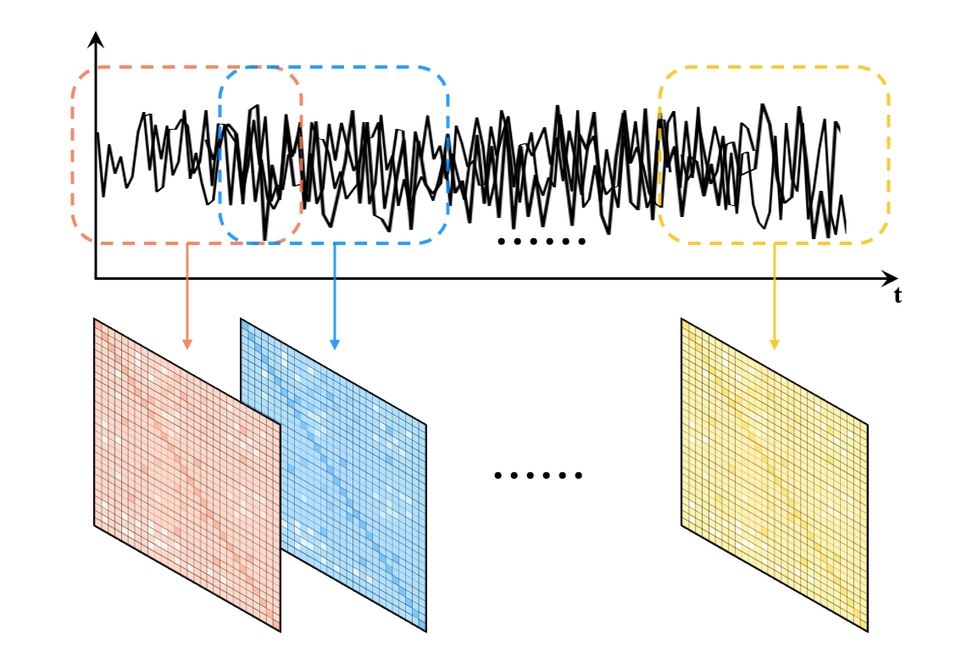
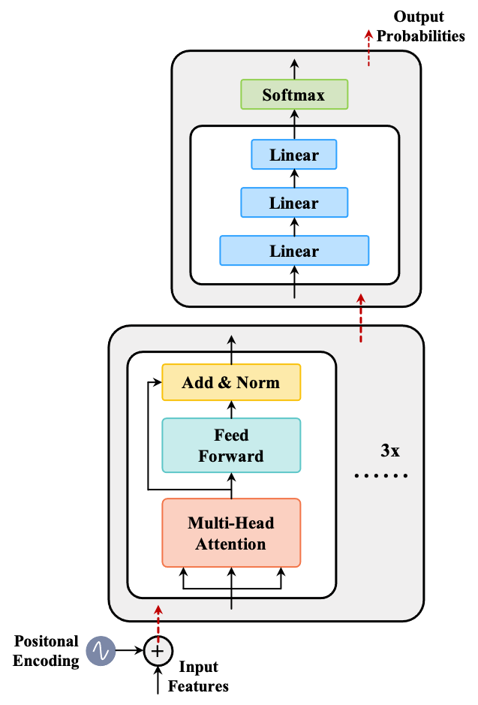
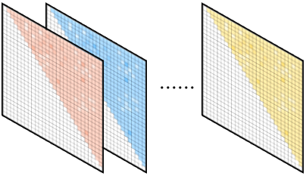
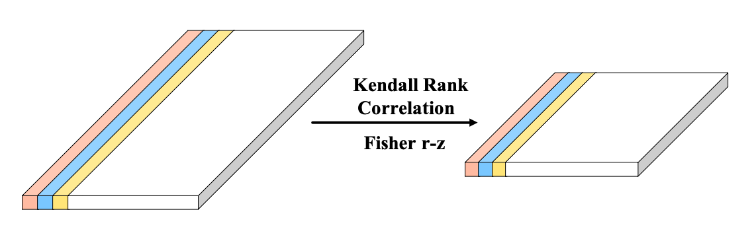
Main
A.
C.
dFNC
Pearson
Correlation
Flatten
B.

Slide 3
Multi-Head Attention Explanation
II. Multi-Head Attention
Linear
Concat
Scaled Dot Product Attention
Linear
Linear
Linear
Q
K
V

