Slide 1
BSDS Assignment 4
Group members: Shujian Wen, Wenbo wang, Liang Zhang
Group name: 6666

Slide 2

hypothesis
Use Kafka to achieve asynchronous application design
Presumably higher client loads and faster processing time
Scalable architecture
Streaming API

Slide 3
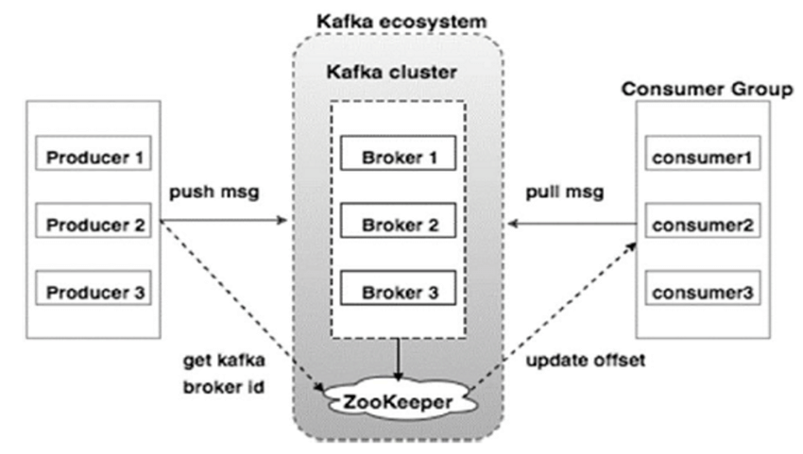
Kafka architecture
Producer: clients POST request
Consumer: database insertion
Broker: topic with partitions
Zookeeper: coordination for brokers
(Kafka cluster)

Slide 4
Measurements
How many clients can it hold (32, 64, 128, 256, 512…)
For each client, how fast can it process (compare with AWS, GCP, Lambda)
more posts (with/without kafka), more server

Slide 5
Methods
Parameters:
Number of clusters in kafka (cluster)
0, 2, 4
Number of nodes in each cluster (nodes)
5, 10, 15
post/get Percentage (producer)
1/5, 1, 5

Slide 6
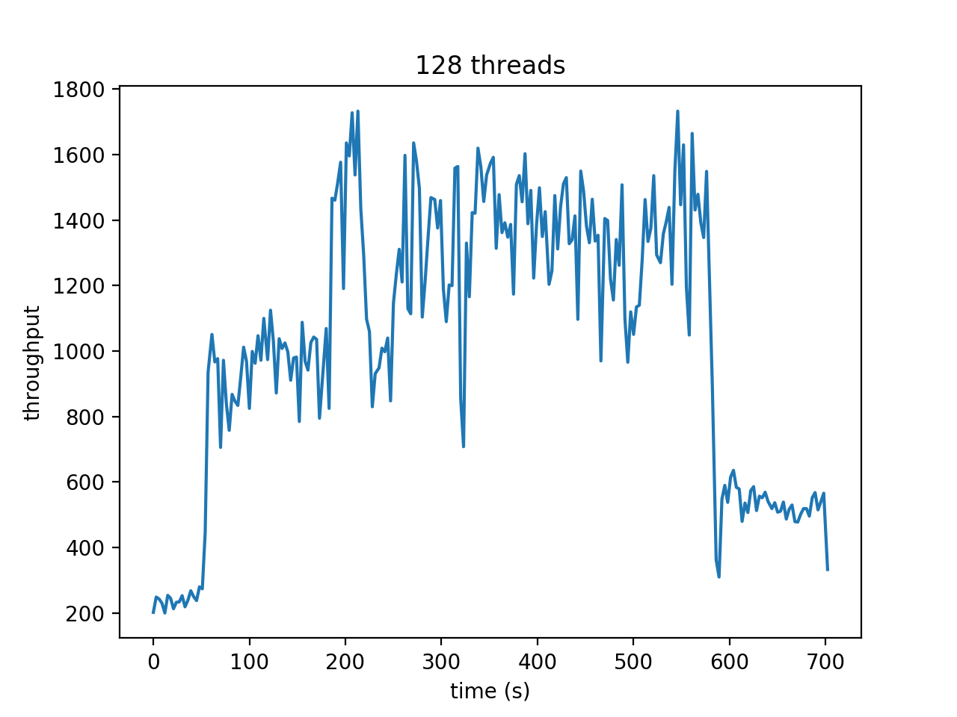
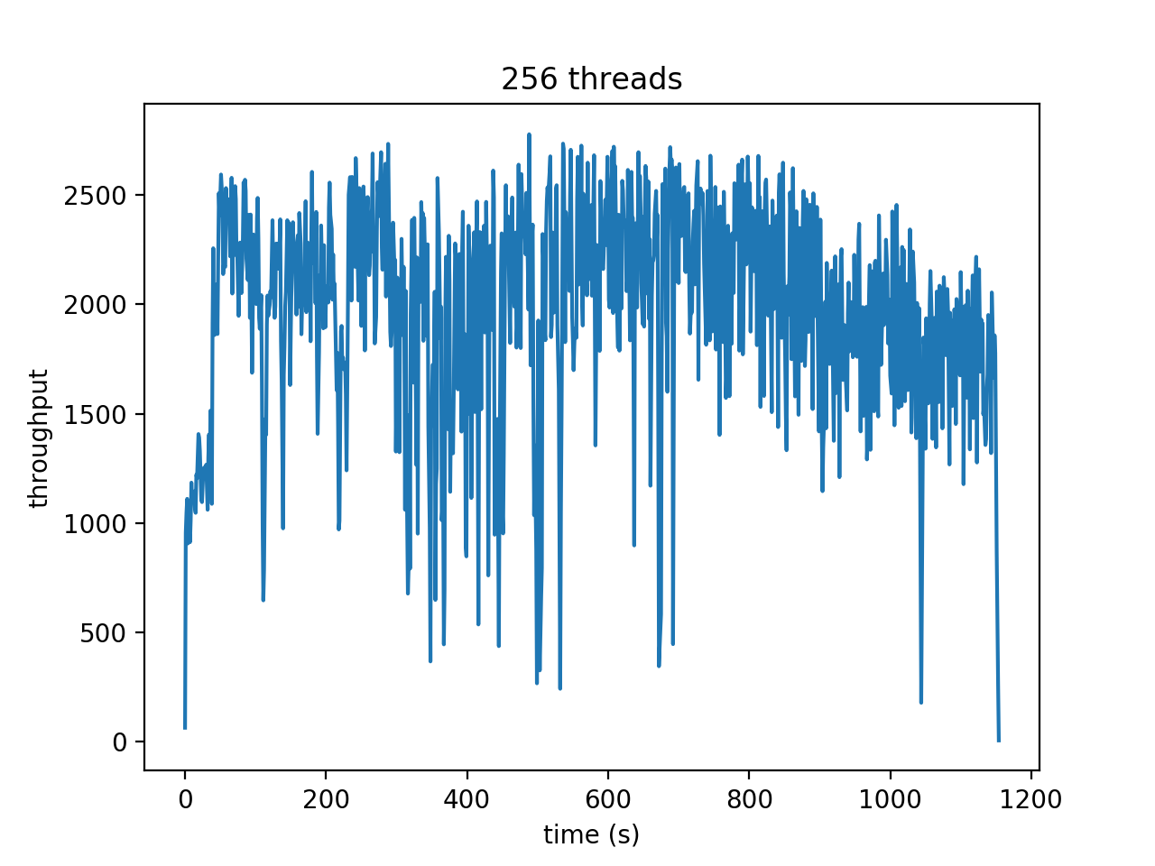
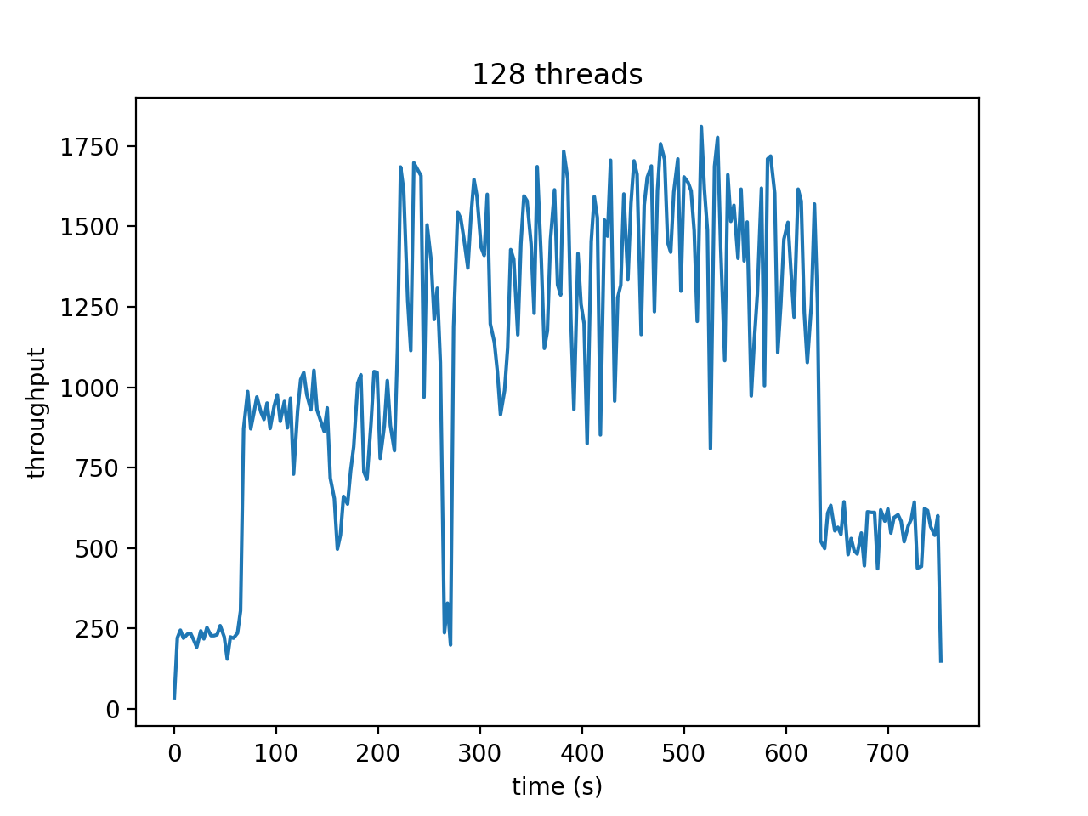
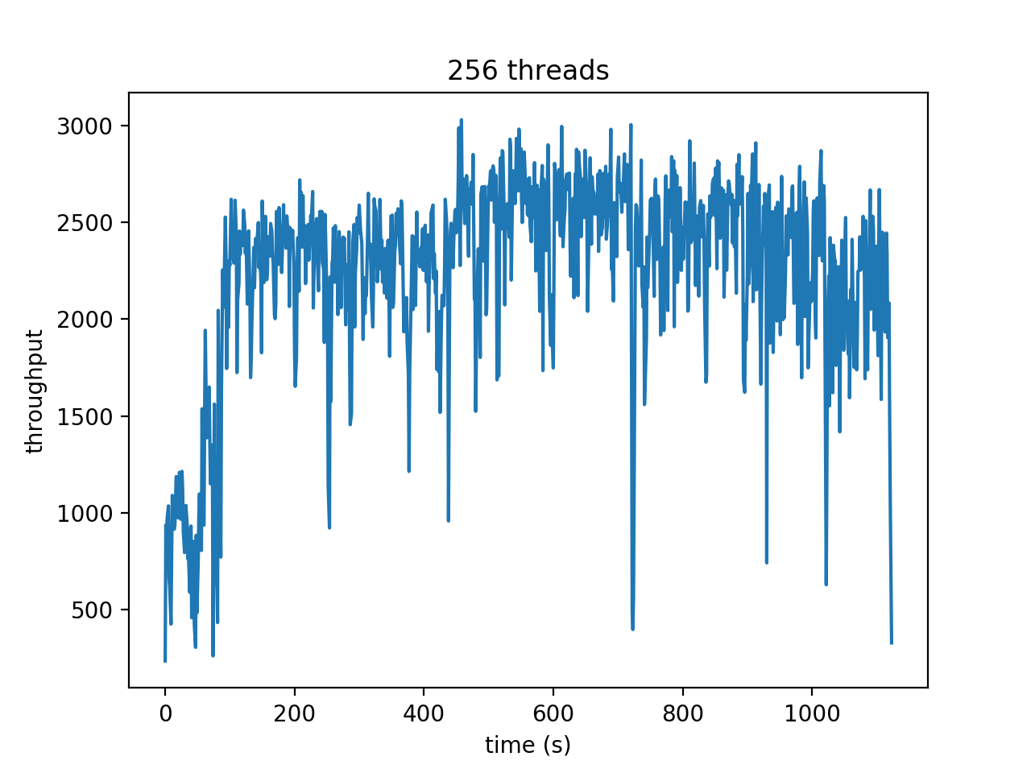
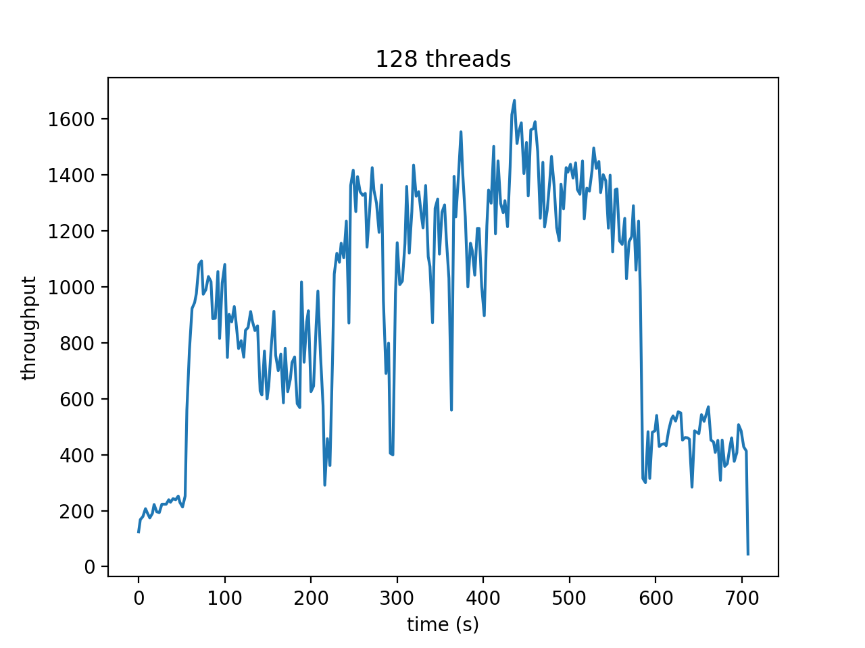
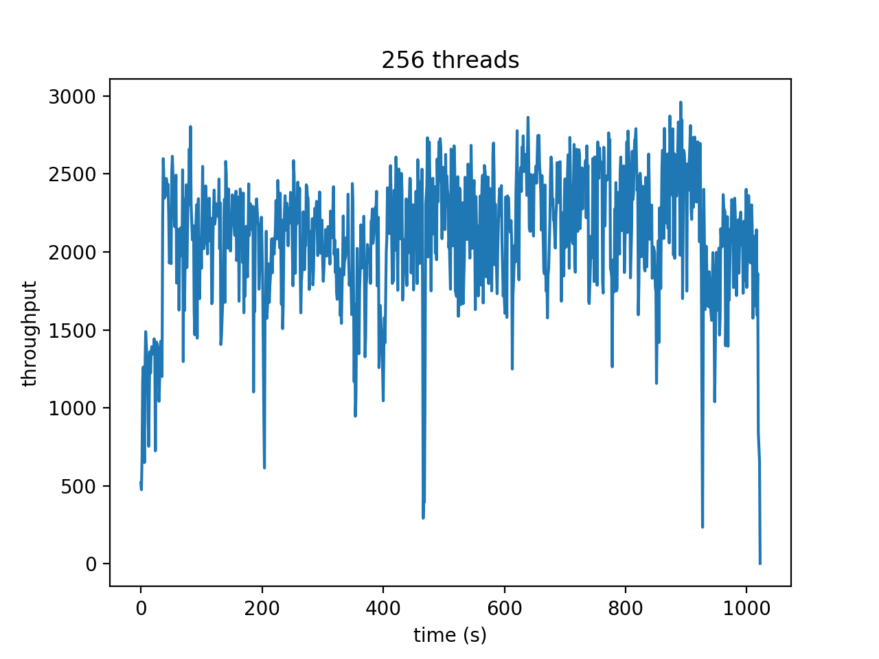
Number of clusters in kafka with: number of nodes = 10 post/get percentage = 1
Number of clusters | time |  |  |  | throughput
 | 32 | 64 | 128 | 256 | 128 | 256
0 | 525 | 556 | 702 | 1153
2 | 518 | 562 | 720 | 1123
4 | 510 | 548 | 705 | 1112

Slide 8
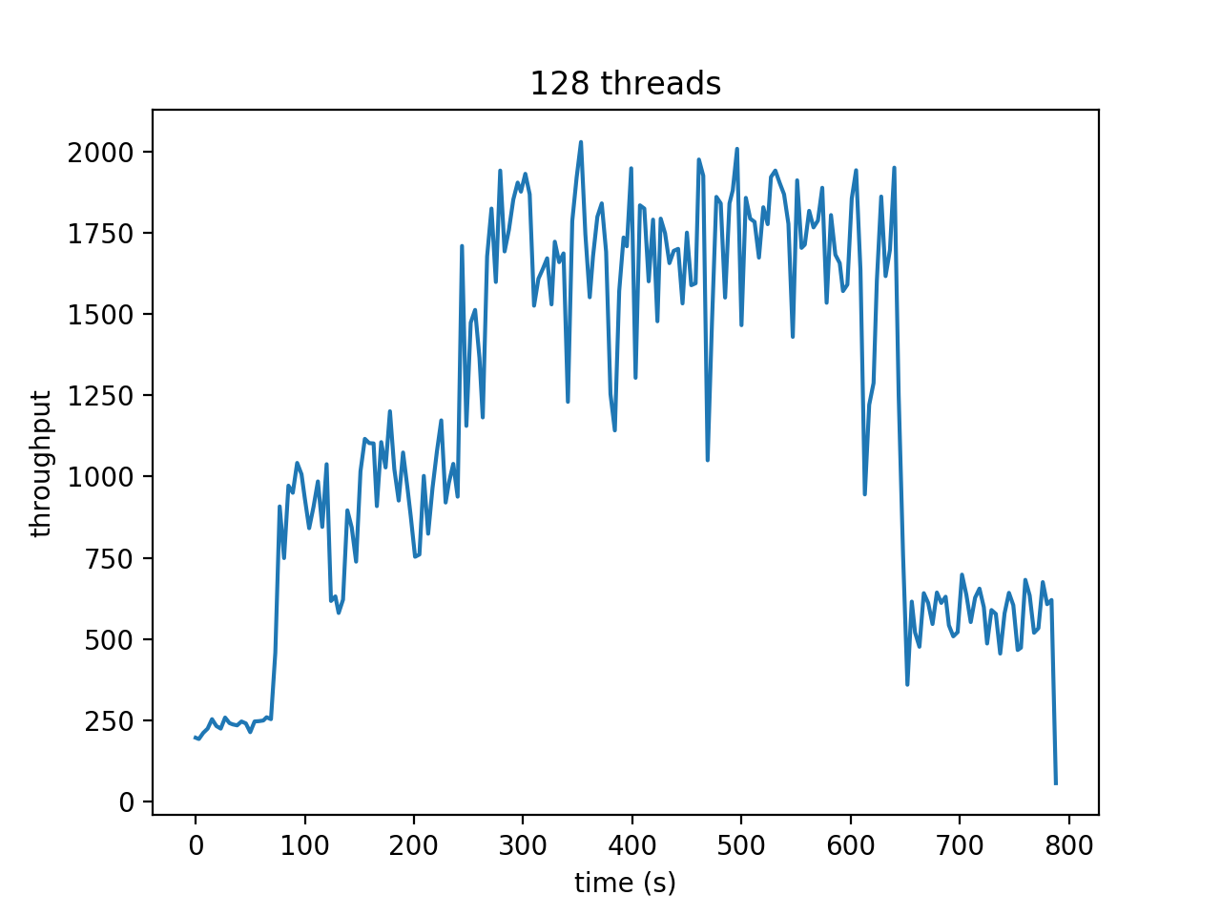
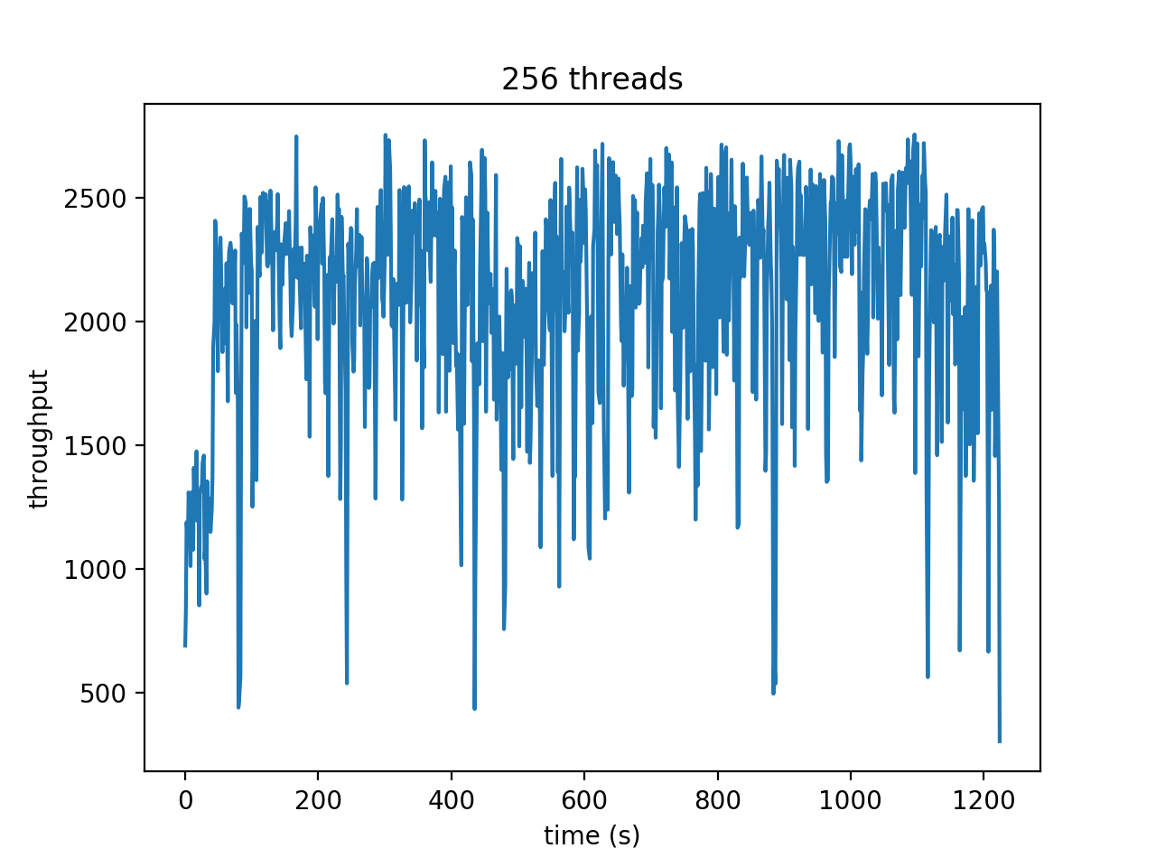
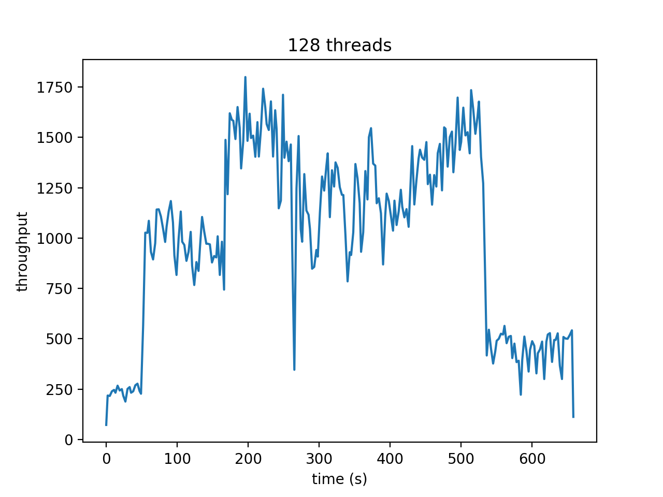
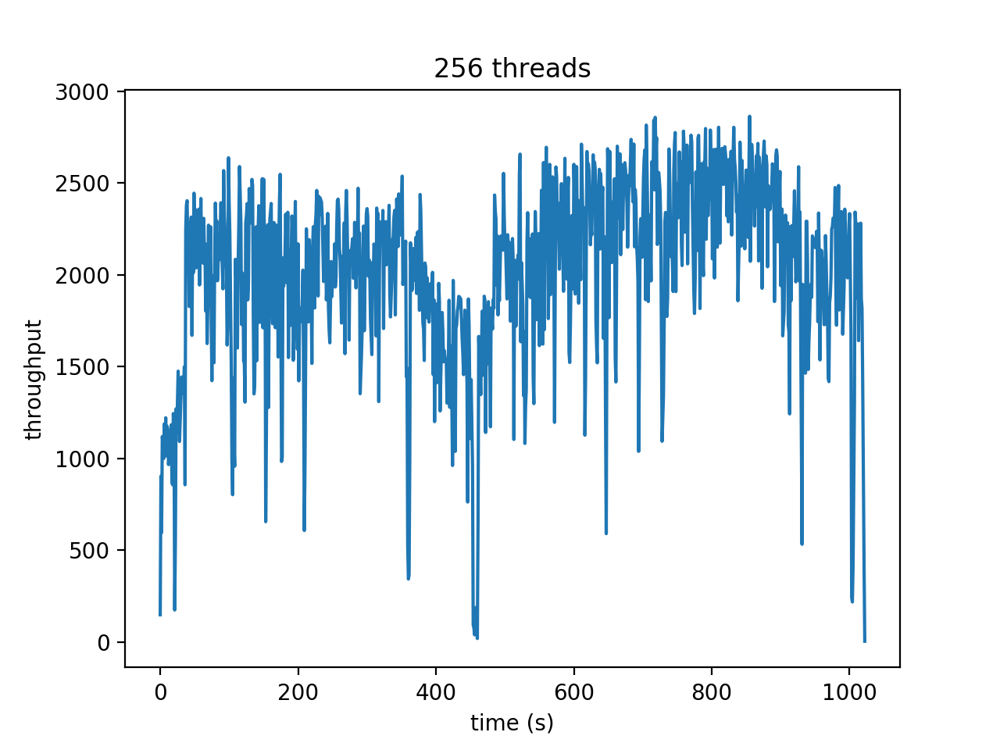
Number of nodes in each cluster with: number of clusters = 2 post/get percentage = 1
Number of nodes | time |  |  |  | throughput
 | 32 | 64 | 128 | 256 | 128 | 256
5 | 572 | 621 | 788 | 1226
10 | 518 | 562 | 720 | 1123
15 | 478 | 514 | 656 | 1021

Slide 10
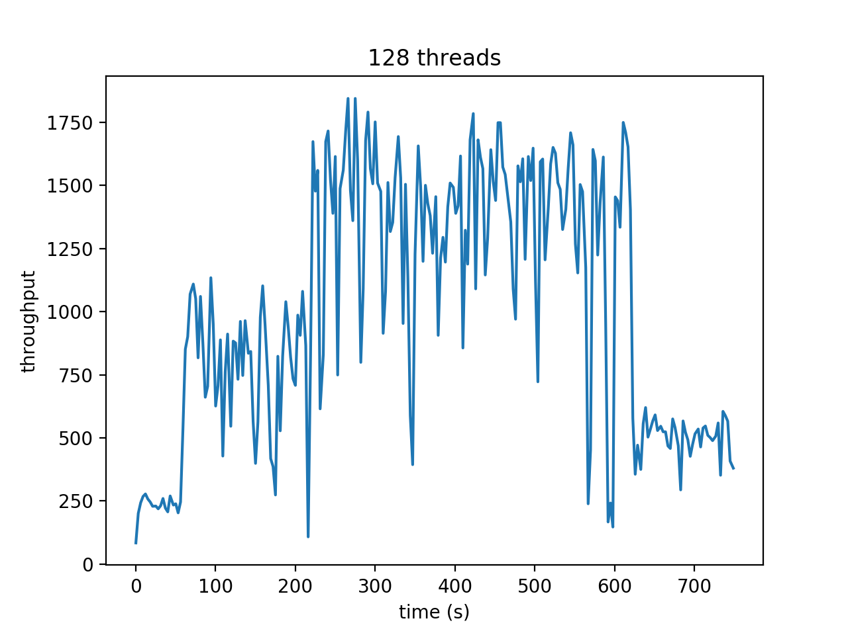
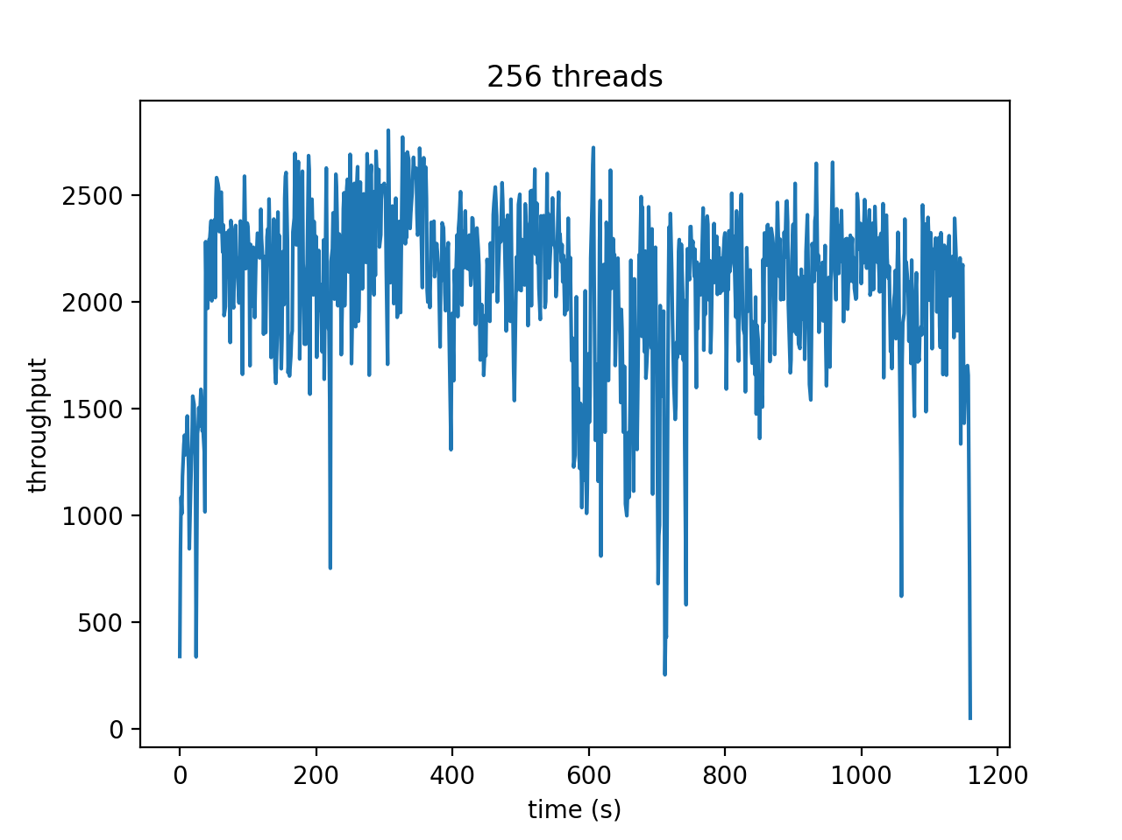
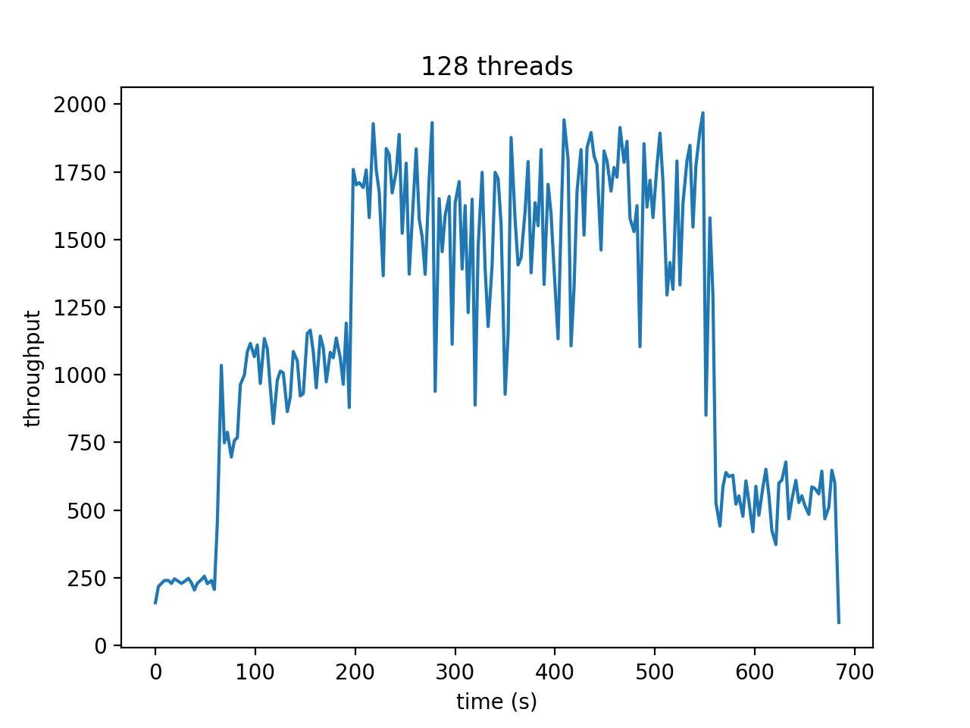
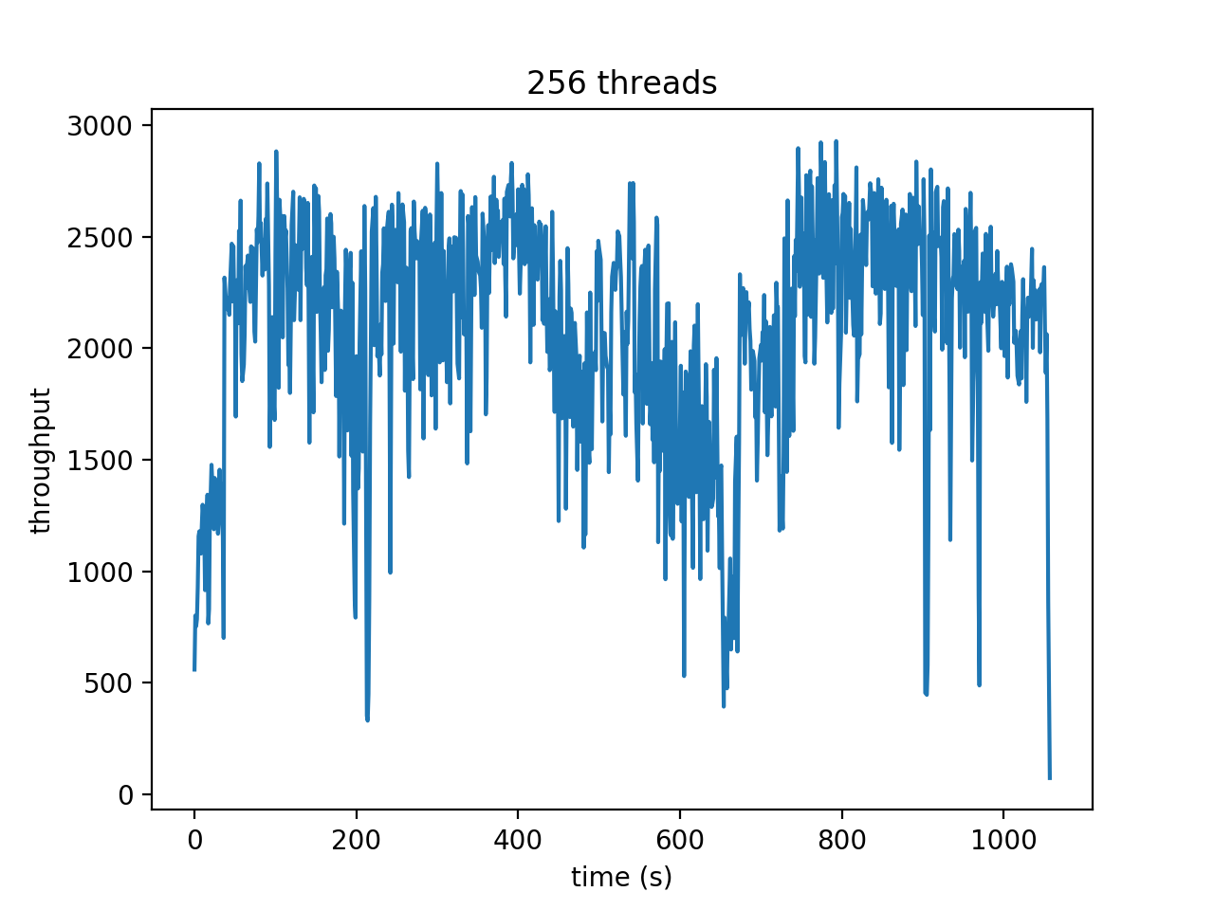
post/get percentage with: number of clusters = 2 Number of nodes = 10
POST/GET Percentage | time |  |  |  | throughput
 | 32 | 64 | 128 | 256 | 128 | 256
1/5 | 548 | 592 | 749 | 1159
1 | 518 | 562 | 720 | 1123
5 | 498 | 542 | 684 | 1057

Slide 12
conclusion
All the above three methods don’t have effects in holding more clients
Maximum 256 clients, reaching the throughput limit of 2500
The limit may due to network speed
May run client on aws for future work
For the total running time
Increasing Number of clusters has no effect
Increasing Number of nodes in each cluster shortens by 10%
Increasing post/get Percentage from 1 to 5 shortens by 5%

Slide 13
Thanks !
https://github.com/Greatjian/CS_6650_distributed_system

