Slide 1

BINARY SEARCH BRILLIANCE
GDG On Campus, VIT Chennai

Slide 2
ABOUT US
Grecil Unadkat
grecilunadkat@gmail.com
+91 7567151302
Madhava Sai Teja
madhavasaiteja@gmail.com
+91 70135 05728

Slide 3
DEFINITION
What even is Binary Search?
Binary search is an algorithm used to find a target value 𝑇 in the domain of a monotonic function 𝑓(𝑥) by iteratively narrowing down the search interval by half.

Slide 4
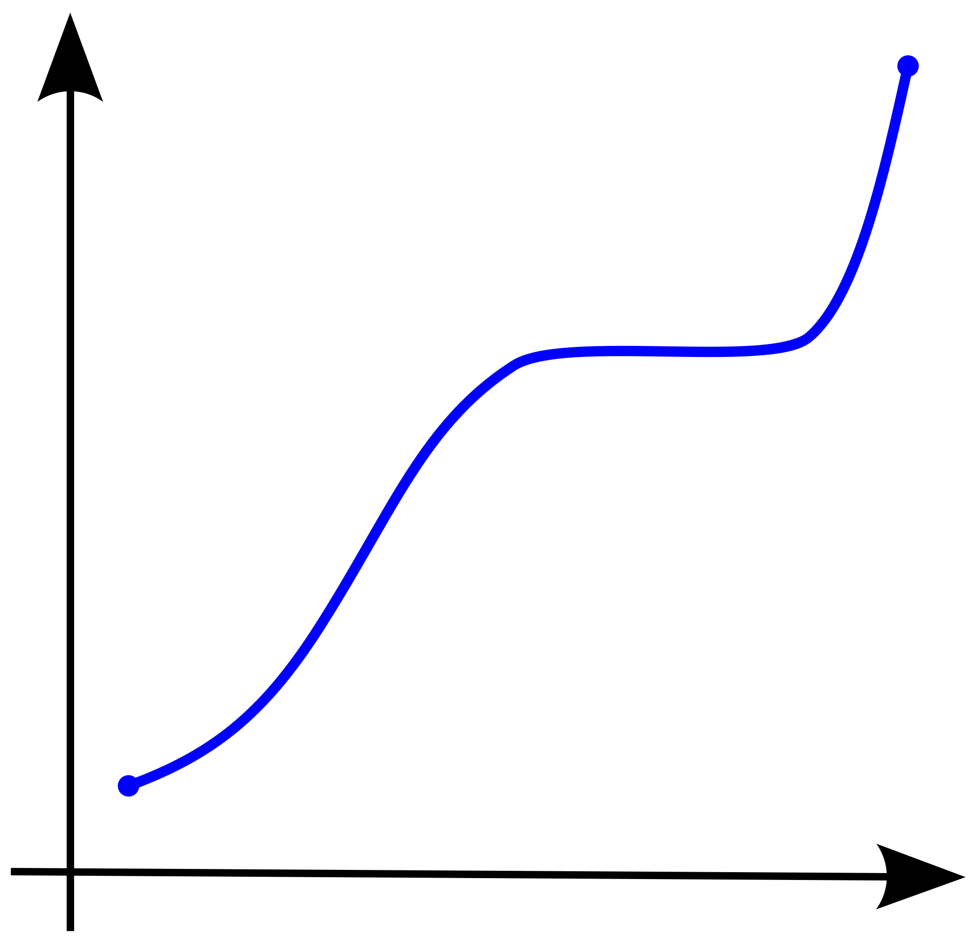
MONOTONIC FUNCTION
A monotonic function is a function that either increases or decreases consistently across its entire domain.

Slide 5
left = Lower Limit of Function
right = Upper Limit of Function
while (left <= right) {
mid = left + (right - left) / 2
if (check(mid)) {
left = mid + 1
}
else {
right = mid - 1
}
}

Slide 6
IS BINARY SEARCH EVEN USEFUL?
Excerpt from a news report on increasing bike theft incidents, where a computer scientist tried explaining binary search to a cop -
“Afterwards I found a chatroom thread among Cambridge computer scientists, one of whom had also been told that unless he could pin down the moment of theft no one would look at the footage. He said he had tried to explain sorting algorithms to police — he was a computer scientist, after all.
You don’t watch the whole thing, he said. You use a binary search. You fast forward to halfway, see if the bike is there and, if it is, zoom to three quarters of the way through. But if it wasn’t there at the halfway mark, you rewind to a quarter of the way through. It’s very quick. In fact, he had pointed out, if the CCTV footage stretched back to the dawn of humanity it would probably have only taken an hour to find the moment of theft. This argument didn’t go down well.”

Slide 7
TYPES OF PROBLEMS
01
1D ARRAYS
03
BSOA
02
2D ARRAYS
04
DP
Binary Searching for an element in a 1D array.
Binary Search on Answers
Binary Searching for an element in a 2D array.
Dynamic Programming with Binary Search

Slide 8
01
1D ARRAYS
Binary Searching for an element in a 1D array

Slide 9
UPPER BOUND
BINARY SEARCH BOUNDARIES
LOWER BOUND
First index where the element is strictly greater than target value T.
First index where the element is greater than or equal to target value T.

Slide 10
BINARY SEARCH BOUNDARIES
LOWER BOUND
UPPER BOUND
IF T = 2
[0,1,2,2,2,2,3,4,5]

Slide 11
bool upperBoundCheck(mid) {
return arr[mid] <= target
}
bool lowerBoundCheck(mid) {
return arr[mid] < target
}

Slide 12
TERNARY SEARCH
Ternary Search is a search algorithm used to find the maximum or minimum of a unimodal function (a function that increases up to a single peak or decreases up to a single trough and then decreases or increases). It works by dividing the search range into three parts instead of two (as in binary search) and iteratively narrowing the range containing the extremum.

Slide 13
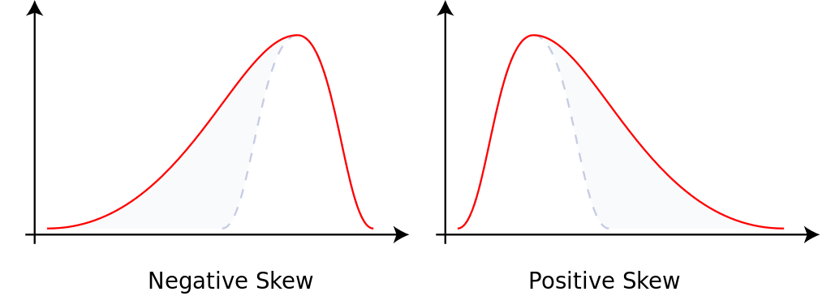
UNIMODAL FUNCTION
A unimodal function has exactly one local extremum (maximum or minimum) in a given interval, with the function being monotonic on either side of that extremum.

Slide 14
EXTREMUM
[0,1,1,3,4,5,5,6,7,5,4,3,3,3,2,1]
MID1 = L+(R-L)/3
MID2 = R-(R-L)/3

Slide 15
02
2D ARRAYS
Binary Searching for an element in a 2D array

Slide 16
MULTPLICATION TABLE
You are given an 𝑛×𝑚 multiplication table, where the value at the intersection of the 𝑖-th row and 𝑗-th column is 𝑖⋅𝑗 (with rows and columns numbered starting from 1). Your task is to determine the 𝑘-th largest number in this table.The 𝑘-th largest number is defined as the 𝑘-th element when all 𝑛⋅𝑚 numbers in the table are sorted in non-decreasing order. (1 ≤ n, m ≤ 5·(10^5); 1 ≤ k ≤ n·m)

Slide 17
1 | 2 | 3 | 4 | 5 | 6
2 | 4 | 6 | 8 | 10 | 12
3 | 6 | 9 | 12 | 15 | 18
4 | 8 | 12 | 16 | 20 | 24
N = 4 M = 6 K = 13

Slide 18
03
BSOA
Binary Search on Answer

Slide 19
FACTORY MACHINES
A factory has n machines which can be used to make products. Your goal is to make a total of t products. For each machine, you know the number of seconds it needs to make a single product. The machines can work simultaneously, and you can freely decide their schedule. What is the shortest time needed to make t products?
(1 ≤ n ≤ 2·(10^5); 1 ≤ t ≤ 10^9; 1 ≤ k_{i} ≤ 2·(10^5))

Slide 20
N = 3 T = 7 K = [3, 2, 5]
Days Required - 8
MACHINE 1 – 2 Products Produced
(Day 3, Day 6)
MACHINE 2 – 4 Products Produced
(Day 2, Day 4, Day 6, Day 8)
MACHINE 3 – 1 Product Produced
(Day 5)

Slide 21
AGGRESSIVE COWS
Given an array of length ‘N’, where each element denotes the position of a stall. Now you have ‘N’ stalls and an integer ‘K’ which denotes the number of cows that are aggressive. To prevent the cows from hurting each other, you need to assign the cows to the stalls, such that the minimum distance between any two of them is as large as possible. Print the largest minimum distance.
(2 ≤ N ≤ (10^5); 2 ≤ K ≤ N; 1 ≤ N_{i} ≤ (10^9))

Slide 22
N = 5 K = 3
[1, 2, 4, 8, 9]
Cow 1
Cow 2
Cow 3
Maximum Possible Minimum Distance = 3

Slide 23
04
DP
Dynamic Programming with Binary Search

Slide 24
LONGEST INCREASING SUBSEQUENCE
You are given an array containing n integers. Your task is to determine the longest increasing subsequence in the array, i.e., the longest subsequence where every element is larger than the previous one. A subsequence is a sequence that can be derived from the array by deleting some elements without changing the order of the remaining elements.
(1 ≤ n ≤ 2·(10^5); 1 ≤ x_{i} ≤ 2·(10^5))

Slide 25
N = 8
[7, 3, 5, 3, 6, 2, 9, 8]
[3, 5, 6, 9]
Length of Longest Increasing Subsequence = 4

Slide 26
PROJECTS
There are n projects you can attend. For each project, you know its starting and ending days (a_{i} and b_{i}) and the amount of money you would get as reward (p_{i}). You can only attend one project during a day. What is the maximum amount of money you can earn?
(1 ≤ n ≤ 2·(10^5); 1 ≤ a_{i} ≤ b_{i} ≤ 10^9; 1 ≤ p_{i} ≤ 10^9)

Slide 27
N = 4
Events = [[2,4,4],[3,6,6],[6,8,2],[5,7,3]]
2
6
[2,3,4,5,6,7,8]
4
3
Maximum Reward = 4 + 3 = 7

Slide 28
CONTEST TIME

Slide 29
THANK YOU!
DOES ANYONE HAVE ANY QUESTIONS?
Grecil Unadkat
grecilunadkat@gmail.com
+91 7567151302
Madhava Sai Teja
madhavasaiteja@gmail.com
+91 70135 05728

