Slide 1
PASS OR NOT
Data Mining
Peilin Zhan
Tutor：Pinglu Zhang

Slide 2

CONTENT
1
2
Data View
Exploratory
Data Analysis
3
4
Feature Engineering
Model Training &
Model Evaluation

Slide 3
1
POWER POINT
Check the Data：
·To define the problem
·To know the datas

Slide 4

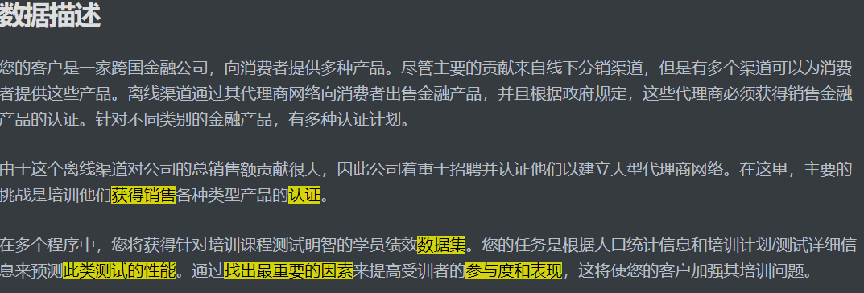
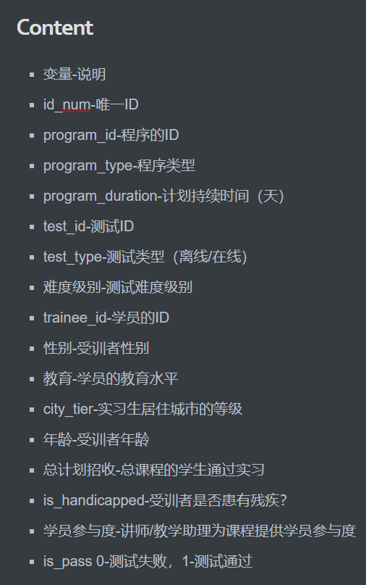

Datas View

Slide 5
2
POWER POINT
Exploratory Data Analysis

Slide 6
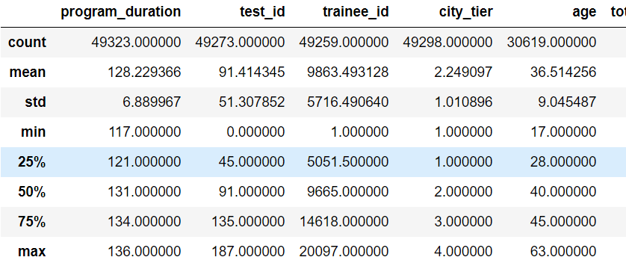
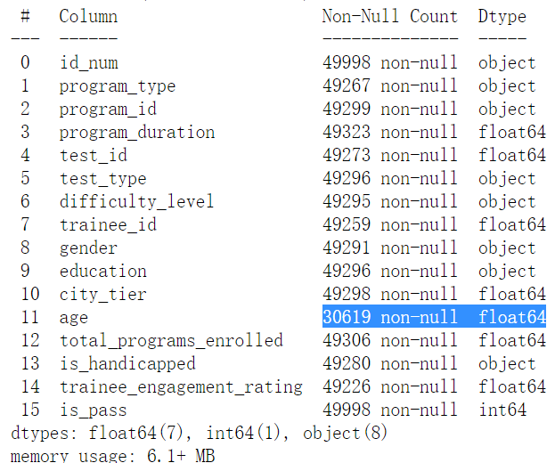
Exploratory Data Analysis
Detailed datas

Slide 7
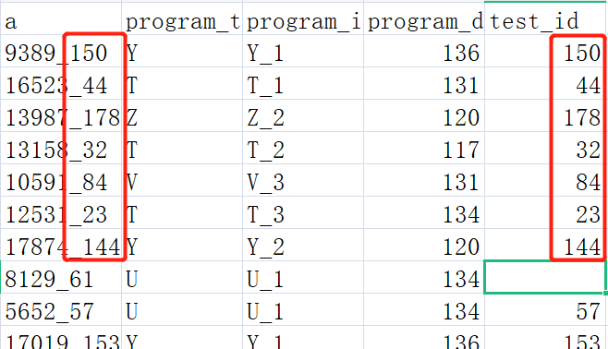
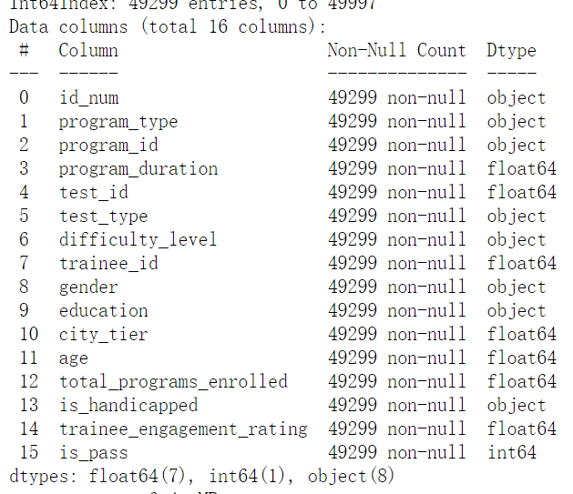
Exploratory Data Analysi
How to deal with the blanks
1
By Mean
2
By Regular Expression
3
By Clearing Out
4
By Fitted Datas

Slide 8
3
POWER POINT
Feature Engineering

Slide 9

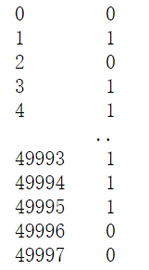
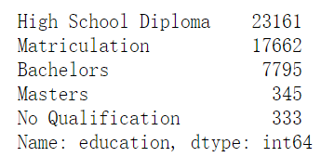
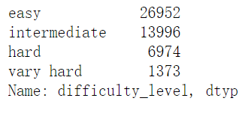
Feature Engineering
Feature Encoding
More Details
gender
difficulty_level
program_type
......

Slide 10
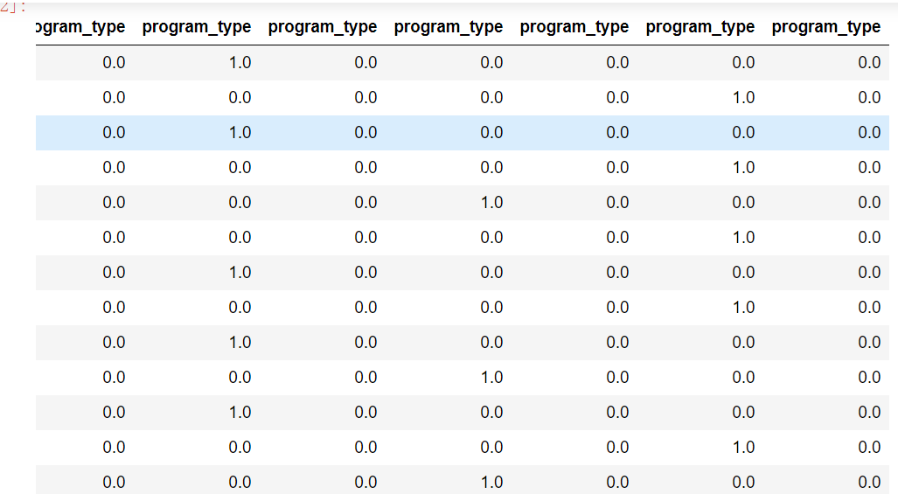
Feature Engineering
Feature Encoding
difficulty_level
: Different distance
1,2,3,4...
program_type
: The same distance

Slide 11

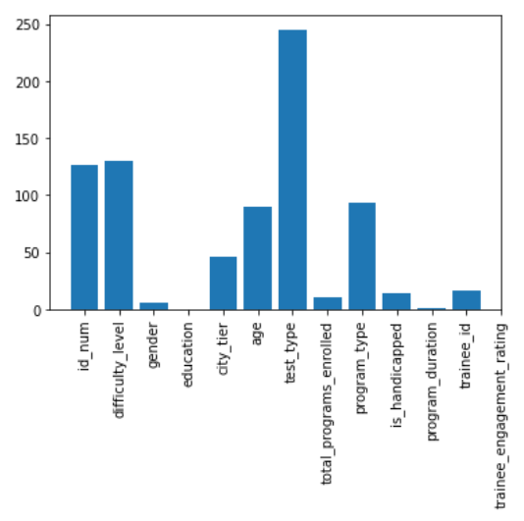
Feature Selection
SelectKBest
ADD CSV

Slide 12
4
POWER POINT
Model Training &
Model Evaluation

Slide 13
Model Training
Linear Regression
Kfold？
Predict
Fit
id_num
age
difficulty
city_tier
test_type
program_type

Slide 14
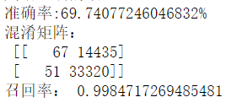
Model Evaluation
Accuracy & Recall
Calculate accuracy
correctly identified / identified
correctly identified / original corpus

Slide 15

Thanks
Peilin Zhan

